Slide 1

AMCAT Data Analysis

Slide 2
About me
My name is Venna Leela Sai Devi. I completed Under graduation and Currently focusing on Generative AI.
My Goal is to leverage usage of AI across different industries making things better with the help of AI.
Github : https://github.com/bhargavanaik24/Amcat
Linkedin : https://www.linkedin.com/in/bhargava-naik-banoth-48a8b8333/

Slide 3
Agenda
Introduction:
The Dataset is released by AMCAT which is an organization will conduct test for the Engineering students who seeking job.
The Test results was shared with recruiters they will conduct the direct interview for students who performed well.
Objective:
Based on students performance on AMCAT Test, Engineering Background find out salary, jobTitles, Joblocations, Employment Roles.

Slide 4
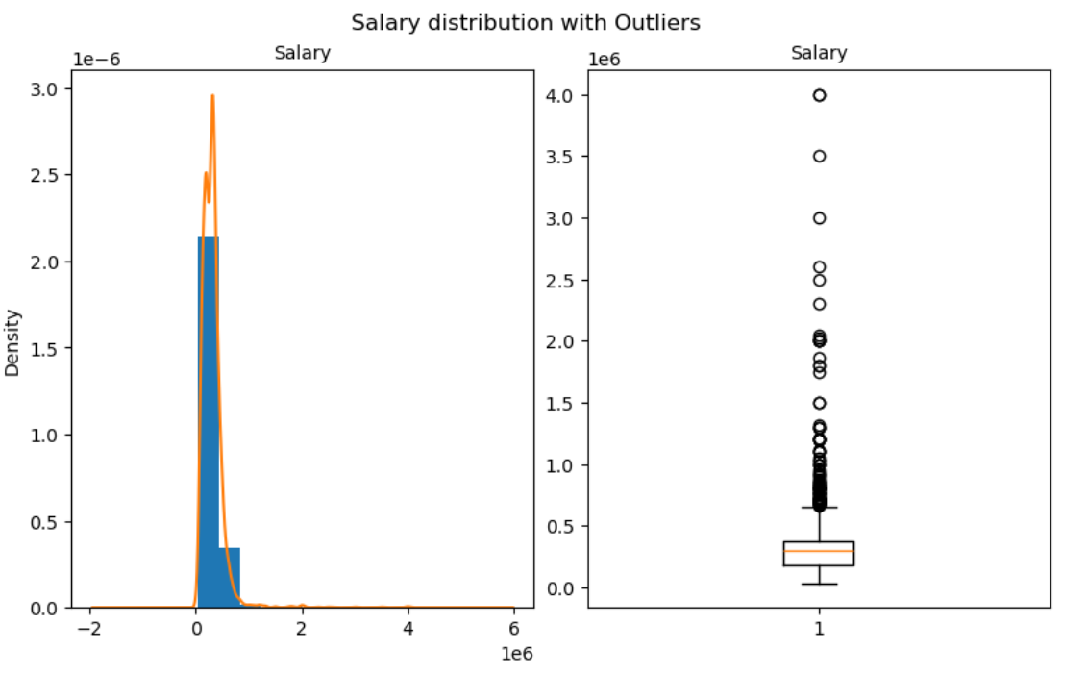
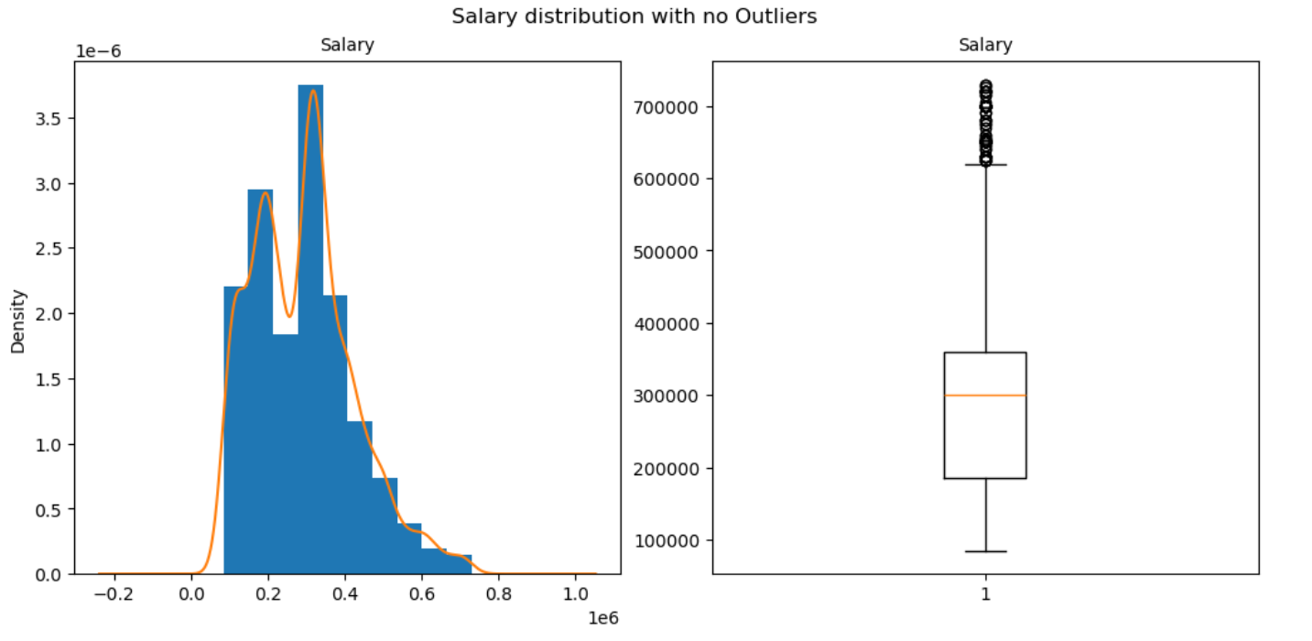
Exploratory Data Analysis:
Data Cleaning Steps :
As you see in right side plot salary feature has outliers. Conducted IQR method to detect outliers.

Slide 5
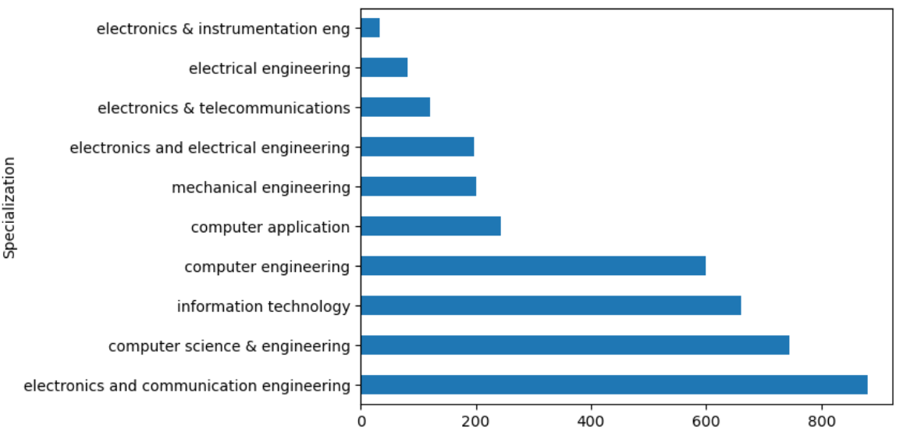
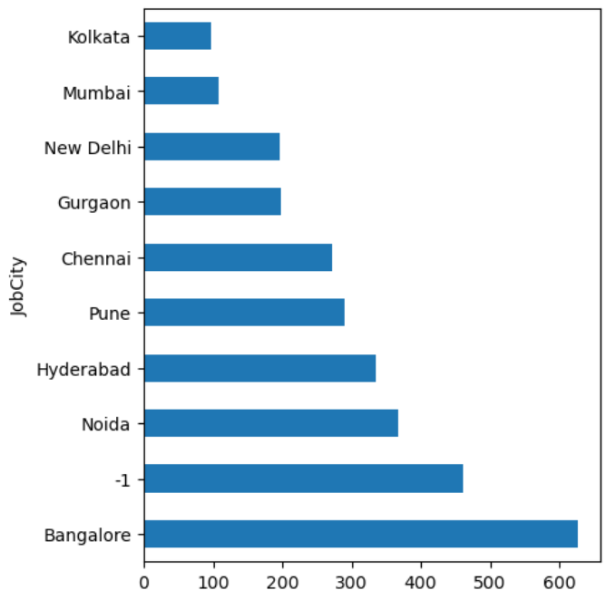
Univariate Analysis
Most of the students were did graduation in ECE, CSE, IT and CE.
If you look at Jobcity feature there is a value `-1` which has high frequent, In reality there is no `-1` as a city name.

Slide 6
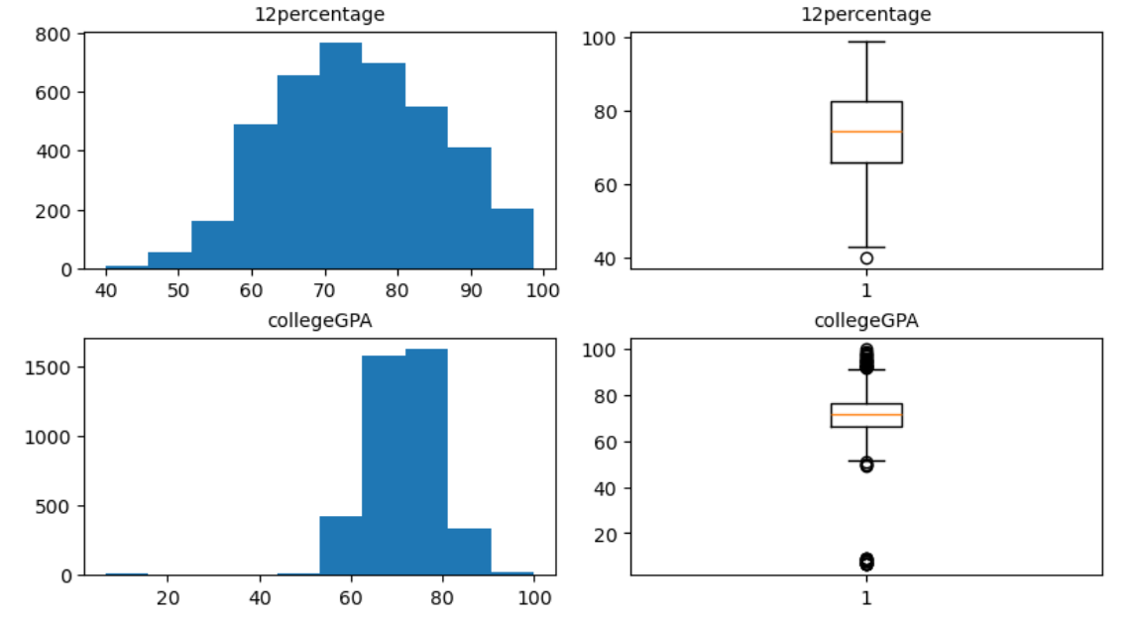
In Graduation there are few people `GPA` has lower compared to remaining population.

Slide 7
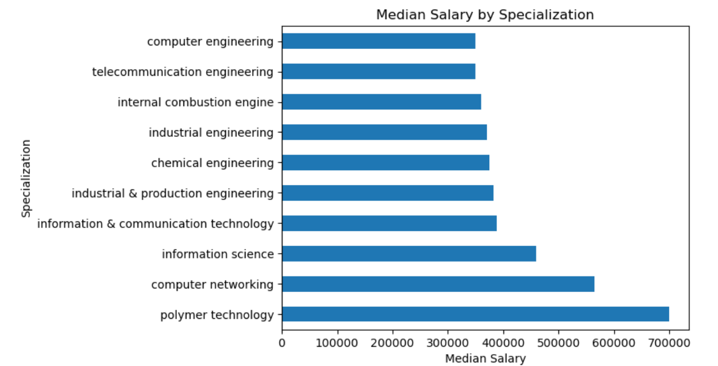
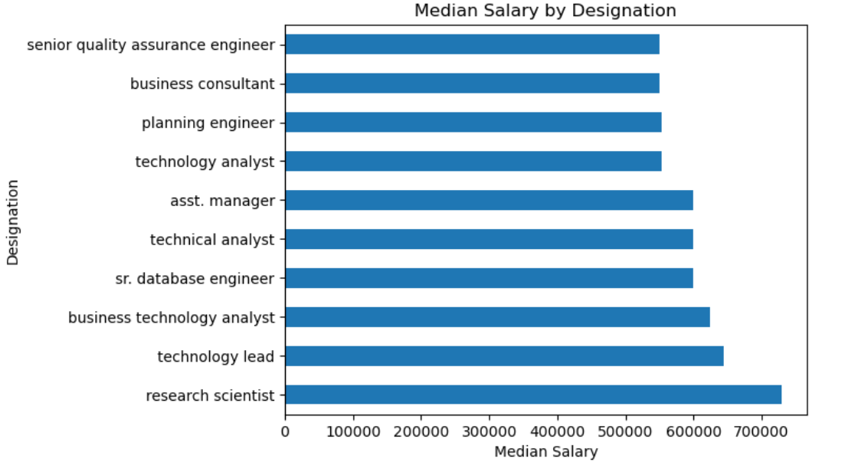
Bivariate Analysis
The persons who hold their position as `Research scientist, Technical Lead, Business Analyst` earning Highest average salary compared to other designations.
People who are working in Jamnagar, Rajpura, Patna getting high salary.
Persons who completed Mtech and MSC getting more salary.

Slide 8
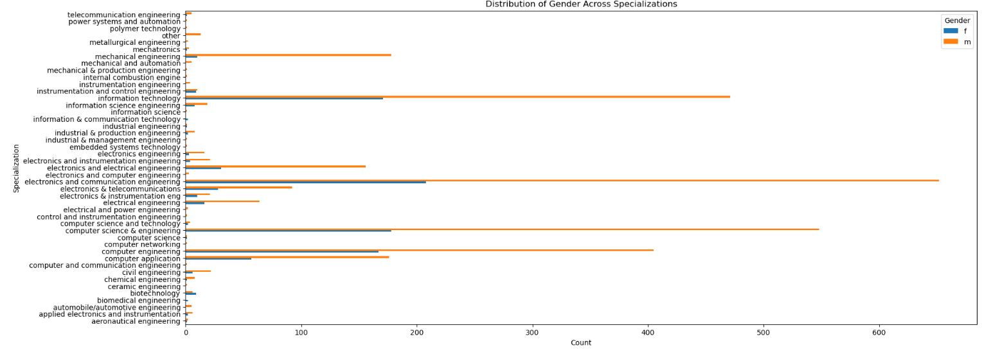
There is significant relationship between Gender and Specialization it is varying, most of the males and females were choosen a CSE,IT, ECE as their specialization.

Slide 9
Conclusion:
The persons who hold their position as Research scientist, Technical Lead, Business Analyst earning High average salary compared to other designations.
Persons who completed Btech most of their employment outcome was Software Engineer, Software Developer, System Engineer.
Most of the males were working as a Software Engineer , Software Developer Compared to females.
In Bangalore city most of the males and females are working compared to other cities.

Slide 10

THANK YOU

