Slide 1
Inside a Neural Network
Six components, one learning loop, and what 23 training runs in TensorFlow Playground taught me
Bindu Bhargava Reddy Chintam | AIML-501: Model Development | Indiana Wesleyan University | October 2026
Notes:
This deck explains the six building blocks of a neural network and ties each one to an experiment I ran in TensorFlow Playground.

Slide 2
Six parts, three jobs
I sorted the six components by the job each one does. That grouping is the backbone of this deck.
1
Structure
2
Signal
3
Learning loop
Where data goes
How data is shaped
How the network improves
Layers
Weights and biases
Loss function
Stages that transform the data
Dials that set each input's influence
Scores how far off a prediction is
Neurons
Activation functions
Optimizer
Units that each do one small calculation
Bends that let the network learn curves
Rule that nudges weights to lower the loss
Notes:
Structure decides where data goes, signal decides how it is shaped on the way, and the learning loop decides how the network gets better. Weights and biases sit in the signal group because they act on every value that flows through the network, even though the optimizer is what changes them.

Slide 3
How data flows through the network
Input layer
Hidden layer 1
Hidden layer 2
Output layer
Learning loop
1
Loss: compare prediction with the true label
2
Gradients: trace the error back through each weight
3
Optimizer: nudge every weight a small step
2 features: x1, x2
4 neurons
3 neurons
1 prediction
4
Repeat for the next batch
Forward pass: weighted sums and activations, layer by layer
Notes:
Data moves left to right in the forward pass. The loss compares the output with the truth, backpropagation sends the error back, and the optimizer updates every weight. One pass over the whole training set is one epoch.

Slide 4
Layers: stages that build features
I
Input layer
What changed when I added layers
Receives the raw features, such as a point's x and y position. It does no math of its own.
Circle dataset, 600 epochs, same random seed
H
Hidden layer
Each layer builds new features from the one before. Early layers find simple boundaries; deeper layers combine them into shapes.
O
Output layer
Turns the last features into the answer, such as orange or blue for a classifier.
Notes:
With no hidden layer the network can only draw a straight line, so it cannot wrap around a circle (test loss 0.532). One hidden layer with four neurons got the loss down to 0.009.

Slide 5
Neurons: one small calculation each
The math
w1 = 0.8
x1 = 1.0
Weighted sum: z = w1·x1 + w2·x2 + b
z = 0.8(1.0) + (-0.4)(0.5) + 0.1 = 0.7
Activation: a = f(z)
ReLU(0.7) = 0.7, sigmoid(0.7) = 0.668
Every neuron in a layer runs this same two-step recipe with its own weights, and passes a to every neuron in the next layer.
Σ then f
w2 = -0.4
a = 0.7
x2 = 0.5
bias b = 0.1
Notes:
A neuron multiplies each input by a weight, adds a bias, and passes the sum through an activation function. The numbers here are a worked example, not values from a trained model.

Slide 6
Weights and biases: the dials that learn
w
Every connection has a weight
Counting the dials
It scales how much one neuron's output matters to the next neuron.
My Playground network: 2 → 4 → 2 → 1
25
w
Sign and size both matter
In Playground, blue lines are positive, orange are negative, and thicker lines are larger weights.
w
Biases shift the threshold
learnable numbers:
(2×4 + 4) + (4×2 + 2) + (2×1 + 1)
= 12 + 10 + 3
A bias lets a neuron turn on even when its inputs are small.
w
Training only changes these numbers
Large language models use the same idea with billions of these numbers.
The layers and activations stay fixed; learning means finding better weights and biases.
Notes:
Weights times inputs, plus a bias, is the only place a network stores what it has learned. Counting them shows why bigger networks need more data and compute.

Slide 7
Activation functions: adding the bends
XOR data, same network, 600 epochs
Linear (no bend)
test loss 0.496
fails
Sigmoid
test loss 0.044
under 0.1 at epoch 483
Tanh
test loss 0.016
under 0.1 at epoch 60
ReLU
test loss 0.002
under 0.1 at epoch 15
Without a bend, stacking layers still gives a straight line.
Notes:
ReLU keeps positive values and zeroes the rest. Sigmoid squeezes values into 0 to 1, and tanh into -1 to 1. With a linear activation, the XOR pattern could not be learned at all.

Slide 8
Loss functions: scoring the mistakes
L
Mean squared error
L
Cross-entropy
For numbers (regression)
For classes (classification)
L = average of (prediction − truth)²
L = −log(probability given to the true class)
Big misses cost much more than small ones: a miss of 0.9 costs 0.81, a miss of 0.1 costs 0.01.
Confident mistakes are punished hard: 0.9 on the right class costs 0.105, but 0.1 costs 2.303.
In Playground: labels are -1 and +1, and the loss shown is the average of ½(output − label)². A network that guesses one class everywhere scores about 1.0. That is exactly what one of my runs did (test loss 1.032).
Notes:
The loss turns every prediction into one number to minimize. The choice of loss decides what kind of mistake the network cares about most.

Slide 9
Optimizers: small steps downhill
Learning rate test: circle data, 600 epochs
The update rule
w ← w − η · ∂L/∂w
∂L/∂w is the slope of the loss for that weight, found by backpropagation.
η is the learning rate: the size of each step.
Stochastic gradient descent uses small batches; Adam also adapts the step for each weight.
Too small crawls (epoch 568 to get under 0.1). Too large overshoots and never settles. 0.03 to 0.3 got there by epoch 62.
Notes:
The optimizer is the only component that changes the weights. The learning rate decides whether it walks, runs, or jumps past the bottom of the loss surface.

Slide 10
One training step, all six parts together
1
2
3
4
5
6
Feed in
Combine
Bend
Score
Trace back
Adjust
Input layer takes a batch of points
Neurons form weighted sums with their weights and biases
Activation functions shape each sum
Loss function compares output with labels
Backpropagation finds each weight's share of the error
Optimizer updates every weight by a small step
Repeat for every batch. One full pass over the training data is one epoch; my Playground runs used 600 to 1,500 epochs.
Notes:
Steps 1 to 3 are the forward pass and steps 4 to 6 are the learning loop. This is the cycle the architecture slide shows as a loop.

Slide 11
What 23 Playground runs showed
Change tested | Setting | Test loss | What it shows
Hidden layers | none vs 4 then 2 | 0.532 | Depth lets the boundary curve (0.532 to 0.001)
Better features | x1², x2², no hidden layer | 0.001 | Good inputs can replace hidden layers
Random start | same setup, first seed | 1.032 | A bad start can freeze learning
Hard data | spiral, 4 then 2 | 0.468 | Too small a network for the shape
Hard data | spiral, 8-8-6 + 7 features | 0.045 | Capacity plus features solve it (0.138 without features)
Noise | xor, noise 0 vs 50 | 0.275 | Noise raises the floor (from 0.016)
Activation | xor, linear | 0.496 | No bend, no curve
Learning rate | circle, rate 3 | 0.718 | Steps too big to settle
All runs: same seed unless noted, batch size 10, 50% of points held out for testing. Loss above 0.1 in red.
Notes:
I changed one thing at a time and kept the seed fixed so each difference comes from the setting I changed. Full numbers for all runs are in the companion document.

Slide 12
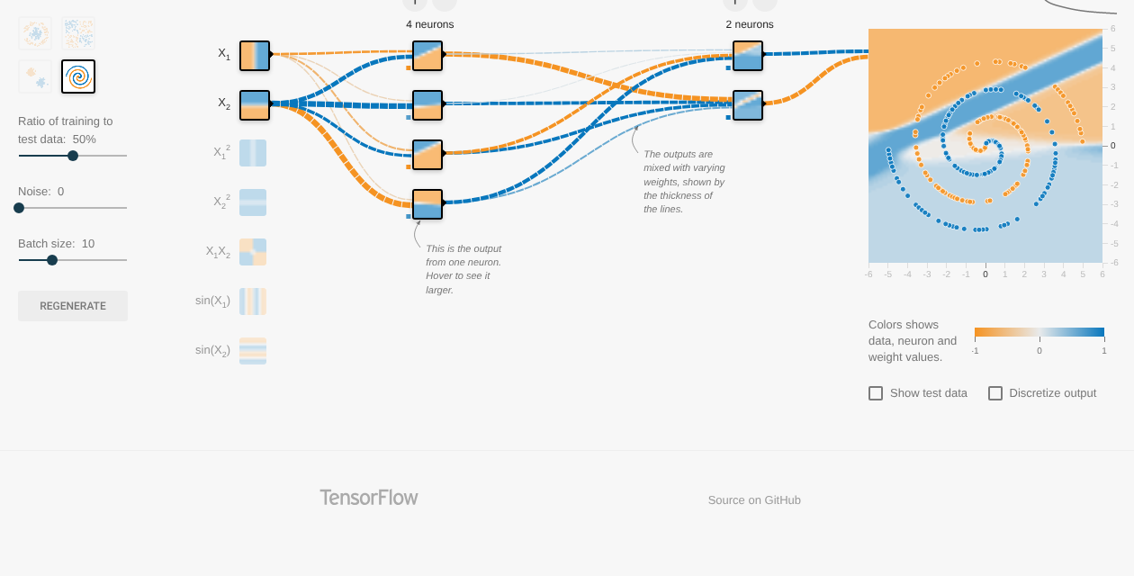
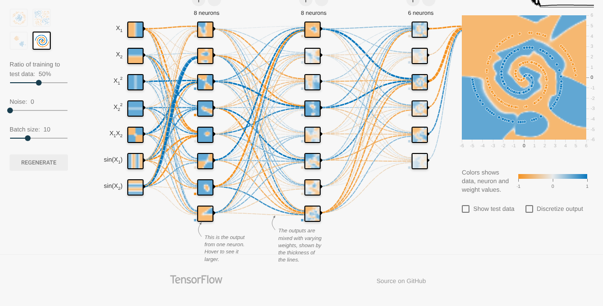
Seeing it: the spiral before and after
Small network, 2 inputs: test loss 0.468
Deeper network, 7 inputs: test loss 0.045
Screenshots from my TensorFlow Playground runs (1,500 epochs). Left: the network cannot follow the arms of the spiral. Right: extra layers and features such as sin(x1) let it trace both arms.
Notes:
The orange and blue background is what the network predicts for every point in the plane. The dots are the real data.

Slide 13
Why visualizing networks matters
Pictures make the math checkable
Structure is a choice, not a default
Seeing weights as colored lines and outputs as maps showed me when a network was stuck, long before the loss number said why.
The circle needed a hidden layer, unless I gave it better features. Model design starts with the data.
The learning loop can fail quietly
Simple parts, big systems
A bad learning rate or an unlucky start gave confident, wrong answers. Watching training is part of building responsibly.
The 25 dials in my small network and the billions in a language model follow the same six-part recipe.
Layers and neurons give the shape. Weights and activations carry the signal. Loss and the optimizer do the learning.
Notes:
These are the four insights I took from building this deck and running the experiments.

Slide 14
References
3Blue1Brown. (2017, October 5). But what is a neural network? | Deep learning chapter 1 [Video]. YouTube. https://www.youtube.com/watch?v=aircAruvnKk
Goodfellow, I., Bengio, Y., & Courville, A. (2016). Deep learning. MIT Press. https://www.deeplearningbook.org
Google. (2025). Neural networks. Machine Learning Crash Course. https://developers.google.com/machine-learning/crash-course/neural-networks
IBM Technology. (2022, May 24). Neural networks explained in 5 minutes [Video]. YouTube. https://www.youtube.com/watch?v=jmmW0F0biz0
Kingma, D. P., & Ba, J. (2014). Adam: A method for stochastic optimization. arXiv. https://doi.org/10.48550/arXiv.1412.6980
Rumelhart, D. E., Hinton, G. E., & Williams, R. J. (1986). Learning representations by back-propagating errors. Nature, 323(6088), 533–536. https://doi.org/10.1038/323533a0
Smilkov, D., & Carter, S. (n.d.). TensorFlow Playground [Web application]. Retrieved October 27, 2026, from https://playground.tensorflow.org

