Slide 1

INTRODUCTION TO SYSTEMVERILOG

Slide 2

Project Collaborator under
“Professor Venkatesh Patil”
“Professor Brain”
Feedback and Evaluation by
“T.A Mahidhar Regalla”

Slide 3
APB PROTOCOL

Slide 4
Team Members

Slide 5




DHUSHYANTH
dharmava@pdx.edu
923259229
BHARGAV
bhargavc@pdx.edu
982707347
SAHIL KHAN
sahilk@pdx.edu
980980741
ADITYA SHAH
aadityas@pdx.edu
958728607

Slide 6
. Concept oriented
.code

Slide 7
. Concept oriented
.code
.concept oriented
.code

Slide 8
. Concept oriented
.code
.concept oriented
.code
.concept oriented
.code

Slide 9
.concept oriented
.code
.concept oriented
. code
. Concept oriented
.code
.concept oriented
.code

Slide 10
Table of contents

Slide 11
Table of contents
High level view

Slide 12
Table of contents
Semi-conductor ecosystem
High level view

Slide 13
Table of contents
Semi-conductor ecosystem
Comparison
High level view

Slide 14
Table of contents
Semi-conductor ecosystem
Comparison
High level view
pros and cons

Slide 15
Table of contents
Semi-conductor ecosystem
Comparison
High level view
pros and cons
Challenges

Slide 16
Table of contents
Semi-conductor ecosystem
Comparison
Adopted In the industry
High level view
pros and cons
Challenges

Slide 17
Table of contents
Semi-conductor ecosystem
Comparison
Adopted In the industry
High level view
pros and cons
Challenges

Slide 18
Description of high-level view of the topic presenting

Slide 19
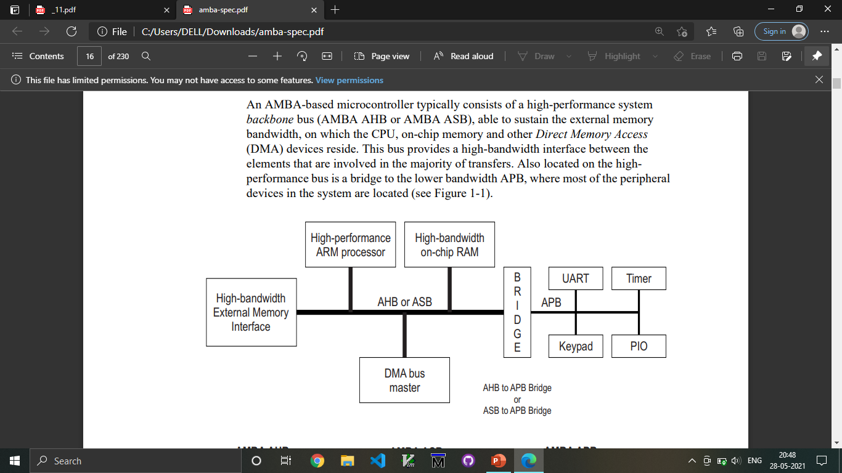
AMBA ARCHITECTURE:

Slide 20
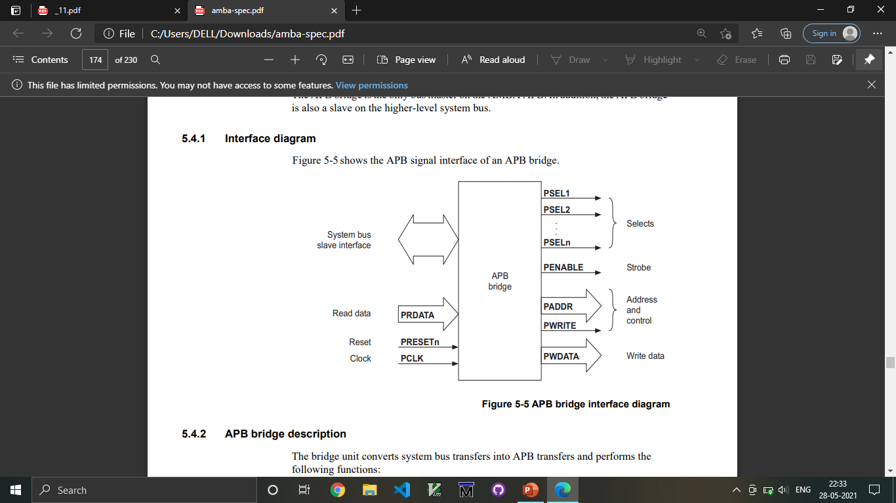
AMBA ARCHITECTURE:

Slide 21
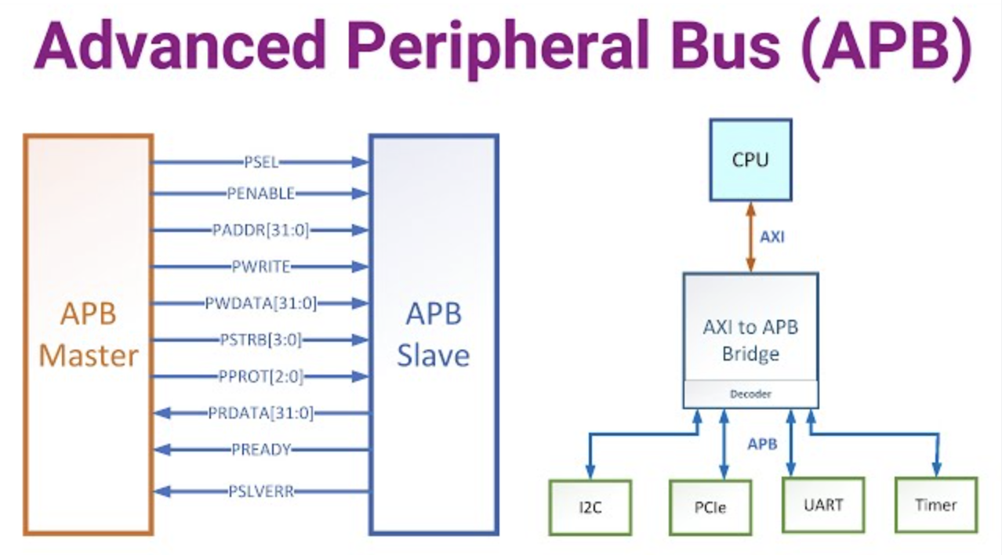

Slide 22
APB BUS
Slave-1
Master
APB BUS
Slave-2

Slide 23
BLACKBOX:

Slide 24
pclk
presetn
addrin
APB BUS
Slave-1
datain
Master
newd
wr
APB BUS
Slave-2

Slide 25
The APB interface is especially suited for accessing programmable control registers of peripheral devices, making it an essential component of the ARM architecture.
Key components:
Signal Descriptions: Detailed descriptions of various signals used in APB communications.
Operating States: A clear outline of different states within the APB interface, such as IDLE, SETUP, and ACCESS, providing a comprehensive understanding of the protocol’s operation.
Interface Protection: Mechanisms for error detection using parity checks to ensure data integrity during transfers.

Slide 26
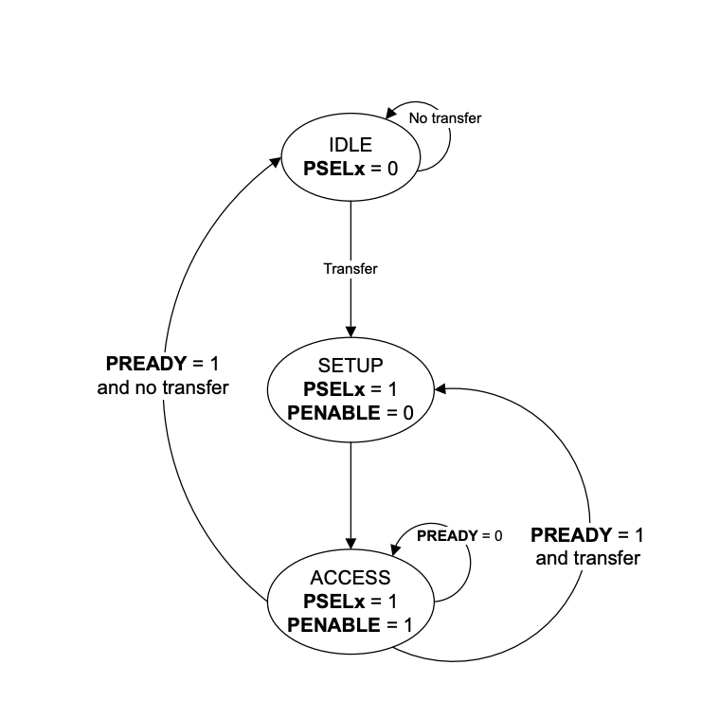

Slide 27
Start
NO
IDLE
Rst = 1
NO
YES
New = 1
SETUP
Psel = 1
Penable = 0
ACCESS
Psel = 1
Penable = 1
NO
Pready = 1
YES

Slide 28
ERROR
Address range error:
Paddr<=15
Address value error:
Paddr<=0
write Data range error:
Pwdata>=0

Slide 29
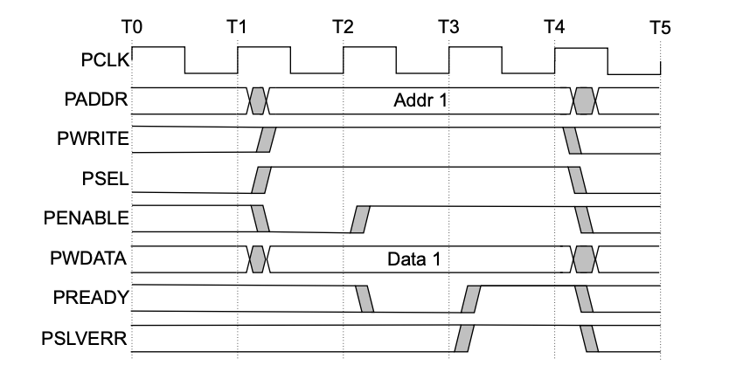
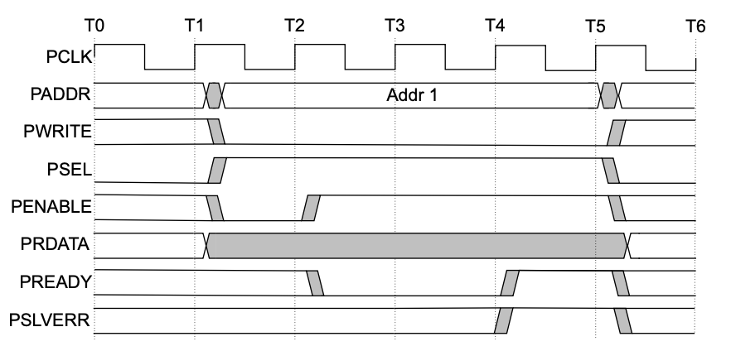
Write Transfer
Read Transfer

Slide 30
WAVE FORMS:

Slide 31
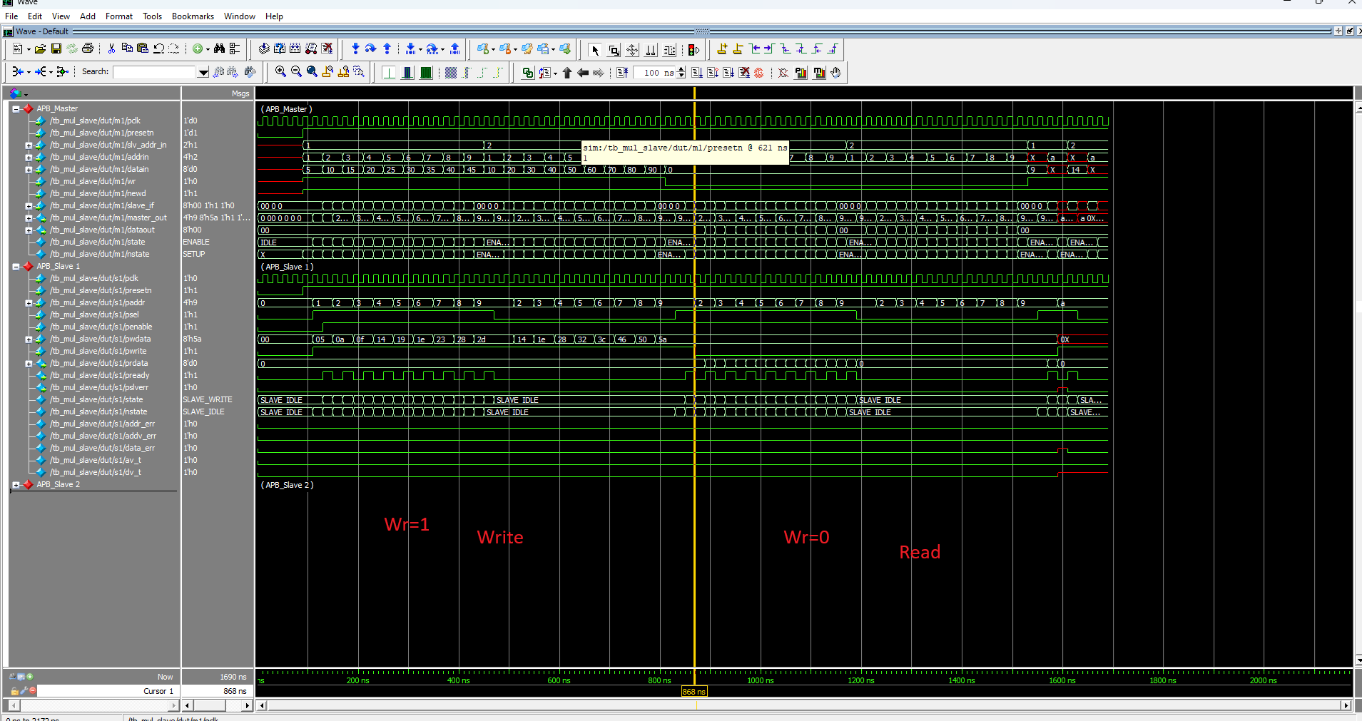
MASTER – SLAVE1

Slide 32
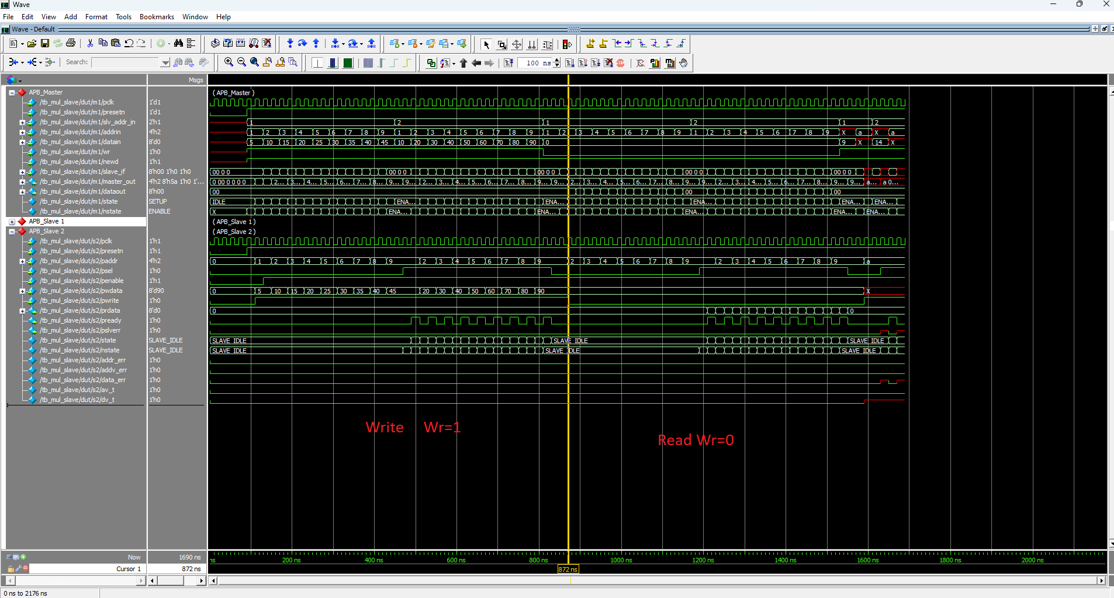
MASTER – SLAVE2

Slide 33
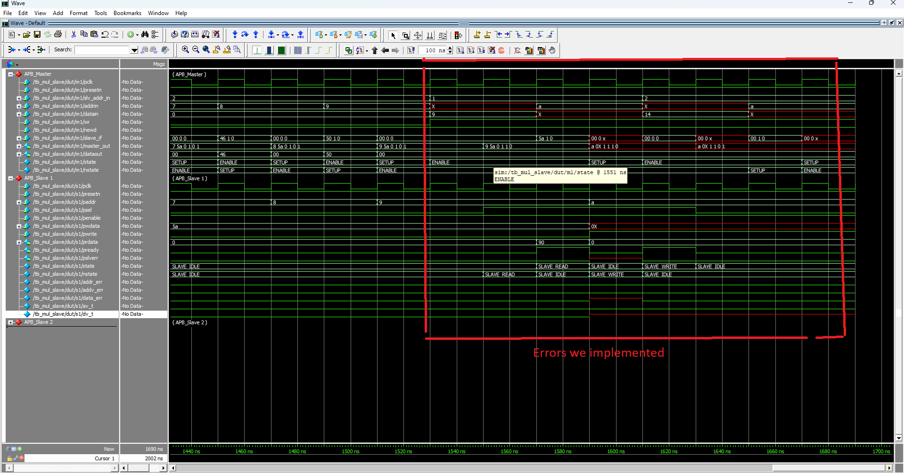
MASTER – SLAVE1 ERROR

Slide 34
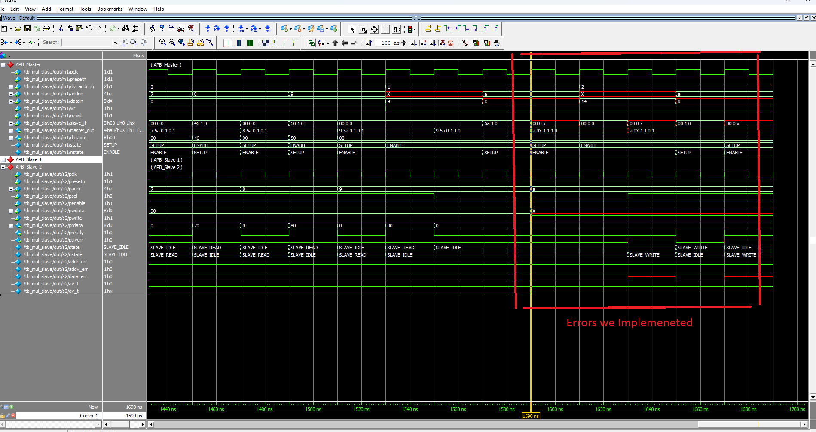
MASTER – SLAVE2 ERROR

Slide 35
Where does this topic fit into the Semiconductor Ecosystem?

Slide 36
Semiconductor Ecosystem
Integration of Components
Design Simplification:
Support for Diverse Applications
Power Efficiency
Compatibility with ARM Architectures
AMBA APB allows for efficient integration of multiple components, “enabling coherent communication among the CPU, memory, and peripherals”.
the APB simplifies the design and “implementation of peripherals, reducing development time and cost for semiconductor manufacturers”.
low-power characteristics of the APB are beneficial in” battery-operated devices, making it suitable for a wide range of applications in the semiconductor market, “particularly in mobile and embedded systems”.
The APB protocol is designed to work seamlessly within the ARM ecosystem, “enhancing the Compatibility of ARM-based processors with various peripherals.
APB allows it to be utilized in various sectors, including “consumer electronics, automotive, and industrial applications”, further establishing its importance within the semiconductor landscape.

Slide 37
Why there is a need for the given technology/protocol/subject? If there are competing technologies, do the comparison

Slide 38
the AMBA APB protocol arises from several factors within the semiconductor industry
Low-Cost Interface: The APB protocol is a low-cost interface that “reduces hardware complexity, ideal for cost-sensitive applications”.
Power Efficiency: “It is optimized for minimal power consumption, crucial for mobile and embedded systems where battery life matters”.
Simplicity and Ease of Use: APB's simple, “synchronous design makes it easy to implement, reducing the learning curve and speeding development”.
Standardization: “Part of the AMBA family, it ensures standardized interfaces for compatibility and easier component integration”.
Competing Technology
AHB offers high performance with burst transfers for complex, high-speed applications, but at higher cost and power consumption.
AXI provides flexibility for high-performance SoCs with out-of-order transactions, while APB suits simpler, low-cost peripherals.

Slide 39
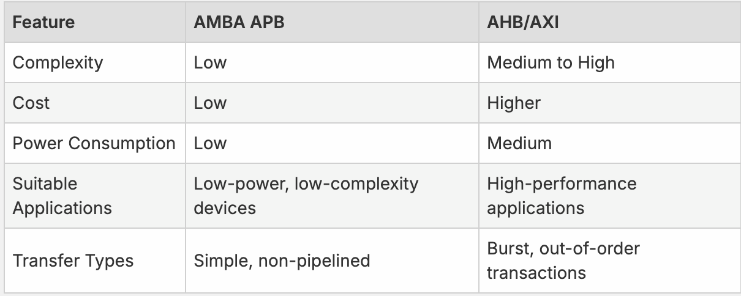

Slide 40
What are the competing technologies compared with the APB. Pros and Cons.

Slide 41
APB-PROTOCOL
Advantages :
Simplicity
Low Power Consumption
Cost-Effectiveness
Scalability
Ease of Integration
Disadvantages:
Limited Bandwidth
No Pipelining
Wait States
Higher Latency Compared to AHB
Complex Transfers

Slide 42
1. Wishbone
Pros: Open-source and free, encouraging wide adoption and flexibility.
Cons: Lack of standardization may cause incompatibility between implementations.
2. I2C (Inter-Integrated Circuit)
Pros: Simple two-wire design reduces PCB complexity and allows multiple devices.
Cons: Limited to low data rates, unsuitable for high-speed applications.
3. SPI (Serial Peripheral Interface)
Pros: High-speed, full-duplex communication for efficient data transfer.
Cons: Requires more lines, complicating PCB design and lacks easy multi-master support.
4. AXI (Advanced eXtensible Interface)
Pros: High performance with burst transfers and low latency, ideal for high-speed needs.
Cons:Complex and resource-intensive, potentially unsuitable for low-power designs.
5. CAN (Controller Area Network)
Pros: Reliable with strong error detection, commonly used in automotive systems.
Cons:Lower data rates and potential latency compared to other protocols.
Notes:
1. Wishbone
​Pros: Open-source and free, encouraging wide adoption and flexibility.​
Example: Wishbone is used in open-source projects like OpenCores, allowing designers to share and integrate components without fees.
2. I2C (Inter-Integrated Circuit)
Pros: Simple two-wire design reduces PCB complexity and allows multiple devices.
Example: I2C connects multiple sensors to a microcontroller using just two wires, simplifying the circuit design.
3. SPI (Serial Peripheral Interface)
Pros: High-speed, full-duplex communication for efficient data transfer.
Example: SPI is used to quickly transfer data between a microcontroller and a high-speed memory chip.
4. AXI (Advanced eXtensible Interface)
Pros: High performance with burst transfers and low latency, ideal for high-speed needs.
Example: AXI allows fast data transfer in complex SoCs, like those used in smartphones for graphic processing.
5. CAN (Controller Area Network)
Pros: Reliable with strong error detection, commonly used in automotive systems.
Example: CAN ensures safe communication between car components, like the engine and brakes, making vehicles more reliable.

Slide 43
What are the challenges with the selected topics in terms effort for RTL coding, Verification or Implementation (FPGA/ASIC)?

Slide 44
Challenges
RTL Coding Challenges
Verification Challenges
Implementation Challenges (FPGA/ASIC)
Complex Integration: Integrating peripherals with APB can result in complex RTL designs, demanding “careful timing and signal integrity”.
Signal Handling: APB requires precise management of control signals (e.g., PADDR, PWRITE, PENABLE), adding coding effort to meet protocol specifications.
Protocol Compliance: Verifying APB compliance is challenging, “requiring all signals to meet timing and valid conditions across operational states”
.Error Checking: Implementing APB parity error checking involves complex verification with extensive test cases for error scenarios.
Functional Verification: Ensuring functional accuracy in diverse devices necessitates intricate verification and advanced methodologies
Resource Utilization: Extra check signals and parity bits increase resource use on FPGAs/ASICs, affecting area and power consumption.
Timing Closure: Additional “timing constraints from parity checks and clock synchronization make achieving timing closure more challenging”.
Compatibility Issues: Ensuring APB compatibility with other bus protocols requires interfacing logic, adding to designcomplexity.

Slide 45
How well APB adopted in the industry? Is there a wide adoption/ receding adoption due to competing technology / new technology and slow in adoption.
How well is your topic of selection adopted in the industry? Is there a wide adoption/ receding adoption due to competing technology / new technology and slow in adoption. Explain. How well is your topic of selection adopted in the industry? Is there a wide adoption/ receding adoption due to competing technology / new technology and slow in adoption. Explain.

Slide 46
Low-Cost Design
Shift Towards Higher Performance Interfaces
lowers design costs and development time,” making it ideal for cost-sensitive applications”.
shifts towards high-performance “protocols like AXI “
Compatibility with AMBA
Emerging Technologies
As part of the AMBA standards, APB integrates well with other “Arm protocols, simplifying design and encouraging its use in diverse systems”.
High-performance standards like PCIe are increasingly adopted,
Widespread Use
Industry Trends
APB is “widely used in consumer electronics, automotive, and industrial applications” for interfacing low-speed peripherals like timers and UARTs.
Growing processing demands and complex SoC architectures could reduce APB’s adoption

Slide 47
top three new things

Slide 48
RME Support: APB5's RME support boosts security by enabling enhanced memory region management and access control.
Error Handling Mechanisms: Understanding error response mechanisms, like the PSLVERR signal, improves system reliability by signaling read/write errors.
Signal Validity Rules: Familiarity with APB signal validity rules and timing requirements is essential for ensuring protocol compliance during design and verification.

Slide 49
References:
Arm Ltd. (2003-2023). AMBA APB Protocol Specification. ARM IHI 0024E.
Arm Ltd. Web Address: http://www.arm.com

Slide 50


