Slide 1

Financial Product Recommendation
Bhargav Devarapalli
Linkedin : https://www.linkedin.com/in/bhargavdevarapalli/
Github : https://github.com/bhargavddb/Finance_Final_Project

Slide 2
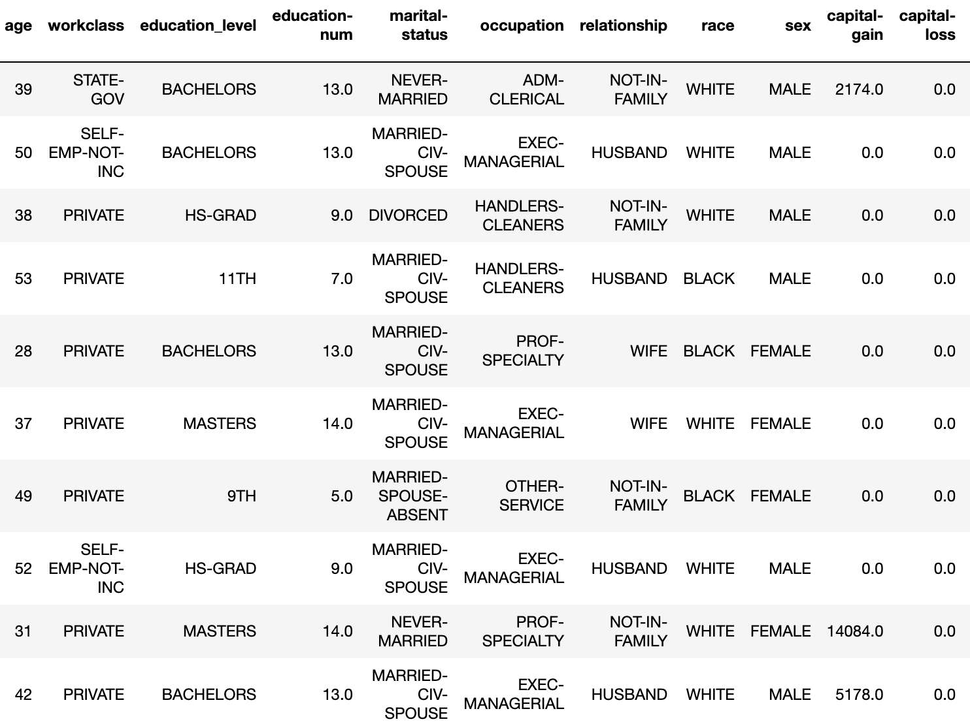
Project Overview
This project aims to build a machine learning model that predicts an individual's income bracket based on demographic and employment-related features such as age, work class, education, and hours worked per week. The income brackets are divided into two categories: `<= 50K` and `> 50K`.
The ultimate goal of this prediction is to recommend suitable financial products to individuals, such as stocks, credit cards, or loan offers based on their income group.

Slide 3
Data Loading and Cleaning
• Dataset includes features such as age, education, work class, and hours worked per week.
• Missing values/Data Cleaning were handled in key columns like work class, Education Level and occupation.
• Outliers in numerical features such as capital gain and hours worked were identified using Histogram/IQR.
• Inconsistent and Duplicate data entries were removed to ensure data quality is maintained

Slide 4
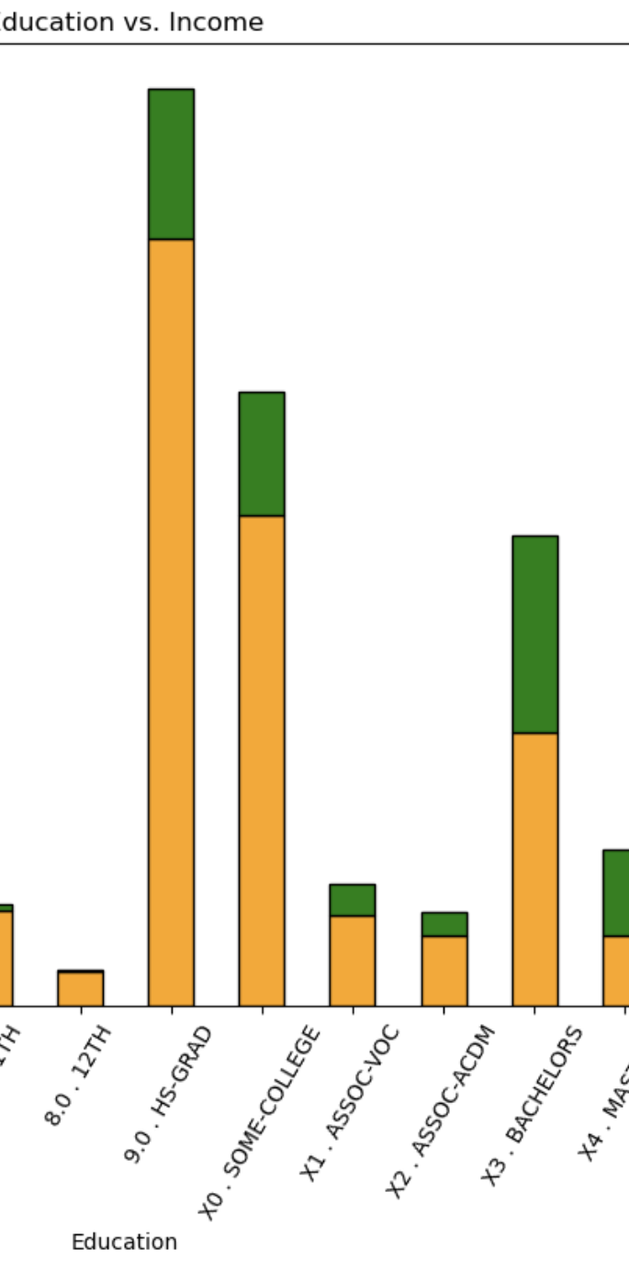
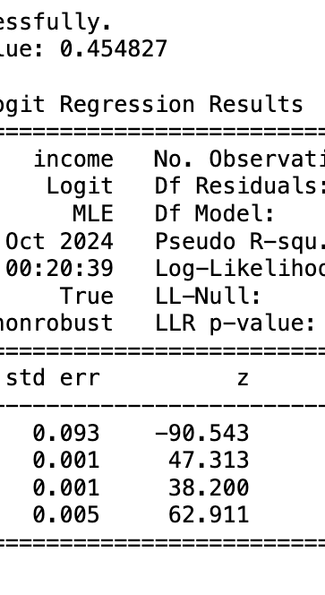
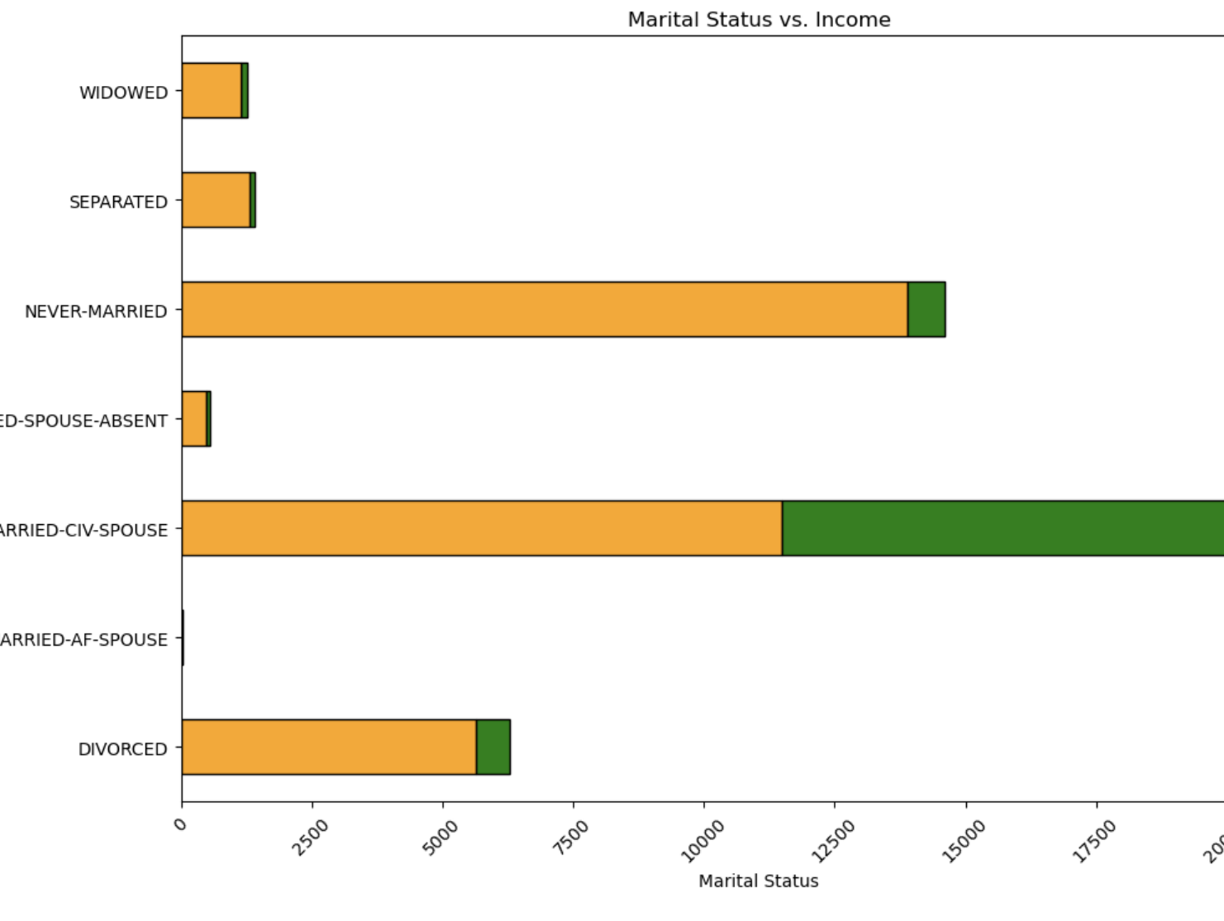
Exploratory Data Analysis
• Key relationships explored between features and income:
- Age: Income increases with age, peaking in middle age.
- Education: Higher education levels correlate with higher income.
- Gender and Marital Status: Income disparities exist across gender and marital status.
- Hours Worked: Positive correlation between hours worked per week and income.

Slide 5
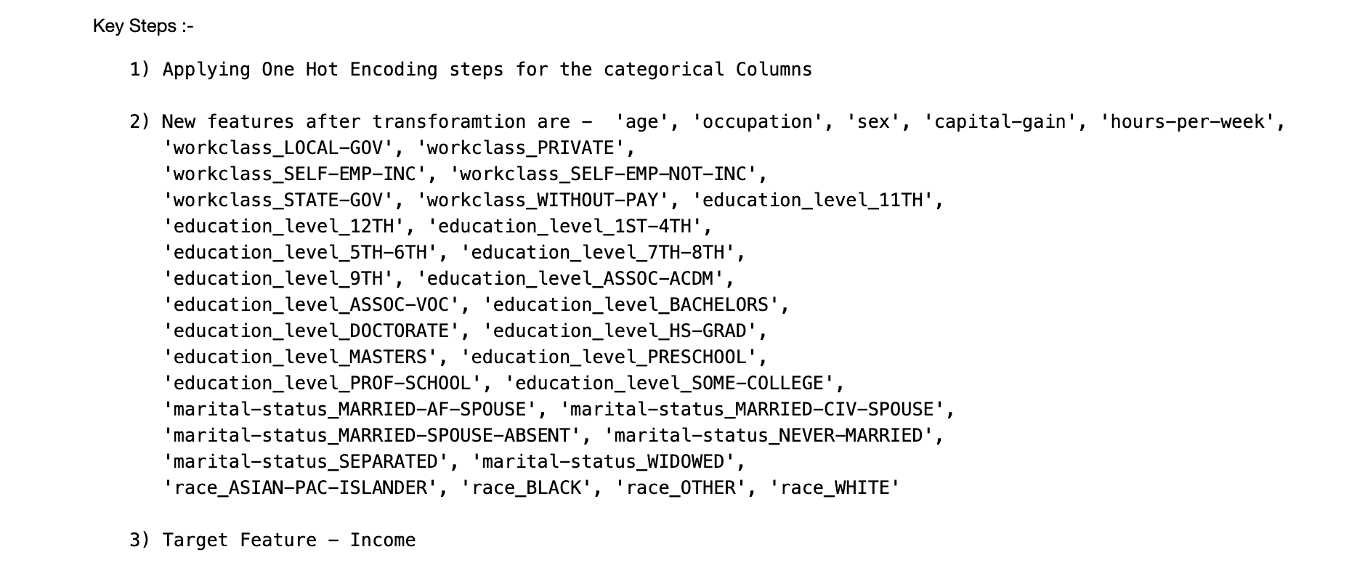
Feature Engineering and Preprocessing
• One-hot encoding was applied to categorical variables (e.g., work class, education).
• Numerical features were scaled for normalization.
• Data was split into training and testing sets to ensure model generalization.

Slide 6
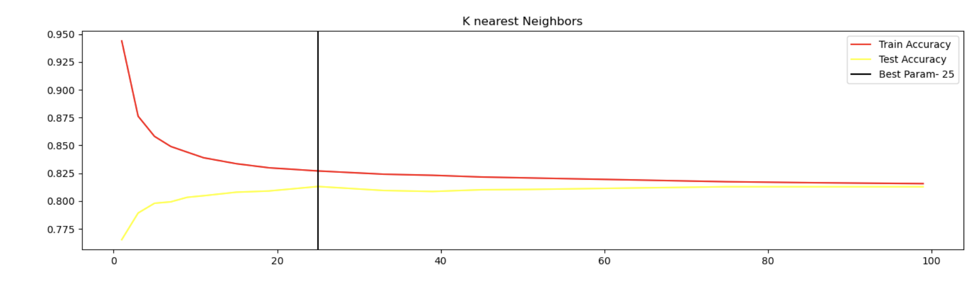
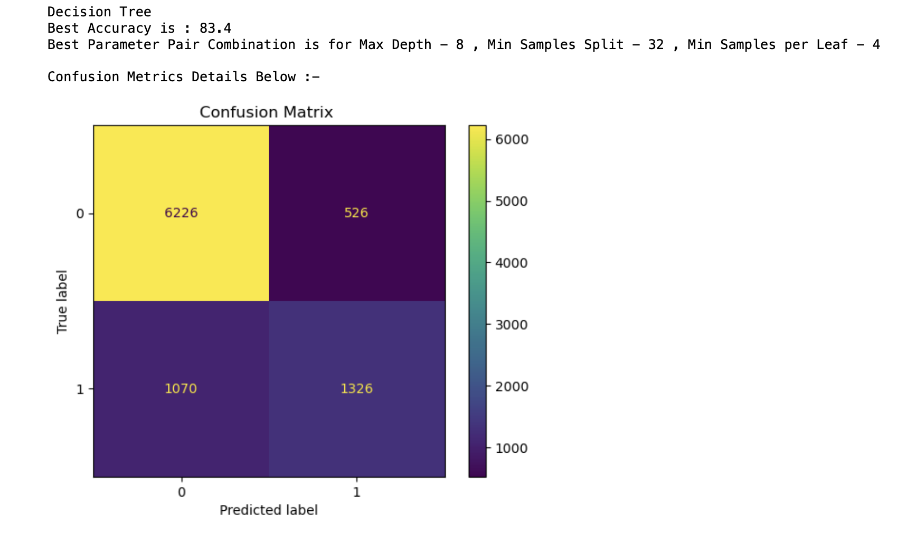
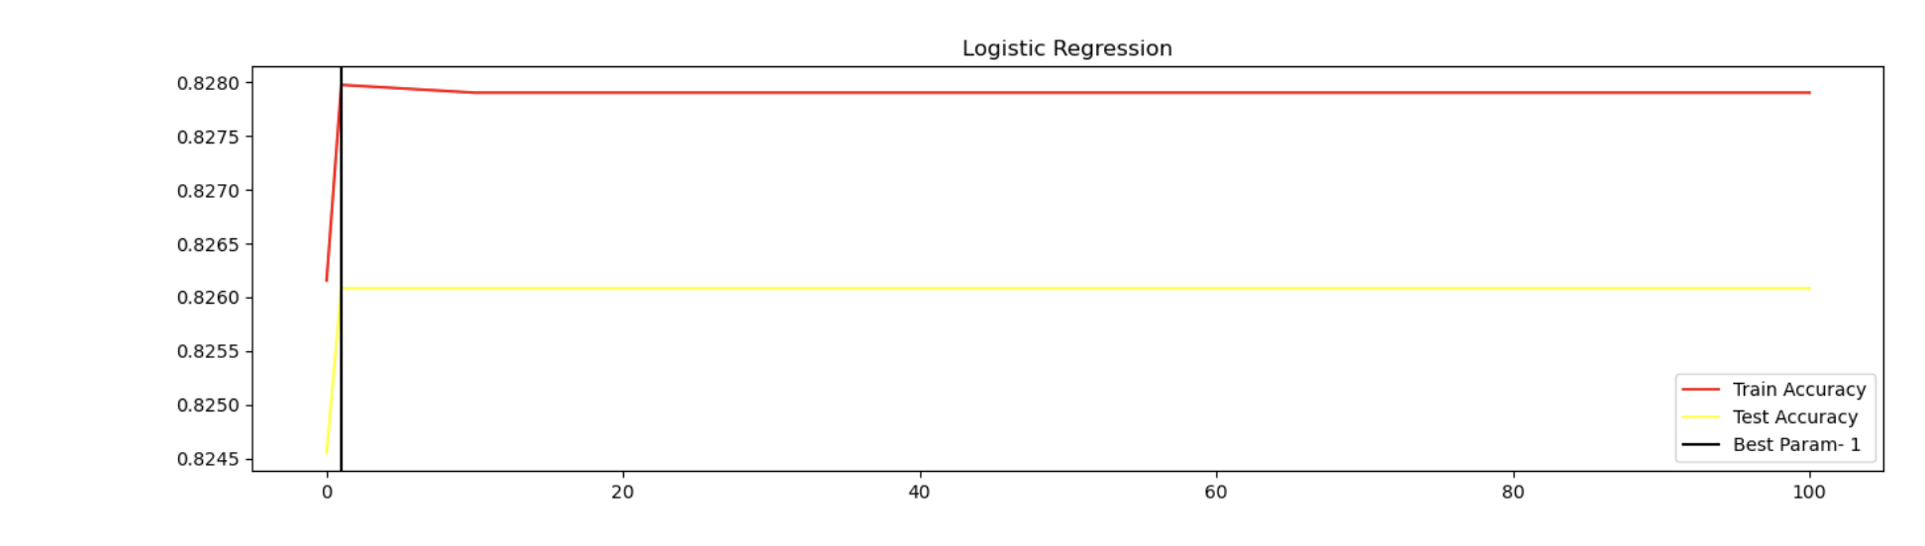
Model Building and Testing
• Models tested: K-Nearest Neighbors, Logistic Regression, Decision Trees.
• Performance evaluated using accuracy, confusion metrics.
• Logistic Regression and Decision Trees achieved an accuracy of ~83%

Slide 7
Conclusions and Future Work
• Key features influencing income include education level, hours worked, and occupation.
• Future steps involve exploring advanced models Xgboost, Feature Engineering and Label encoding
• Use techniques like SMOTE (Synthetic Minority Over-sampling Technique) to balance the dataset or apply class weighting in the models to give more weight to the minority class. You could also use precision-recall metrics rather than accuracy to assess model performance for imbalanced data.
• Future steps involve exploring advanced models Xgboost, Feature Engineering and Label encoding
• Aim to refine product recommendations based on improved income prediction models.

