Slide 1
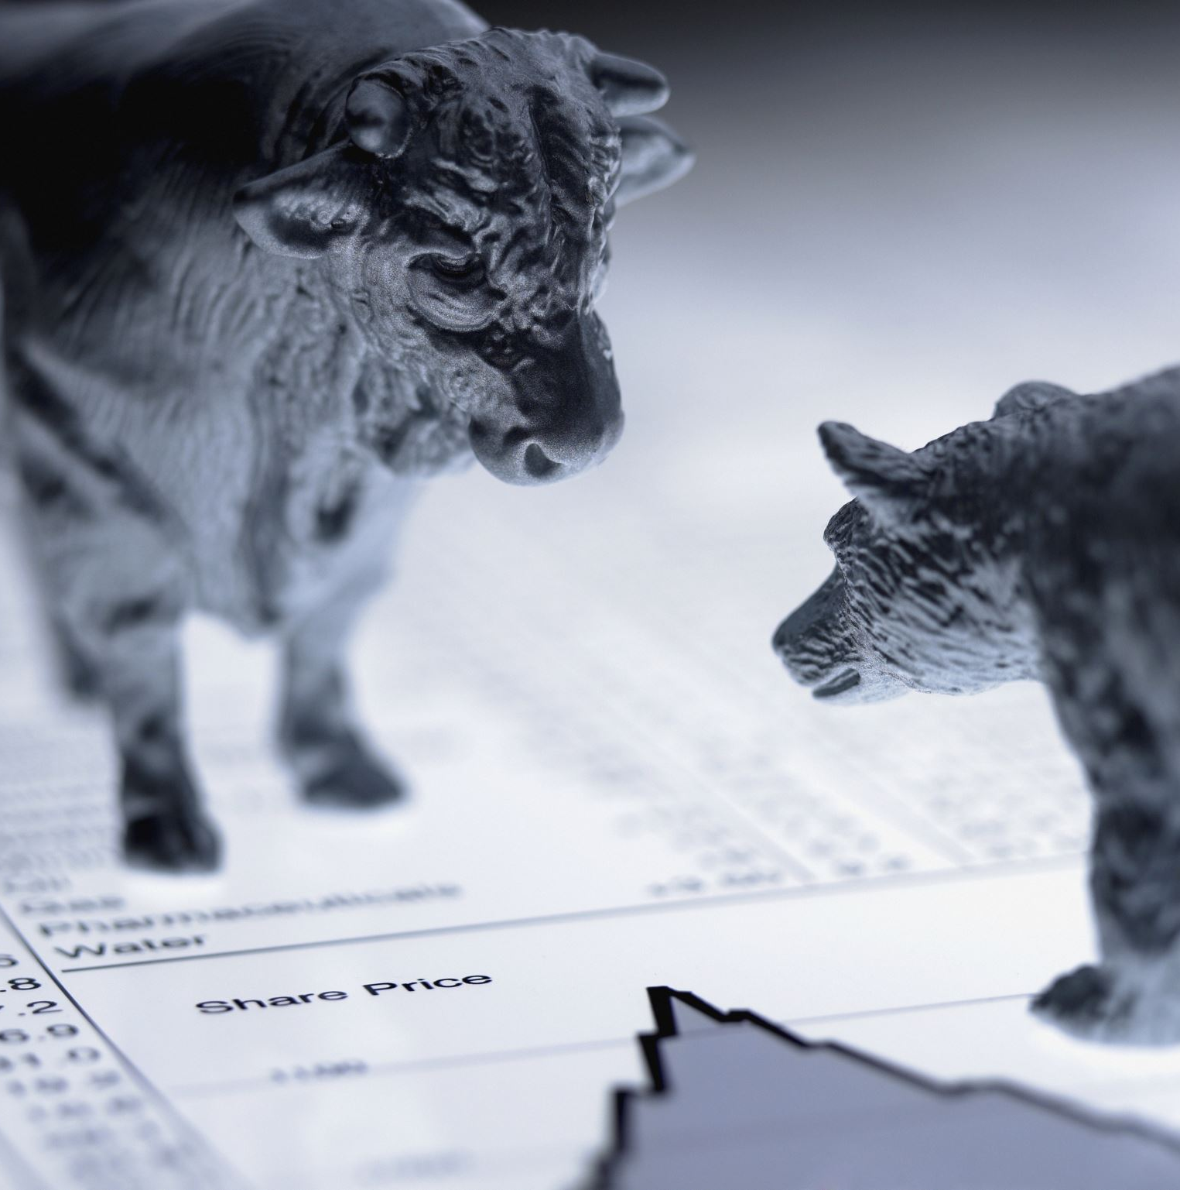
Financial Product Recommendation APP PATRON
Bhargav Devarapalli
Linkedin : https://www.linkedin.com/in/bhargavdevarapalli/
Github : https://github.com/bhargavddb/Brainstation_Final_Project

Slide 2

Project Overview
Patron is a Streamlit-based application designed to recommend financial products to users based on their demographic data and predicted income category. This tool uses machine learning models and clustering techniques to provide tailored recommendations.

Slide 3
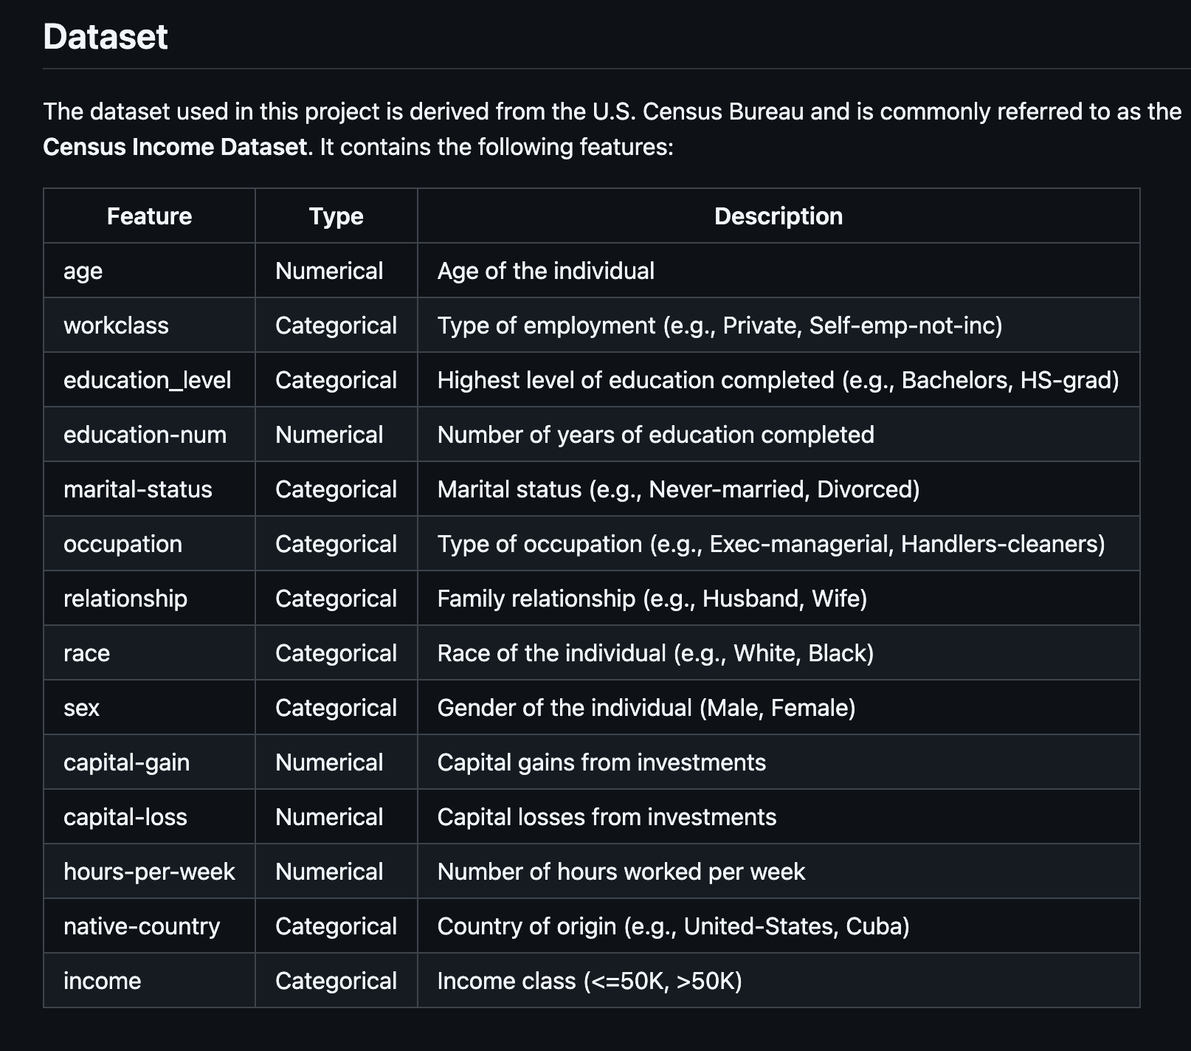
Data Loading and Cleaning
• Dataset includes features such as age, education, work class, and hours worked per week.
• Missing values/Data Cleaning were handled in key columns like work class, Education Level and occupation.
• Outliers in numerical features such as capital gain and hours worked were identified using Histogram/IQR.
• Inconsistent and Duplicate data entries were removed to ensure data quality is maintained

Slide 4
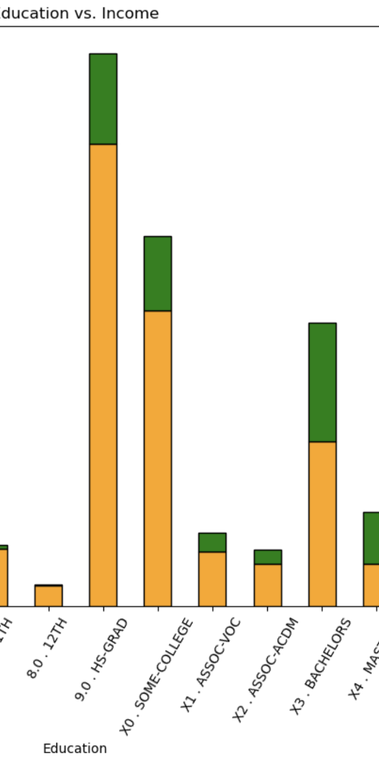
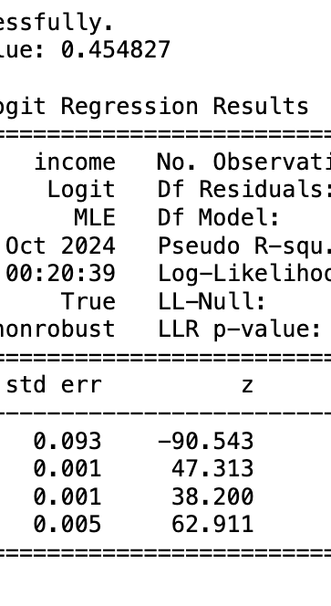
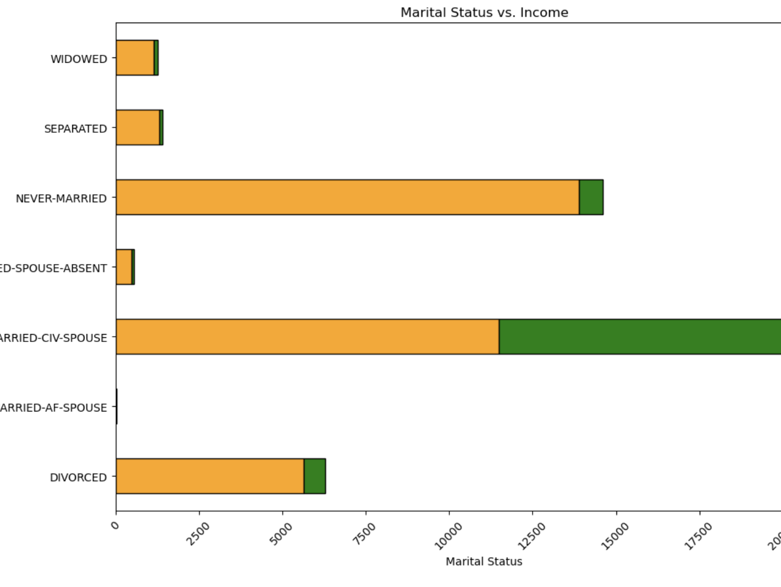
Exploratory Data Analysis
1) Most People work for Private Sector. Self Employed People has >50% change of having Higher Income
2) Captial Gain column has outliers and if the Gain is >5k there is a 80 % of Higer Income(> 50K)
3) Males tend to earn more than Women in terms of Higher Income
4) Married People have better chance of having Higher Income
5) Occupations like (Executives and Professionals) will have higher chance of earning >50 K
6) People with Higer degress( Bachelors and Above) will have higher chance of earning >50 K
7) Looks like there is no significant Correlation between All the Numerical Columns and therefore we will have to keep all the three Columns - Age, Educational-Number,Hours-per-Week
8) Tested the above mentioned point through Logistic Regression model and found same three columns to be effective
9) Hours Worked has a significant impact on the Income
10) Men tend to get paided higher compared to Women

Slide 5
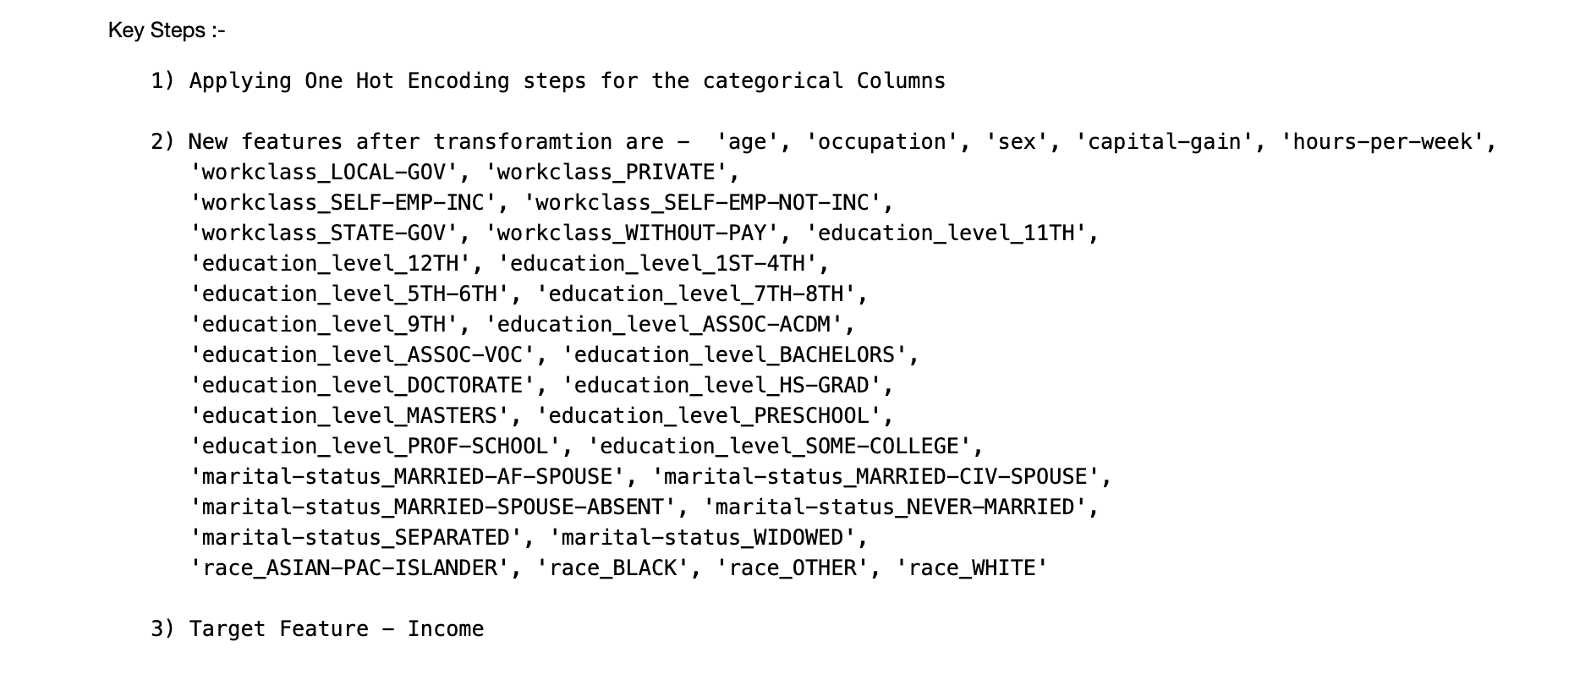
Feature Engineering and Preprocessing
• One-hot encoding was applied to categorical variables (e.g., work class, education).
• Numerical features were scaled for normalization.
• Data was split into training and testing sets to ensure model generalization.

Slide 6
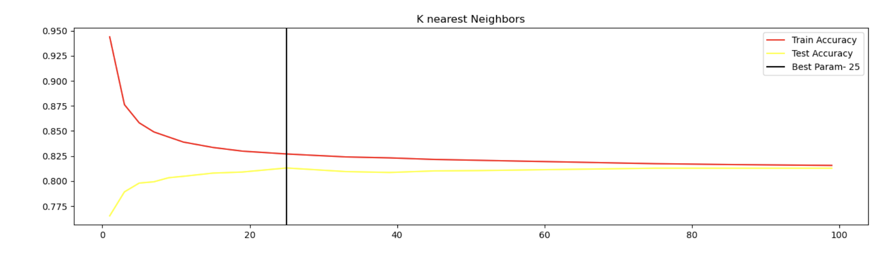
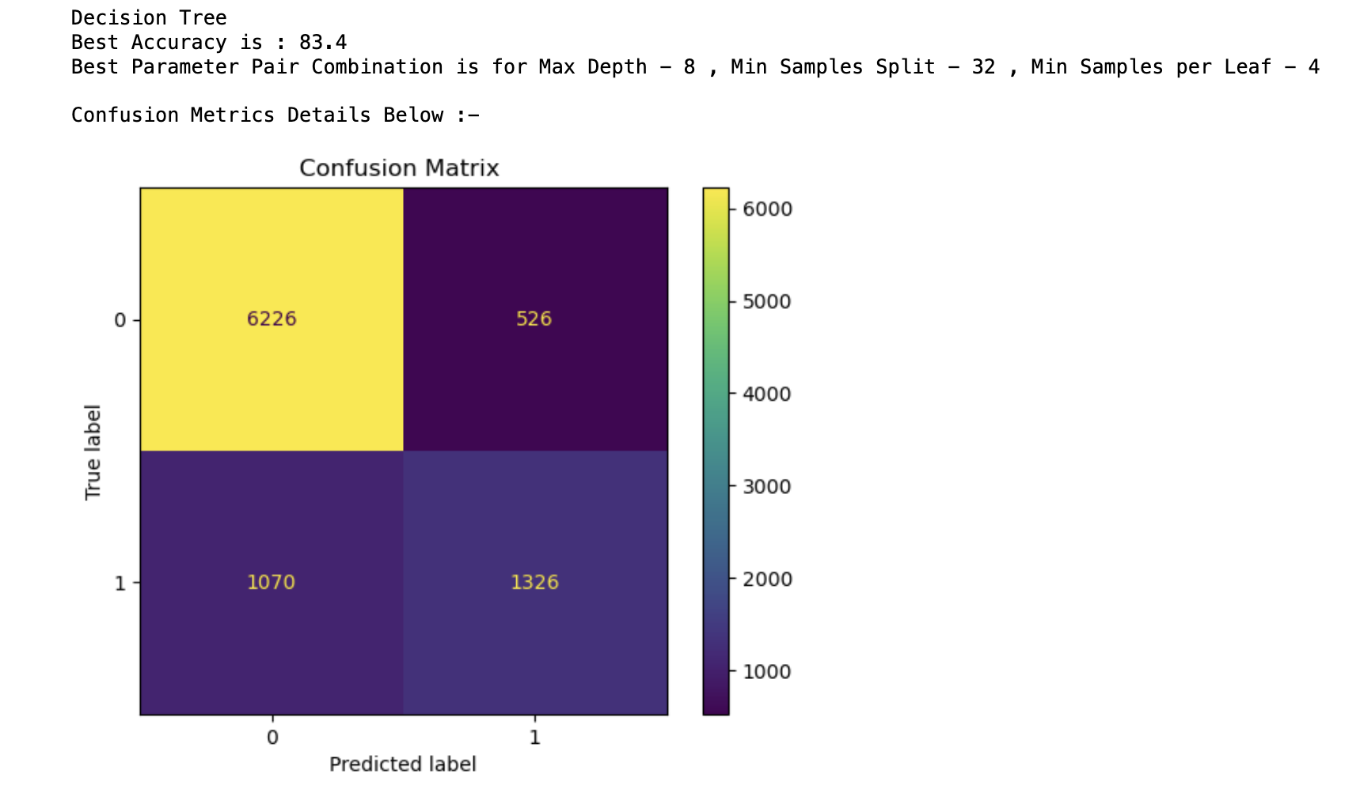
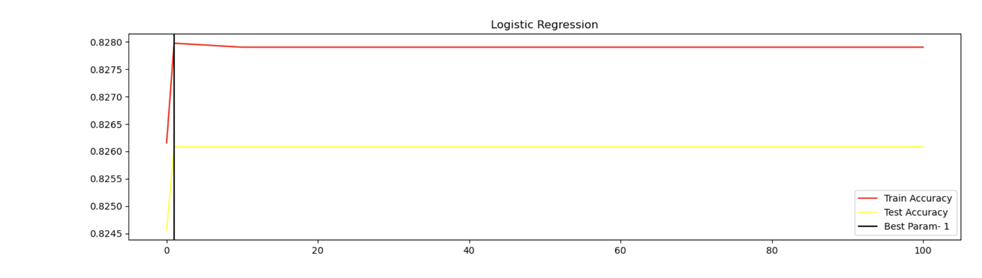
Model Building and Testing
• Models tested: K-Nearest Neighbors, Logistic Regression, Decision Trees.
• Performance evaluated using accuracy, confusion metrics.
• Logistic Regression and Decision Trees achieved an accuracy of ~83%

Slide 7
Demo
Link :- https://patron-bd.streamlit.app/

Slide 8
Conclusions and Future Work
• Migrate to Django/ Flask framework for Performance and scalability
• Aim to refine product recommendations based on improved income prediction models by using Deel Learning Model
• Allow users to upload custom datasets
• Enable live updates for input changes(API based for Service Model )

