Slide 1
Laser shooter - a raspberry-pi project

Slide 2
Abstract-
A robot using raspberry pi 3, that uses a pi camera module,a laser light source and a combination of two micro servo motors to track a particular object of a particular colour and shine laser light on that object.

Slide 3


Slide 4
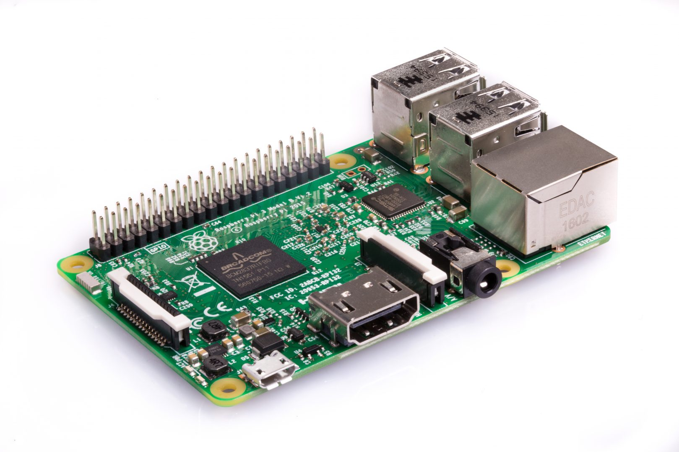

Slide 5
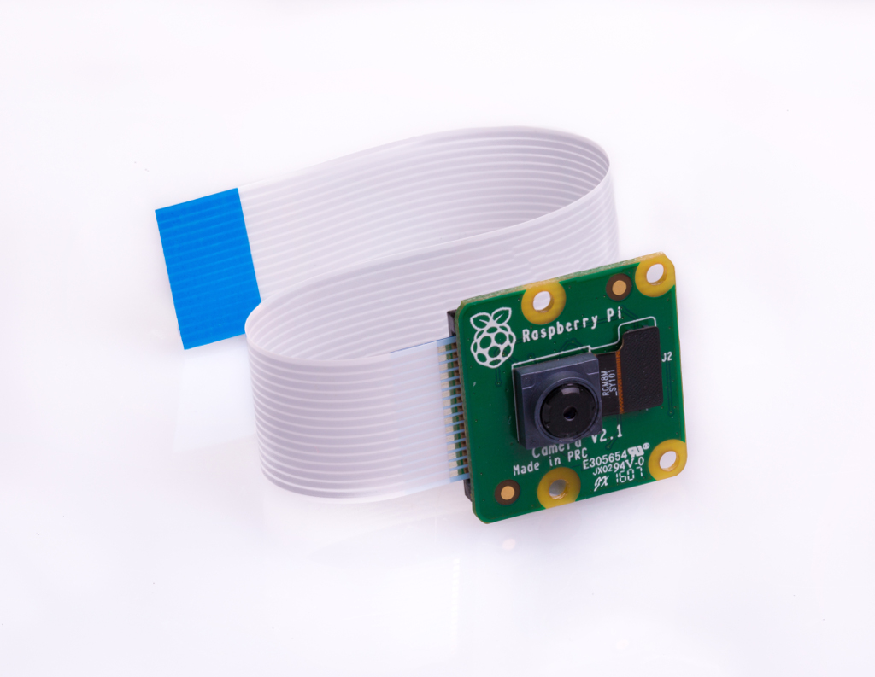

Slide 6
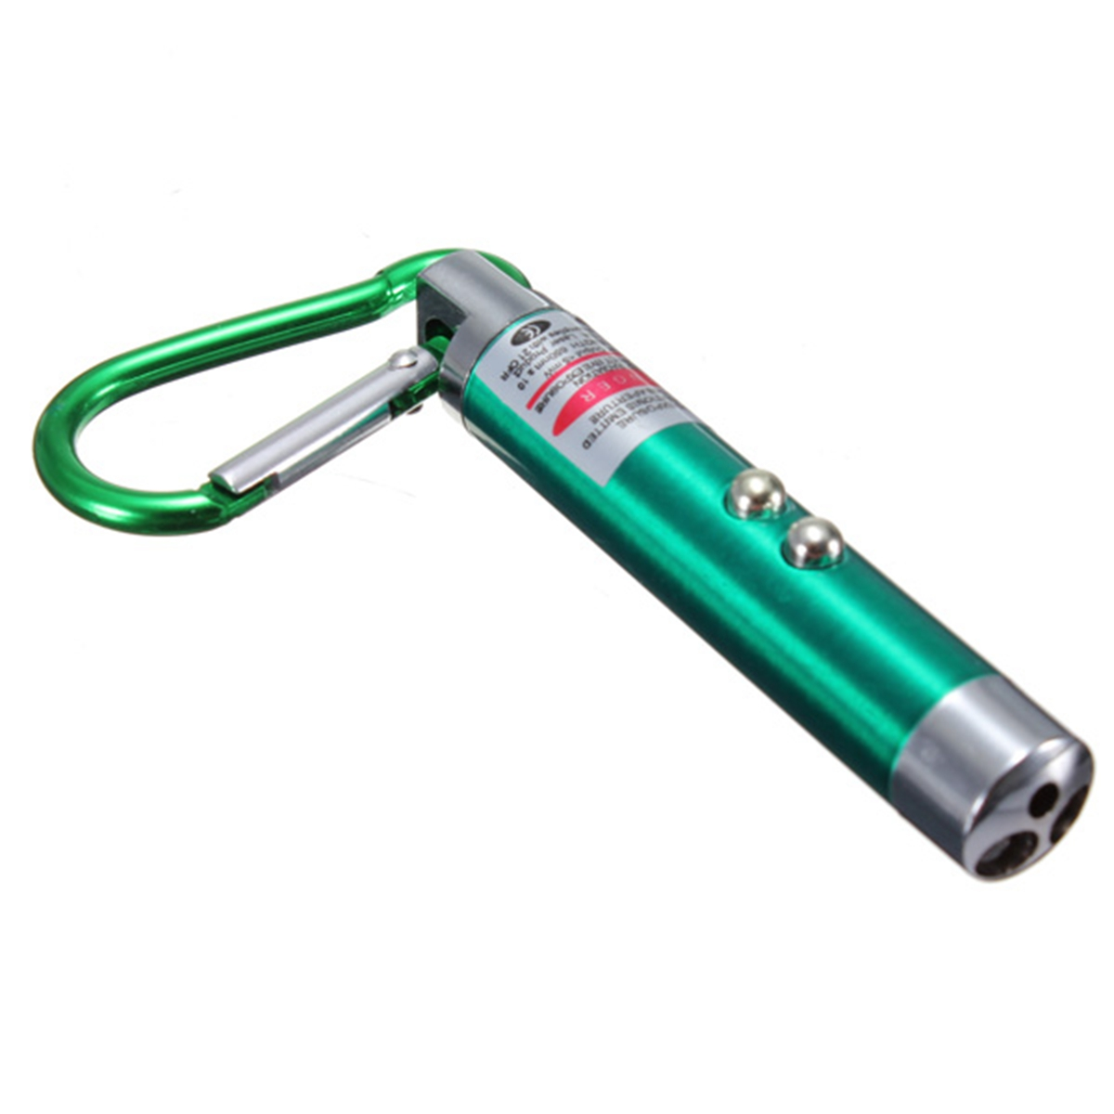

Slide 7
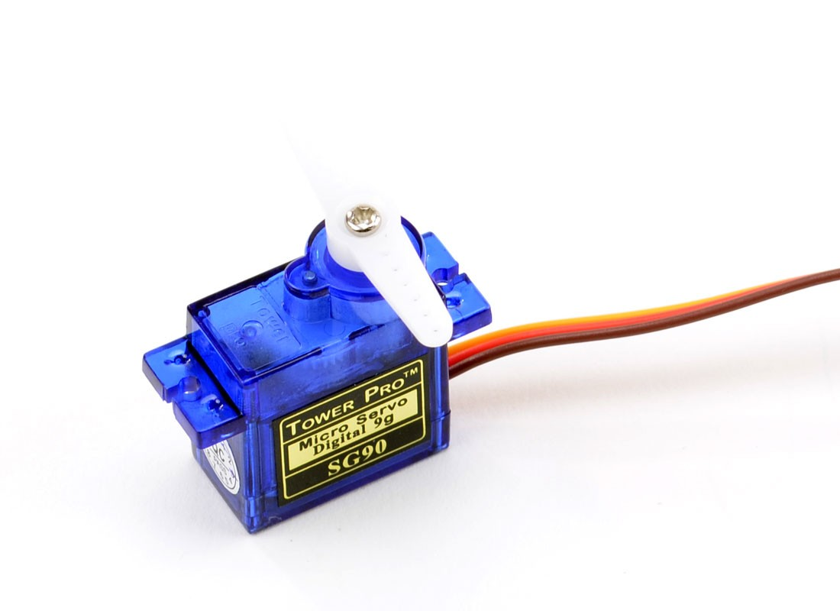
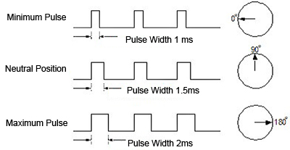
Micro Servo Motor-

Slide 8
OpenCV-
OpenCV (Open Source Computer Vision Library) is an open source computer vision and machine learning software library. OpenCV was built to provide a common infrastructure for computer vision applications and to accelerate the use of machine perception in the commercial products. Being a BSD-licensed product, OpenCV makes it easy for businesses to utilize and modify the code.

Slide 9
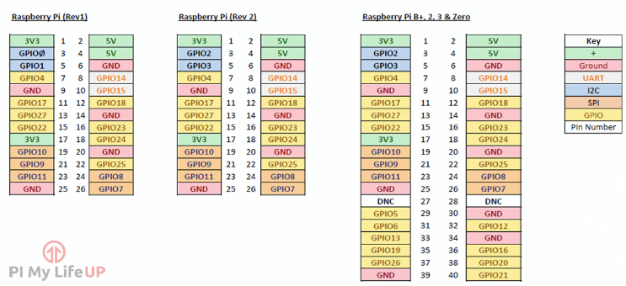
GPIO pinout-

Slide 10
(0,0)
(0, 720)
(544, 0)
(720, 544)

Slide 11
1465
1845
1600
1285

Slide 12
calculation...
Cx = x coordinates of the object.
Cx = y coordinates of the object.
x = respective duty cycle for servo 1(x-coordinates)
y = respective duty cycle for servo 2(y- coordinates)
x = 1845 - ( ( 245 / 720 ) * cx )
y = 1465 - ( ( 180 / 544 ) * cy )

Slide 13
challenges-
-hardware
-software

Slide 14
Hardware challenges-
1.laser
2.sturdiness
3.camera

Slide 15
Software challenges-
1.Installing OpenCV
2.servo jitters
3.

Slide 16
Any questions..!?

Slide 17
THANK YOU.

