Slide 1
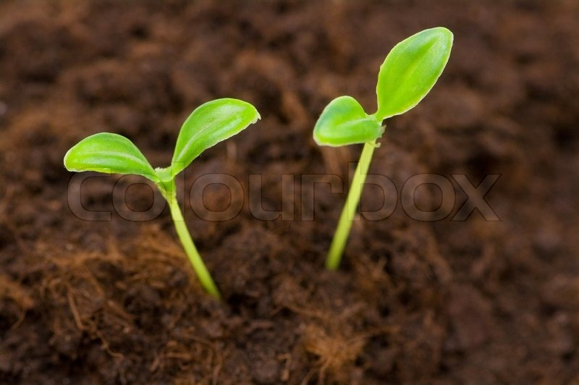
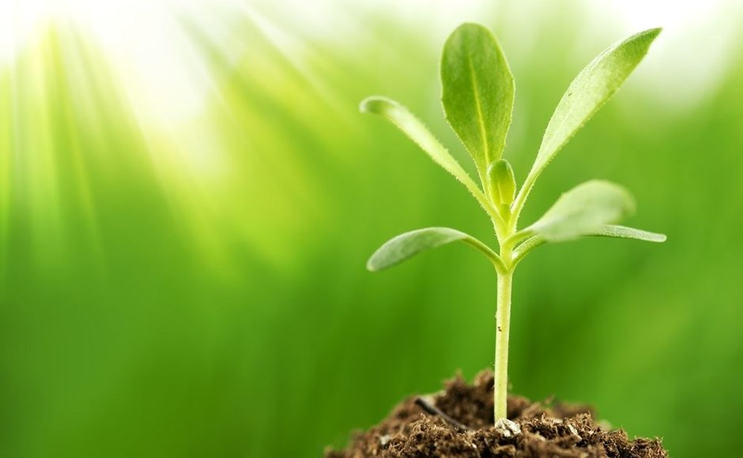
SEMILLA
Problem: Classification of plant seedlings
Karthik . A * Bramesh Jain * Naveen Raj HN * Karthik K * Kiran SM * Adarsha Ballal * Darpan Acharya * Deekshith Kamath * Bhargav Hegde

Slide 2
Problem statement: Classification of plant seedlings
- Tools and Framework to be used.
- Numpy, pandas, Keras Tensorflow.

Slide 3
Team Structure and Roles-
Karthik A
Kiran SM
Research Member
Naveen Raj. HN
Application Architect
Karthik . K
Solution Specialist
Brahmesh Jain
NLP Engineer
Deekshith Kamath
ML\AI Manager
Bhargav hegde
Business Development Manager
Darpan Acharya
Sales Specialist
Adarsha Ballal

Slide 4
Problems on programmers side:
*poor image quality
*unreliable data sets
*high variety of samplings
*time consuming
Problem on client side:
*lack of knowledge of the benefits

Slide 5
Technological modules used:
NumPy:it is fundamental package for scientific computing in python. It is used for Complicated mathematical operations and array operations.
PANDAS:it is a software library written for python for data manipulation and analysis. In particular it offers data structures and operations for manipulation numerical tables and time series.
KERAS:it is an open source neural network library written in python. It is capable of running on top of TensorFlow, Microsoft Cognitive Toolkit or Theano.Designed to enable fast experimentation with deep neural networks, it focuses on being user-friendly, modular, and extensible.

Slide 6
Concept validation
Concept validation is a process of showing design concepts to users to discover whether the users feel that these concepts address their needs. It also allows us to get feedback from users on ideas.

Slide 7
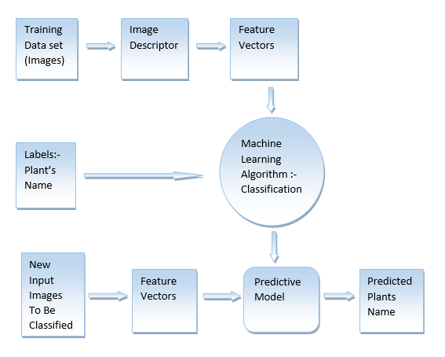

Slide 8
Solution to the problem
We build a model for the plant seedling classification using the concept of Convolution Neural Networks(CNN) and building a Machine learning model.Here we preprocess the plant seedling images.7 varieties of plant seedling data is used to train the model and we test the model with the image of the seedling to be recognised.The model identifies the type of the seedling with a certain amount of accuracy.

Slide 9
Improving scalability
Scalability is the ability of the model to grow and manage increasing demand.To improve scalability we require more resources such as seedling dataset having images of more variety of seedlings and greater quality of images.We can use better Machine learning algorithms suitable for handling large datasets and providing a better accuracy to improve the scalability

Slide 10
Estimated Time and Accuracy improvement
The model uses training dataset and 50 epochs to train the model which approximately takes 4-5 hours after which the model is tested.The accuracy that the model produces is around 80%-90%.
We can improve the accuracy of the model by taking more amount of plant seedling images in the dataset, having more epochs and using better image processing techniques

Slide 11
SWOT ANALYSIS
STRENGTHS | WEAKNESSES
OPPORTUNITIES | THREATS
1.Production
2.Branding
3.Grow staff
4.Profit
1.Marketing
2.R and D
3.Financial
4.Cash Flow
1.Customer service
2.Social Media
1.New Technology
2.Market
3.Economy

Slide 12
Estimated cost of the proposed product
The costs involved in building the model includes the cost of collection of data,transport and advertising our model to be recognised.The various technologies involved in preprocessing the image of the seedlings add to the major cost of the model.

Slide 13
MARKETING CONCEPTS:
The marketing concept is the philosophy that firms should analyze the needs of their customers and then make decisions to satisfy those needs, better than the competition. The different strategies used are -
Social marketing concept
Product concept
Marketing concept
Production concept
Selling concept

Slide 14
The idea of production concept - “Consumers will favor products that are available and highly affordable”,This concept is one of the oldest marketing management orientations that guide sellers.
The product concept holds that the consumers will favor products that offers the most in quality, performance and innovative features.

Slide 15
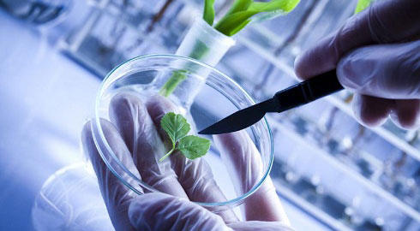
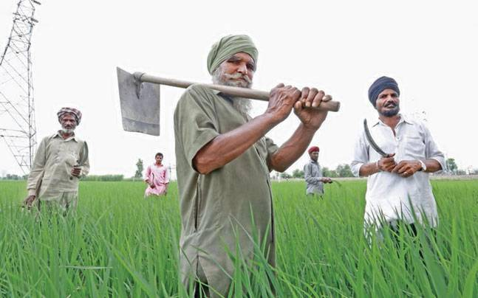
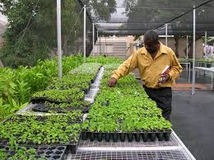
Our customers
Biotechnologists
Farmers
Plant Nurseries

Slide 16
THANK YOU

