Slide 1

HRB1-ACCOUNT SYSTEM
Madhuri Sarode – 16294879
Bhargavi Chennupati – 16271057
Bhavana Kota-16275870

Slide 2
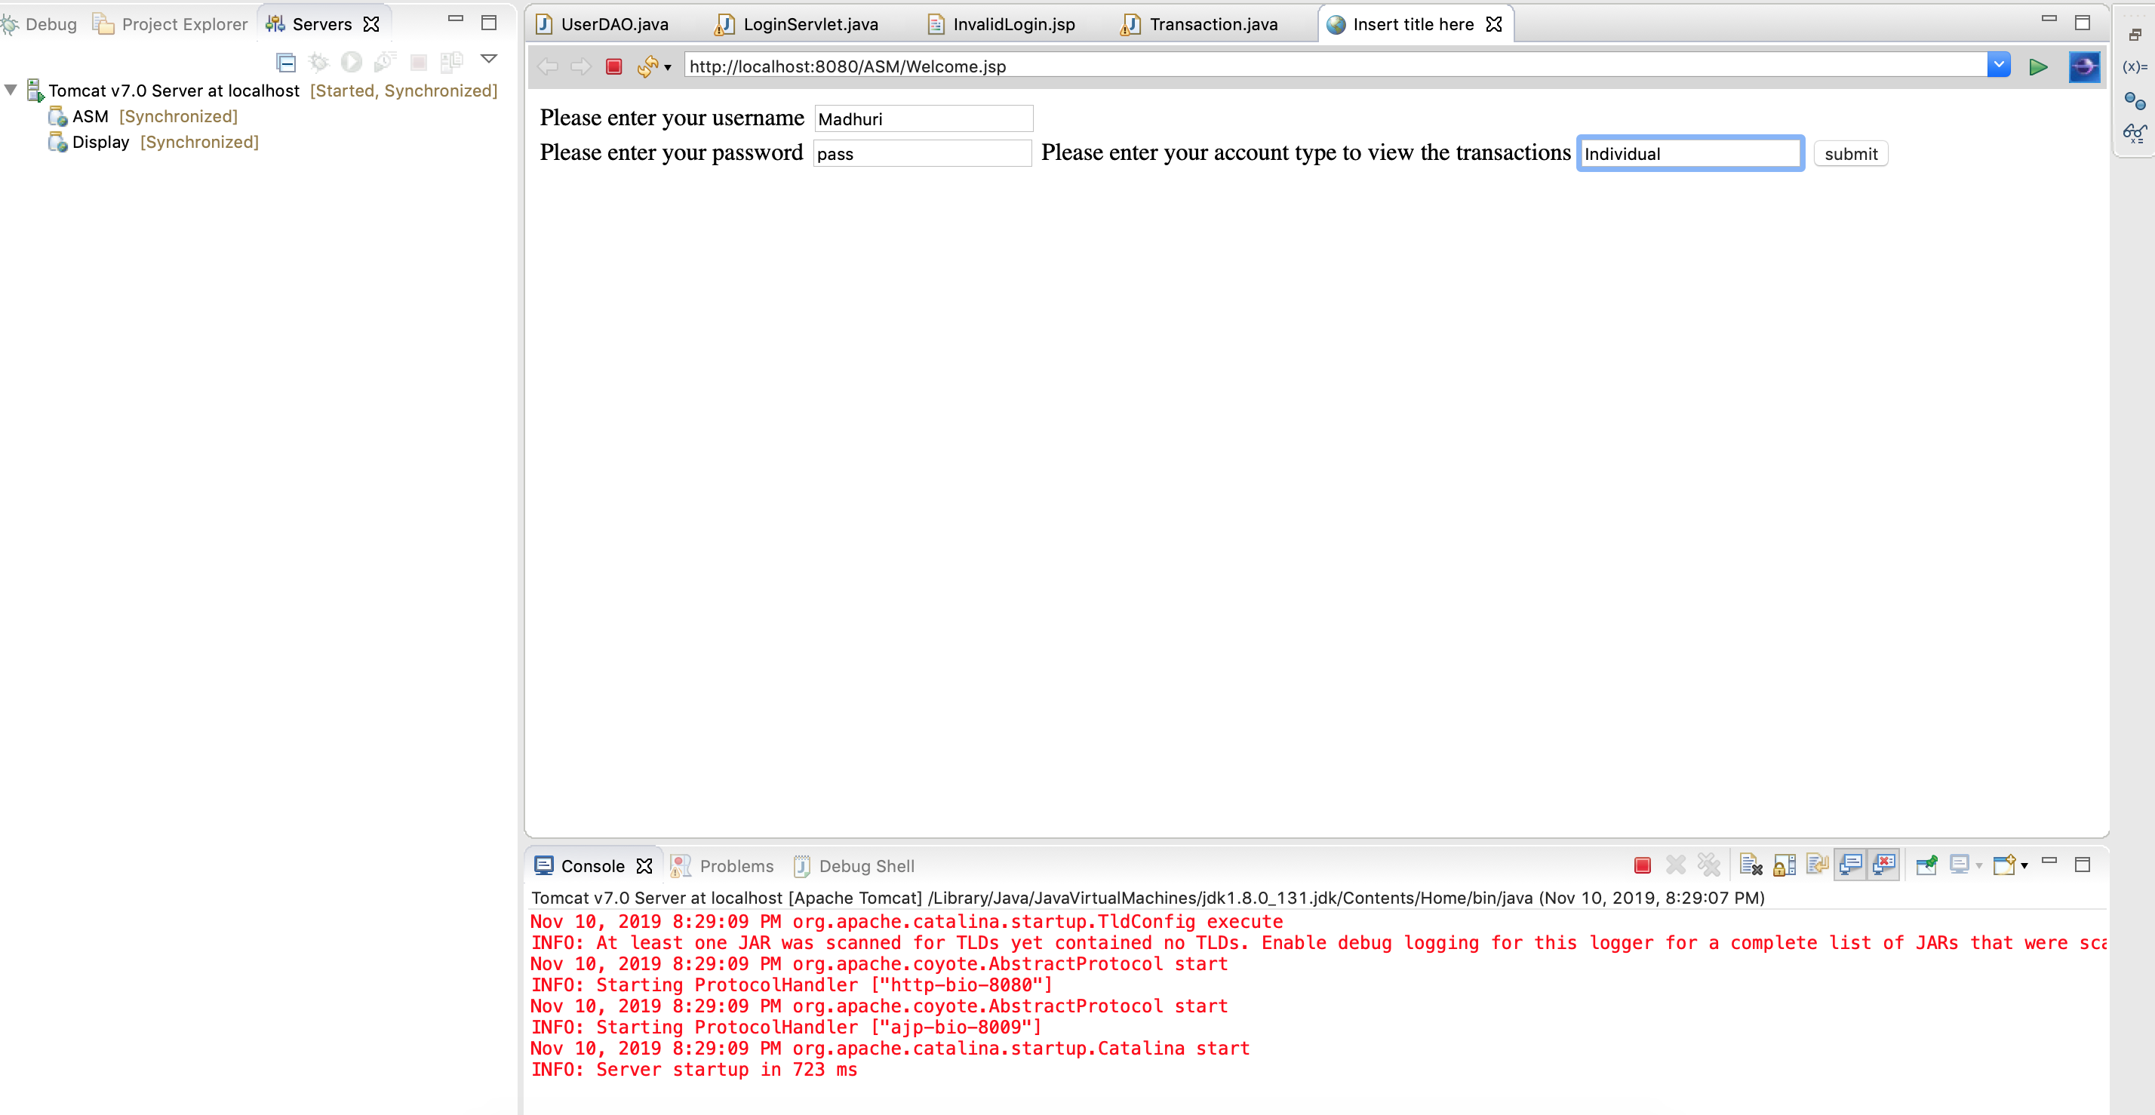
Login Page

Slide 3
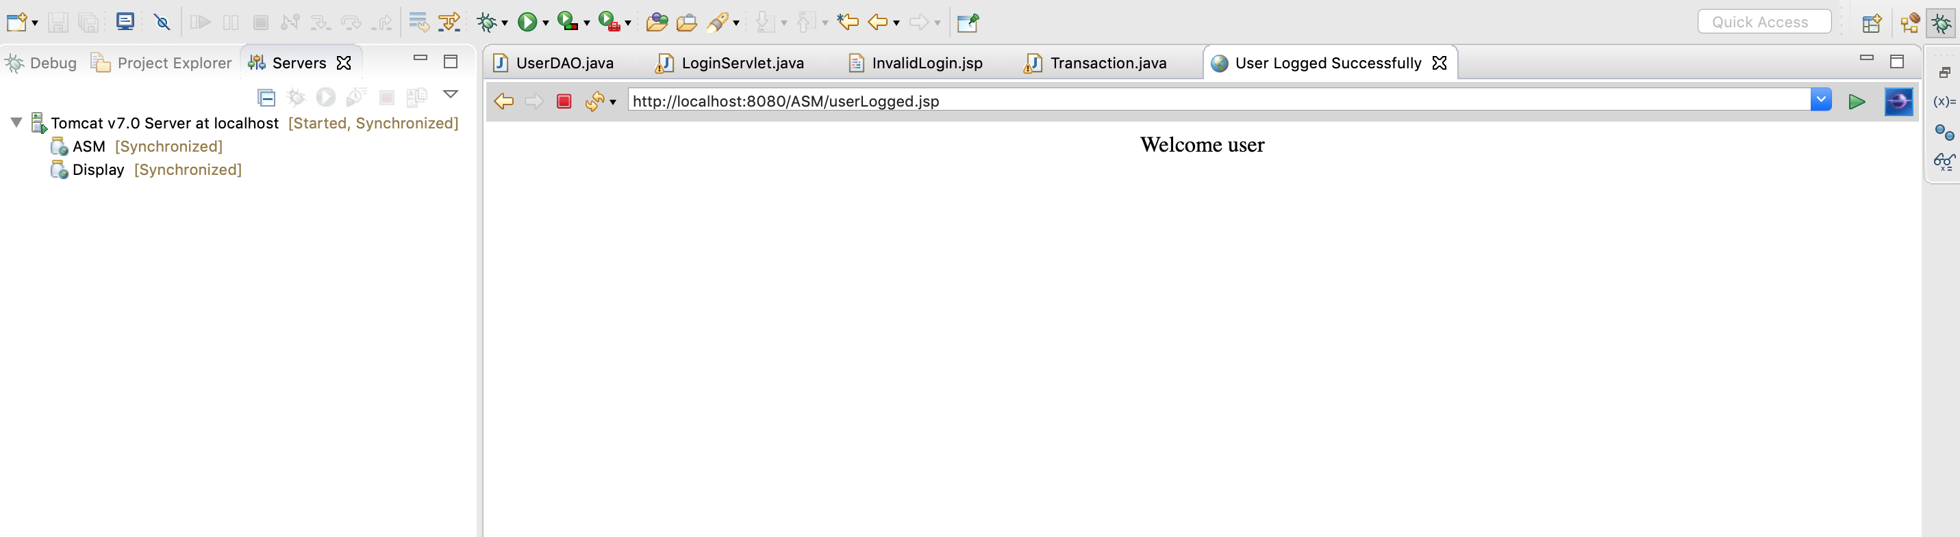

Slide 4
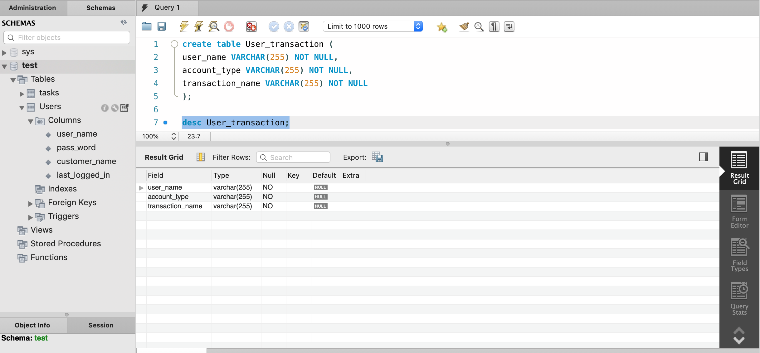
Creating a Table

Slide 5
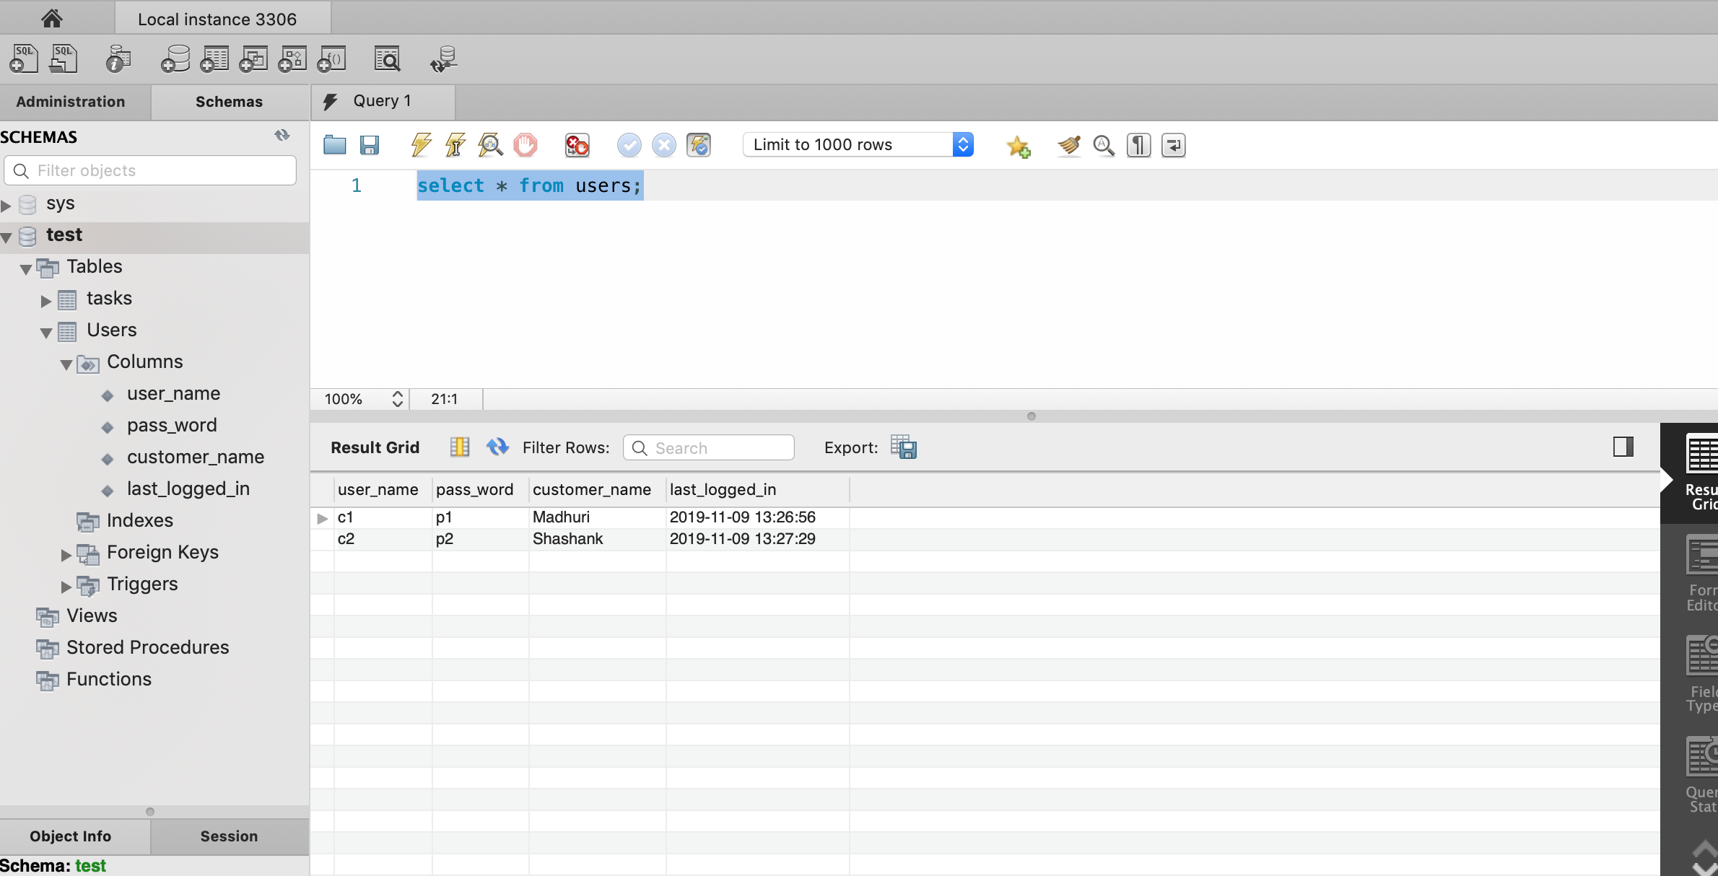

Slide 6
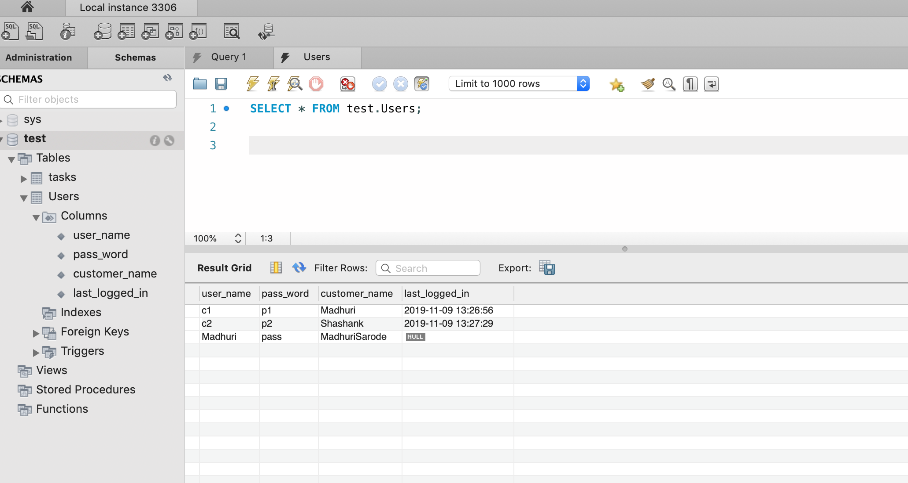

Slide 7
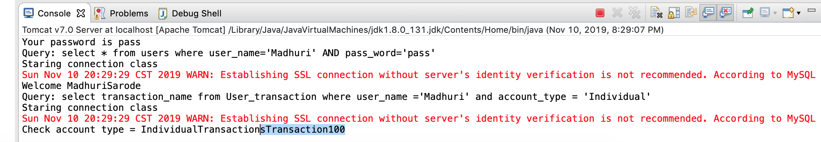

Slide 8

Thank You

