Slide 1
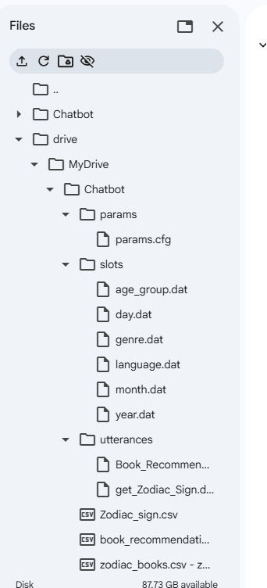
Python Chatbot
Scope
Files
What was added to enable book_suggestion intent
Utterances, slot files, CSV, params.cfg, tests
Outcome
Intent handling, slot extraction, action functions

Slide 2

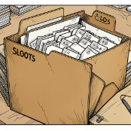
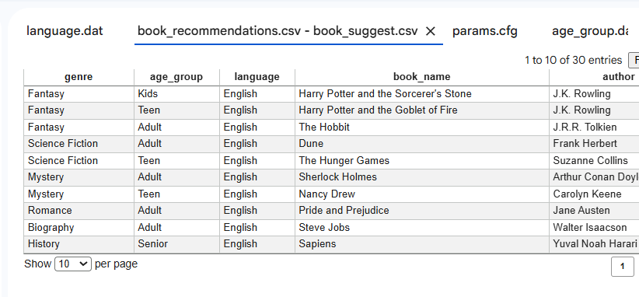
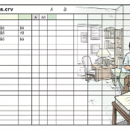
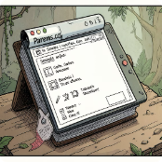
New Files for book_suggestion Intent
book_suggestion.dat
Slots
age_group.dat (9), language.dat (4), genre.dat (10)
61 training utterances
Book_suggestions.csv
params.cfg (updated)
30 book-author-language-genre rows
Adds book_suggestion intent + bookSuggestion_Action()

Slide 3
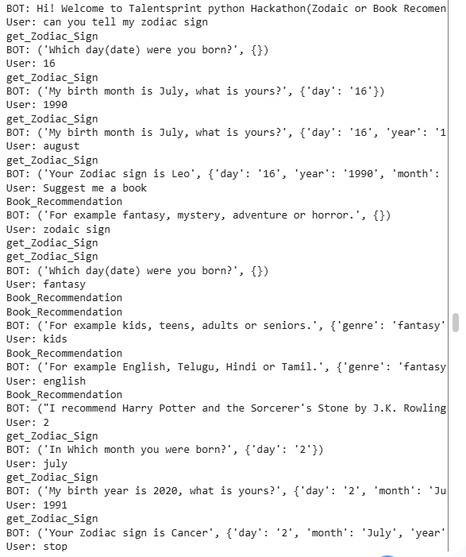
Core Dialogue Engine & Flow
1. Slot Extraction
2. Intent Classification
getattributes() reads *.dat, matches slots, replaces text with $slot
TF-IDF + MultinomialNB trained on 100 utterances, accuracy = 1.0
3. Intent Loading & Slot Check
4. Actions & Session
bookSuggestion_Action()/zodiacSign_Action() set IntentComplete; Session.reply() manages state
loadIntent() + check_required_params() → prompts if missing

Slide 4
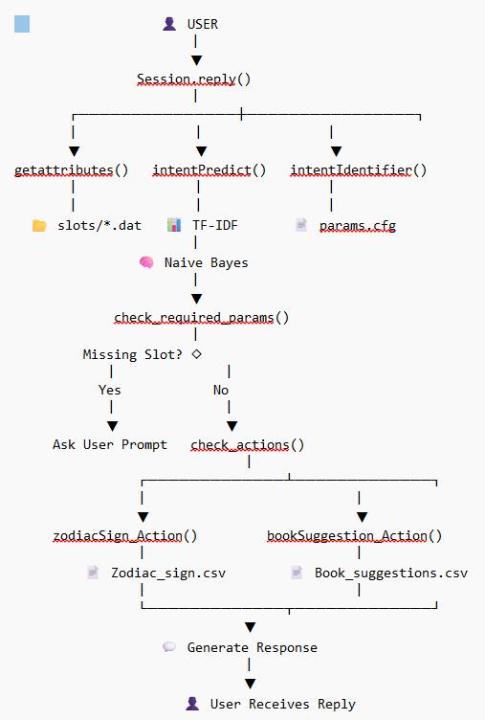

Architecture Visual: Process Steps
Slot Extraction
Intent Classification
Slot Filling & Action
Session Management

Slide 5
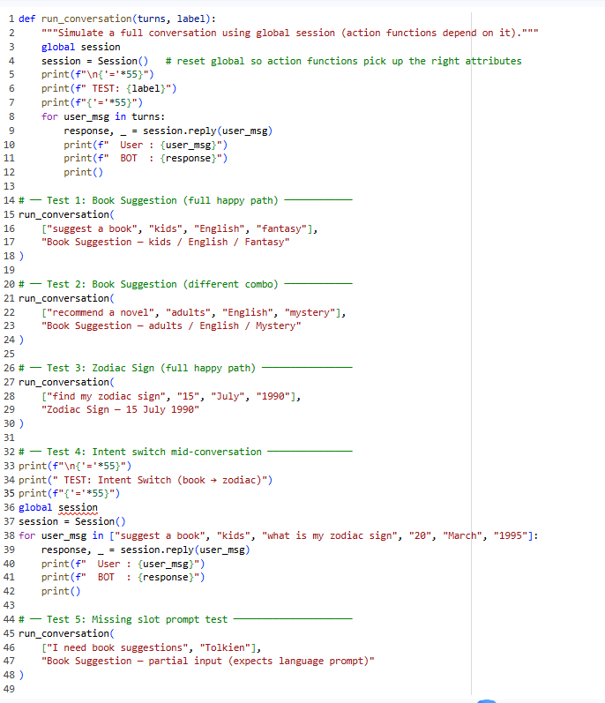
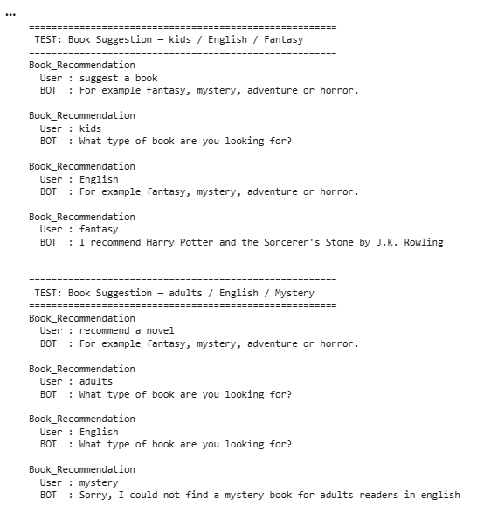
T
E
S
T
Intent Classification
I
N
G

Slide 6
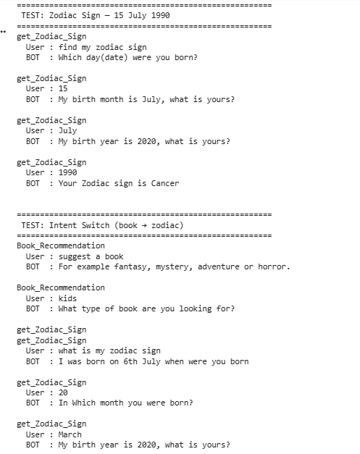
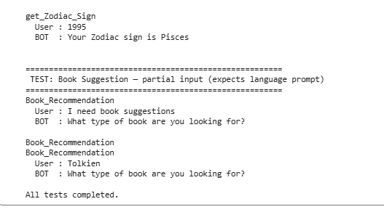

Slide 7

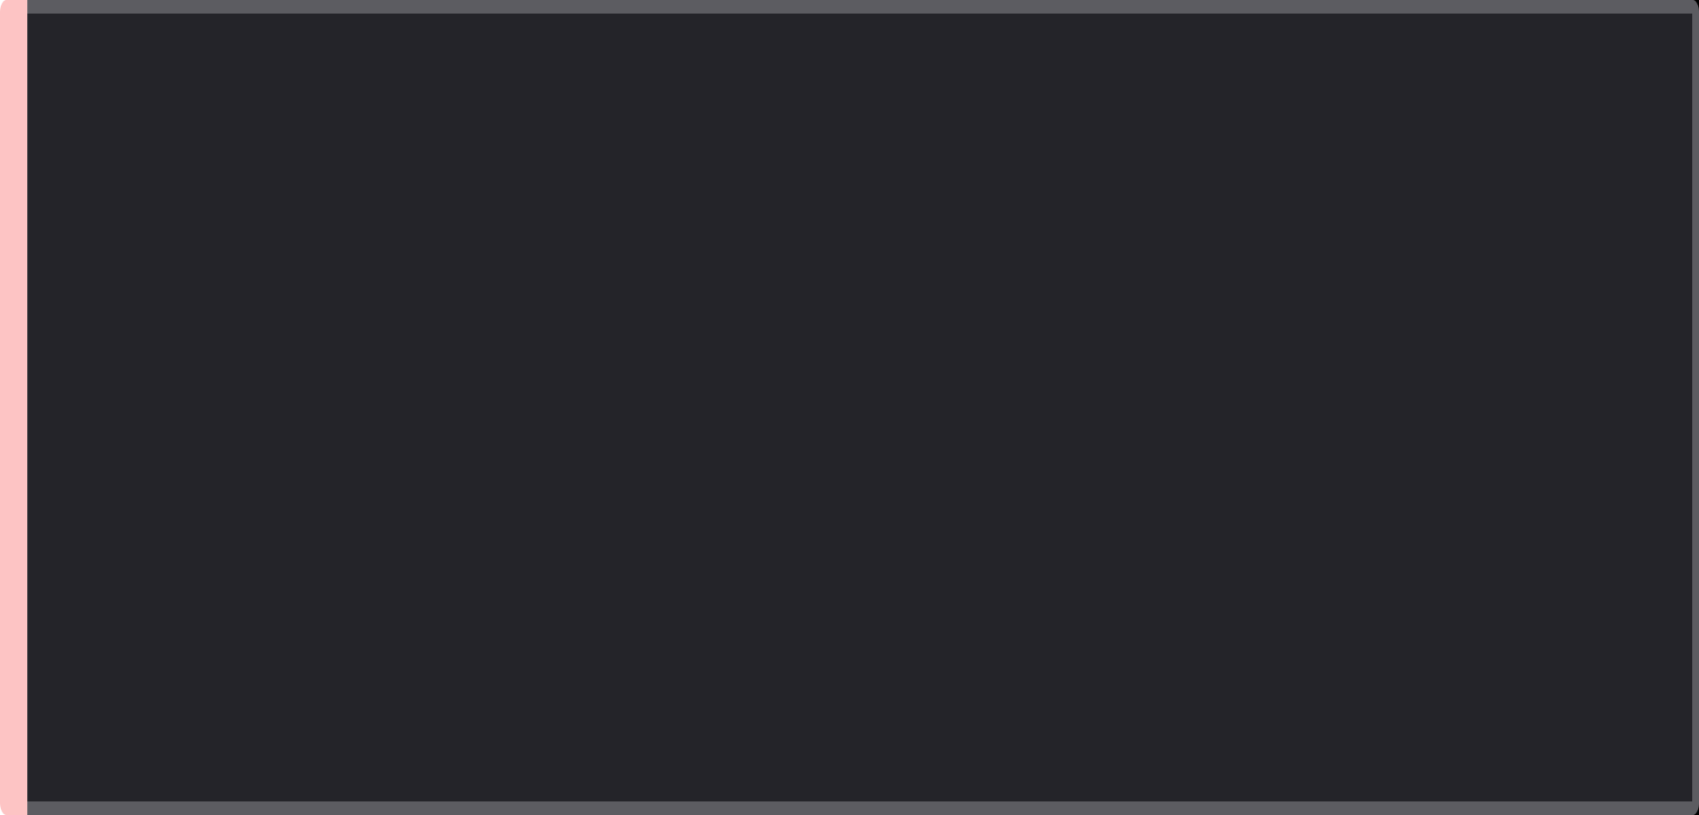
Hackathon Deliverables & Demo Flows
Demo Flow 1
Checklist
suggest a book → kids→ English → fantasy → book result
Tasks: dat + slots + CSV, TF-IDF model, actions, tests
Demo Flow 2
book_suggestion.dat + slots + params.cfg
Book_suggestions.csv
TF-IDF + MultinomialNB (100% utterances)
Actions implemented + tests
zodiac: 15 July 1990 → Cancer
Demo Flow 3
Start book intent → switch to zodiac mid-flow → intent switch works

Slide 8
Measuring Intent Classification Accuracy
Approach
Held out test
TF-IDF (uni + bi-grams) over every .dat utterance; the file name is the intent label.
75 / 25 stratified split - precision, recall and F1 all 1.00.
100%
5- Fold Cross Validation
Model Comparison
Cross-validated accuracy
Mean accuracy 100% (+/- 0%) - confirms it isn't a lucky split.
Count vs TF-IDF x Logistic regression/ NaiveBayes / SVM - best combination selected.
2 intents - 114 utterances - TF-IDF features
The score is high because the two intents use near-disjoint vocabulary; overlapping intents would need confidence thresholds.

Slide 9
Robust Slot Filling: Synonyms & Fuzzy Matching
The Problem
Synonym Map
Live examples
Baseline slot matching needs an exact word; real users use synonyms and make typos.
'sci-fi' -> fantasy, 'children' -> kids, 'scary' -> horror; normalised to the canonical CSV value.
“i want a sci-fi book” → fantasy
“a book for children” → kids
“something scary” → horror
“romence please” → romance
“in englsh” → english
Fuzzy Fallback
Guardrails
difflib corrects typos (romence -> romance, englsh -> english) for the active intent's slots.
Cutoff 0.85 and skip words under 4 chars, so stop-words like 'in' can't match 'hin'.

Slide 10
Alexa vs Python Chatbot: Side-by-Side
Alexa Skill (ASK + Lambda)
Python Chatbot (notebook)
PROS
PROS
+ Voice-first, hands-free on real devices
+ Built-in ASR & NLU, ready-made slot types
+ APL visual cards + Open Library covers
+ Managed scaling; publishable to users
+ Full, transparent control of every step
+ Runs offline; instant test & iterate
+ Custom ML (TF-IDF + classifier) we own
+ Easy to evaluate (CV, confusion matrix)
CONS
CONS
– Depends on cloud console & AWS Lambda
– Slower to debug (request JSON, redeploys)
– Less control over the matching logic
– Text-only — no real voice interface
– Slot filling & NLU are hand-built
– Notebook demo, not a deployable product
Same skill, two implementations: Alexa delivers real voice UX, while the Python bot gives transparent, testable logic.

