Slide 1
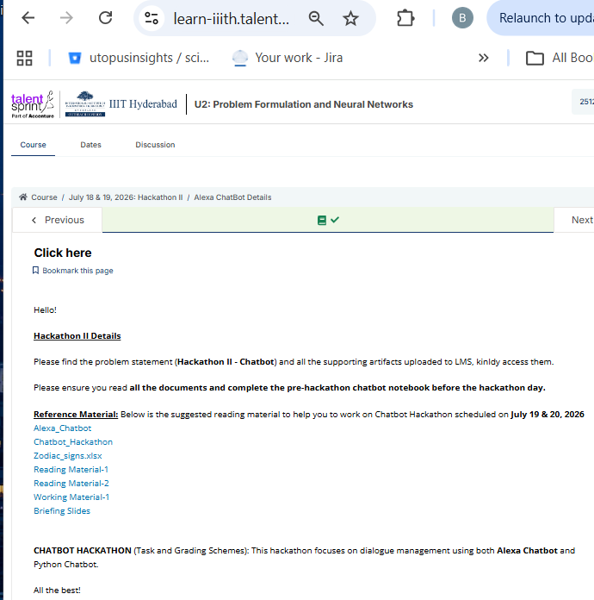
Zodiac Guide — Alexa Skill: Challenges, Debugging Journey, and Improvements
A concise technical walkthrough for Alexa skill developers and engineers: how we built a birthday-to-zodiac assistant, the issues encountered in the interaction model and Lambda, the fixes applied, and the improvements that turned a simple calculator into a conversational hackathon-ready assistant.

Slide 2
Project Objective & High-Level Flow
The initial goal was straightforward: accept a user's birth date and return the correct zodiac sign. From that seed we evolved the skill into a multi-turn conversational assistant that maintains session state, provides personality summaries, daily horoscopes, and personalized book recommendations.
01
02
Launch & Onboarding
Birthday Capture
Welcome prompt and immediate request for birth date (no unnecessary yes/no step).
Elicit and validate month, day, and year slots with built-in types and supportive utterances.
03
04
Zodiac Profile
Optional Book Recommendation
Compute sign, return enriched response: readable date, sign, traits, lucky color & number, compatible signs, and horoscope.
Multi-turn: ask if user wants recommendations; follow-up supports genre, age group, and language filters.

Slide 3
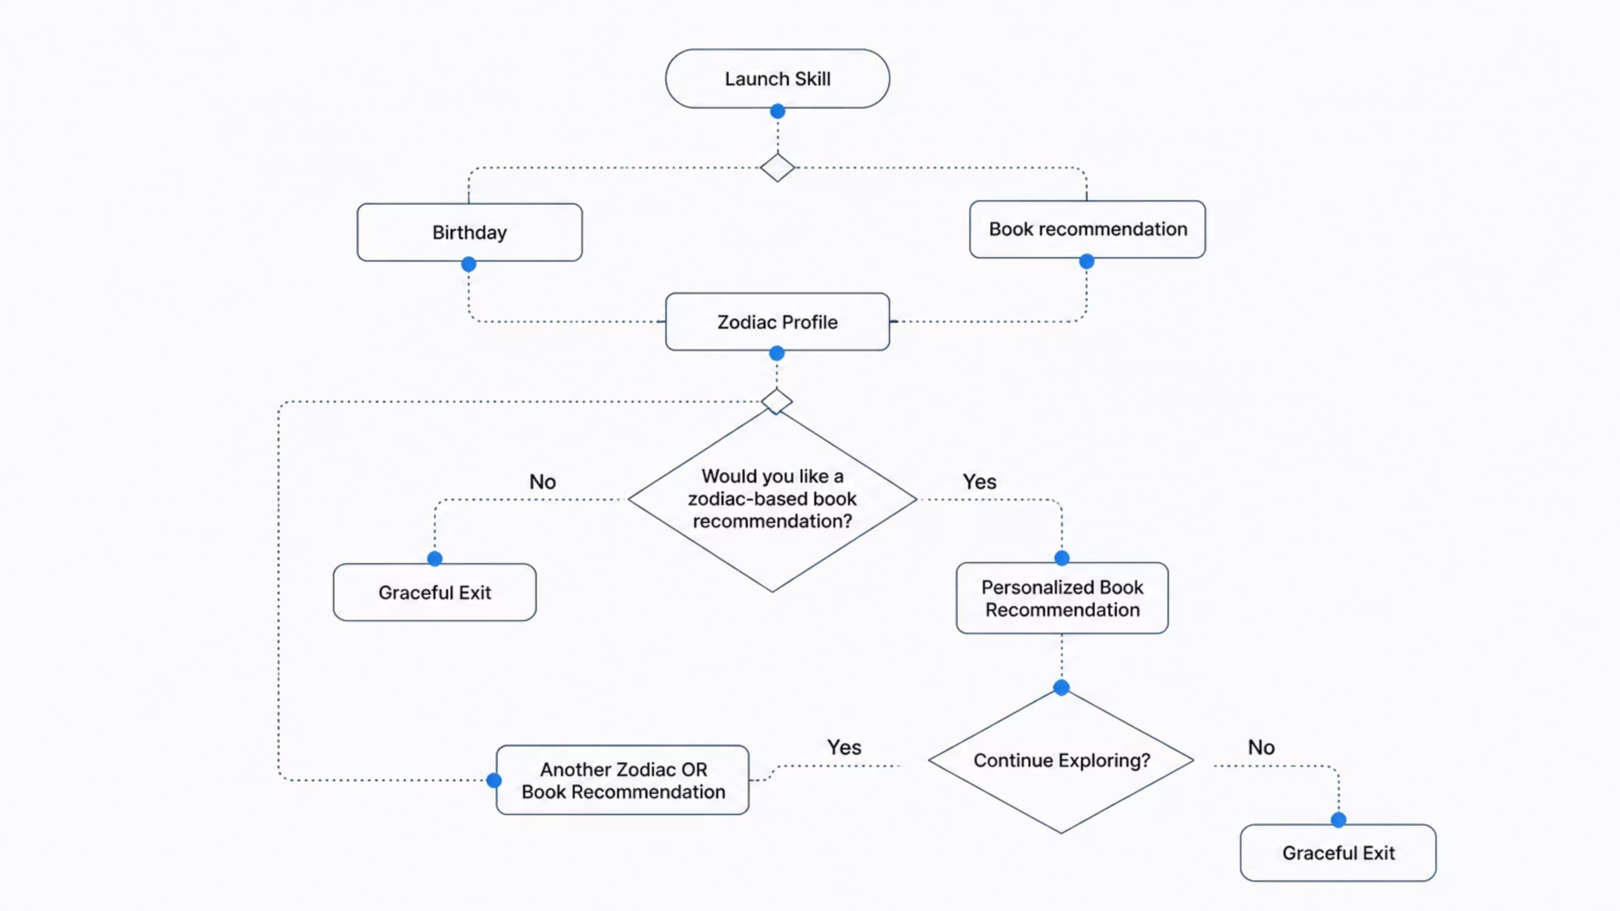
This diagram shows the complete decision tree and user journey through all possible paths in the Zodiac Guide skill, from launch through graceful exit.

Slide 4
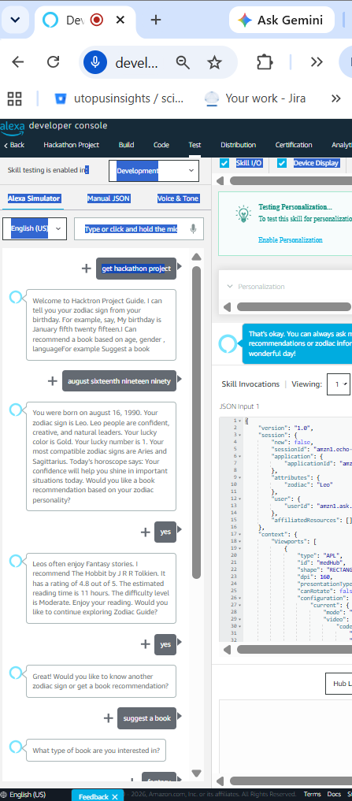







Demo Flow 1: Main Demo (Happy Path)
This outlines the intended successful user interaction and system responses for the primary demonstration.
User Initiates Skill
User Input: Open skill
Expected Output: Launch
Provides Birthday for Zodiac
User Input: "My birthday is August sixteenth nineteen ninety"
Expected Output: Zodiac Profile (Leo with traits, lucky color/number, compatibility)
Requests Zodiac Profile Details
User Input: YES (to zodiac profile)
Expected Output: Zodiac Profile (Leo with traits, lucky color/number, compatibility)
Requests Book Recommendation
User Input: YES (to book recommendation)
Expected Output: Zodiac Book Recommendation (mystery genre for adults in English)
Specifies Recommendation Criteria
User Input: "Recommend a mystery book for adults in English"
Expected Output: Continue Exploring (offer another recommendation)
Declines Further Exploration
User Input: NO (to continue exploring)
Expected Output: Standard Book Recommendation (alternative genre)
Skill Exits Gracefully
Expected Output: Graceful Exit (thank you and goodbye)

Slide 5

Demo Flow 2: Negative Path (User Declines Recommendations)
User Input:
Open skill
"My birthday is January tenth twenty fifteen"
NO (decline book recommendation)
Expected Output:
Alexa: "Would you like a book recommendation based on your zodiac personality?"
User: "No"
Alexa: "That's okay. You can always ask me for personalized book recommendations or zodiac information anytime. Have a wonderful day!"
Key Behavior:
Graceful handling of user decline — no pressure, friendly tone, leaves door open for future interactions.

Slide 6
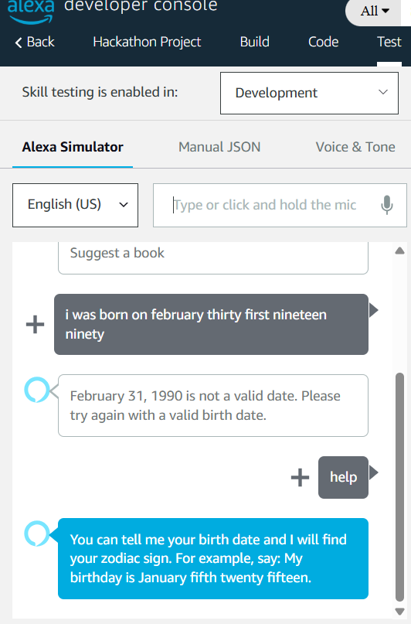
Demo Flow : Help Intent
User Input:
- "help"
Expected Output:
Alexa: "You can tell me your birthday to know your zodiac sign, ask for a book recommendation, or get a personalized recommendation based on your zodiac personality."
Key Behavior:
Clear, concise help message that summarizes all three main capabilities:
01
02
Birthday → Zodiac sign lookup
Book recommendation request
03
Zodiac-based personalized recommendation

Slide 7


Major Issues Encountered (Summary)
Silent after "Yes"
Slot Naming Validation
Empty Custom Slot Type
Root cause: LaunchRequest asked a YES/NO question but no intent handled a standalone "Yes" reply. Fix: simplify launch to request birth date directly to avoid unhandled intents.
Error: slot names must start/end with alphabetic characters. Fix: standardized slot names to month, day, year.
Custom MONTH slot had no values — removed it and used AMAZON.Month to leverage built-ins.
Repeated Elicitation & Missing Values
Lambda ValueError
Alexa repeatedly asked day/month/year because day and year were not being captured; observed request JSON showed day='?' which fed into Lambda as a non-numeric value.
Python int() conversion failed on '?' — the fix was twofold: correct slot types/utterances and add defensive parsing/validation in Lambda before numeric conversion.

Slide 8
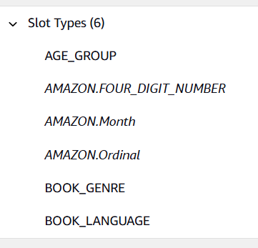
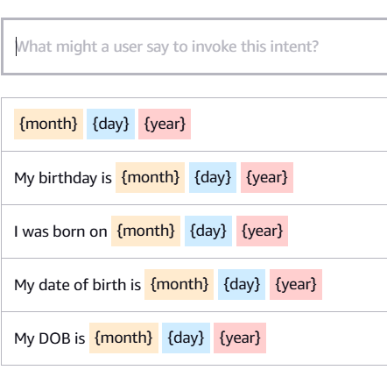
Interaction Model Fixes (Detailed)
We focused on aligning slot types, utterances, and dialog elicitations with natural speech patterns. Key changes:
Slot names standardized: month, day, year.
Replaced custom MONTH type with AMAZON.Month for robust month recognition (full and short forms).
Changed slot types: day → AMAZON.Ordinal (captures 'fifth', 'sixteenth'), year → AMAZON.FOUR_DIGIT_NUMBER, month → AMAZON.Month.
Added utterance patterns in both orders: "{month} {day} {year}" and "{day} {month} {year}" and natural variants like "January fifth twenty fifteen" to reflect real speech.
Populated user utterances for each dialog elicitation prompt so Alexa can recognize expected replies during slot elicitation (critical for dialog model completeness).

Slide 9
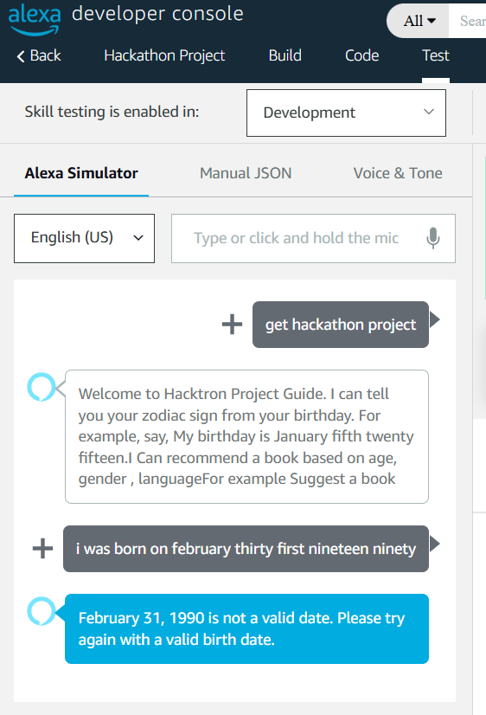
Lambda Code & Data Validation Enhancements
Backend fixes improved resilience and correctness:
Defensive Parsing
Before int() conversions, verify slot values exist, normalize ordinal text to integers, and handle common ASR artifacts ('?', 'unknown').
Datetime Validation
Use Python's datetime and calendar logic to validate dates and leap years (reject February 31, April 31, Feb 29 on non-leap years), returning descriptive prompts when invalid.
Error Handling
Catch ValueError and TypeError in Lambda, log full request JSON for debugging, and respond with a friendly re-prompt rather than failing silently.
Logging
Inspect request JSON during tests. Log recognized slot resolutions and their raw values to trace ASR mismatches vs slot type expectations.

Slide 10
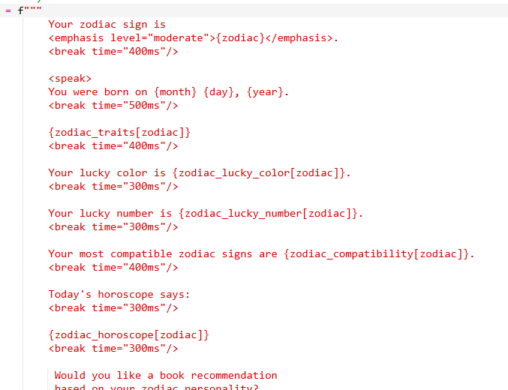
Speech & SSML Improvements
Improving voice quality makes interactions sound professional and reduces user friction. Changes include carefully applied SSML:
Use <break time="300ms"/> to separate phrases (e.g., between the spoken date and the zodiac result).
Use <emphasis level="moderate"> for the zodiac sign to highlight the key output.
Concise, friendly phrasing: "You were born on August 16, 1990. Your zodiac sign is Leo."
Fallback and reprompt messages use softer prosody to reduce perceived abruptness.

Slide 11




Feature Additions: Enriched Zodiac Profile
Beyond the basic sign lookup, we built a richer response package to increase engagement and demo value:
Personality Traits
Lucky Color
Lucky Number
Compatibility
Return the lucky color with a short usage tip (e.g., "Gold — great for accessories on presentation days").
Include lucky number and a short suggestion how to use it (e.g., "Consider 1 for timing decisions or milestone planning").
List compatible signs (e.g., "Leo is compatible with Aries and Sagittarius") with a one-sentence rationale.
Concise, 2–3 sentence description tailored to the sign (e.g., "Leos are confident, creative, and natural leaders — they thrive on recognition and take bold initiative").
Daily horoscope snippet included; short and actionable (one sentence) so it fits voice UX constraints.

Slide 12
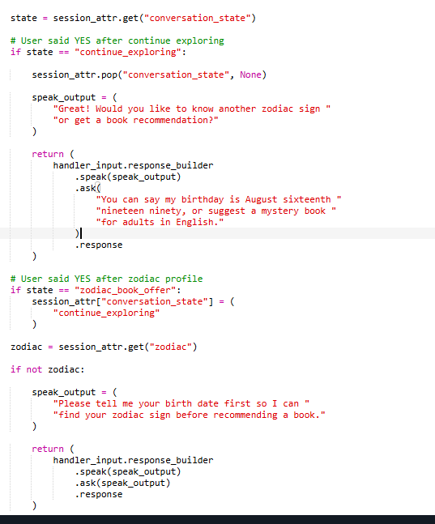

Book Recommendation Flow & Conversational UX
We implemented a personalized recommendation engine that uses a CSV-backed knowledge base combined with in-session preferences:
Filters Supported
Genre, age group, language, and zodiac personality mapping to preferred genres (e.g., Leos → Fantasy).
Recommendation Metadata
Return rating, reading time, and difficulty level in the spoken response and optionally as a card in the Alexa app.
Session & State
Maintain conversation_state to allow "continue exploring" or "another recommendation" flows without the user repeating context.

Slide 13
Lessons Learned & Best Practices
Key takeaways for Alexa skill developers when building robust voice experiences:
Interaction model correctness is as important as backend logic — mismatched slot types or missing utterances often cause perceived runtime errors.
Always inspect the request JSON during debugging. The slot values and resolutions tell the real story of what Alexa heard.
Use built-in slot types whenever possible (AMAZON.Month, AMAZON.Ordinal, AMAZON.FOUR_DIGIT_NUMBER) to leverage Alexa’s recognition models.
Validate user input server-side before converting values — protect Lambda against ASR artifacts and malformed inputs.
Design for natural speech order and populate sample utterances that match how users speak (month-first patterns are common).
Enhance speech with SSML but keep responses concise for voice UX; include reprompts and graceful fallback language.
Pro tip: Add comprehensive developer logs during testing and remove or lower verbosity before production to avoid cost and log noise.

Slide 14
Feature Enhancements Beyond the Core Skill
Building on the working skill, we added four enhancements to enrich the book-recommendation experience and make the demo stand out:
01
02
APL Visual Cards
Multi-Language Selection
Rich on-screen book cards showing title, author, and cover art alongside the voice reply.
Request books across English, Hindi, Tamil, and Telugu within a single conversation.
03
04
Author Synonyms
Open Library Covers
Spoken name variations resolve to the correct catalogue author, reducing 'not found' errors.
Live book-cover titles fetched in real time from the Open Library API.

Slide 15
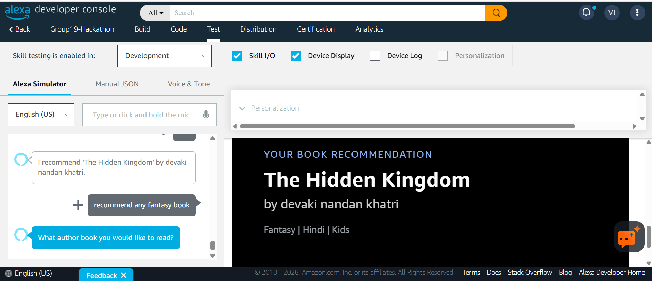
Enhancement: APL Visual Cards for Book Recommendations
On screen-enabled Alexa devices, each recommendation now renders as a rich visual card instead of voice alone.
01
why it matters
• Shows book title, author, and cover art with the spoken reply
• Genre-based accent colours make every card feel tailored
• Falls back gracefully to voice-only on devices without a screen

Slide 16
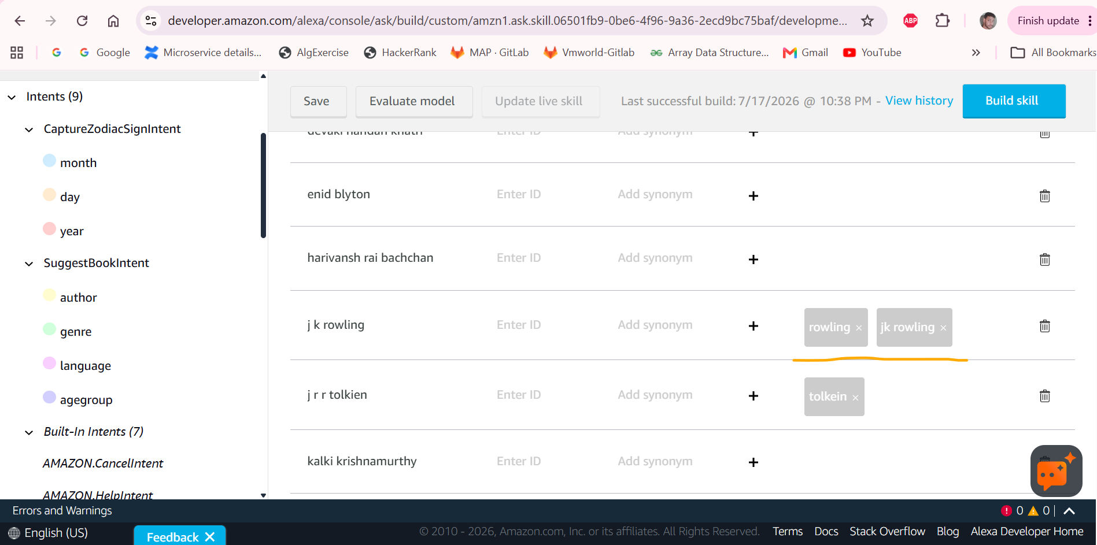
Enhancement: Author Synonyms for Robust Recognition
Real-world variations of an author's name now resolve to the correct catalogue entry.
03
why it matters
• Synonyms map spoken variants (e.g. 'J. K. Rowling' -> 'j k rowling')
• Reduces 'author not found' failures caused by speech-to-text spelling
• The same robustness approach is mirrored in the Python chatbot

Slide 17
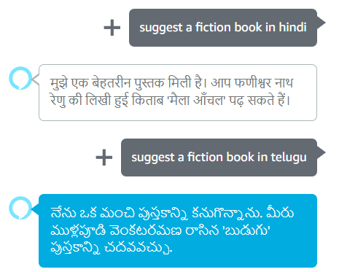
Enhancement: Multi-Language Book Selection
Users can ask for books in more than one language within a single conversation.
02
why it matters
• Supports English, Hindi, Tamil, and Telugu from one dialogue
• Language captured as a slot and combined with genre and age filters
• Broadens the skill's reach to multilingual readers

Slide 18
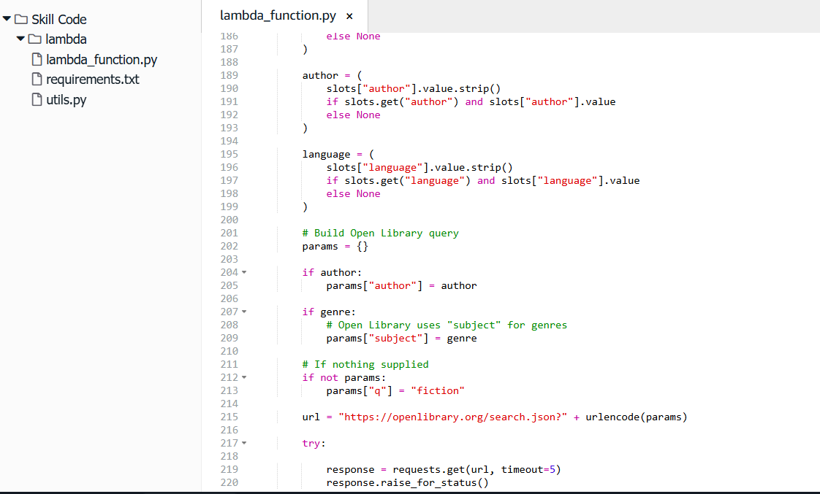
Enhancement: Live Cover Art via the Open Library API
Book covers are fetched in real time from the Open Library API to enrich the visual card.
04
why it matters
• Calls Open Library to retrieve book recommendations by configured slots
• Keeps the catalogue lightweight - no need of google sheets
• Delivers a polished, professional look for the live demo

Slide 19
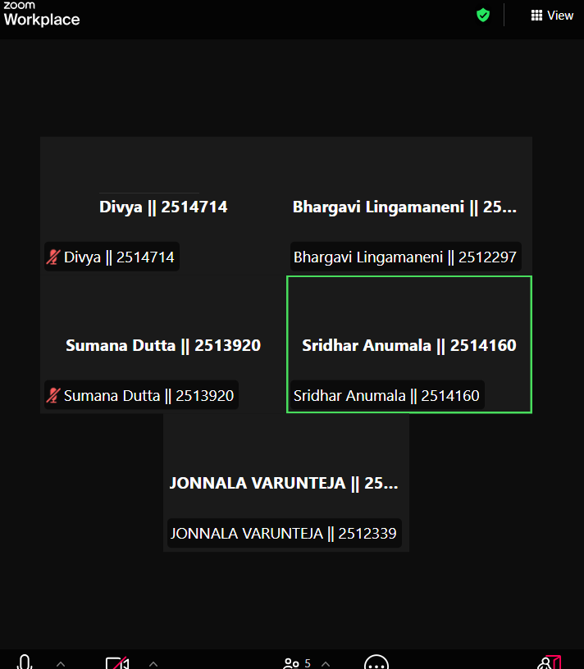
Project Status, Next Steps, and Hackathon Checklist
Completed
Potential Enhancements
Birthday→Zodiac detection, personality details, horoscope, book recommendations (genre/age/language), multi-turn flow, graceful exits, help/fallback intents, session state management, CSV integration.
Multiple recommendation candidates, rating-based sorting, mood-based suggestions, memory of past recommendations to avoid repeats, merging preferences into a single recommendation engine.

