Slide 1

Complete Hackathon Learning Journal: Weather Classification → Generation
Concise record of experiments across six notebooks (MH1–MH6). Built for ML practitioners and hackathon participants, with a focus on reproducible methods, failure analysis, and deployable results.

Slide 2
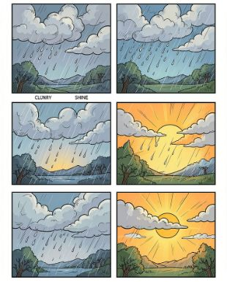
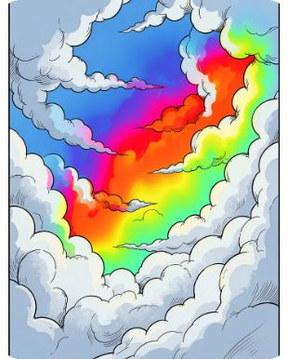
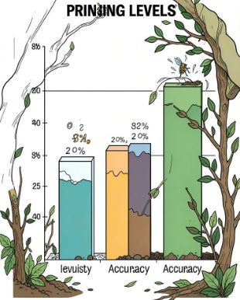
MH1 — Baseline Transfer Learning
Setup
Diagnostics
Pruning
1125 images across 4 classes. Split 70/15/15 (seed=42). Trained ResNet18 and VGG16 with frozen feature extractors and a classifier head only.
Created confusion matrices, per-class accuracy tables, layer-activation views, and Grad-CAM heatmaps. The models showed complementary failure modes, which helped pinpoint where each one struggled.
ResNet18 held up under 50% pruning but collapsed at 70%. VGG16 improved after 70% pruning and fine-tuning, suggesting its extra parameters acted as a regularizer.
Key metrics: ResNet18 reached 95.29% test accuracy with a 5.32% gap; VGG16 reached 94.71% with a 1.58% gap. For reproducibility, use weights='IMAGENET1K_V1' and freeze features for fast baseline runs.

Slide 3
MH2 — Advanced Optimization
Stage 1 — Augmentation (ResNet18)
Stage 2 — Fine-tuned VGG16
Stage 3 — Ensemble
Unfroze the last convolution block and used discriminative learning rates (conv: 1e-4 SGD; FC: 1e-3 Adam). Result: 94.71% test, 97.62% validation, early stop at epoch 12, with ≈7.1M trainable parameters.
Soft-voting ResNet18 + VGG16 improved test accuracy to 95.29% (+0.59%). The ensemble fixed many model-specific errors; the remaining mistakes were mostly ambiguous images.
Added flips, 15° rotation, and ColorJitter. Test accuracy fell to 92.35% because frozen features could not adapt and the FC head was too limited.
Stage 4 — Distillation
Stage 5 — VGG16 70% Pruning
Used the ensemble as teacher and a random CNN student (23.9M params). With T=3 and α=0.7, the student reached 91.18% accuracy (95.7% transfer). Takeaway: pretrained students work better.
Applied global L1 pruning at 70%, then fine-tuned for 5 epochs. Test accuracy rose to 95.88% — the best result — showing that removing redundant weights can act as strong regularization.
Inference time on Colab T4: ResNet18 1.37s, Student 1.34s, Pruned VGG16 1.49s, VGG16 1.74s, Ensemble 1.80s. The dataset appears to top out at about 96% because some labels are ambiguous.

Slide 4
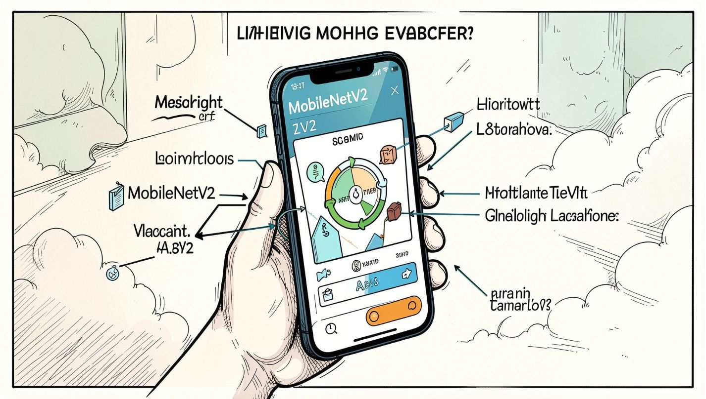

MH3 — MobileNetV2 Distillation
Use a pretrained MobileNetV2 student with 3.4M parameters and depthwise separable convolutions, which reduce computation by splitting standard convolutions into channel-wise and pointwise steps. Replace the classifier with Linear(1280, 4).
This should outperform a random CNN student because pretrained features provide a stronger starting point for distillation.
Recommendation: prefer pretrained compact architectures, such as MobileNet or EfficientNet-Lite, for production distillation.

Slide 5

MH4 — ONNX Deployment & Live Demo
1
2
3
4
File corruption
Fine-tuning instability
ONNX export issues
Compression results
The downloaded .pt file was truncated (185MB vs. 512MB). To make MH4 self-contained, we retrained and pruned the model inside the notebook instead of transferring large files.
ONNX FP32: 512.2MB and 1.3× faster. ONNX INT8: 128.1MB, 4× smaller, with CPU time of about 390ms. The quantization overhead hurt speed on a generic CPU, but INT8 still won on model size; hardware determines the speed tradeoff.
Pruning caused loss oscillation. The fix: save the best validation checkpoint, lower the learning rate to 5e-5, and validate on the validation set—not the test set.
The Dynamo-based exporter mis-handled a VGG reshape. We switched to dynamo=false (the TorchScript export path) for a reliable ONNX export.
We also made the demo more robust: switched weather validation to wttr.in so no API key is needed, added the missing Colab import for files.upload, and standardized preprocessing to resize any phone photo to 224×224.

Slide 6
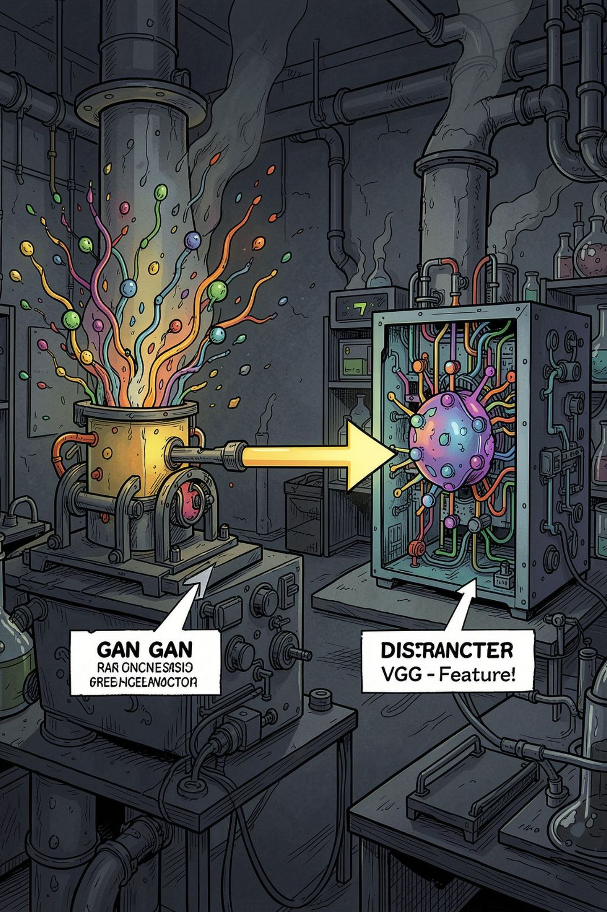
MH5 — Conditional GAN Weather Generator
Design choices
Generate 64×64 images and normalize pixels to [-1,1]. Use nn.Embedding for class conditioning, so the model can learn a weather label alongside the image. The generator is trained from scratch, while the discriminator reuses frozen VGG16 features.
Training stabilizers
Use label smoothing (real = 0.9) to soften the discriminator’s targets. Frozen discriminator features help encode realism, and concatenating the class embedding with the noise vector improves control over the generated weather type.
Validation loop
Run a trained classifier on generated images as a proxy for FID. If the classifier predicts the intended weather label with high confidence, the generator is learning meaningful weather semantics.

Slide 7
Cross-Notebook Key Learnings
1 — Augmentation
Augmentation only works well with fine-tuned features; with an FC-only head, it can actually hurt performance.
2 — Fine-tuning
Unfreezing the last convolutional block and using a discriminative learning rate delivered the best generalization on small datasets.
3 — Ensembles
Ensembles help most when models fail in different ways; they only sometimes fix truly ambiguous errors.
4 — Pruning > Distillation
70% pruning, followed by fine-tuning, produced the best test result: 95.88%.
5 — Dataset ceiling
The dataset appears capped at roughly 96% because the class definitions overlap, creating human-level ambiguity.
Operational takeaways: save the best checkpoint, avoid file transfers for large artifacts, and note that PyTorch export mode (dynamo) affects ONNX reliability.

Slide 8
Problems Encountered & Applied Fixes
Each fix maps to a small, reproducible change. The workflow emphasizes validation-set checks, deterministic split seeds, and automatic best-checkpoint saving during fine-tuning of pruned models.
Problem | Fix
Augmentation reduced accuracy | Fine-tuned the last convolutional block
Weak student CNN | Switched to pretrained MobileNetV2
Corrupted model file | Kept training and pruning inside the notebook for a self-contained workflow
Fine-tuning oscillation | Saved the best checkpoint and reduced the learning rate to 5e-5
ONNX shape error | Exported with dynamo=False
No weather API key | Switched to wttr.in, which requires no key
NameError after refactor | Added from google.colab import files
INT8 slower on CPU | Accepted hardware-dependent speed and used INT8 for size savings

Slide 9
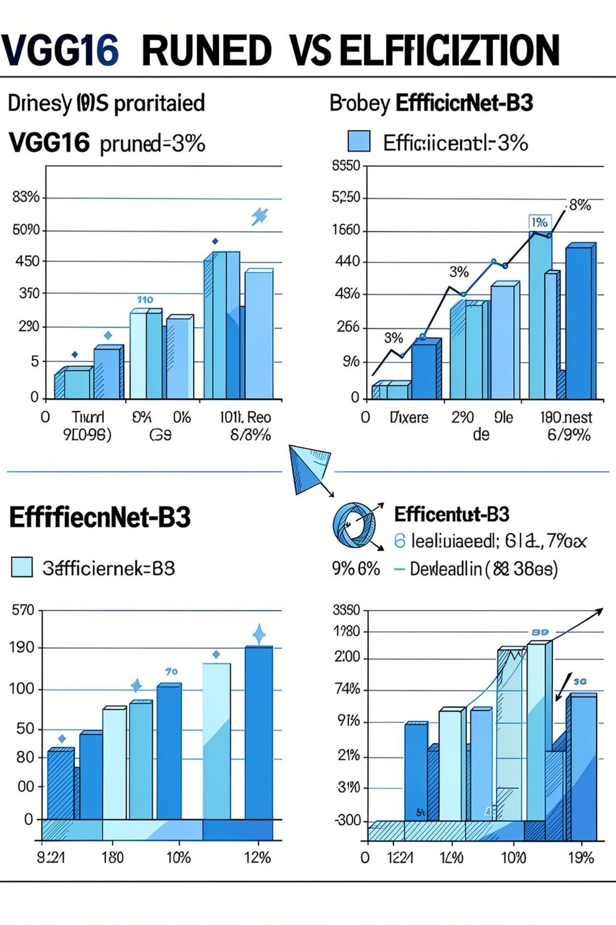



MH6 — EfficientNet-B3 + Test-Time Augmentation (Ceiling Test)
Model
EfficientNet-B3 — 12M parameters, 300×300 inputs. Fine-tuned more deeply (last 2 blocks) with discriminative learning rates and cosine annealing.
Tactics
Used label smoothing (0.1), 7-view test-time augmentation, and no early stopping (25 epochs). Compared fairly against the pruned VGG16 head-to-head.
Outcome
All three independent runs — pruned VGG16, EfficientNet-B3, and EfficientNet-B3 + TTA — converged at 95.88%, strong evidence of a dataset ceiling.
Bottom line: architecture and training choices improved stability and efficiency, but ambiguous labels capped test accuracy.

Slide 10
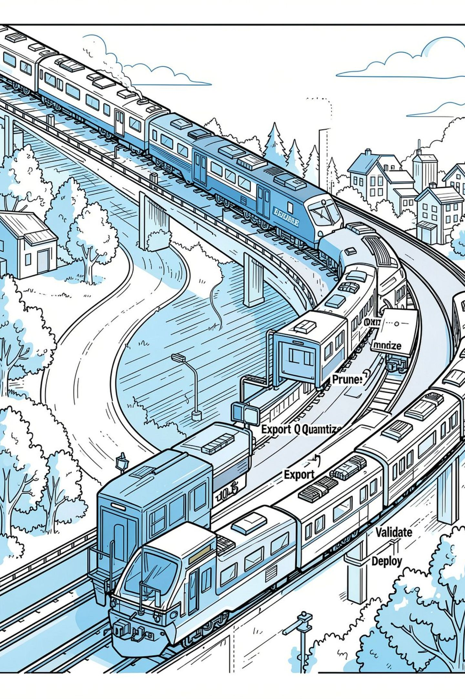

Recommendations & Next Steps
For small datasets, prioritize pruning, careful fine-tuning, and best-checkpoint tracking to keep the best model state.
For deployment, export to ONNX first, then quantize to INT8 when the target hardware supports INT8 acceleration. Otherwise, stay with FP32 to minimize latency.
Use pretrained compact models such as MobileNetV2 and EfficientNet-lite as student models for distillation on edge devices.
For generation tasks, validate GAN outputs with the trained classifier, and use FID and IS as secondary quality checks.
Reduce transfer risk by keeping notebooks self-contained and storing large artifacts in cloud snapshots (GCS/S3) with checksums for integrity.
Final note: the empirical ceiling is about 95.9%, so the best way to improve further is to curate the dataset—especially by relabeling ambiguous cases.

