Slide 1

Awesome Chocolates
Sales Performance Dashboard
By Bhargavi

Slide 2
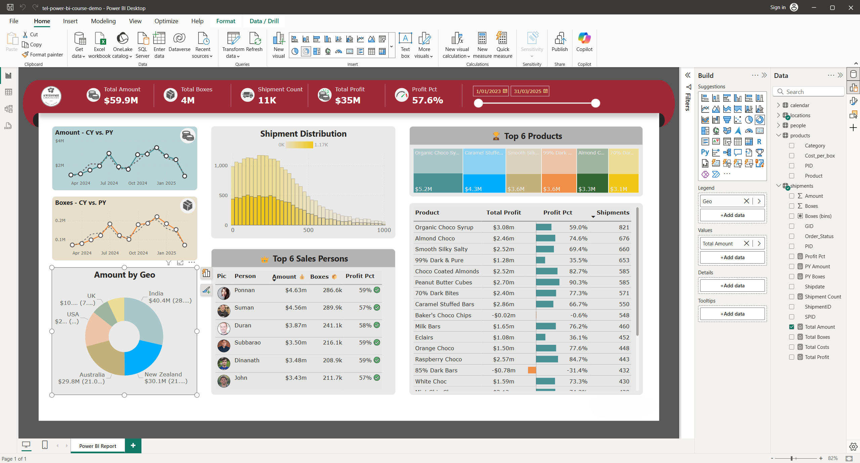
Power BI Dashboard Overview

Slide 3
Scenarios
Analyses based On The Following Points:
• Profit - It shows the net earnings after deducting all costs from total sales.
Helps identify overall business performance and profitability trends.
• Shipment Count -Shows the net earnings after deducting all costs from total sales.
Helps identify overall business performance and profitability trends.
• Amount Per Box - Helps evaluate pricing effectiveness and product value realization.
• Top Most Profitable- Supports decision-making for promotions, production focus, and investments.
• Amount – Compares Current Year (CY) sales amount with Previous Year (PY).
Used to measure growth, decline, and year-on-year performance trends.

Slide 4
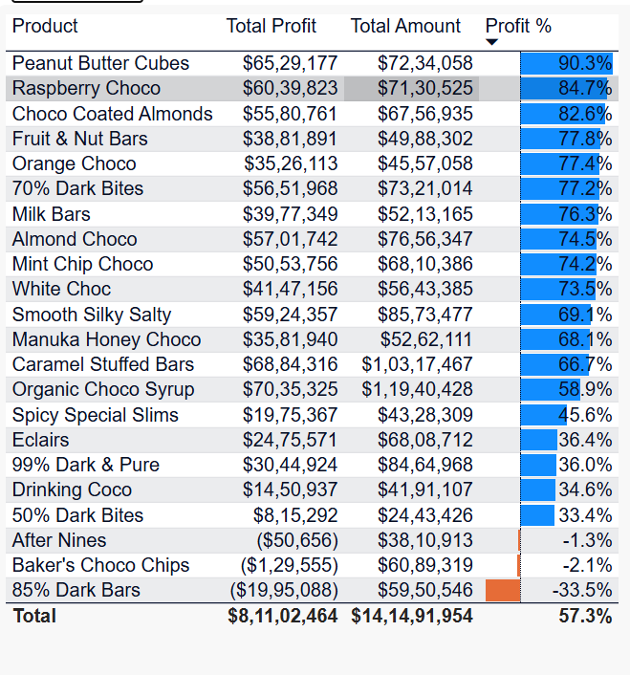
This image represents a Shipment Distribution chart (histogram-style bar chart) showing how shipments are spread across different shipment values.
Our Products List

Slide 5
Detailed Profitability Analysis of Products
Metric | Value
Total Sales (Amount) | $141.49 Million
Total Profit | $81.10 Million
Overall Profit Margin | 57.3%
Business Status | Profitable & Stable
Focus on high-margin products for growth.
Improve or discontinue loss-making products.
Review pricing and costs for low-margin items.
The business overall is healthy and profitable.

Slide 6
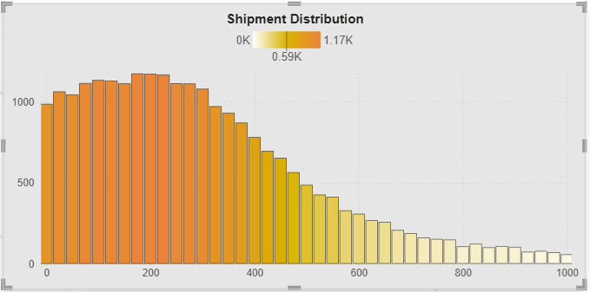
This image represents a Shipment Distribution chart (histogram-style bar chart) showing how shipments are spread across different shipment values.
Shipment Distribution Analysis
High concentration at lower shipment values (0–300):
Most shipments fall in this range, indicating frequent small-sized shipments.
Peak frequency around 150–250 units:
This is where the maximum number of shipments occurs.
Gradual decline after 300 units:
As shipment size increases, the number of shipments decreases.
Very few large shipments (700–1000 units):
Large-volume shipments are rare compared to smaller ones.

Slide 7
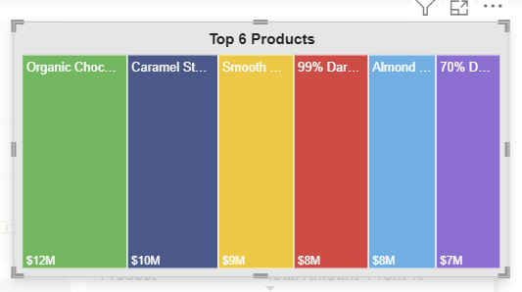
This image shows a column chart titled “Top 6 Products”, representing sales value (in million dollars) for the best-performing products
Top 6 Products
Organic Chocolate – $12M
This is the top-selling product, generating the highest revenue.
Caramel Sticks – $10M
The second highest performer, contributing strongly to total sales.
Smooth Chocolate – $9M
A close third, showing consistent customer demand.
99% Dark Chocolate – $8M
Moderate sales, preferred by a niche segment.
Almond Chocolate – $8M
Equal sales to 99% Dark Chocolate, indicating similar market demand.
70% Dark Chocolate – $7M
The lowest among the top six, but still a significant contributor.

Slide 8
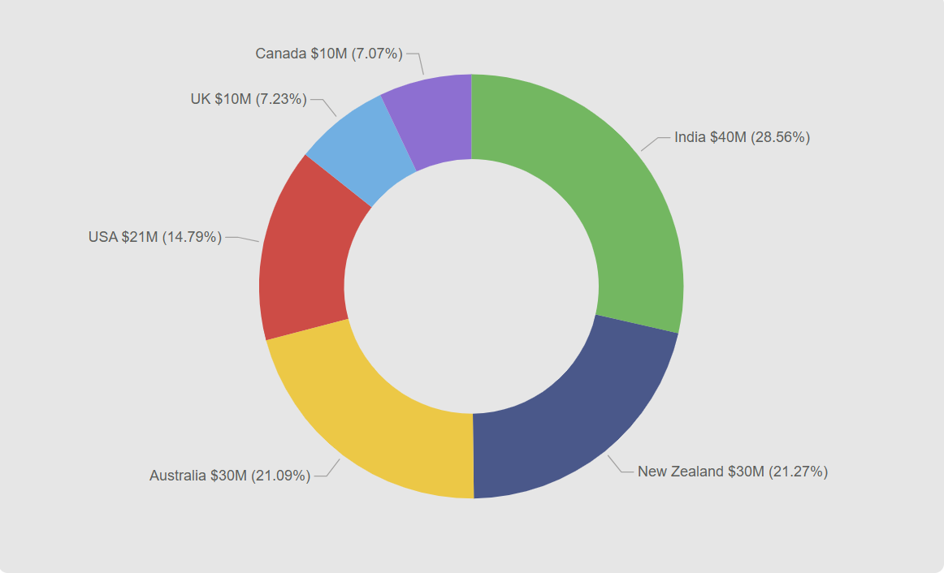
Amount by Geo
The total revenue is divided among six countries.
Each colored segment represents a country’s share in total revenue, shown in amount ($M) and percentage

Slide 9
Geographical & Sales Insights
India – $40M (28.56%)
India contributes the highest share, accounting for nearly one-third of total revenue.
New Zealand – $30M (21.27%)
New Zealand is the second-largest contributor.
Australia – $30M (21.09%)
Australia’s contribution is almost equal to New Zealand’s.
USA – $21M (14.79%)
The USA contributes a moderate share of the revenue.
UK – $10M (7.23%)
The UK contributes a smaller portion.
Canada – $10M (7.07%)
Canada has the lowest share, nearly equal to the UK.

Slide 10
My Recommendations :
• Focus on improving low-performing shipment segments.
• Optimize logistics for frequent shipment sizes.
• Strengthen regional strategies using dashboard insights.
• Use Power BI for continuous monitoring and reporting.

Slide 11
Tools and Technologies Used:
1. Dashboard Objective
To analyze sales, shipments, profitability, and performance trends
2. Data Collection
Sales, shipment, cost, and product data imported from Excel source
3. Data Cleaning & Transformation (Power Query)-Merge Query
4.Data Modeling- Used star schema for better performance
5. Measure Creation (DAX)
Key measures created:
Total Amount, Total Boxes, Shipment Count, Total Profit, Profit %,
CY vs PY Amount, CY vs PY Boxes, Amount per Box.

Slide 12
Thank You

