Slide 1
PREDICTING STOCK MARKET PRICE USING TIME SERIES FORECASTING
M.Harika 314126510062
G.Bhargavi 314126510025
G.Priyasha 314126510021
I.Vijay Kumar 314126510026
PROJECT GUIDE
K.SURESH
(Asst. Prof)

Slide 2
BASE PAPER
The idea of this project is taken from the paper titled as “Stock Price Forecasting Using Information From Yahoo Finance and Google Trend”.
In this paper, they first applied the conventional ARMA time series analysis on the historical weekly stock prices of Apple company and then obtained forecasting results.
Then they proposed an algorithm to evaluate news/events related to Apple stock

Slide 3
ABSTRACT
Stock market price forecasting is a critical and important topic in financial and Academic studies. The aim of this project is to test various algorithms to build a model which can make predictions with less error and more accuracy. Many new machine learning algorithms are being created.

Slide 4
CONTD…
The algorithms used are recurring neural networks, long short term memory networks, gated recurrent networks and deep learning networks which have potential to outperform conventional forecasting methods if tuned properly for such type of data.

Slide 5
PROBLEM STATEMENT
The main aim is to predict the prices of stock market using the methods in Time Series Analysis such as:
Exponential smoothing method
Box jenkins method
Prophet
RNN(reccurent neural network)

Slide 6
INTRODUCTION
Stock price prediction is very important as it is used by most of the business people as well as common people. People will either gain money or lose their entire life savings in stock market activity. It is a chaos system. Building accurate model is difficult as variation in price depends on multiple factors such as news, social media data, fundamentals, production of the company, government bonds, historical price and country’s economics.

Slide 7
LITERATURE SURVEY
The basic theory regarding stock price forecasting is the Efficient Market Hypothesis (EMH), which asserts that the price of a stock reflects all information available and everyone has some degree of access to the information.
Time series analysis covers a large number of forecasting methods. Researchers have developed numerous modifications to the basic ARIMA model and found considerable success in these methods
Almost all the studies suggest that additional factors should be taken into account on top of the basic or unmodified model. The most common and important one of such factors is the online news information related to the stock.

Slide 8
EXISTING SYSTEM
In the present system, only the algorithms of Exponential Smoothening and Box jenkins algorithms are implemented.
The above algorithms doesn’t consider the randomness of the values present . They will ignore such values which results in less accuracy and efficiency.

Slide 9
PROPOSED SYSTEM
We will build a model using recurrent neural network algorithm which will also consider the randomness of input.
As a result, we can achieve more accuracy , more efficiency and less execution time.

Slide 10
ARCHITECTURE DESIGN
Graphical User Interface
Pattern Evaluation
Data Mining Engine
Cleaning, Integration, Selection
Database Warehouse
Data lake
Other Sources

Slide 11
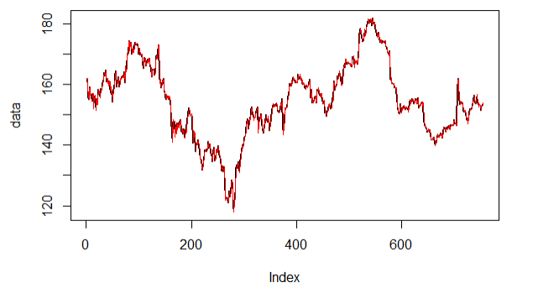
IMPLEMENTATION
PREDICTED DATA OF ARIMA

Slide 12
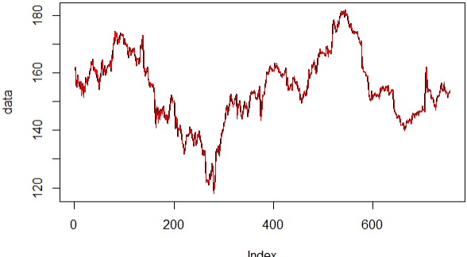
CONTD…
Fitted plot of arima

Slide 13
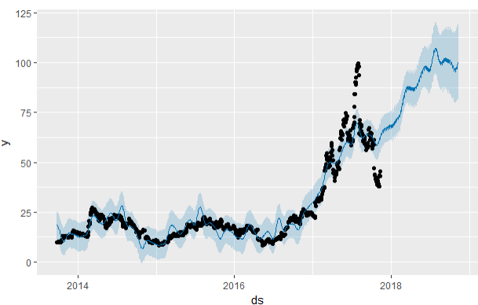
CONTD…
prophet

Slide 14
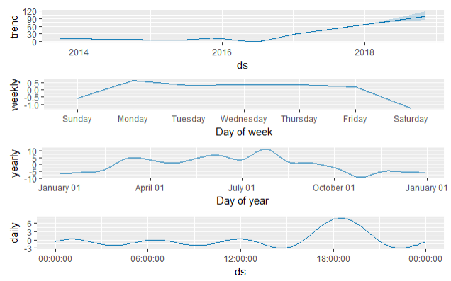
Contd…
prophet_components

Slide 15
THANKYOU

