Slide 1
Personal Expense Tracking System
B.Tech CSE Mini Project | Mohan Babu University
Presented by: [Your name], [Roll number]
Notes:
Introduce the project: a web app to record, filter and analyse personal expenses. Add your name and roll number on this slide before presenting.

Slide 2
Problem and objectives
The problem
Objectives
Students and families lose track of where money goes. Paper notes and memory are unreliable, and totals by month or category are hard to calculate by hand.
Record expenses with validation
Organise them by category
Filter by date and category
Show totals, percentages and charts
Keep data safely in MySQL
Notes:
Explain why expense tracking matters and list the five objectives.

Slide 3
Technology stack
Python + Flask
MySQL + PyMySQL
Pandas + NumPy
Web server, routes and templates
Relational storage with parameterized SQL
Totals, averages, percentages, monthly grouping
Matplotlib
HTML, CSS, JavaScript
unittest
Pie and bar charts rendered as PNG images
Responsive pages, confirmation dialogs, form checks
83 automated tests
Notes:
Walk through each technology and what it is used for in this project.

Slide 4
Architecture
Browser
HTML, CSS, JS
Flask routes
app.py
Validators + Repository
validators.py, repository.py
MySQL
categories, expenses
→
→
→
analysis/ package
Safety
Pandas and NumPy compute statistics; Matplotlib draws charts. Safe for empty data.
Parameterized SQL, input validation, CSRF tokens, escaped HTML, clear error pages.
Notes:
Follow a request from the browser to the database and back. Mention the analysis package and the safety measures.

Slide 5
Database design
categories
expenses
id (primary key)
name (unique, required)
description
created_at
id (primary key)
title, notes
amount DECIMAL(10,2), must be > 0
expense_date DATE
category_id (foreign key)
One category has many expenses. A category that still has expenses cannot be deleted (ON DELETE RESTRICT).
Notes:
Explain the one-to-many relationship and the rules enforced by the database.

Slide 6
Key features
Expense management
Category management
Add, edit, delete with clear validation messages
Add, rename, protected delete
Filters
Dashboard
Date range, category, or both together
Totals, average, this month, category shares
Charts
Reports and export
Pie chart by category, bar chart by month
Monthly report and CSV download
Notes:
Demonstrate each feature live if time allows.

Slide 7
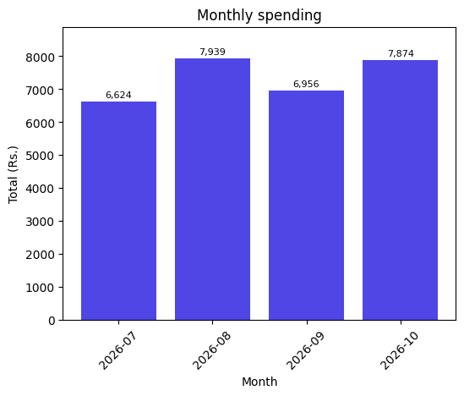
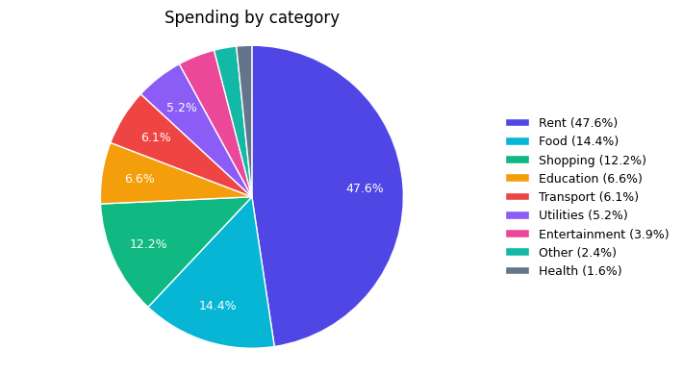
Results: charts from the sample data
Generated by the application from the 34 fictional sample expenses (July to October 2026).
Notes:
These are real outputs of the charts module using the sample data.

Slide 8
Testing
83
78
5
automated tests
run in the standard setup
optional MySQL-only tests
Covered: create, list, edit, delete, positive amounts, required fields, categories
Covered: date, category and combined filters; monthly and category totals; empty data
Static review: imports, routes, templates, forms, schema match
Standard tests use SQLite in a temporary folder; real data is never touched
Notes:
Explain that the optional MySQL tests need a separate database ending in _test.

Slide 9
Conclusion and future scope
Conclusion
Future scope
The system records and organises expenses reliably, answers date and category questions quickly, and presents spending as numbers and charts. It runs locally with a simple Windows setup.
User login and multiple users
Monthly budgets and alerts
Recurring expenses
Import from bank statements
Mobile-friendly app
Notes:
Summarise, then invite questions.

