Slide 1
Title
Project Title: Multi-Source Sales Data Pipeline & Business Insights Dashboard
Intern Name: Alahari Bhargavi
Company: Flipkart Pvt Ltd
Mentor: Jayanth Pathwari
Duration: 45 Days Internship Project
Project Objective
Build a robust data pipeline that:
Integrates CSV, JSON, and Excel files
Cleans & transforms the data
Analyzes sales trends
Delivers insights through visual dashboards and PDF reports

Slide 2
Tools & Technologies Used
Languages/Libraries: Python, pandas, numpy, matplotlib, seaborn
Reporting: jinja2, pdfkit
Automation: argparse, subprocess
IDE: VS Code
Others: wkhtmltopdf, Flask, GitHub
. Dataset Description
Files Provided:
sales_data.csv: Contains daily sales transactions
product_metadata.json: Maps products to categories
region_info.xlsx: Contains regional manager information

Slide 3
Sample Preview:
Date,Product,Units Sold,Revenue,Region
01-01-2025,Widget A,10,100,North
02-01-2025,Widget B,5,75,South
03-01-2025,Widget A,8,80,North
[
{"Product": "Widget A", "Category": "Gadgets"},
{"Product": "Widget B", "Category": "Accessories"}
]
Region | Manager
North | Alice
South | Bob

Slide 4
Data Integration
A. data_integration.py
import pandas as pd
import json
sales_df = pd.read_csv("sales_data.csv")
with open("product_metadata.json") as f:
product_data = json.load(f)
product_df = pd.DataFrame(product_data)
region_df = pd.read_excel("region_info.xlsx")
merged = pd.merge(sales_df, product_df, on="Product", how="left")
final_df = pd.merge(merged, region_df, on="Region", how="left")
final_df.to_csv("final_output.csv", index=False)
print(" Data integration completed.")
print(final_df.head())
Output :
Date Product Units Sold Revenue Region Category Manager
0 01-01-2025 Widget A 10 100 North Gadgets Alice
1 02-01-2025 Widget B 5 75 South Accessories Bob
2 03-01-2025 Widget A 8 80 North Gadgets Alice

Slide 5
Data Cleaning Output :
Missing values after cleaning:
Date 0
Product 0
Units Sold 0
Revenue 0
Region 0
Category 0
Manager 0
dtype: int64
Missing values before cleaning:
Date 0
Product 0
Units Sold 0
Revenue 0
Region 0
Category 0
Manager 0
dtype: int64
Missing values after cleaning:
Date 0
Product 0
Units Sold 0
Revenue 0
Region 0
Category 0
Manager 0
dtype: int64
B. data_cleaning.py
import pandas as pd
df = pd.read_csv('final_output.csv')
print("Missing values before cleaning:")
print(df.isnull().sum())
print()
df['Date'] = pd.to_datetime(df['Date'], format='%d-%m-%Y', errors='coerce')
df = df.dropna(subset=['Date', 'Product', 'Revenue'])
print("Missing values after cleaning:")
print(df.isnull().sum())
print()
print("Data types after conversion:")
print(df.dtypes)
df.to_csv('final_output_cleaned.csv', index=False)
print("\n Cleaned data saved to 'final_output_cleaned.csv'")
Data types after conversion:
Date datetime64[ns]
Product object
Units Sold int64
Revenue int64
Region object
Category object
Manager object
dtype: object
✅ Cleaned data saved to 'final_output_cleaned.csv'

Slide 6
C. eda_visualization.py
import pandas as pd
import matplotlib.pyplot as plt
df = pd.read_csv('final_output_cleaned.csv')
df['Date'] = pd.to_datetime(df['Date'], format='%Y-%m-%d')
df['Month'] = df['Date'].dt.to_period('M')
monthly_sales = df.groupby('Month')['Revenue'].sum().reset_index()
plt.figure(figsize=(8, 5))
plt.plot(monthly_sales['Month'].astype(str), monthly_sales['Revenue'], marker='o')
plt.title("Monthly Revenue Trend")
plt.xlabel("Month")
plt.ylabel("Total Revenue")
plt.xticks(rotation=45)
plt.tight_layout()
plt.show()
region_sales = df.groupby('Region')['Revenue'].sum().reset_index()
plt.figure(figsize=(6, 4))
plt.bar(region_sales['Region'], region_sales['Revenue'], color='skyblue')
plt.title("Region-wise Revenue")
plt.xlabel("Region")
plt.ylabel("Revenue")
plt.tight_layout()
plt.show()
category_sales = df.groupby('Category')['Revenue'].sum().reset_index()
plt.figure(figsize=(6, 4))
plt.bar(category_sales['Category'], category_sales['Revenue'], color='orange')
plt.title("Category-wise Revenue")
plt.xlabel("Category")
plt.ylabel("Revenue")
plt.tight_layout()
plt.show()
summary = df.groupby(['Region', 'Category'])['Revenue'].sum().reset_index()
print("\nRevenue by Region and Category:")
print(summary)
summary.to_csv('summary.csv', index=False)
print(" Summary exported to summary.csv")

Slide 7
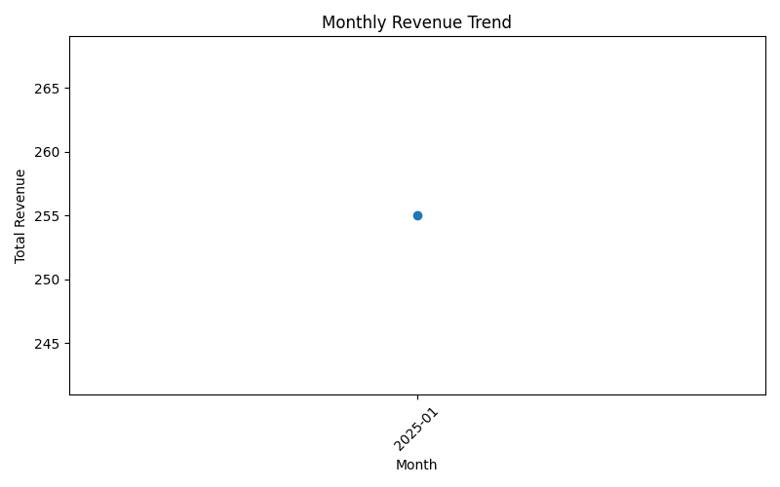
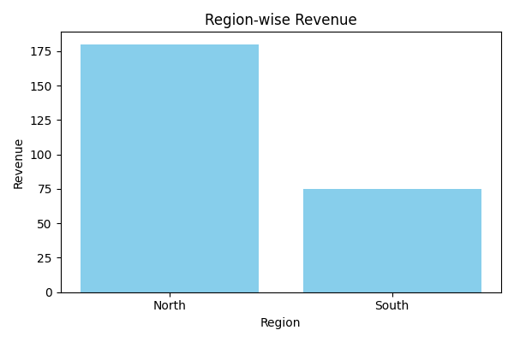
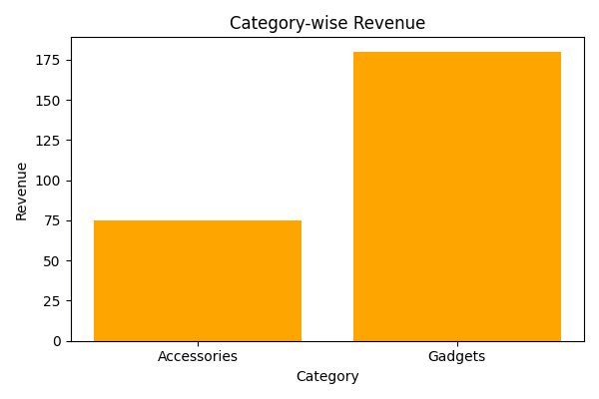

Slide 8
D. data_visualization.py
import pandas as pd
import matplotlib.pyplot as plt
import seaborn as sns
df = pd.read_csv('final_output_cleaned.csv')
df['Date'] = pd.to_datetime(df['Date'], format='%Y-%m-%d')
df['Month'] = df['Date'].dt.to_period('M')
sns.set(style="whitegrid")
monthly_sales = df.groupby('Month')['Revenue'].sum().reset_index()
region_sales = df.groupby('Region')['Revenue'].sum().reset_index()
category_sales = df.groupby('Category')['Revenue'].sum().reset_index()
fig, axs = plt.subplots(3, 1, figsize=(10, 15))
sns.lineplot(ax=axs[0], x=monthly_sales['Month'].astype(str), y='Revenue', data=monthly_sales, marker='o')
axs[0].set_title("Monthly Revenue Trend")
axs[0].set_xlabel("Month")
axs[0].set_ylabel("Total Revenue")
axs[0].tick_params(axis='x', rotation=45)
sns.barplot(ax=axs[1], x='Region', y='Revenue', data=region_sales, palette="Blues_d")
axs[1].set_title("Region-wise Revenue")
axs[1].set_xlabel("Region")
axs[1].set_ylabel("Revenue")
sns.barplot(ax=axs[2], x='Category', y='Revenue', data=category_sales, palette="Oranges_d")
axs[2].set_title("Category-wise Revenue")
axs[2].set_xlabel("Category")
axs[2].set_ylabel("Revenue")
plt.tight_layout()
plt.show()
fig.savefig("dashboard.png", dpi=300)

Slide 9
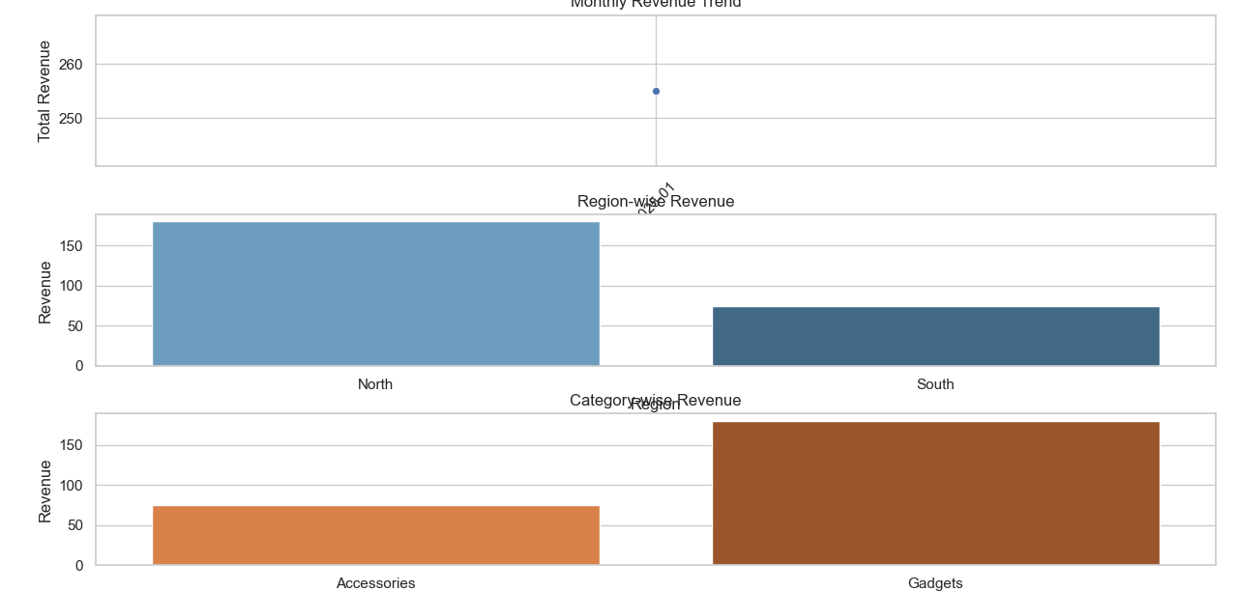

Slide 10
D. generate_report.py
import pandas as pd
import pdfkit
from jinja2 import Environment, FileSystemLoader
df = pd.read_csv('final_output_cleaned.csv')
summary = pd.read_csv('summary.csv')
total_revenue = df['Revenue'].sum()
top_region = df.groupby('Region')['Revenue'].sum().idxmax()
top_category = df.groupby('Category')['Revenue'].sum().idxmax()
env = Environment(loader=FileSystemLoader('.'))
template = env.get_template("report_template.html")
html_out = template.render(
total_revenue=total_revenue,
top_region=top_region,
top_category=top_category,
summary_table=summary.to_html(index=False)
)
config = pdfkit.configuration(wkhtmltopdf=r"C:\Program Files\wkhtmltopdf\bin\wkhtmltopdf.exe")
pdfkit.from_string(html_out, "sales_report.pdf", configuration=config)
print(" PDF report generated: sales_report.pdf")
Output :
PDF report generated: sales_report.pdf

Slide 11
E. automate_pipeline.py
import argparse
import subprocess
def run_script(script_name):
print(f"\n Running {script_name}...")
subprocess.run(["python", script_name], check=True)
parser = argparse.ArgumentParser(description="Flipkart Data Analysis Pipeline")
parser.add_argument('--clean', action='store_true', help='Run data cleaning')
parser.add_argument('--eda', action='store_true', help='Run exploratory data analysis')
parser.add_argument('--report', action='store_true', help='Generate PDF report')
parser.add_argument('--all', action='store_true', help='Run all steps')
args = parser.parse_args()
if args.clean:
run_script("data_cleaning.py")
if args.eda:
run_script("eda_visualization.py")
if args.report:
run_script("generate_report.py")
if args.all:
run_script("data_integration.py")
run_script("data_cleaning.py")
run_script("eda_visualization.py")
run_script("generate_report.py")
Execution Instructions
python automate_pipeline.py –all
Make sure to install all dependencies from requirements.txt and have wkhtmltopdf added to system PATH

Slide 12
Running data_cleaning.py...
Missing values before cleaning:
Date 0
Product 0
Units Sold 0
Revenue 0
Region 0
Category 0
Manager 0
dtype: int64
Data types after conversion-:
Date datetime64[ns]
Product object
Units Sold int64
Revenue int64
Region object
Category object
Manager object
dtype: object
Missing values after cleaning:
Date 0
Product 0
Units Sold 0
Revenue 0
Region 0
Category 0
Manager 0
dtype: int64
Missing values after cleaning:
Date 0
Product 0
Units Sold 0
Revenue 0
Region 0
Category 0
Manager 0
dtype: int64
Running data_cleaning.py...
Missing values before cleaning:
Date 0
Product 0
Units Sold 0
Revenue 0
Region 0
Category 0
Manager 0
dtype: int64
Data types after conversion:
Date datetime64[ns]
Product object
Units Sold int64
Revenue int64
Region object
Category object
Manager object
dtype: object
Cleaned data saved to 'final_output_cleaned.csv'
C:\Users\admin\Desktop\flipkart>python automate_pipeline.py --all
Running data_integration.py...
Data integration completed
Cleaned data saved to 'final_output_cleaned.csv'
Running eda_visualization.py...
EDA visualizations saved as PNGs.
Running generate_report.py...
PDF report generated: sales_report.pdf
Date Product Units Sold Revenue Region Category Manager
0 01-01-2025 Widget A 10 100 North Gadgets Alice
1 02-01-2025 Widget B 5 75 South Accessories Bob
2 03-01-2025 Widget A 8 80 North Gadgets Alice

Slide 13
Login Dashboard
Objective: Develop a secure, user-accessible web interface using Flask to manage access to sales reports (e.g., PDF report generated in previous steps).
Tools Used:
Python
Flask
HTML/CSS (Jinja2 templates)
Features:
Secure login authentication
Dashboard view to download sales_report.pdf

Slide 14
app.py
from flask import Flask, render_template, request, redirect, url_for, send_file
app = Flask(__name__)
USERNAME = "admin"
PASSWORD = "flipkart123"
@app.route('/', methods=['GET', 'POST'])
def login():
error = None
if request.method == 'POST':
if request.form['username'] == USERNAME and request.form['password'] == PASSWORD:
return redirect(url_for('dashboard'))
else:
error = 'Invalid username or password'
return render_template('login.html', error=error)
@app.route('/dashboard')
def dashboard():
return render_template('dashboard.html')
@app.route('/download')
def download_report():
return send_file('sales_report.pdf', as_attachment=True)
if __name__ == '__main__':
app.run(debug=True)
Output :
* Serving Flask app 'app'
* Debug mode: on
WARNING: This is a development server. Do not use it in a production deployment. Use a production WSGI server instead.
* Running on http://127.0.0.1:5000
Press CTRL+C to quit
* Restarting with stat
* Debugger is active!
* Debugger PIN: 957-077-339

Slide 15
Login.html
<!DOCTYPE html>
<html>
<head>
<title>Login</title>
</head>
<body>
<h2>Login to Dashboard</h2>
{% if error %}
<p style="color:red;">{{ error }}</p>
{% endif %}
<form method="POST">
<input type="text" name="username" placeholder="Username" required><br><br>
<input type="password" name="password" placeholder="Password" required><br><br>
<input type="submit" value="Login">
</form>
</body>
</html>
report_template.html
<!DOCTYPE html>
<html>
<head>
<meta charset="utf-8">
<title>Sales Report</title>
<style>
body { font-family: Arial; padding: 20px; }
h1 { color: #2c3e50; }
table { width: 100%; border-collapse: collapse; margin-top: 20px; }
th, td { padding: 8px 12px; border: 1px solid #ccc; text-align: center; }
</style>
</head>
<body>
<h1>Flipkart Sales Report</h1>
<p><strong>Total Revenue:</strong> ₹{{ total_revenue | round(2) }}</p>
<p><strong>Top Performing Region:</strong> {{ top_region }}</p>
<p><strong>Top Product Category:</strong> {{ top_category }}</p>
<h2>Revenue Summary by Region and Category</h2>
{{ summary_table | safe }}
</body>
</html>
Dashboard.html
<!DOCTYPE html>
<html>
<head>
<title>Dashboard</title>
</head>
<body>
<h2>Welcome to Flipkart Dashboard</h2>
<p><a href="/download">Download PDF Report</a></p>
</body>
</html>
Total Output :
Flipkart Sales Report Total Revenue: ₹255 Top Performing Region: North Top Product Category: Gadgets Revenue Summary by Region and Category Region Category Revenue North Gadgets 180 South Accessories 75

Slide 16
Project Structure :
flipkart/
│
├── data_integration.py # Step 1: Merges CSV, JSON, Excel into one DataFrame
├── data_cleaning.py # Step 2: Cleans data (missing values, date format)
├── eda_visualization.py # Step 3: Generates charts with matplotlib/seaborn
├── generate_report.py # Step 4: Converts summary to PDF
├── automate_pipeline.py # Step 5: Automates all scripts using CLI options
│
├── sales_data.csv # Raw CSV data (sales)
├── product_metadata.json # Raw JSON data (product categories)
├── region_info.xlsx # Raw Excel data (region managers)
│
├── final_output.csv # Merged data after integration
├── final_output_cleaned.csv # Cleaned version of the merged data│

Slide 17
├── monthly_revenue.png # EDA Visualization 1
├── region_revenue.png # EDA Visualization 2
├── category_revenue.png # EDA Visualization 3
│
├── sales_report.pdf # Final PDF business report
│
├── requirements.txt # All required Python libraries
├── README.md # GitHub instructions (to be written)
│
├── app.py # Flask-based login dashboard
│
├── templates/ # HTML templates for Flask
│ ├── login.html # Login form UI
│ └── dashboard.html # Jinja2 HTML used for PDF export
│
└── static/ # Reserved for future use (CSS, JS, image)
└── report_template.html

Slide 18
THANK YOU
I would like to express my sincere gratitude to Flipkart Pvt Ltd for providing me with the opportunity to undertake the project titled “Multi-Source Sales Data Pipeline & Business Insights Dashboard” as part of my internship. This project has been an enriching experience that allowed me to apply and enhance my skills in data integration, transformation, visualization, and reporting using real-world business datasets.
I am especially grateful to my mentor, Mr. Jayanth Pathwari, for his continuous support, valuable guidance, and encouragement throughout the course of the project. His timely feedback and insights have been instrumental in the successful completion of each milestone.
This internship has greatly contributed to my professional growth by deepening my understanding of data science practices in a business context. I am truly thankful for the opportunity to learn, contribute, and grow as part of this esteemed organization.

