Slide 1
Online Insurance Management System
S.Bhavana(192211410)
P.Bhargavi(192211104)

Slide 2
PROBLEM STATEMENT
The Online Insurance Management System aims to streamline the management of insurance policies, customer information, claims, and payments, enhancing efficiency and reducing paperwork.
This system will feature secure user registration and authentication, allowing customers to manage personal information, view and purchase policies.
For administrators, it will provide tools to manage customer and policy databases, oversee claim processing, and generate comprehensive reports and analytics.
Utilizing PHP for server-side scripting and MySQL for the database, the system ensures data security with HTTPS and robust input validation.

Slide 3
ABSTRACT
"Online insurance management Application" is a user-centric web application designed for efficient management.
Users can go through the website can register through online
It is developed by using Visual Studio for frontend development and powered by XAMPP with PHP for backend operations
the platform offers users a streamlined experience to make the registration of the insurance easily
The application supports comprehensive details of the customers who and all registered
1

Slide 4
EXISTING SYSTEM
The existing manual insurance management systems are fraught with inefficiencies that hinder smooth experiences for both insurers and policyholders
Manual processing of policy applications, claims, and customer service inquiries often leads to prolonged turnaround times.
It results in increased operational costs and potential revenue losses for insurance companies
In offline Insurance it requires visiting an insurance office which can be time consuming process.
It involves more paper work and in-person interactions, which can take longer
2

Slide 5
Proposed system
Online Insurance can be accessed anytime and anywhere with an internet connection .
The process is usually faster and can be completed from home.
Customer service is usually through chat, email or phone.
It offers variety of payment including UPI transactions and net banking.
Renewal remainders are sent via email or SMS.
Data will be more secure
24/7 customer support will be provided.
3

Slide 6

Module description
Administrator operations
In administrator operations we have
policy management
customer management
user operations
In user operations we have
policy management
customer support
4

Slide 7
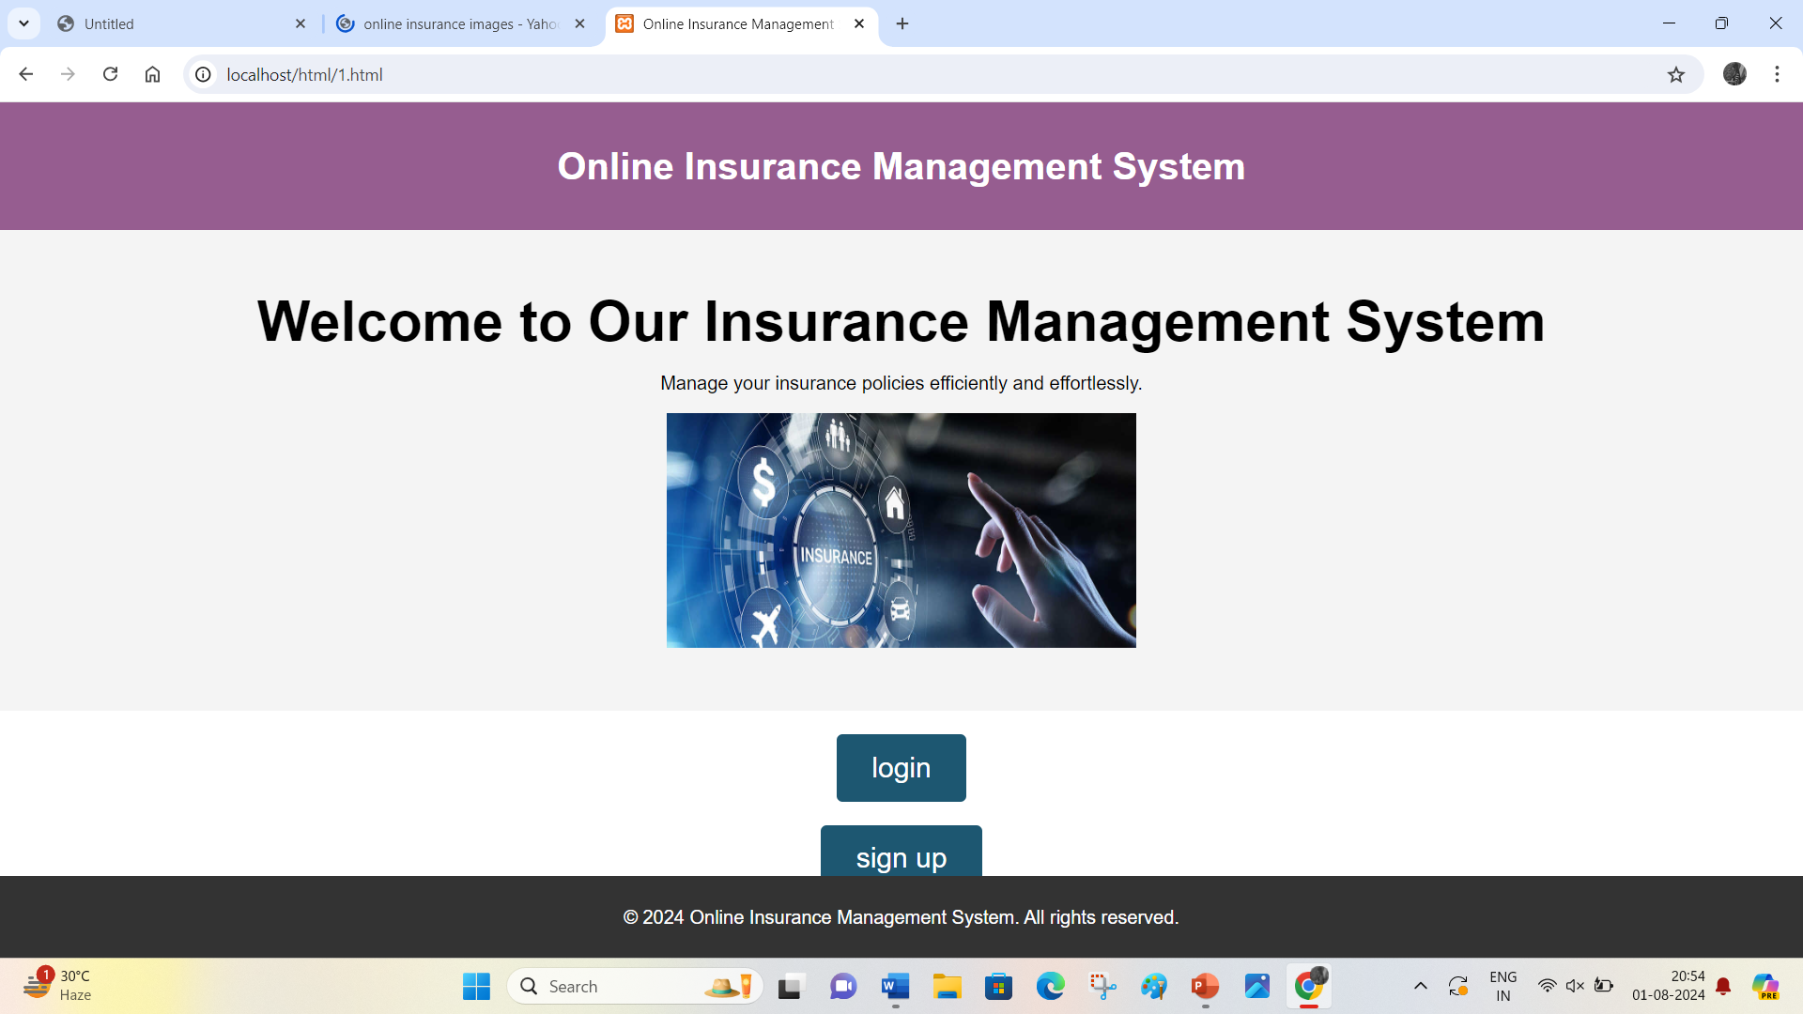
Screen shots
5

Slide 8
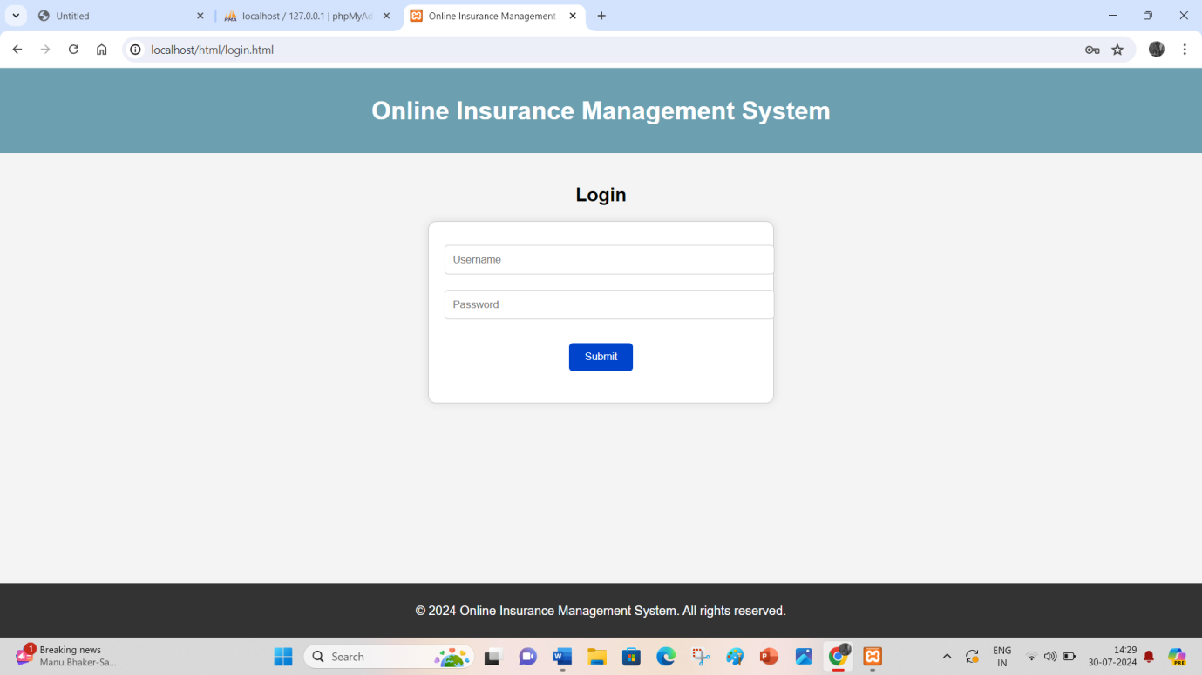

Slide 9
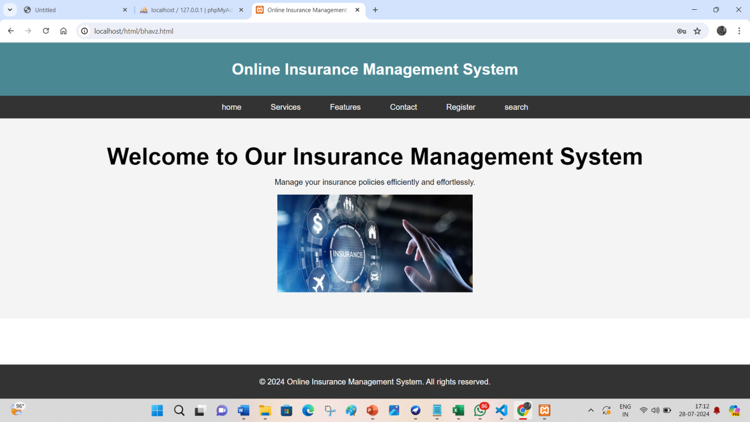

Slide 10
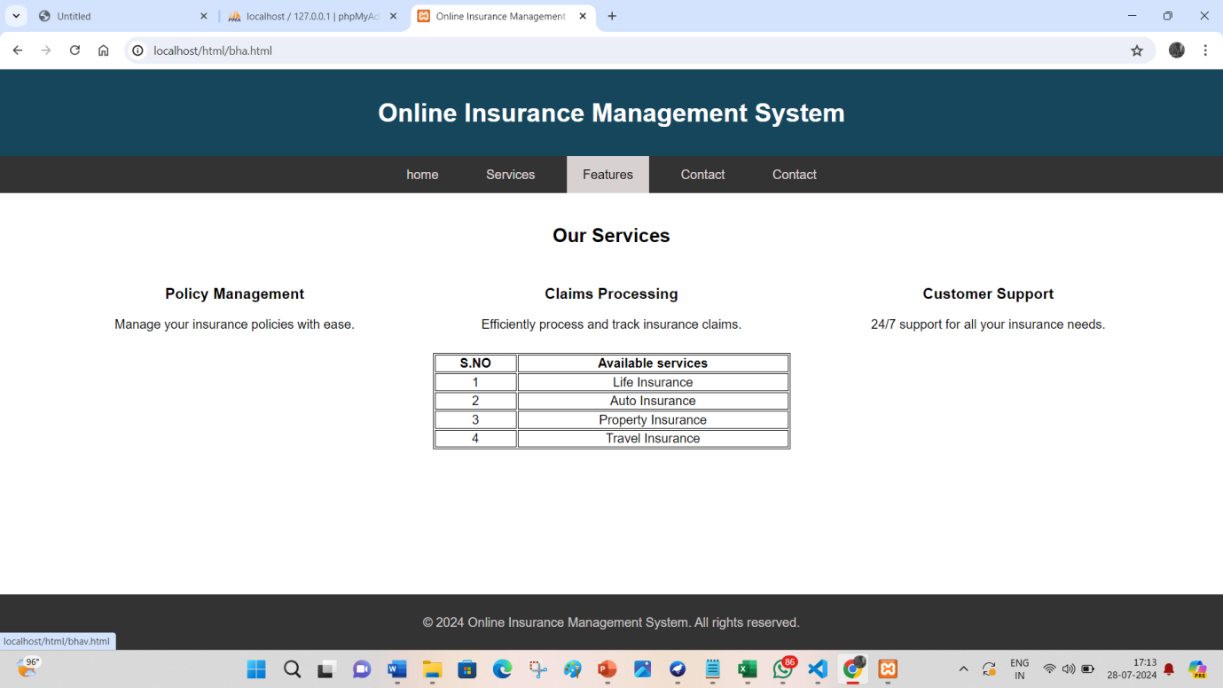

Slide 11
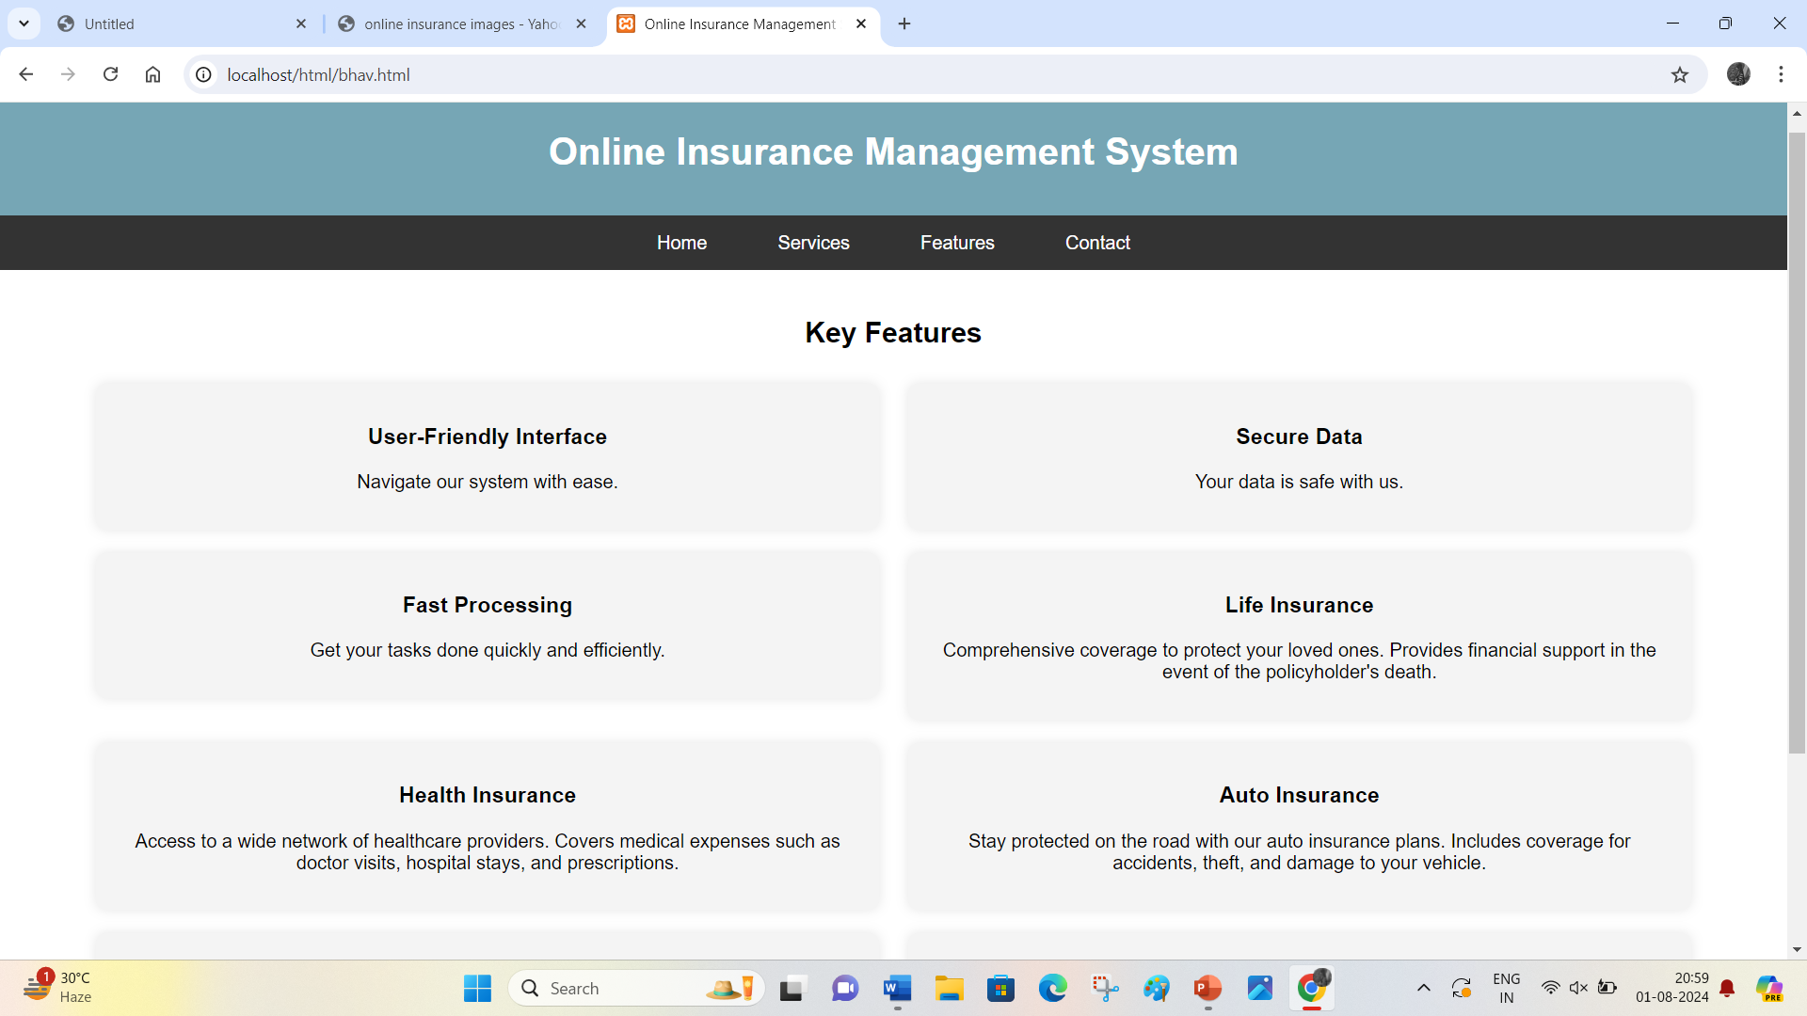

Slide 12
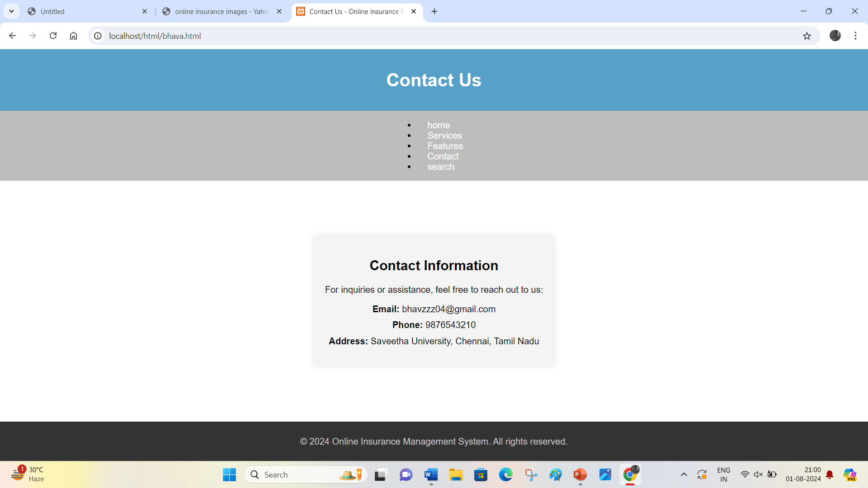

Slide 13
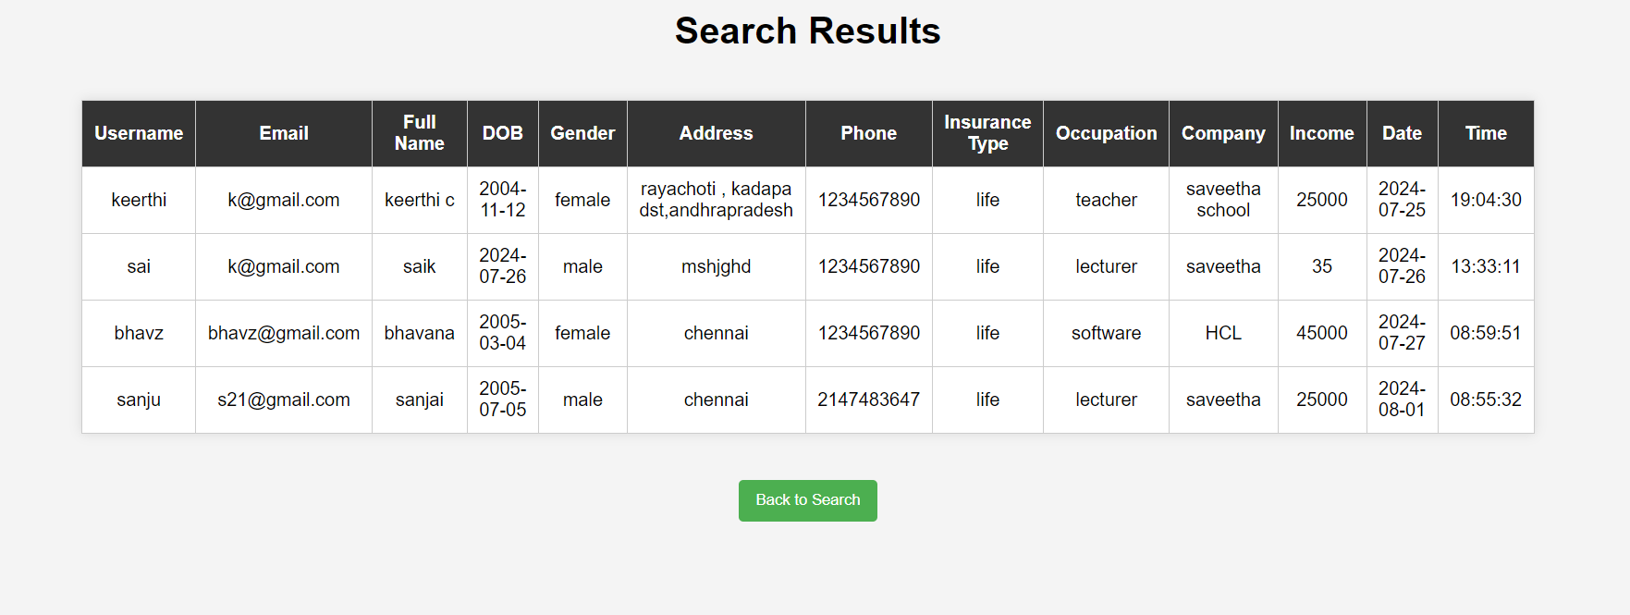

Slide 14
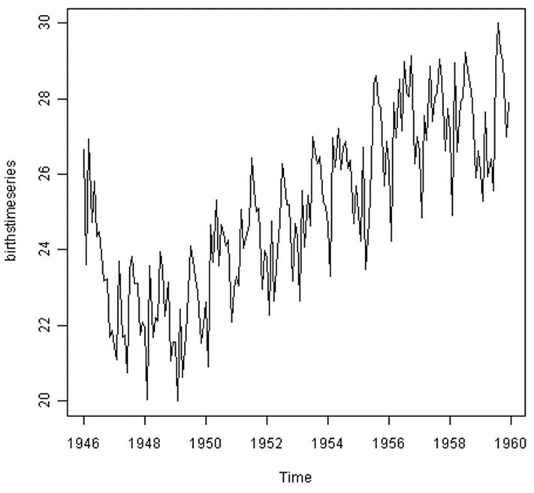
conclusion
The "Online Insurance Management System" is a comprehensive web platform.
It is designed to revolutionize the way insurance processes are handled
ensuring efficiency, accuracy, and convenience for both insurers and policyholders.
Which is easy to access through online internet connection we can apply for this rather than offline
6

Slide 15
Future enhancement
As the "Online Insurance Management System" evolves, several future enhancements can be implemented to further improve user experience and engagement
This includes allowing users to search for policies and claims based on specific criteria such as policy type, claim status, and date range, making it easier to find relevant information quickly
Enabling users to receive digital policy documents, participate in loyalty and referral programs, and access detailed policy
Furthermore, implementing a secure and efficient payment gateway with multiple payment options can enhance transaction security and user trust
7

Slide 16
references
Smith, J., & Williams, R. (2022). Digital Transformation in the Insurance Industry: Trends and Strategies. Journal of Insurance Studies, 15(3), 45-67. Retrieved from Journal of Insurance Studies
Patel, M. (2021). An Overview of Modern Insurance Management Systems. Insurance Technology Review, 8(2), 112-129. Retrieved from Insurance Technology Review
Lee, K., & Kim, H. (2023). The Impact of Online Insurance Management Systems on Customer Satisfaction. International Journal of Insurance Technology, 12(1), 89-104. Retrieved from International Journal of Insurance Technology
Brown, T., & Garcia, L. (2020). Enhancing Security in Online Insurance Management Systems. Cybersecurity Journal, 9(4), 321-339. Retrieved from Cybersecurity Journal
Johnson, D., & Davis, P. (2023). Case Study: Implementing an Online Insurance Management System in a Mid-Sized Insurance Company. Journal of Applied Insurance Technology, 11(3), 201-219. Retrieved from Journal of Applied Insurance Technology
Sharma, R., & Wong, S. (2021). Boosting Customer Engagement with Online Insurance Platforms. Journal of Customer Relationship Management, 7(2), 54-71. Retrieved from Journal of Customer Relationship Management
8

Slide 17


