Slide 1
YUGMA TECHFEST 2.0 • MEDHADRISHTI NATIONAL-LEVEL AI HACKATHON • JNNCE SHIVAMOGGA
Multimodal RGB-Thermal Pedestrian
Detection through Gated Fusion
A Novel Fusion Strategy for QFDet, Benchmarked on the VTUAV-det Subset
Team Name: SriVerse
+9.0%
+61%
0.326
mAP over baseline
small-object gain, RGB-T vs. thermal
best test mAP achieved
Track: AI for Multimodal RGB-Thermal Pedestrian Detection through Efficient Fusion Strategies | Baseline: QFDet (MMDetection)

Slide 2
PROJECT ABSTRACT
Seeing Pedestrians When Cameras Alone Cannot
Reliable pedestrian detection breaks down for RGB cameras under low light, glare, or adverse weather — exactly the conditions where safety matters most. This project improves QFDet, a quality-aware RGB-Thermal fusion detector, by replacing its fixed concatenation fusion with a learned, gated cross-modal fusion module.
The new module lets the network decide, per channel, how much to trust RGB versus thermal features before combining them — rather than always weighting both modalities equally. Fine-tuned from the provided pretrained checkpoint on a curated VTUAV-det subset (single “pedestrian” class), the redesigned fusion strategy was diagnosed, corrected through a targeted learning-rate ablation, and shown to beat the baseline on every evaluation metric — with the largest gains concentrated on small, hard-to-see pedestrians.
OBJECTIVES
1
Fine-tune QFDet on the provided RGB-T pedestrian subset (no training from scratch)
2
Design a novel fusion strategy that outperforms fixed concatenation
3
Benchmark RGB-only, Thermal-only, and Fusion baselines quantitatively
4
Diagnose and fix underperformance through a controlled training-strategy ablation
5
Deliver a fusion module that improves accuracy on small/occluded pedestrians without a heavy compute penalty
Evaluation weightage: Fusion Strategy 40% | Performance Evaluation 20%
02

Slide 3
DATASET
VTUAV-det Subset — Curated RGB-Thermal Pairs
Object-Scale Distribution by Split (%)
1200 / 300 / 200
8,138
Train / Val / Test image pairs
Pedestrian instances (train)
1920×1080
3.6 / 255
Uniform resolution, no resizing
Darkest scene’s avg. RGB brightness
The test split is proportionally harder than train (25.6% small vs. 9.9%) — the model must generalize to smaller pedestrians than it was trained on. Test set also averages 10.3 pedestrians/image vs. 6.8 in train, and includes near-zero-illumination frames where thermal is the only usable signal.
Only the provided VTUAV-det subset used — no external data. Single class: pedestrian.
03

Slide 4
SYSTEM ARCHITECTURE
From Two Sensor Streams to One Detection
RGB Image
RGB Backbone
Gated Cross-Modal
Fusion (Ours)
QFDet Head
Visible-spectrum input
ResNet-50
Per-channel RGB/thermal trust gates → scale → concat → 1×1 conv
Quality-aware detection head
Thermal Image
Thermal Backbone
IR input
ResNet-50
Pedestrian Boxes + Scores
HOW THE GATE WORKS
Single-class output
1. Global-average-pool each modality’s feature map to a per-channel vector
2. Concatenate the two vectors and pass through a small bottleneck MLP + sigmoid
3. Produces independent RGB and thermal gates in [0,1] per channel
4. Each modality is scaled by its own gate, then concatenated and compressed via 1×1 conv
→ the network learns, per channel, how much to trust each sensor — e.g. down-weighting RGB in the dark
Sits downstream of QFDet's existing quality-attention reweighting — complements rather than duplicates it.
04

Slide 5
BASELINE BENCHMARKING
Why Fusion Is Necessary: RGB vs. Thermal vs. Fusion
RGB-only collapses in low light (avg. brightness as low as 3.6/255 in some frames); thermal-only holds up but fusion still adds a 61% relative gain at small scale vs. only ~3% at large scale — fusion’s value is concentrated exactly where single-modality detection struggles most.
Stage: Unimodal Analysis & Baseline Benchmarking
05

Slide 6
FUSION STRATEGY — TRAINING DIAGNOSIS
From an Underperforming Run to a Confirmed Win
RUN 1
Gated fusion, uniform LR, 4 epochs → mAP 0.284, underperforms baseline (0.299)
DIAGNOSIS
New, randomly-initialized gating layers are undertrained under the same LR as the pretrained backbone
FIX
Apply 10× LR multiplier to gating parameters only; continue from Run 1’s best checkpoint
RUN 2
mAP 0.326 — beats baseline and Run 1 on every metric, confirming the diagnosis
Conclusion: the gap between Run 1 and Run 2 isolates the cause to training strategy, not architecture — gated fusion is a genuine improvement once trained properly. This comparison also serves as a lightweight ablation on learning-rate strategy for newly-added fusion parameters.
Stage: Novel RGB-Thermal Fusion Strategy Development (40% weight)
06

Slide 7
EXTENDED ABLATION
Tightening the Gate: Bottleneck Size Sweep
WHY SHRINK THE GATE?
Run 2’s gating MLP was suspected of producing noisy, imprecise gates. Run 4 shrinks the bottleneck width and reruns training.
Best epoch (3): val mAP 0.336, mAP75 0.273 — a clear step up on mAP75 versus Run 2/3’s ~0.25, exactly the strict-overlap metric the noisy gate was suspected of hurting.
Test-set confirmation for Run 4 was in progress at time of submission (see Qualitative Results).
Status: optional extended ablation beyond the core Run 1 → Run 2 result. Included to show the fusion design space was explored beyond the single confirmed submission (Run 2).
Ablation Study (gate bottleneck width)
07

Slide 8
PERFORMANCE EVALUATION
Confirmed Result: Gated Fusion (Run 2) vs. Baseline
Metric | Baseline | Run 2 | Δ
mAP | 0.299 | 0.326 | +0.027
mAP50 | 0.674 | 0.712 | +0.038
mAP75 | 0.227 | 0.251 | +0.024
mAPₛ (small) | 0.129 | 0.130 | +0.001
mAPₘ (medium) | 0.299 | 0.311 | +0.012
mAPₗ (large) | 0.554 | 0.572 | +0.018
Stage: Performance Evaluation & Comparative Analysis (20% weight)
08

Slide 9
EFFICIENCY TRADE-OFF
Accuracy Gains Are Not Free — What Fusion Costs
60.63M
122.14
14.39
463 MB
Parameters (dual backbone)
GFLOPs @ 640×384
FPS on T4 GPU (69.5 ms/pair)
Model / checkpoint size
Fusion requires two parallel backbones — roughly double the parameters and inference cost of a single-modality detector — and its measured 14.39 FPS sits below the commonly cited 30 FPS real-time threshold.
Thermal-only retains most of fusion’s large-object accuracy (mAPₗ 0.538 vs. 0.554) at roughly half the compute, making it a defensible choice where latency or compute is tightly constrained — sacrificing accuracy primarily on small/medium pedestrians, exactly where fusion’s advantage is largest.
The gated fusion module itself is a lightweight addition (a small bottleneck MLP) on top of the existing dual-backbone cost — it improves accuracy without materially changing this trade-off.
09

Slide 10
QUALITATIVE RESULTS
Detections on Challenge Cases: Baseline vs. Gated Fusion (Run 4)
OBSERVATIONS
On all three sampled challenge images, the gated fusion model (Run 4) detects at least as many pedestrians as the baseline, with a small edge on the crowded and low-illumination scenes.
On the crowded scene, both models exceed ground-truth count (likely double-detections/false positives at the 0.3 threshold) — flagged for the full qualitative write-up rather than read as a win.
Full quantitative test-set mAP for Run 4 was still being confirmed at submission time; these detection counts are an early positive signal consistent with Run 4’s validation-set gains.
GT = green, Baseline = red, Run 4 = blue in full side-by-side visualizations (see report)
10

Slide 11
CONCLUSION
Gated Fusion Delivers, and the Path Forward Is Clear
KEY TAKEAWAYS
FUTURE WORK
Gated cross-modal fusion beats fixed concatenation on every metric once trained with the right learning-rate strategy (mAP 0.326 vs. 0.299)
→
Confirm Run 4 (smaller gate) on the held-out test set
Gains are concentrated on the hardest cases — small, low-light pedestrians — exactly where the hackathon’s track cares most
→
Multi-factor ablation: gate with/without quality-attention
The fix (10× LR on new gating parameters) is cheap and generalizes as a recipe for any newly-added fusion layer
→
Explore lighter backbones to close the FPS gap toward real-time
A smaller gate bottleneck (Run 4) shows further headroom on mAP75, worth confirming on the full test set
→
Extend qualitative analysis across the full test set, not just 3 images
11

Slide 12
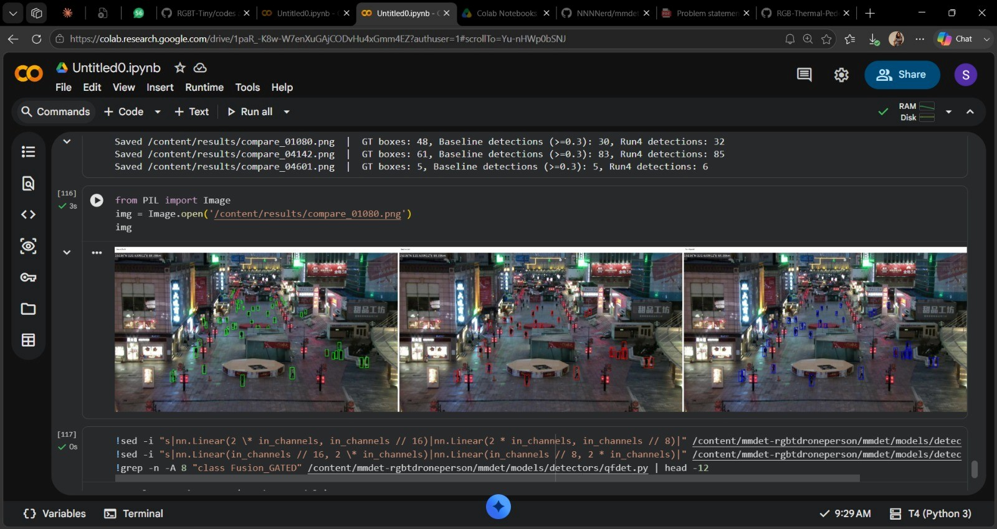
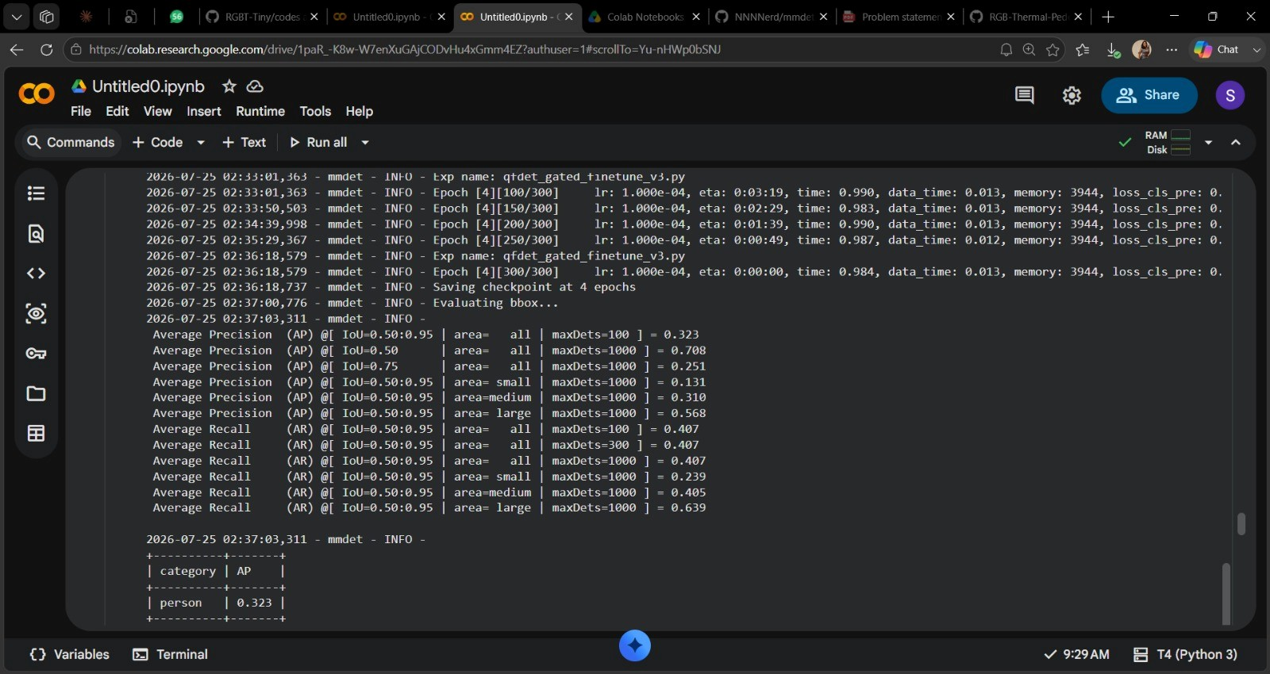
RESULT

Slide 13
THANK YOU

