Slide 1


ZOMATO RESTAURANTS AND METADATA

Slide 2
INTRODUCTION:
1.Zomato is a popular food-tech company that was founded in 2008 by Deepinder Goyal and Pankaj Chaddah. It began as an online restaurant discovery platform that provided menus, ratings, and reviews of restaurants in various cities around the world.
2.Zomato has a presence in over 25 countries and more than 10,000 cities worldwide. The company has over 150 million monthly active users and has partnered with over 1.5 million restaurants globally.

Slide 3
OBJECTIVE:
1To analyze the distribution of restaurants and cuisines in different geographical locations.
To identify the most popular collections and cuisines in different cities
To explore the relationship between restaurant pricing and customer satisfaction
To study the impact of timing and location on restaurant popularity and customer traffic.
1
2
3
4

Slide 4
STEPS TAKEN BEFORE DATA ANALYSIS:
1.Identify and handling the missing values.
2.Removing the duplicates .
3.Standardization of the data.
4.Removing the outliers and converting data types.
5.Normalization of the data.

Slide 5
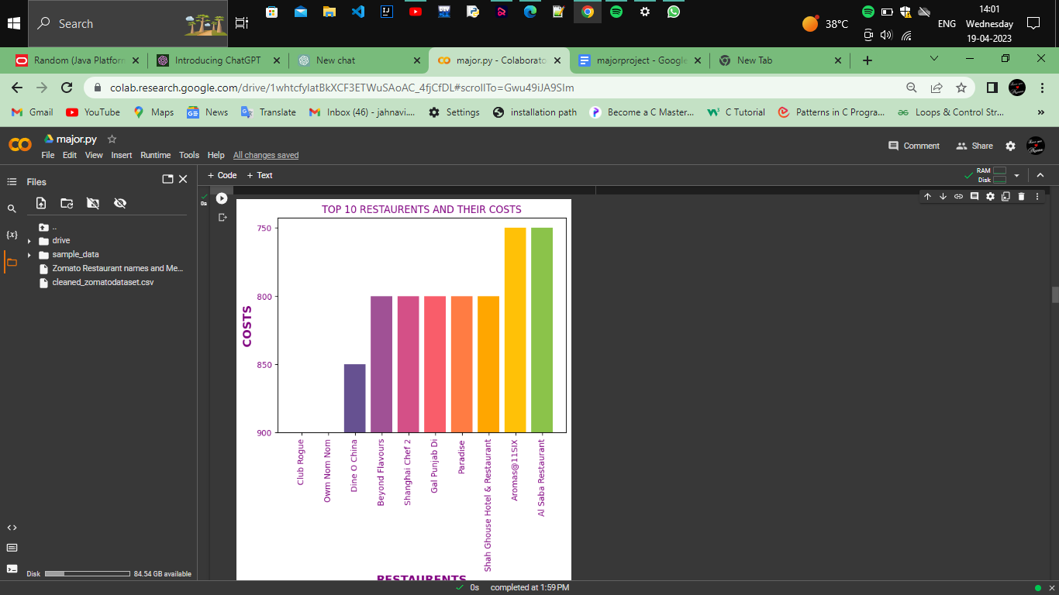
DATA ANALYSIS: visualizing the top 10 restaurants costs:
1.The above graph shows the top 10 restaurants and their costs.
2.Here it show the restaurants names on the x axis and the costs on the y axis .
3.It is plotted in such a way that descending order of the costs and restaurants based on that.
4.The top 10 restaurants of costs vary from the 850 to 750 rupees.

Slide 6
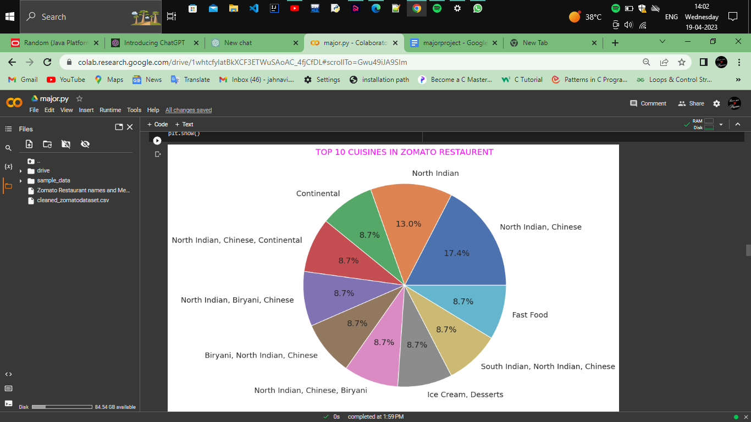
Visualizing the top10 cuisines offered by restaurants:

Slide 7
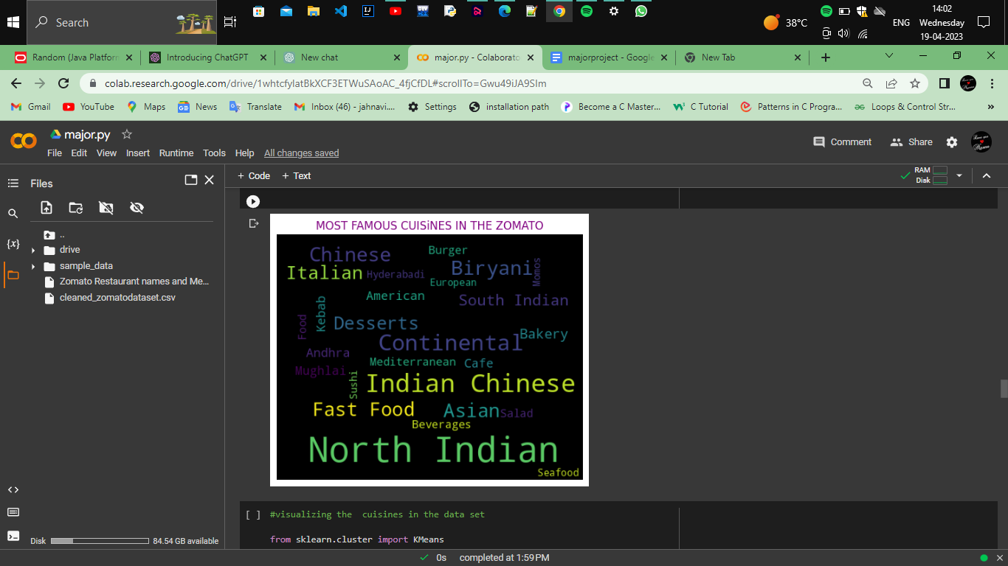
Visualizing the famous cuisines using the word cloud:

Slide 8
Reasons to use the k-means clustering for the analysis:
1.K-means is computationally efficient: K-means is computationally efficient and can handle large datasets,
2.K-means is suitable for datasets with continuous variables: K-means works well with continuous variables, which is often the case in datasets like Zomato that involve prices, ratings, and other quantitative features.
3.It is the type of the unsupervised learning and helps in grouping the data on the similarities between them and make them into a clusters and also assign a centroid for each cluster based on the information we provided it contains the nearest data points to it.

Slide 9
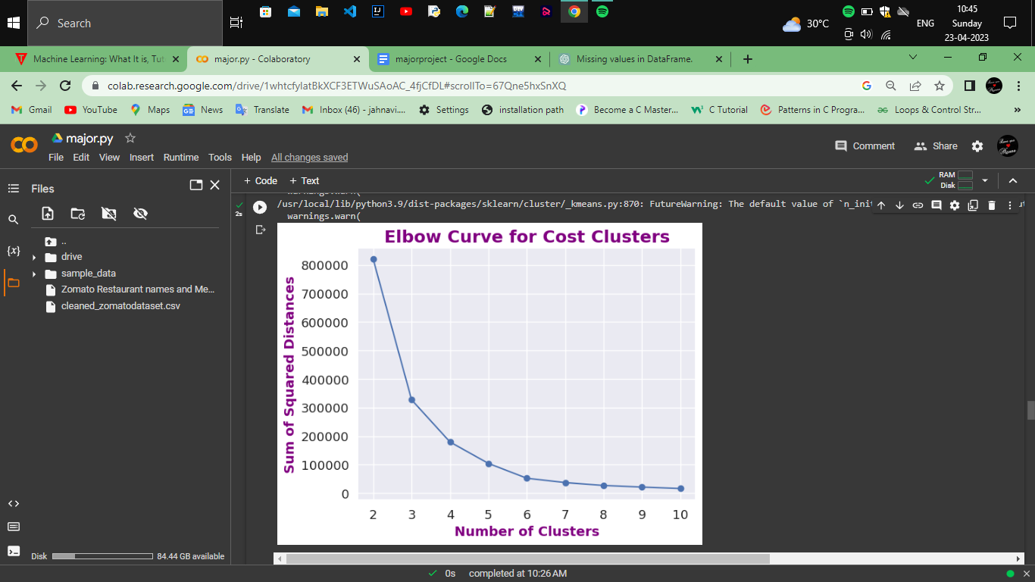
Using the elbow-method to calculate the optimal number of clusters:
1.The elbow graph is a tool used in unsupervised learning to help determine the optimal number of clusters for a given dataset. Typically, the graph plots the within-cluster sum of squares (WSS) against the number of clusters, and the "elbow" point is the point where the rate of decrease in WSS starts to level off.
2.The above graph shows the 5 optimal number of clusters.

Slide 10
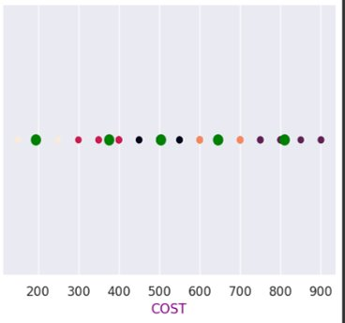
Using the k-means algorithm for the data:
1.we can see the cost clusters that is 5 clusters green colour dots indicates the centroids of the each clusters .Now for further analysis average of the each cluster in the above graph are:
Cluster 1: 502.777778
Cluster2: 809.090909
Cluster 3: 375.000000
Cluster 4: 644.736842
Cluster 5: 193.750000
2.we can observe the average rate of cost is high for the second cluster we can say that most of the costs are in range of 300 to 400 which common people can afford the expenses.

Slide 11
Using of hierarchical clustering for data:
1.Hierarchical clustering is another type of clustering algorithm that works by creating a hierarchy of clusters. In this method, the algorithm starts by considering each point as an individual cluster and then iteratively merges the closest pair of clusters until only one cluster remains.
2.For more accuracy of the data we have to use different algoritm for the given dataset.It will also make us predict the more insights of the data and helps for marketing.

Slide 12
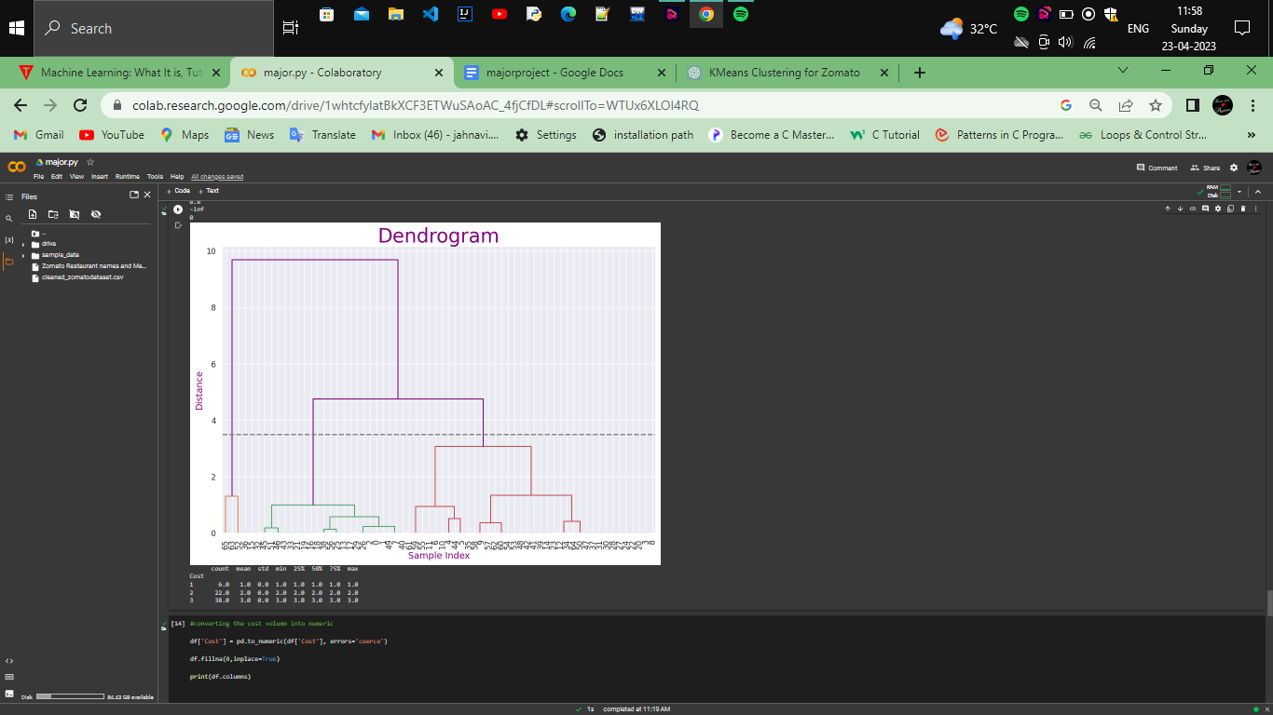
Analysis by hierarchical clustering:
1.The different colors of branches in a dendrogram represent different clusters or groups that are formed during the clustering process. When the algorithm groups similar data points together, it creates a new branch or cluster, which is represented by a different colour in the dendrogram.
2.A big branch in a dendrogram indicates a larger distance between clusters. This means that the data points in those clusters are more dissimilar than the data points in other clusters that are connected by smaller branches. The bigger the branch, the greater the distance between the clusters.

Slide 13
CONCLUSION:
1.From the above observations we can conclude that clustering based on cost can help to identify pricing trends in different regions or neighbourhood, which can inform business decisions such as setting prices or expanding to new locations.
2.Another possible conclusion is that there may be distinct clusters of restaurants at different price points, which may have different customer preferences and behavior.
3.From association rule mining we can conclude the relationship between the different attributes of the restaurants, Association between different cuisine types: Association rule mining can reveal which cuisines are often associated with each other in the dataset. For example, the analysis might reveal that restaurants serving North Indian cuisine are often associated with South Indian cuisine or that restaurants serving Continental cuisine are often associated with European cuisine.

Slide 14
THANK YOU

