Slide 1
Task Manager App
Organize tasks with responsive layouts, custom widgets, and API integration

Slide 2
Aim
Build a task manager app to organize tasks with responsive layouts, custom widgets, and API integration, featuring animations and tested components for reliability.

Slide 3
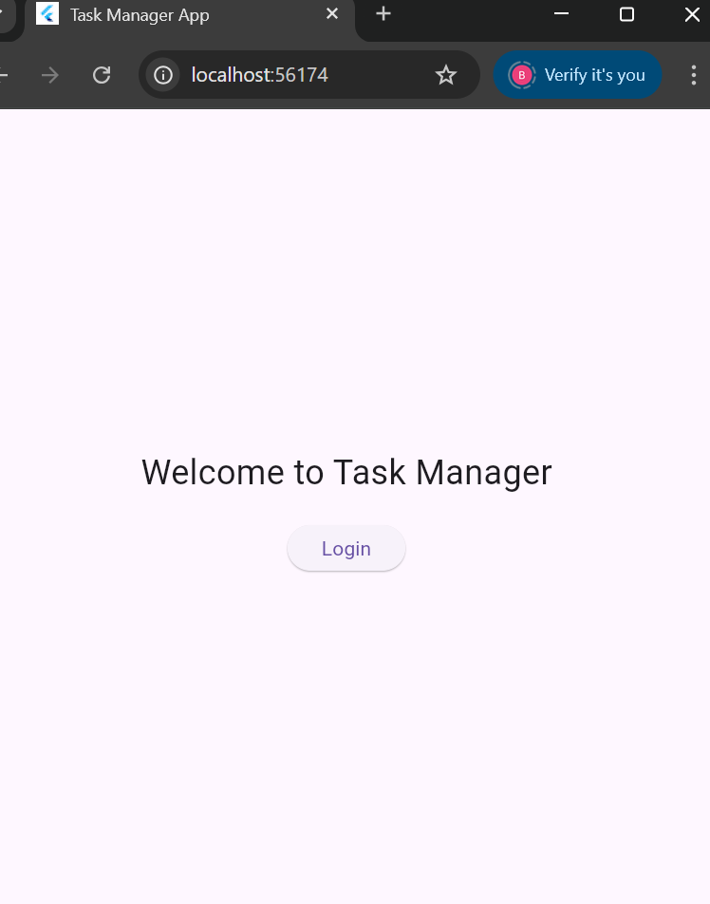
OUTPUT : LOGIN SCREEN

Slide 4
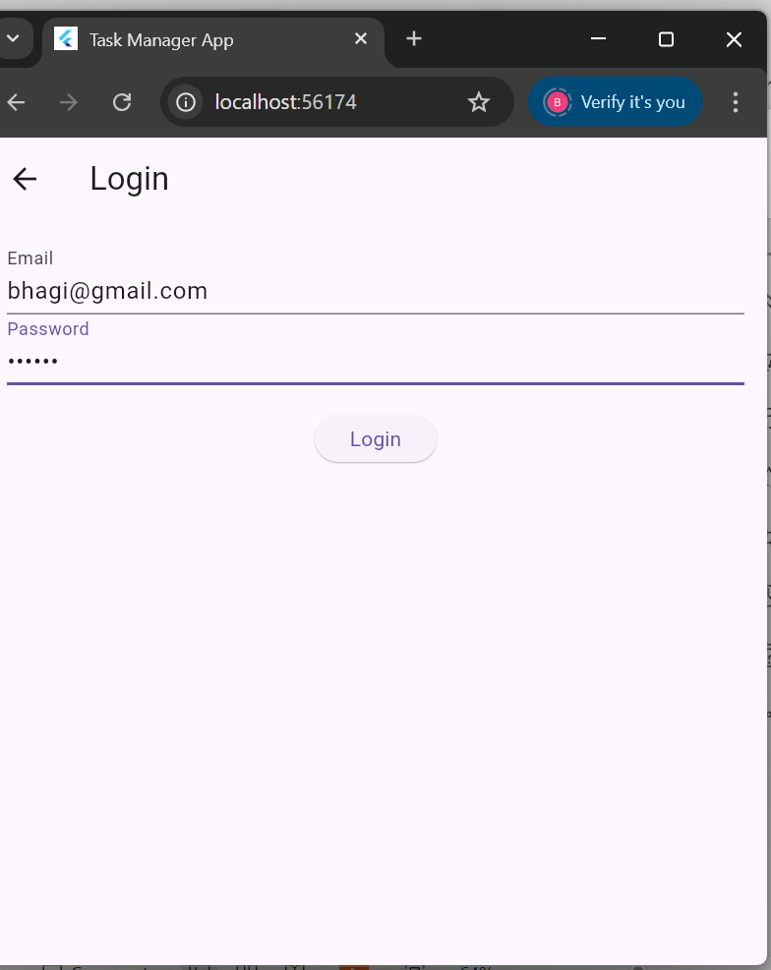
OUTPUT: LOGIN SCREEN

Slide 5
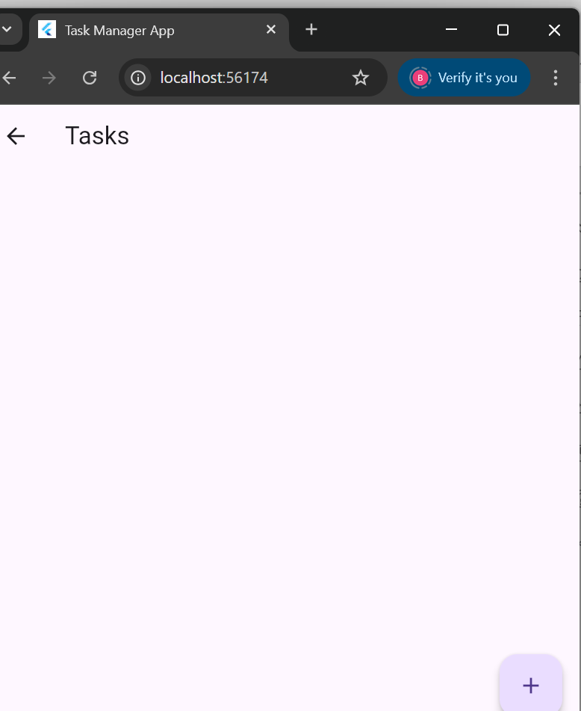
ADD TASKS SCREEN

Slide 6
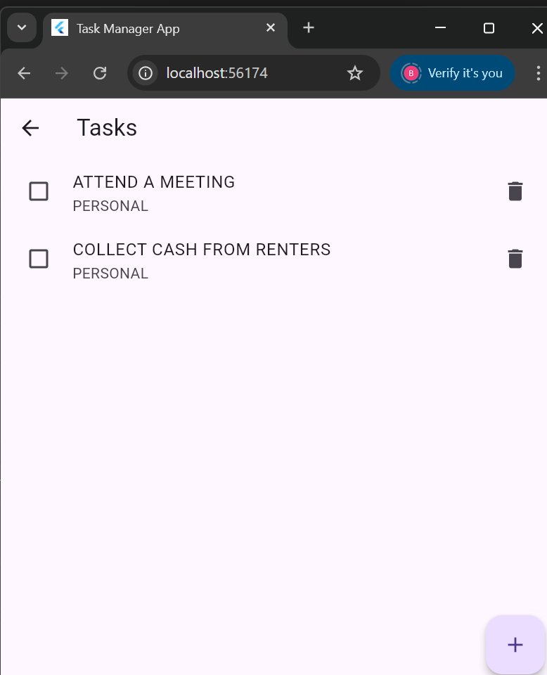
TASKS ADDED

Slide 7
Procedure Overview
1. Design a GridView of tasks using a custom TaskTile widget.
2. Use LayoutBuilder for responsive column layout.
3. Set up named routes to navigate to task edit screen.
4. Manage tasks with Provider (add/remove).
5. Fetch task categories from REST API.
6. Animate task completion.
7. Write unit tests for API.
8. Use Flutter DevTools for debugging and optimization.

Slide 8
GridView & TaskTile
• GridView to display tasks in cards.
• TaskTile widget with Row containing checkbox and title.
• Styled using a custom theme for consistency.

Slide 9
Responsive Layout
• LayoutBuilder ensures responsiveness.
• >600px: Show 3 columns.
• <=600px: Show 1 column.
• Provides smooth scaling across devices.

Slide 10
Advantages
Organizes tasks in one place
Improves productivity and focus
Helps manage time efficiently
Supports collaboration and teamwork
Tracks progress and accountability
Provides flexible views (list, calendar, board)
Integrates with other tools (email, cloud, calendar)
Reduces stress by preventing last-minute rushes

Slide 11
Disadvantages
May feel overwhelming if too many tasks are listed
Can be time-consuming to update regularly
Dependence on technology (needs internet or device)
Learning curve for complex apps
May cause stress if tasks are constantly tracked
Risk of data loss if app crashes or sync fails
Can reduce flexibility if strictly followed

Slide 12
How Our App Stands Out
Simple, clean, and user-friendly design
Faster performance with minimal setup
Smart reminders (AI-based suggestions)
Customizable views (List / Calendar )
Offline + Online sync for flexibility
Strong data security & privacy

Slide 13
Future Upgrades
AI Task Assistant – auto-prioritize tasks
Voice & Chat Integration – add tasks hands-free
Gamification – rewards & streaks for motivation
Cross-Platform Sync – seamless use on mobile, web, desktop
Collaboration Tools – team chat, file sharing, real-time updates
Analytics Dashboard – productivity insights & reports

Slide 14
THANK YOU

