Slide 1
Journey to Private Cloud
Anuradha Murthy

Slide 2
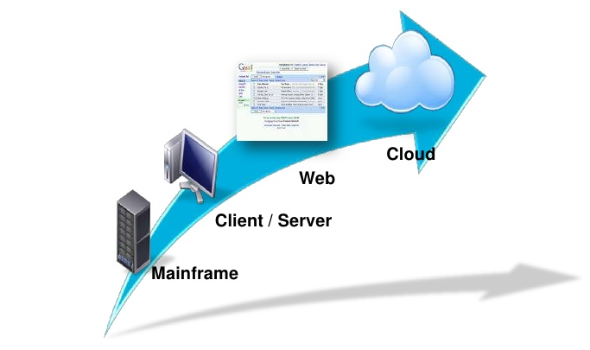
The Enterprise Computing Journey

Slide 3
Enterprise IT – A past ??
The IT Infrastructure of many enterprises today are characterized by following features:
Complex
Very Expensive
Rigid, not flexible
Isolated systems, developed to support individual applications across the enterprise

Slide 4
Emergence of the Public cloud
At the other end, we have the Public cloud which could be characterized as:
Simple
Low-cost
Flexible and
Dynamic

Slide 5
The Enterprise IT advantage !!
Trust
Security
Reliability
Control

Slide 6
Is Public cloud a magic solution ?? Hold on….
There are certain major concerns of Public cloud solutions namely:
Security and
Reliability

Slide 7
The big Leap: Journey to Private cloud
The Magic solution to the problems that today’s Enterprises are facing seems to lie in ‘Journey to the Private cloud’ which combines the advantages of both Stand-alone Enterprise IT and Public cloud together to offer:
Simplicity
Trust
Dynamism
Control
Low-cost, achieved by IT Infrastructure sharing
Reliability
Security and
Flexibility
A MAGIC ‘ALL AS ONE’ SOLUTION BUCKET ????

Slide 8
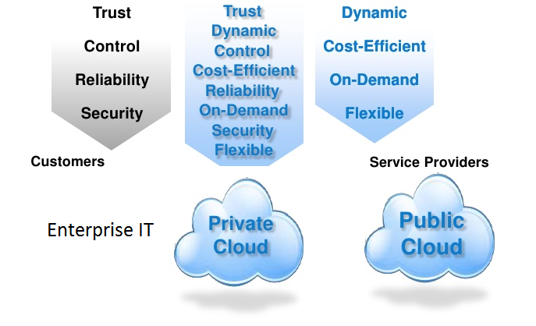
Journey to Private cloud

Slide 9
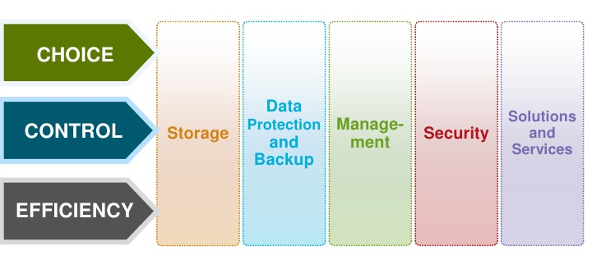
What Private Cloud provides us ?

Slide 10
Beginning the Journey to Private cloud

Slide 11
Transforming the Infrastructure – Reducing cost
What we need to achieve ??
Lowering the total cost of IT Applications
What to focus on ?
Lowering costs through
Simplicity
Efficiency and
Protection
Reducing risk of transformation

Slide 12
Transforming the Infrastructure – Improving Service Levels
What we need to achieve ??
Increased Service Levels through
Higher availability
Faster time to completion
What to focus on ?
Scalability
Continuity
Security

Slide 13
Transforming the Infrastructure - IaaS
What we need to achieve ??
Agility
What to focus on ?
Standardization
Automation

Slide 14
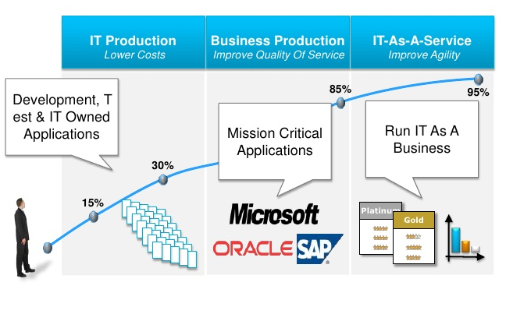
Private Cloud – Infrastructure Journey

Slide 15
Applications
Legacy Applications
SaaS
Replatformed applications

Slide 16
Applications – Workload Optimization
Cost
Trust
Functionality

Slide 17
Access
The End devices : iPad, Laptop, Desktop. Mobile applications
Policies established to focus on
Scalability
Cost Efficiency
Automation

Slide 18
Changing the face of IT
People – Introducing new IT roles
Cloud Architect
Cloud Admin
Technology
Introducing new technologies to reduce costs
Processes
Introducing new processes to improve Service levels
Relationships
Improve Business relationships to achieve agility

Slide 19
Time for Questions!!

Slide 20
Shoot your Offline Queries
Anuradha Murthy
Associate General Manager
HCL Technologies Limited
Anuradha.bhakri@hcl.com

