Slide 1
PHP – An Introduction
Albert Morita – UCR Libraries Systems Dept.
December 9, 2004
Version 2.0

Slide 2
Agenda
1. Brief History of PHP
2. Getting started
3. Examples

Slide 3
Brief History of PHP
PHP (PHP: Hypertext Preprocessor) was created by Rasmus Lerdorf in 1994. It was initially developed for HTTP usage logging and server-side form generation in Unix.
PHP 2 (1995) transformed the language into a Server-side embedded scripting language. Added database support, file uploads, variables, arrays, recursive functions, conditionals, iteration, regular expressions, etc.
PHP 3 (1998) added support for ODBC data sources, multiple platform support, email protocols (SNMP,IMAP), and new parser written by Zeev Suraski and Andi Gutmans .
PHP 4 (2000) became an independent component of the web server for added efficiency. The parser was renamed the Zend Engine. Many security features were added.
PHP 5 (2004) adds Zend Engine II with object oriented programming, robust XML support using the libxml2 library, SOAP extension for interoperability with Web Services, SQLite has been bundled with PHP

Slide 4
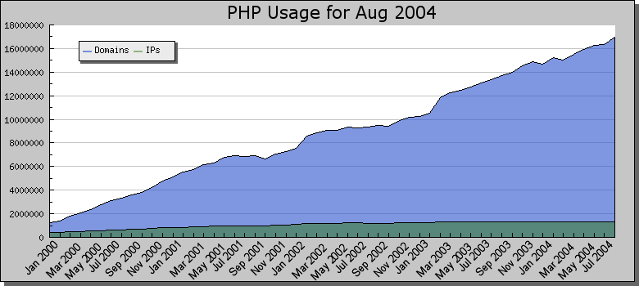
Brief History of PHP
As of August 2004, PHP is used on 16,946,328 Domains, 1,348,793 IP Addresses http://www.php.net/usage.php This is roughly 32% of all domains on the web.

Slide 5
Why is PHP used?
Easy to Use
Code is embedded into HTML. The PHP code is enclosed in special start and end tags that allow you to jump into and out of "PHP mode".
<html>
<head>
<title>Example</title>
</head>
<body>
<?php
echo "Hi, I'm a PHP script!";
?>
</body>
</html>

Slide 6
Why is PHP used?
Cross Platform
Runs on almost any Web server on several operating systems.
One of the strongest features is the wide range of supported databases
Web Servers: Apache, Microsoft IIS, Caudium, Netscape Enterprise Server
Operating Systems: UNIX (HP-UX,OpenBSD,Solaris,Linux), Mac OSX, Windows NT/98/2000/XP/2003
Supported Databases: Adabas D, dBase,Empress, FilePro (read-only), Hyperwave,IBM DB2, Informix, Ingres, InterBase, FrontBase, mSQL, Direct MS-SQL, MySQL, ODBC, Oracle (OCI7 and OCI8), Ovrimos, PostgreSQL, SQLite, Solid, Sybase, Velocis,Unix dbm

Slide 7
Why is PHP used?
Cost Benefits
PHP is free. Open source code means that the entire PHP community will contribute towards bug fixes. There are several add-on technologies (libraries) for PHP that are also free.
 | PHP
Software | Free
Platform | Free (Linux)
Development Tools | Free PHP Coder, jEdit

Slide 8
Getting Started
How to escape from HTML and enter PHP mode
PHP parses a file by looking for one of the special tags that
tells it to start interpreting the text as PHP code. The parser then executes all of the code it finds until it runs into a PHP closing tag.
HTML
PHP CODE
HTML
<?php echo “Hello World”; ?>
Starting tag | Ending tag | Notes
<?php | ?> | Preferred method as it allows the use of PHP with XHTML
<? | ?> | Not recommended. Easier to type, but has to be enabled and may conflict with XML
<script language="php"> | ?> | Always available, best if used when FrontPage is the HTML editor
<% | %> | Not recommended. ASP tags support was added in 3.0.4

Slide 9
Getting Started
Simple HTML Page with PHP
The following is a basic example to output text using
PHP.
<html><head> <title>My First PHP Page</title> </head> <body> <?php echo "Hello World!"; ?> </body></html>
Copy the code onto your web server and save it as “test.php”.
You should see “Hello World!” displayed.
Notice that the semicolon is used at the end of each line of PHP code to signify a line break. Like HTML, PHP ignores whitespace
between lines of code. (An HTML equivalent is <BR>)

Slide 10
Getting Started
Using conditional statements
Conditional statements are very useful for displaying specific content to the user. The following example shows how to display content according to the day of the week.
<?php $today_dayofweek = date(“w”); if ($today_dayofweek == 4){ echo “Today is Thursday!”; } else{ echo “Today is not Thursday.”; } ?>

Slide 11
Getting Started
Using conditional statements
The if statement checks the value of $today_dayofweek
(which is the numerical day of the week, 0=Sunday… 6=Saturday)
If it is equal to 4 (the numeric representation of Thurs.) it will display
everything within the first { } bracket after the “if()”.
If it is not equal to 4, it will display everything in the second { } bracket
after the “else”.
<?php $today_dayofweek = date(“w”); if ($today_dayofweek == 4){ echo “Today is Thursday!”; } else{ echo “Today is not Thursday.”; } ?>

Slide 12
Getting Started
Using conditional statements
If we run the script on a Thursday, we should see:
“Today is Thursday”.
On days other than Thursday, we will see:
“Today is not Thursday.”
<?php $today_dayofweek = date(“w”); if ($today_dayofweek == 4){ echo “Today is Thursday!”; } else{ echo “Today is not Thursday.”; } ?>

Slide 13
Examples
PHP is a great way to implement templates on your website.
How to implement a simple page counter

Slide 14
Examples
Step 1: Universal header and footer in a single file
Create a file called header.php. This file will have all of the
header HTML code. You can use FrontPage/Dreamweaver to create the header, but remember to remove the closing </BODY> and </HTML> tags.
<html><head> <title>UCR Webmaster Support Group</title> <link rel="stylesheet" type="text/css" href=“mycssfile.css"> </head> <body> <table width=80% height=30> <tr><td> <div align=center> Page Title </div> </td></tr></table>

Slide 15
Examples
Step 2: Universal header and footer in a single file
Next, create a file called footer.php. This file will have all of the footer HTML code.
<table width=80% height=30> <tr><td> <div align=center> UC Riverside Department<BR> <a href=mailto:someuser@ucr.edu>someuser@ucr.edu</a> </div> </td></tr></table> </body> </html>

Slide 16
Examples
Step 3: Universal header and footer in a single file
This is the basic template that you will use on all of the pages. Make sure you name the files with a .php extension so that the server will process the PHP code. In this example, we assume the header and footer files are located in the same directory.
<?php // header include(“header.php”); ?> Insert content here! <?php // footer include(“footer.php”); ?>

Slide 17
Examples
Benefits:
- Any changes to header or footer only require editing of a
single file. This reduces the amount of work necessary for
site maintenance and redesign.
- Helps separate the content and design for easier maintenance
Header
Page 1
Content
Page 2
Content
Page 3
Content
Page 4
Content
Page 5
Content
Footer

Slide 18
Examples
How to output variables using PHP
Echo is the common method in outputting data. Since it
is a language construct, echo doesn’t require parenthesis
like print().
Output Text Usage:
<?php echo “Hello World”; ?> // prints out Hello World
Output the value of a PHP variable:
<?php echo “$hits”; ?> // prints out the number of hits
Echo has a shortcut syntax, but it only works with the “short
open tag” configuration enabled on the server. <?= $hits ?>

Slide 19
Examples
Other uses with echo()
Automatically generate the year on your pages. This will
print out ©2004 UC Riverside.
©<?php echo date(“Y”); ?> UC Riverside
You will need to escape any quotation marks with a backslash.
<?php echo “I said \”She sells sea shells\” ”; ?>

Slide 20
Additional Information
Some of the new functions added in version 5:
Arrays:
array_combine() - Creates an array by using one array for keys and another for its values
array_walk_recursive() - Apply a user function recursively to every member of an array
Date and Time Related:
idate() - Format a local time/date as integer
date_sunset() - Time of sunset for a given day and location
date_sunrise() - Time of sunrise for a given day and location
time_nanosleep() - Delay for a number of seconds and nano seconds
Strings:
str_split() - Convert a string to an array
strpbrk() - Search a string for any of a set of characters
substr_compare() - Binary safe optionally case insensitive comparison of two strings from an offset, up to length characters
Other:
php_check_syntax() - Check the syntax of the specified file
php_strip_whitespace() - Return source with stripped comments and whitespace

