Slide 1
Car Sales Dashboard
Key Insights & Visualizations

Slide 2
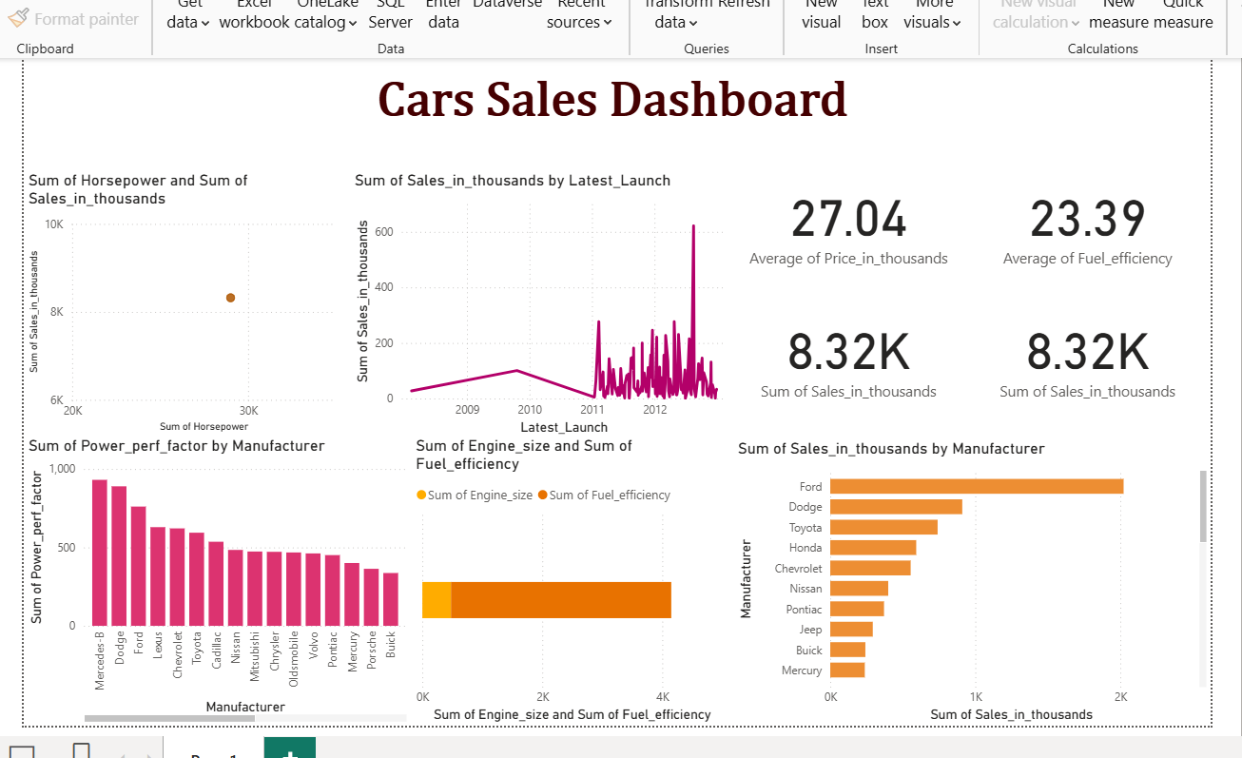

Slide 3
Quick Insights
• Total Sales: 8,320.70K units
• Average Price: $27.04K
• Top Manufacturer by Sales: Ford
• Best Resale Value: Porsche Carrera Cabrio ($67.55K)
• Average Fuel Efficiency: 23.39 mpg

