Slide 1

INTRODUCTION TO LOGICS

Slide 2
THE TOPICS
What is Logic?
Propositional Logic (Sentential Logic)
Formalization
Evaluation
Properties

Slide 3
WHAT IS LOGIC
Logic is the science that studies principles and methods that distinguish good reasoning from bad one.
Logic studies the principles of correct reasoning.
Reasoning: it is a mechanism that we use to obtain new information from existing information.

Slide 4
WHAT IS LOGIC (I)
3 main sentence types in English:
Declarative: assertion (He is here.)
Interrogative: ask question (Is here here?)
Imperative: making requests or issuing commands (Come here!)
Statement:
Declarative sentence
Complete & grammatical
Makes a claim
Can be simple or complex

Slide 5
WHAT IS LOGIC (II)
For this, logic studies the thoughts that have to do with reasoning.
Are all thoughts linked to reasoning? No, not all
Indications (Maximum Speed 60 Kms, Insert Card, etc.)
Interrogations (Will it take place today ?, Is there food ?, etc.)
Exclamations (hurry!!, come!!, etc.)
Lament (What a pity, what joy, etc.)
Emotions (I would like to live in a better world, I wish I could see John Lennon playing)

Slide 6
WHAT IS LOGIC (III)
Declarative sentence: Thoughts that are linked to reasoning:
Express information about something or someone (making a claim)
Today it is 15 degrees celsius.
John is taller than Peter.
The moon is made of cheese.
The order of the factors does not alter the product.
These can be TRUE or FALSE

Slide 7
WHAT IS LOGIC (IV)
Incorrect reasoning:
If the Jets win the Stanley Cup everyone will go to the airport to receive them.
The Jets are well received at the Airport.
Therefore the Jets won the Stanley Cup (we wish..).
Correct reasoning
If the Jets win the Stanley Cup everyone will go to the airport to receive them.
The Jets won the Stanley Cup.
The Jets are well received at the Airport.
(Blue: information that we have - Red: generated information)

Slide 8
WHAT IS LOGIC (V)
In order to arrive to the previous conclussions, the reasoning
schemes are studied, the structure of the sentences and phrases
that intervene in the reasoning are analyzed and the validity or
invalidity of the same is verified.
The reasoning is modeled.

Slide 9
WHAT IS LOGIC (VI)
What does it have to do with computing?
In IT, when we program, we are guided by logical principles, and we apply logic to do the right things.

Slide 10
ELEMENTS OF PROPOSITIONAL LOGIC
PROPOSITIONAL LOGIC
Propositions
Atomic
Molecular
Link terms or connectives

Slide 11
PROPOSITIONS (I)
PROPOSITION: (Statement, Declarative Sentence)
Sentence that describes a property about someone or something.
It has precise words and a clear sense.
Can be evaluated as True or False.

Slide 12
PROPOSITIONS (II)
There are 2 types of propositions:
Atomic (Simple sentence):
Simplest propositions that are indivisible.
John goes to the movies
It is raining today
It is sunny today
Tomorrow I’ll be studying
I ate a pizza yesterday
Molecular (Complex Sentence): Propositions composed of atomic propositions joined by link terms or connectives.

Slide 13
CONNECTIVES (I)
Link terms (or connectives): It links 2 propositions.
Linked propositions can be atomic as well as molecular propositions.
Conjunction ‘AND’ : ^. Connects 2 propositions stating that the two occur simultaneously.
E.g.: John goes to the movies and María makes supper.

Slide 14
CONNECTIVES (II)
Disjunction ‘OR’ : v. Connect 2 propositions stating that at least one of the two things happens or both at the same time.
E.g.: John goes to the movies or María makes supper.

Slide 15
CONNECTIVES (III)
Negation ‘NOT‘ : ~. It does not "connect" between two, but applies to one. Denies what happens in the proposal to which it applies.
E.g.: María does not make supper. I do not live in Uruguay.

Slide 16
FORMALIZATION (I)
Every sentence has an underlying structure that shows how it
articulates the information elements.
The structure is "extracted" via a formalization process.
Understand the meaning of the sentence.
Identify Atomic Propositions
Identify Connectives
Group into Molecular Propositions.
Note: The structure is also called a propositional form.

Slide 17
FORMALIZATION (II)
An example of the formalization process with the following
sentence:
Red roses and yellow cookies
Atom 1 ^ Atom 2
Molecule 1
Formalization is a simple method to understand. But to correctly
apply it, requires practice and moments of understanding and
intuition.

Slide 18
FORMALIZATION (III)
A molecule can have other molecules and successively until it
reaches the atoms.
As we see it:
At the most basic level I have atoms
At the higher level I only have the "big" molecule.

Slide 19
INTERPRETATION (Conditional)
Let’s suppose that we have two sentences that enunciate two different phenomena:
If today rains, I won’t take the bus
If I don’t get paid, I won’t go to work
Note that both sentences have the same logical structure,
p → q. Only p and q are "variables" having different values.

Slide 20
INTERPRETATION
If today rains, I won’t take the bus.
p -> q
-> = then
p = If today rains
q = I won’t take the bus.

Slide 21
INTERPRETATION
If I don’t get paid, I won’t go to work.
p -> q
-> = ,
p = ?
q = ?

Slide 22
AMBIGUITIES
I can say the same in different ways:
Today it is a sunny day.
Today is sunny.
It’s a sunny day today.
In formalization, this translates as a single atomic proposition.

Slide 23
FORMALIZATION AND INTERPRETATION
To formalize consists of extracting the logical structure, we detach from the meaning.
Replacing sentences with symbols
To interpret is to give it meaning.
Substitution of symbols by phrases
A sentence is formalized in a unique way.
The same structure can have multiple interpretations.

Slide 24
TRUTH TABLES
When interpreting the atomic propositions these can be True or False, and this is determined by contrasting the enunciated with the reality.
“It’s morning.”
“The windows is open.”

Slide 25
TRUTH TABLES
The molecular propositions can be True or False too, but are
determined from the truth or falsity of their atomic
propositions first, and then evaluating the connectives.
“It’s morning and the window is open.”
How is it calculated? >> Using truth tables.
They tell us how the truths are calculated for the different molecular propositions.

Slide 26
TRUTH TABLES
Consider a proposition p that can take one of two truth values:
T (true) , or F (false).

Slide 27
NEGATION “~”
~ Not | p
F | T
T | F

Slide 28
TO THE TABLES
Consider two propositions p and q. Each can take one of two truth values: either T (true), or F (false).
Hence, the truth values of p and q can be combined in four different ways:
Both True p=T q=T
Both False p=F q=F
p is True and q False p=T q=F
p is False and q True p=F q=T

Slide 29
CONJUNCTION “^”
Conjunction “and” | ^ | q
T | T | T
T | F | F
F | T | F
F | F | F

Slide 30
DISJUNCTION “v”
Disjunction “or” | V | q
T | T | T
T | F | T
F | T | T
F | F | F

Slide 31
REMEMBER
A sentence corresponds to a unique propositional form.
Sentences always rest on a single structure. (Ambiguity removed)

Slide 32
BOOLEAN LOGIC
Every operation is reduced to:
AND Conjunction (and)
OR Disjunction (or)
NOT Negation (not)
This happens a lot in IT

Slide 33
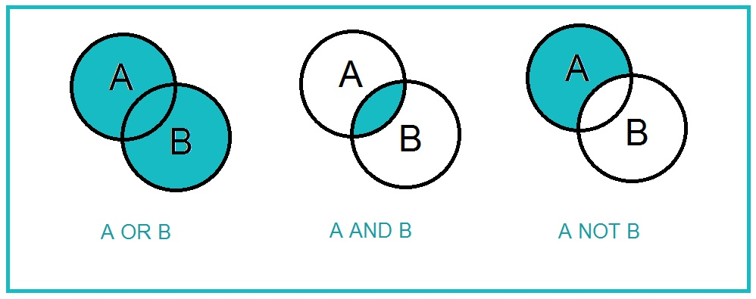
BOOLEAN LOGIC
CAN YOU SPOT ONE MISSING WORD IN THE LAST VENN DIAGRAM?

Slide 34
BOOLEAN LOGIC
EXAMPLE:
R = THEY ARE STEALING.
P = IT IS DAY.
Q = THE WINDOW IS OPEN.
REASONING TO KNOW IF THEY ARE STEALING
“THEY ARE STEALING IF IT’S NOT DAY AND THE WINDOW IS OPEN”
R = NOT(P) AND Q
P | Q | NOT(P) | NOT(P) AND Q
F | F | T | F
F | T | T | T
T | F | F | F
T | T | F | F

Slide 35
CONNECTIVES PRECEDENCE (I)
Remember that a connector links two propositions only, except the NOT that applies to only one.

Slide 36
CONNECTIVES PRECEDENCE (II)
This is just what precedes the connectors or link terms: Which have the highest priority for linking propositions.
You can use "(...)" to make clear what articulates with what. We are good at recognizing links with parentheses.

Slide 37
CONNECTIVES PRECEDENCE (III)
Major to minor precedence:
1. () parenthesis
2. ~ negation NOT
3. ^ conjunction AND
4. V disjunction OR

Slide 38
PRACTICE
If
P = F
Q = F
X = T
Tell me the Truth value for:
P AND Q OR X = T NOT(Q) OR P AND X = T
F AND (Q OR X) = T NOT(Q) AND P OR Q = T
(P AND Q) OR X = T NOT(Q) AND NOT(P) OR Q = T

Slide 39
QUICK PUZZLE
You are visiting the island of knaves and knights where knaves always lie and knights never lie. You meet two natives of the island. A says “B is a knave.” B says “A is a knave.” How many knaves are there? Prove it. You can do it like the book or use more formal methods.

Slide 40
THE END
QUESTIONS?

