Slide 1
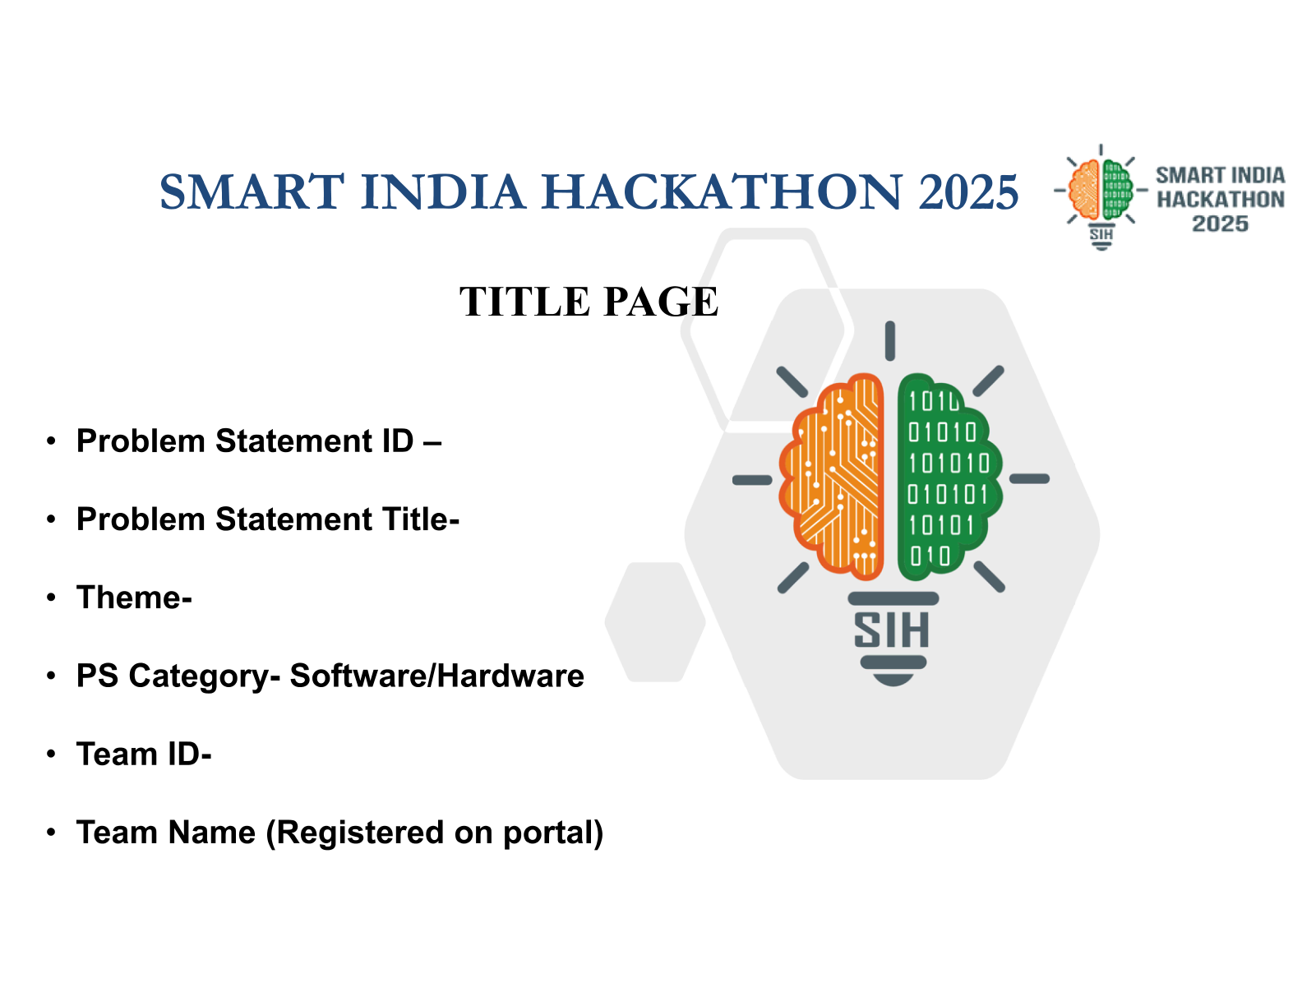

SMART INDIA HACKATHON 2026
PROBLEM STATEMENT ID
26089
PROBLEM STATEMENT TITLE
Cooperative Gig Services Platform for
Household & Community Services
THEME
Agriculture, FoodTech & Rural Development
PS CATEGORY
Software
TEAM ID
[REGISTERED TEAM ID]
TEAM NAME (REGISTERED ON PORTAL)
LABOURLINK [confirm portal spelling]
Connecting Communities with Verified Cooperative Workers.
User-supplied 2026 branding · official approval and team details require confirmation.
Notes:
Problem statement title and theme are taken from the user-provided organizer statement. Do not substitute unofficial themes. Team ID and exact portal spelling remain unconfirmed. The 2026 image is user-supplied, not independently verified as an approved event asset. AI-assisted preparation does not meet any wholly human-created requirement.

Slide 2
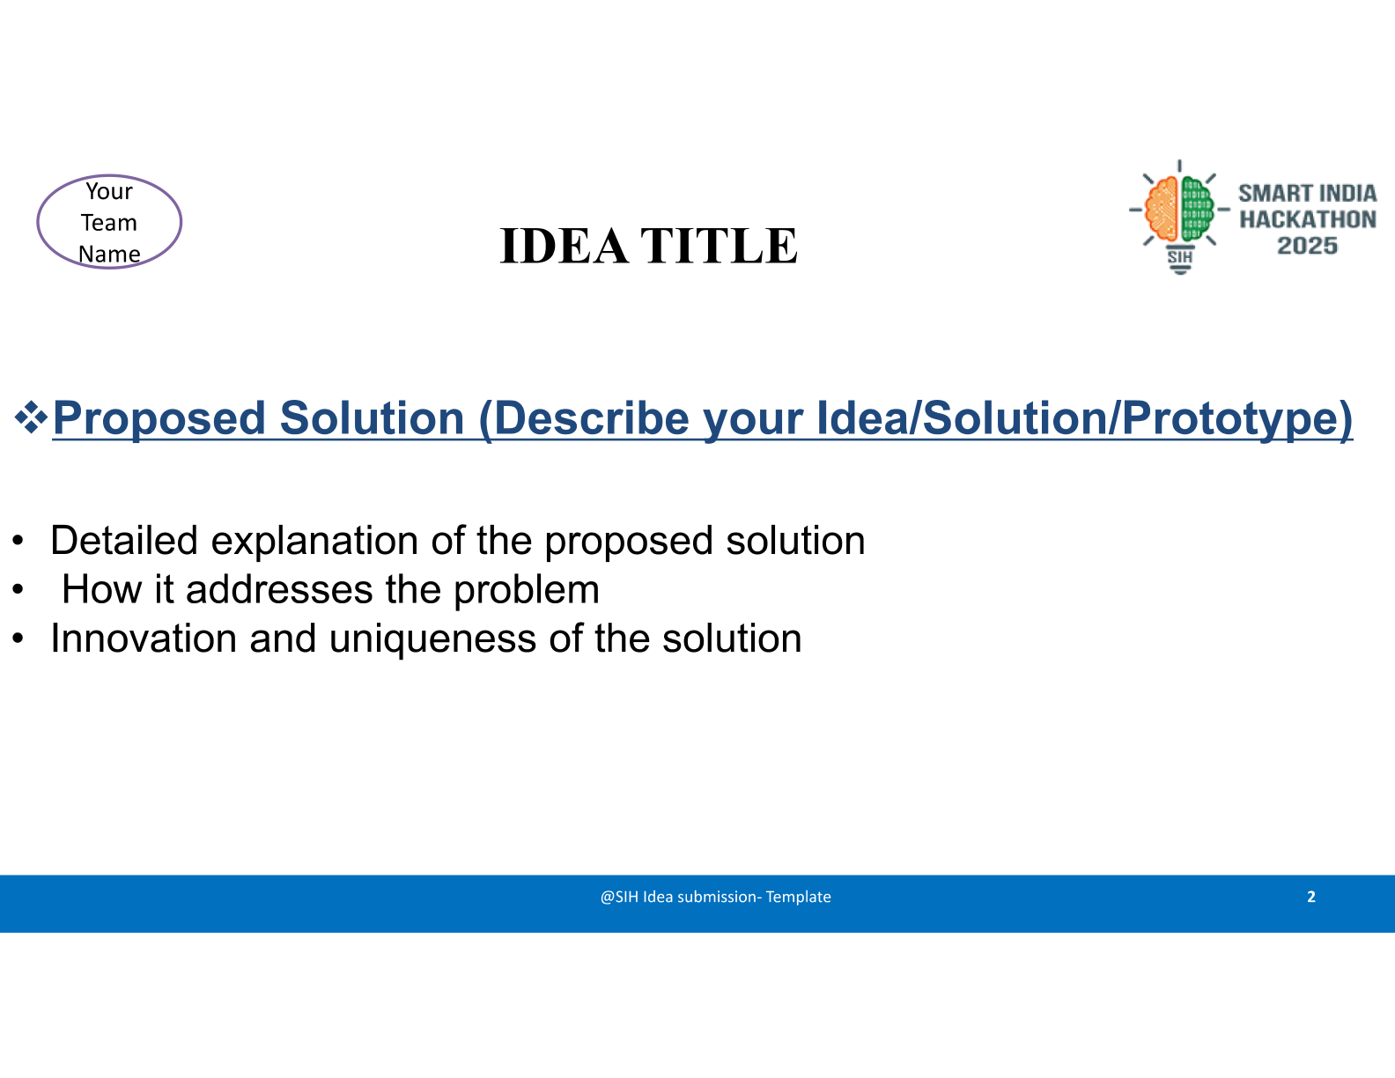
LABOURLINK
LABOURLINK
Proposed Solution (Describe your Idea/Solution/Prototype)
Detailed explanation of the proposed solution
Customer requirement
•
Societies import, verify and manage their worker rosters.
↓
•
Households book services; institutions request multiple workers.
•
Workers review terms, accept work and track earnings.
Chosen / suitable society
How it addresses the problem
Society records → verified profiles → suitable matches
→ completed services → transparent settlement
Capacity available
Shortfall
Innovation and uniqueness of the solution
•
Society-controlled verification and approved policies.
Worker offers
→ acceptance
Authorized federation
→ other societies
•
Separate payment, earning and settlement records.
•
Capacity-aware coordination across participating societies.
Affiliation + authority; no mandatory middleman.
Notes:
Federation involvement depends on affiliation, authorized scope and customer consent, not a fixed headcount threshold. Capacity is filtered by eligible skills and available time before ranking. A federation can contract or execute work where its own rules authorize it; this diagram is not a universal legal hierarchy or payment chain.

Slide 3
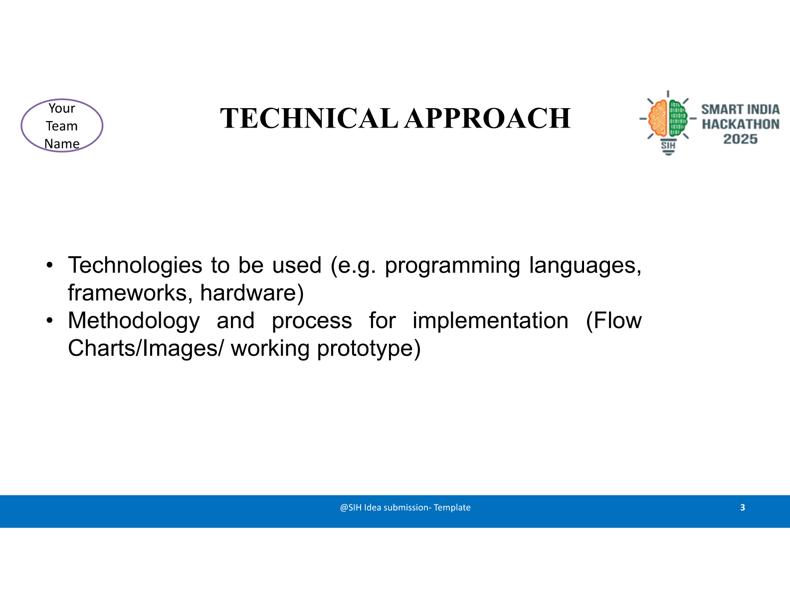
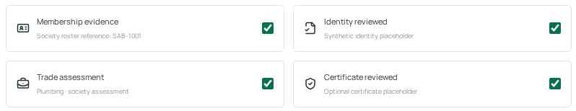
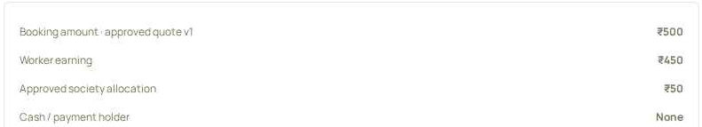
LABOURLINK
Six experiences: Household · Institution · Worker · Society · District · National
Technologies to be used
Methodology and process for implementation
(programming languages, frameworks, hardware)
(Flow Charts/Images/ working prototype)
•
Frontend: React + TypeScript; EN / HI / GU.
Import → verify → match → book → accept
→ complete → record payment → reconcile
•
Planned backend: FastAPI.
•
Planned database: MongoDB + geospatial indexing.
Matching: skill + availability first; then distance, experience, rating and workload.
•
Future authorized providers: payments, OTP, maps, voice, welfare.
Forecast: history → demand baseline → capacity gap → admin review.
Worker verification · synthetic prototype
Separate settlement ledger · synthetic prototype
Prototype scope: synthetic data and simulated handoffs. No live payment, government-data connection, backend or production AI claim.
Notes:
Six frontend experiences: Household, Institution, Worker, Society, District and National. The current preview is one codebase with distinct routes and shared synthetic state; it is not six independently verified deployments. Separate origins need explicit schema-validated export/import. Browser role views are not secure authorization. Production integrations remain future work. Screenshots are actual local synthetic prototype screens, when present.

Slide 4
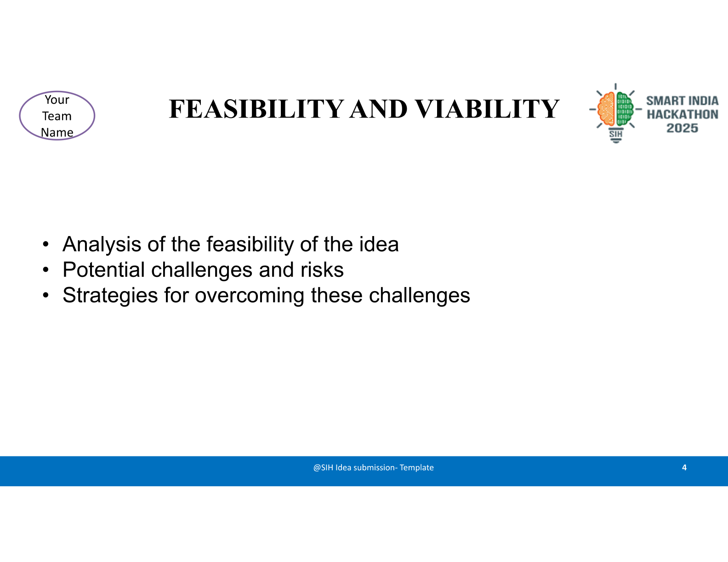
LABOURLINK
Analysis of the feasibility of the idea
•
Start with participating societies’ own records—not assumed government worker-data access.
•
Begin with one society and selected household/community services.
•
Agree cooperative operating charges; do not assume a universal commission.
Potential challenges and risks
Strategies for overcoming these challenges
Incomplete worker records
Validated imports, review queue, verification history
Language / digital-literacy barriers
Simple multilingual screens and assisted onboarding
Overbooking / bulk shortfalls
Time checks, reservations, partial-fulfilment review
Cash, no-shows, payment disputes
Separate ledgers, evidence trail, society review
PROPOSED PILOT — NOT ACHIEVED: 1 society · 100 workers · 300 requests · target ≥90% completion.
Production gate: governance, worker terms, pricing, legal obligations, data consent and provider access.
Notes:
The pilot is proposed, not achieved. No speculative cost estimate or legal-clearance claim is made. Confirm the society actually supplies the selected household/community skills. Cash disputes require reconciliation and cannot trigger duplicate digital charging. No-show allegations must remain unverified until review.

Slide 5
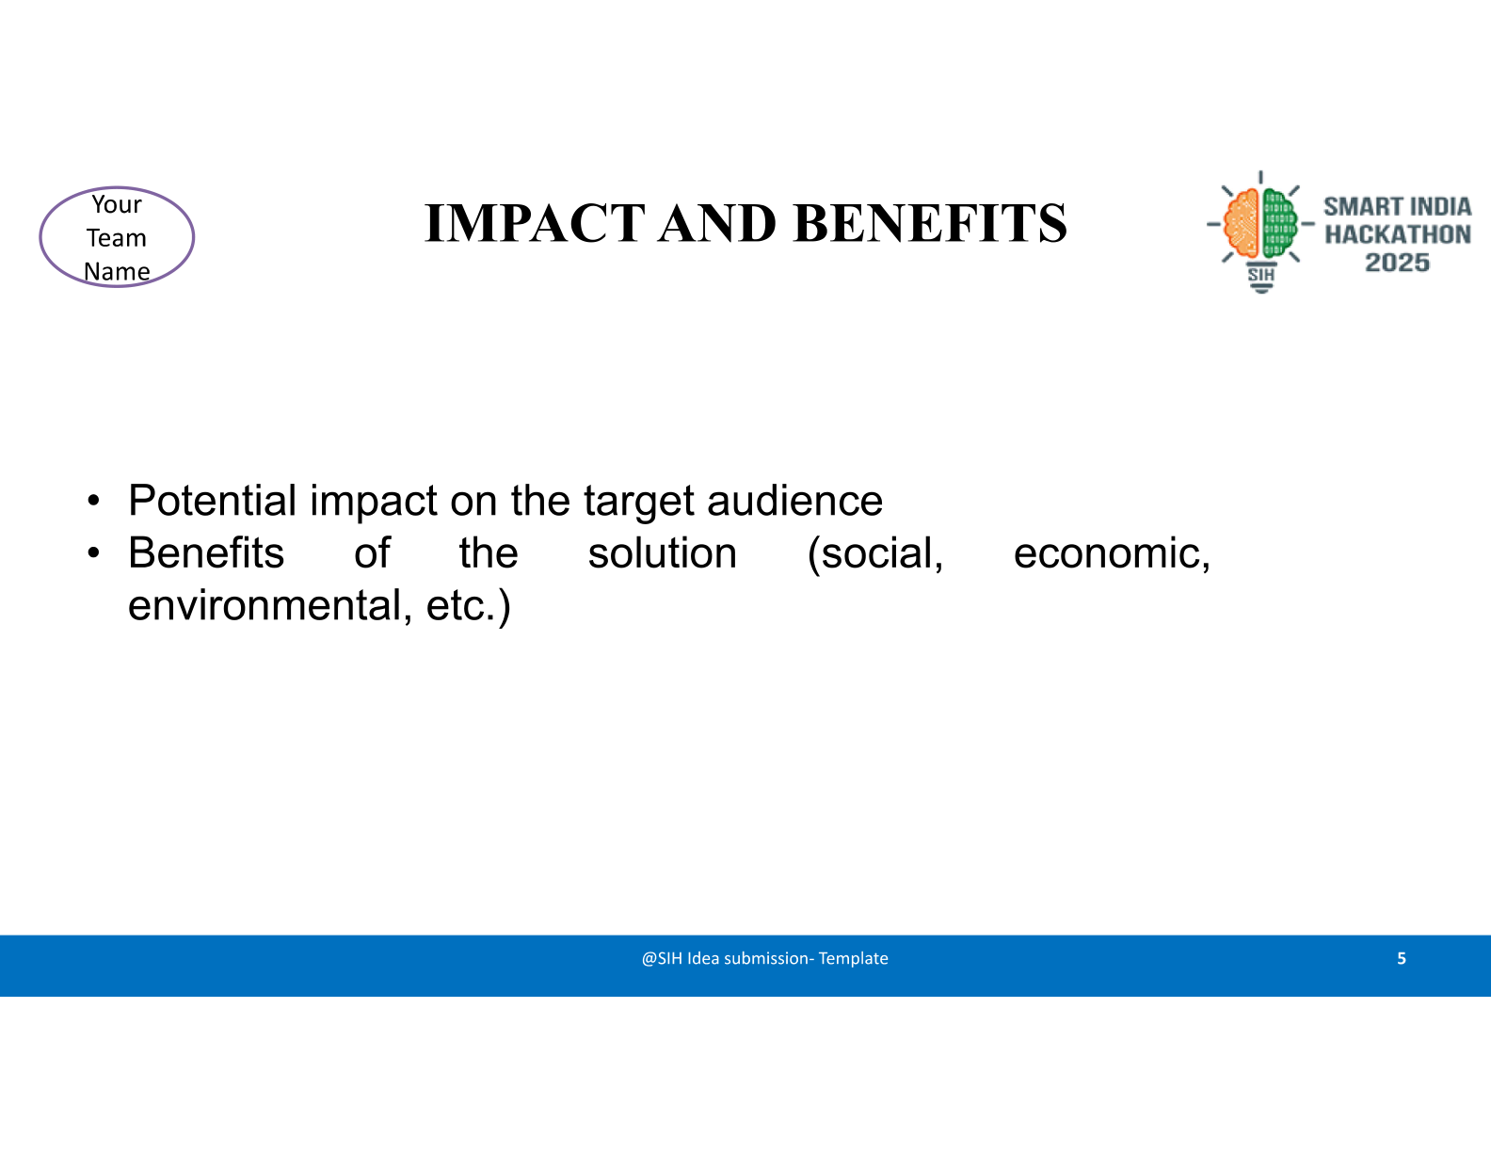
LABOURLINK
Potential impact on the target audience
Workers
Customers
Clearer terms, visible earnings, skill records and welfare guidance.
Discoverable cooperative workers, price visibility and traceable complaints.
Societies
Federations
Organized rosters, allocation tools and settlement visibility.
Authorized capacity and skill-gap summaries—not control over every job.
Benefits of the solution (social, economic, environmental, etc.)
Social: accessible, accountable participation.
Environmental: test travel savings from nearby matching.
Economic: aim for less idle time and clearer payments.
Governance: documented, approved cooperative decisions.
MEASURE: completion · utilization · assignment time · settlement delays
complaint resolution · worker net earnings after reported costs
Digitize the workforce. Keep the cooperative in control.
Notes:
Benefits are hypotheses to evaluate in a pilot, not achieved impact. Workload-aware ranking alone does not prove fair allocations. Evaluate new-worker inclusion and avoid automatically ranking unrated workers last. Nearby matching may reduce travel, but the environmental effect must be measured.

Slide 6
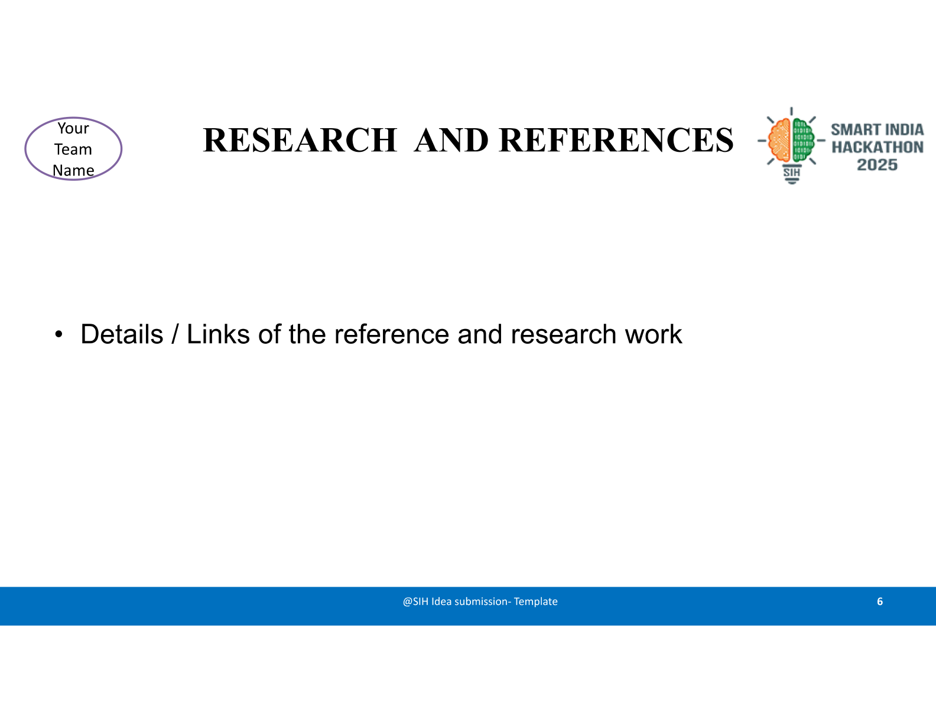
LABOURLINK
Details / Links of the reference and research work
01
SIH PS 26089 — organizer-provided statement
Confirmed portal URL required; title and theme supplied by the team.
02
Ministry of Cooperation — National Cooperative Database
Society information and ecosystem planning; not a worker roster API.
03
Haryana Labourfed — About Us
Documented society/district/state example—not a universal hierarchy.
04
International Cooperative Alliance — Cooperative Identity
Member ownership, democratic control and autonomy.
05
e-Shram — Official FAQs
Registration and welfare facilitation; scheme eligibility remains separate.
Prototype links — URLs pending; add verified links before submission
Household
Institution
Worker
Society
District
National
Notes:
Do not invent live prototype links. The supplied https://labourlink-customer.netlify.app was previously observed only as a landing page, not an end-to-end verified booking flow. This generated preview is not a claim of six separately deployed apps. NLCF About (https://labcofed.in/about-nlcf/) supports training, research and advocacy but not a mandatory national payment chain. ILO freedom of association: https://www.ilo.org/topics-and-sectors/freedom-association. Approved 2026 branding, registered team details, confirmed PS portal URL and final app URLs require team confirmation. The source template requests portal submission as PDF; the user requested this working PPTX only. The seventh instructions slide has intentionally been omitted.

