Slide 1
NETWORK SECURITY PRESENTATION
Program for Resource Interception through Smartphone Monitoring (P.R.I.S.M)
DEVAMALYA HAZRA
VINEETH REDDY YARRAM

Slide 2
Current Scenario
in mobile security
Numerous frameworks, tools for exploitation.
Low level measures (database signatures, network traffic).
Component interactions not taken into account while detecting threats.
Such procedures require architectural knowledge.

Slide 3
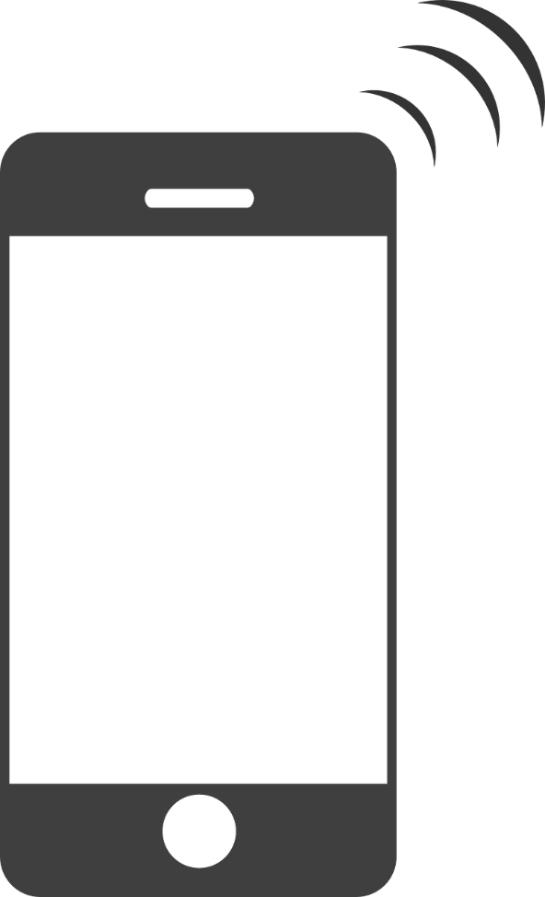
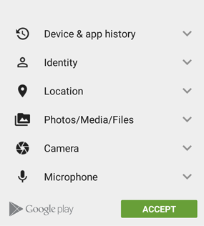
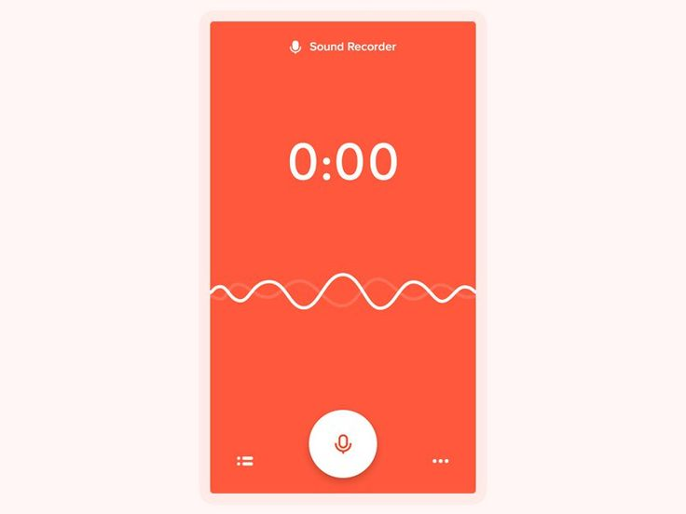

Permission Based Attack.
ADVERTISMENT
Information Flow Control (IFC) can’t be enforced.
AD SERVER
Permission List
MOBILE APPLICATION

Slide 4
What out tool does ?
Extracts entire
Message (SMS) list.
Contact list.
Call log.
Device Information.
and sends them via a secure connection to the PRISM server.
Automatically refresh the server information if the victim adds a new record. (Addition of a new contact, a new incoming SMS etc.).
Read the geolocation (GPS/Network) of the device.
Record audio as soon as the victim receives a call and stops recording when call is disconnected.
Record audio from the phone’s mic on-demand from the server.
Send the recorded files to the server.

Slide 5
Underlying Mechanism.

Slide 6
Demo

Slide 7
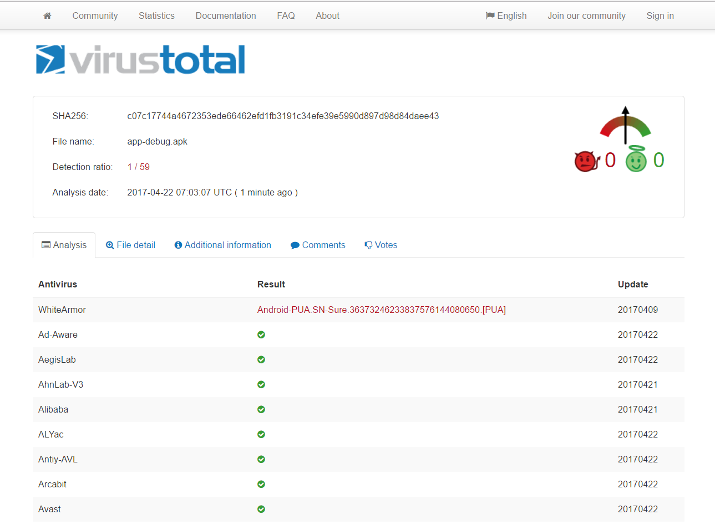
Detection Rate.

