Slide 1
Insurance Policy Voice Agent
Voice-enabled AI assistant for insurance policy queries

Slide 2
Problem Statement – Insurance Policy Confusion
Customers struggle to understand complex policy documents
Traditional support is slow and frustrating
Policy details are buried in lengthy PDFs
High risk of misinterpretation and missed benefits
Need for instant, reliable answers

Slide 3
Why Existing Chatbots Fail
Prone to hallucinations and wrong answers
Generic responses, not policy-specific
Poor handling of voice input/output
Lack of document grounding
Low user trust in critical insurance scenarios

Slide 4
Solution Overview – Voice-Enabled RAG Agent
AI agent answers policy questions using real documents
Voice input and output for natural interaction
Retrieval-Augmented Generation (RAG) ensures accuracy
No hallucinations – answers only from indexed policies
FastAPI backend, browser-based frontend

Slide 5
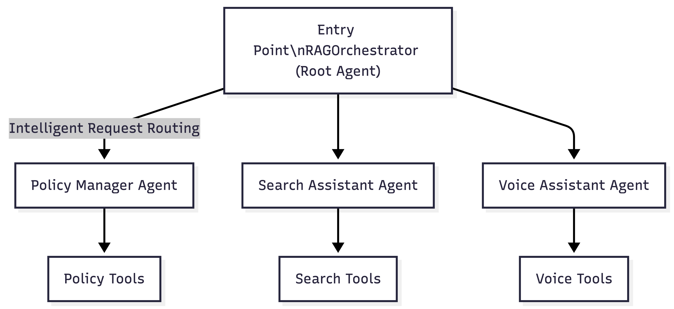
High-Level Architecture

Slide 6
[Diagram] High-Level Architecture

Slide 7
Detailed RAG Flow
User query received (text or voice)
Query embedded using Gemini/AI model
FAISS vector search retrieves relevant policy chunks
Context passed to LLM for grounded answer
Only document-backed responses returned

Slide 8
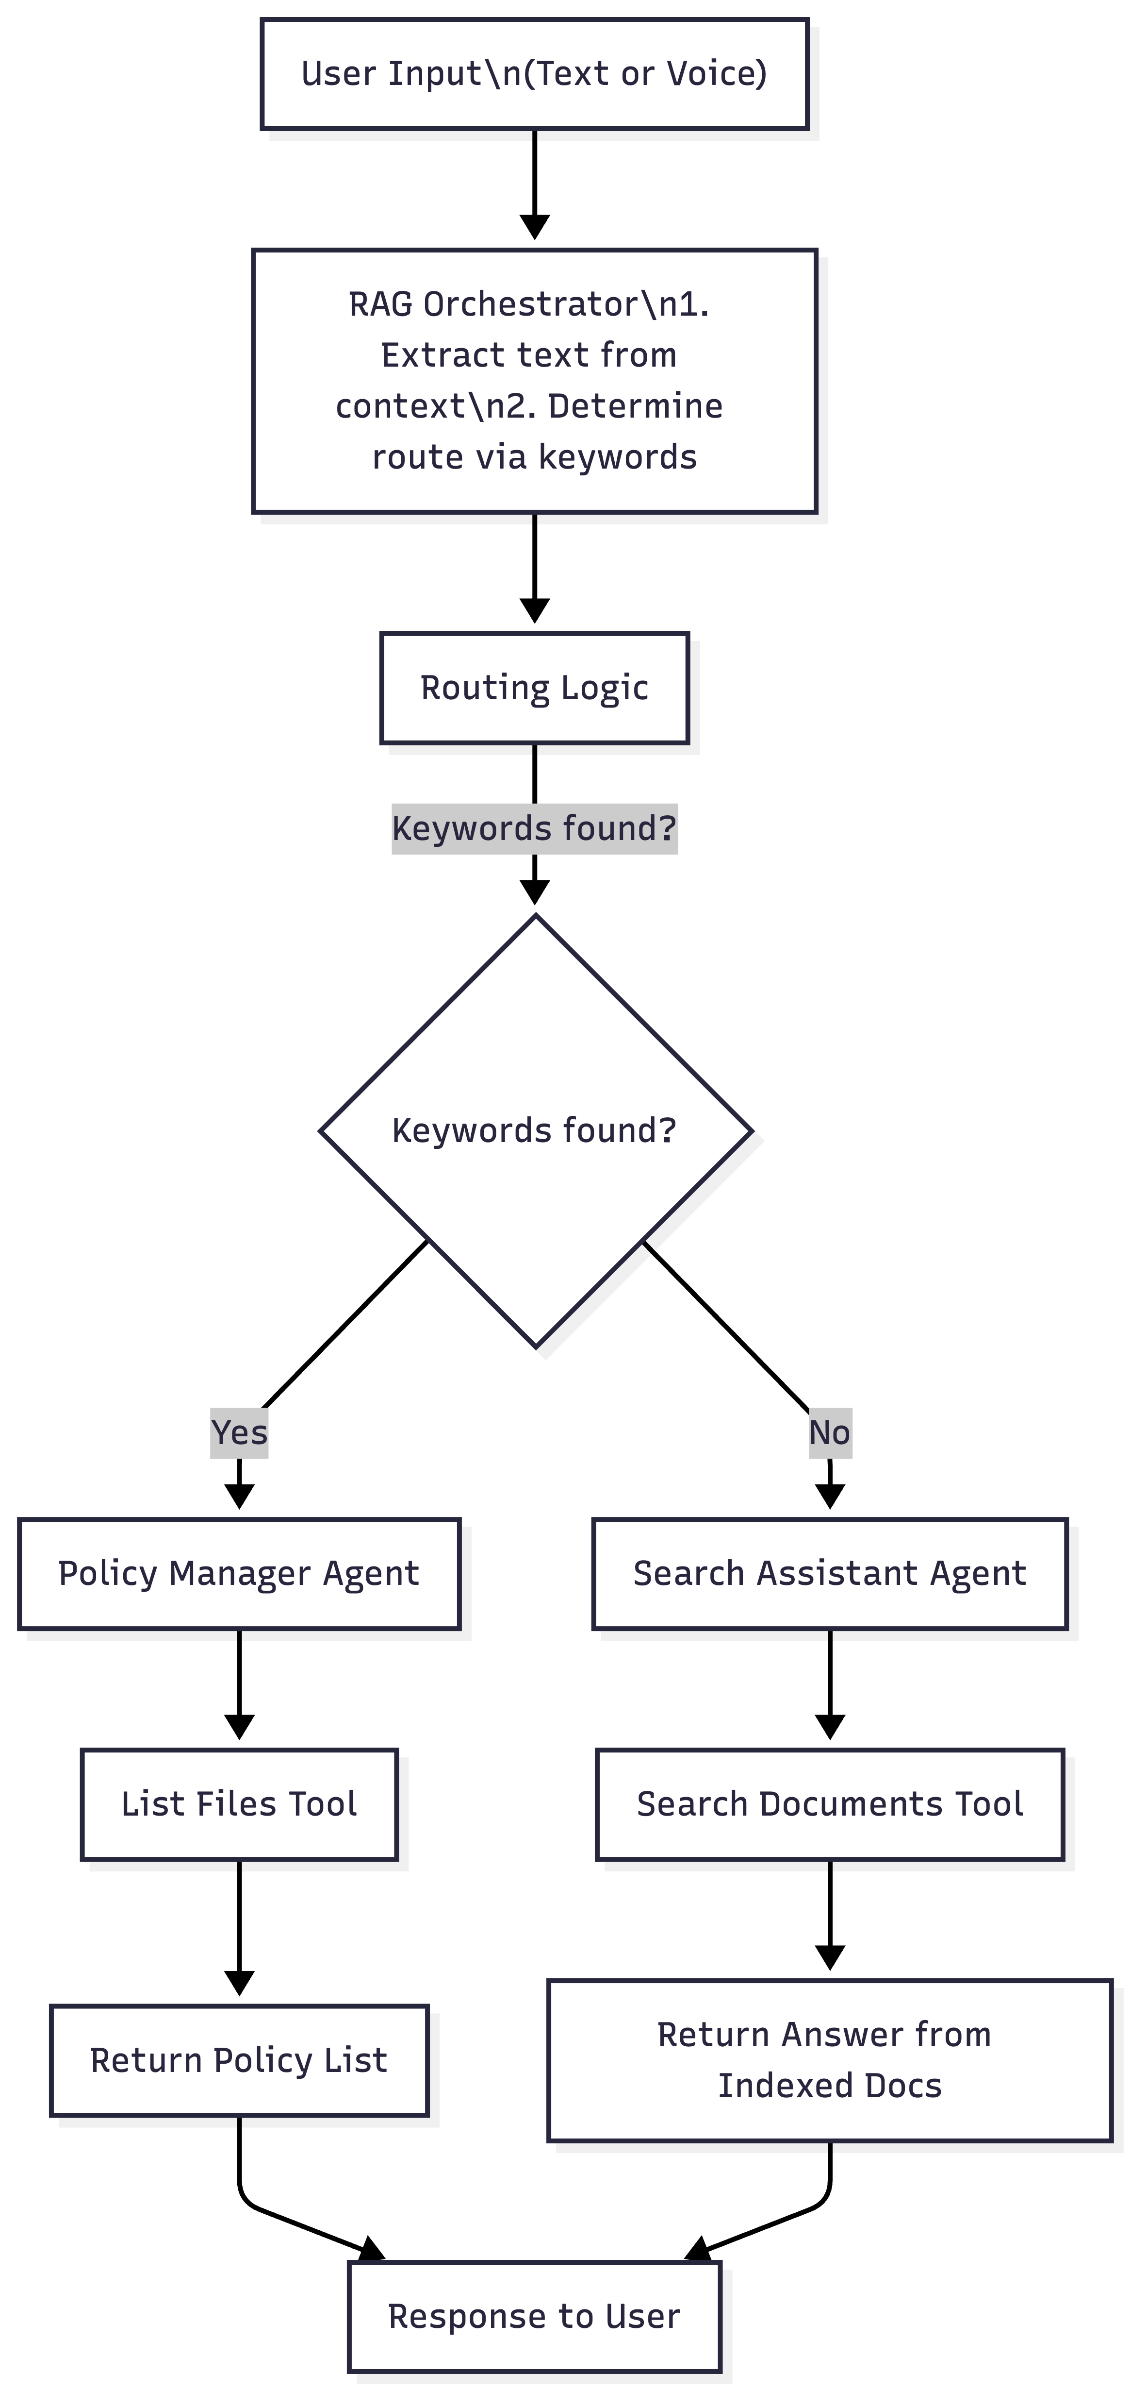
[Diagram] System Flow Diagram

Slide 9
Voice Flow
User speaks into browser mic
Speech-to-Text (STT) converts to text
Text sent to backend RAG pipeline
Answer generated and sent back
Text-to-Speech (TTS) reads answer aloud

Slide 10
No-Hallucination Strategy
Strict grounding: answers only from indexed documents
RAG pipeline enforces document context
No open-ended LLM responses
Policy snippets shown as evidence
User trust through transparency

Slide 11
Tech Stack: Why These Choices?
• FastAPI: High-performance, async Python web framework.
- Technical: Enables fast, scalable APIs for real-time RAG and voice.
- Business: Reduces latency, improves user experience.
• FAISS: Facebook AI Similarity Search.
- Technical: Efficient vector search for large policy docs.
- Business: Enables instant, accurate retrieval, scales to enterprise data.
• Google ADK & Gemini: Advanced LLM and agent orchestration.
- Technical: State-of-the-art language understanding and agent routing.
- Business: Reduces hallucination, increases trust, future-proofs solution.
• python-pptx: Automated PPT generation.
- Technical: Enables hackathon-speed, repeatable slide creation.
- Business: Saves time, ensures consistency for demos.
• Web Speech API: Browser-based STT/TTS.
- Technical: Seamless voice input/output in any browser.
- Business: No install, accessible to all users.

Slide 12
Live Demo Flow
Judge asks a real policy question via mic
System transcribes, searches, and answers instantly
Policy snippet shown as source
Voice output reads answer
End-to-end, judge-friendly experience

Slide 13
Scalability & Enterprise Readiness
Modular microservices architecture
Easy to add new policy documents
Scalable vector search (FAISS)
Secure, compliant data handling
Ready for cloud or on-prem deployment

Slide 14
Future Enhancements
Multilingual voice support
Integration with live insurance systems
Advanced analytics and reporting
Mobile app version
Continuous LLM improvement

Slide 15
Hackathon Impact & Closing
Solves real customer pain point
Demonstrates safe, grounded AI
Voice-first, accessible for all users
Ready for enterprise adoption
Thank you! Questions?

Slide 16
Business Value & Impact
• Reduces customer confusion and support costs
• Increases policyholder satisfaction and trust
• Scalable to any insurance product or region
• Voice-first: accessible to all, including non-technical users
• Ready for enterprise deployment and future enhancements

