Slide 1
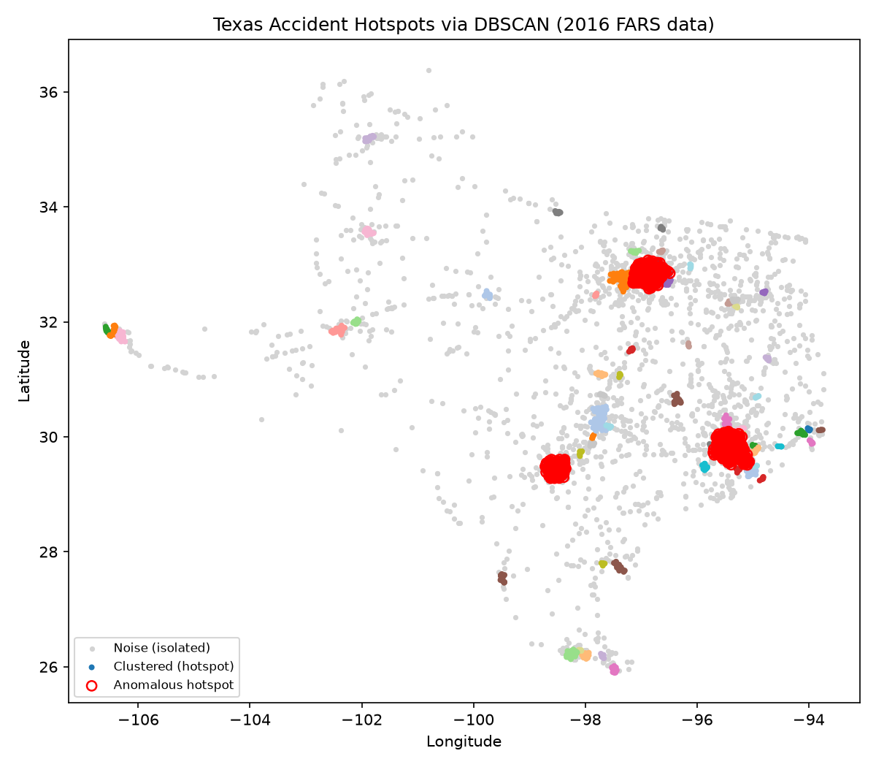
MACHINE LEARNING · DOMAIN: TRAFFIC CONGESTION
Accident Hotspot Detection Using DBSCAN-Based Anomaly Detection
Final project presentation · A.Y. 2026-2027
Bhargav (2520030303)
Dijendra (2520030164)
Guide: Rani Medida

Slide 2
PROBLEM
Where do accidents cluster — and which clusters are abnormal?
The gap
Interventions (signage, enforcement, signal retiming) are often allocated by manual review or anecdote, not systematic spatial analysis.
Accidents also drive recurring delays and secondary bottlenecks.
Our approach
Find dense accident zones automatically with DBSCAN.
Flag clusters whose size or severity is a statistical outlier (z-score > 2).
Extend to predicting multi-fatality crashes and serving the model.
2

Slide 3
MODEL CHOICE
Why DBSCAN instead of K-Means
1
2
3
No preset cluster count
Arbitrary shapes
Built-in noise label
The number of accident-prone zones is unknown in advance.
Follows elongated road corridors instead of forcing round partitions.
Isolated one-off crashes become noise (−1), so true hotspots stand out.
Distance metric: haversine on lat/lon (radians) — true great-circle distance at state scale.
3

Slide 4
DATA
Dataset: U.S. FARS 2016, focused on Texas
34,439
52
3,407
8.3%
accident records nationwide
columns per record
Texas records after cleaning
multi-fatality crashes (282)
Why this dataset: row-level GPS coordinates, credible open source (NHTSA), rich attributes (weather, lighting, time), and documented sentinel values.
Cleaning: dropped FARS sentinel GPS values (99.9999 / 999.9999), filtered to Texas (STATE = 48) — the largest single state.
Why not India data: public data is mostly state/district aggregates (MoRTH), not geocoded rows.
4

Slide 5
METHOD
Methodology: four steps from raw GPS to flagged hotspots
01
02
03
04
Clean
Choose eps
Cluster
Flag anomalies
Remove invalid GPS, keep Texas
k-distance elbow, k = 5 → eps 5 km
DBSCAN, min_samples = 5, haversine
z-score on count & fatalities, > 2
Percentile check: 10th pct of 5-NN distance ≈ 2.0 km, median ≈ 8.5 km — 5 km merges dense urban clusters while rural accidents stay noise.
5

Slide 6
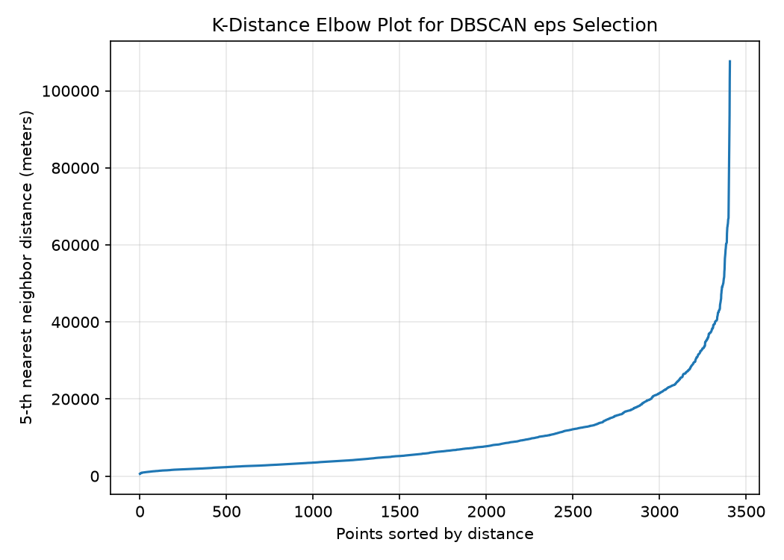
METHOD
Choosing eps with the k-distance elbow
Reading the plot
Distance to each point's 5th nearest neighbour, in metres.
Clear inflection point justifies the neighbourhood radius.
Chosen: eps = 5 km, min_samples = 5.
6

Slide 7
RESULTS
Results: 63 hotspots, 3 statistically anomalous
63
1,709
3
hotspot clusters
noise points (isolated crashes)
anomalous hotspots
Cluster | Likely area | Accidents | Fatalities
0 | Houston metro | 374 | 391
3 | Dallas–Fort Worth metro | 330 | 365
2 | San Antonio metro | 185 | 201
They match Texas's three largest metros: anomalous means a statistical outlier in scale versus the other 60 hotspots, not an unexpected location.
7

Slide 8
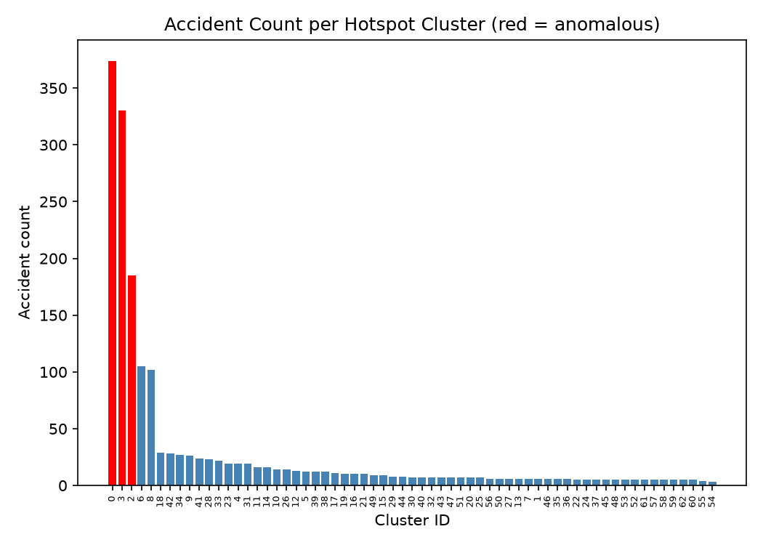
RESULTS
Hotspot map and cluster sizes
8

Slide 9
EXTENSION
Extension: covering every course outcome
Same cleaned data + cluster labels → predict whether a crash is multi-fatality (FATALS ≥ 2).
CO1
CO2
CO3
End-to-end ML lifecycle
Linear learning
Tree-based models
data → features → train → evaluate → deploy → monitor
Logistic Regression; C swept 0.01–100 for bias-variance
Decision Tree + Random Forest; HOUR, DAY_WEEK most important
CO4
CO5
CO6
Clustering
Evaluation & tuning
ML engineering
DBSCAN hotspots + z-score anomaly flagging
70/15/15 stratified split, 5-fold CV, GridSearchCV
shared features, joblib + Flask API, drift check
9

Slide 10
EVALUATION
Model comparison on the held-out test set
Takeaways
Tuned Random Forest selected on ROC-AUC (0.669); accuracy 0.692.
All models beat random (ROC-AUC 0.5, PR-AUC ≈ 0.083).
Absolute scores are modest: weather, time and location alone are limited predictors of a rare, severity-driven outcome.
10

Slide 11
ML ENGINEERING
From notebook to service: packaging and monitoring
Shared features
Package + REST API
Drift monitoring
One compute_features() at train and serve time prevents train/serve skew.
Model, scaler and feature list saved with joblib; Flask /predict endpoint.
Feature means vs training in σ units; flag > 2σ. Test batch max shift 0.082 — no drift.
Traced request: lat 29.80, lon −95.40, clear weather, dark, urban, 22:00, Friday → assigned to hotspot #0 (Houston) → Random Forest probability below the 0.5 threshold → "single-fatality risk".
11

Slide 12
CONCLUSION
DBSCAN finds hotspots without knowing how many exist.
Recovered Texas's three major metro accident concentrations and separated 1,709 isolated crashes as noise.
Z-scores surface statistically unusual hotspots by frequency and severity.
Extension delivers a deployable multi-fatality risk model covering CO1–CO6.
Next: richer features (road type, speed, traffic volume) to lift predictive performance.
Thank you · Questions?

