Slide 1
SOFT COMPUTING · CASE STUDY
GAAPO: a replication audit
and an adaptive operator-selection extension
Reproducing, correcting and stress-testing a genetic algorithm for automatic prompt optimisation
Bhargav · 27 October 2026
qwen2.5:7b optimiser · qwen2.5:3b target · ETHOS multilabel, 433 rows
Notes:
One sentence to open: I reproduced a 2025 paper on evolving prompts with a genetic algorithm, found that its published notebook measures something different from what it claims, fixed it, and then tested the one part of the method the paper never justifies — how the search budget is split between its five operators.

Slide 2
THE ALGORITHM
The paper evolves a prompt, not a model
Population: a set of prompt strings, scored by the target model on a validation split.
Each generation: the best prompts become parents; five operators breed the next set.
Selection: highest validation accuracy survives.
The gap: budget split 40/20/20/10/10 across operators, with no derivation.
Operator | Share | What it does
Random mutation | 40 % | eight hand-written edits
APO / ProTeGi | 20 % | rewrite from the errors made
OPRO | 20 % | learn from best-prompt history
Few-shot | 10 % | append 1–3 labelled examples
Crossover | 10 % | splice two prompts at the midpoint
Two claims to test: it works, and those five weights are the right ones.
GAAPO: replication audit and adaptive operator selection
2
Notes:
Framing: this is a search problem with five neighbourhood operators, so the natural questions for a soft-computing course are operator selection and fitness evaluation. Both turn out to matter.

Slide 3
WHAT THIS STUDY DOES
Three things: audit, ablate, extend
1 Audit
2 Ablate
3 Extend
Re-implement the method from the paper and check it against the published notebook. 24 defects corrected.
First leave-one-out test of the five operators: remove one at a time, three paired repeats.
Replace the fixed 40/20/20/10/10 weights with a controller that learns the allocation from credit.
6 of them change what is measured, not how fast it runs.
Random mutation carries the method; OPRO is unresolved.
Compared against the paper, uniform and random allocation.
≈ 14 hours of local compute, no API cost, no cluster.
GAAPO: replication audit and adaptive operator selection
3
Notes:
The structure of the talk follows these three blocks. The audit is what makes the numbers trustworthy; the ablation says which parts matter; the extension tests the one thing the paper leaves unjustified.

Slide 4
1 · AUDIT
The published notebook does not measure what the paper describes
Duplicates merged, then double-counted. One row reached n = 300 on a 50-example validation set.
Baseline scored on 10 examples, candidates on 50. The published “0.00 → 0.32” compares two different test sets.
“Successive halving” ranked on a cumulative mean and returned that mean as the score.
The bandit rule was not UCB-E, and recycled examples as if they were new evidence.
Generated prompts were never validated. The stored “best prompt” had lost one of the eight labels.
The ablation leaked. APO, OPRO and crossover fell back to the mutation operator, so “without mutation” could still mutate.
24
defects corrected in the corrected notebook
6
of them change what is measured, not only speed
Plus: no RNG control anywhere, one unseeded repeat per ablation arm, ablated arms never scored on test.
GAAPO: replication audit and adaptive operator selection
4
Notes:
Do not read out all 24. The point is that six of them change what is measured, so the published numbers cannot be compared with a corrected run — only the structure of the claims can. That is why the report never claims a reproduction of their tables.

Slide 5
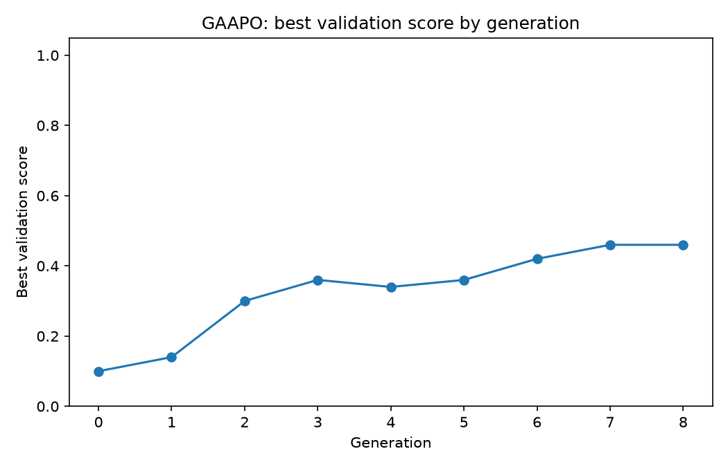
2 · THE RUN
Corrected, the method works — but the gap to test is large
 | Validation (n = 50) | Test (n = 200)
Seed prompt | 0.100 | 0.090
Best evolved prompt | 0.460 | 0.240
Delta | +0.360 | +0.150
Qualitative claim survives: the evolved prompt nearly triples test accuracy.
Quantitative claim does not: validation overstates held-out by 22 points.
Why: the best of 102 candidates ranked on 50 examples is a biased maximum.
GAAPO: replication audit and adaptive operator selection
5
Notes:
This table is the honest version of the paper's headline. The method does improve the prompt — 0.09 to 0.24 on held-out data is real. What does not survive is the size of the improvement they report.

Slide 6
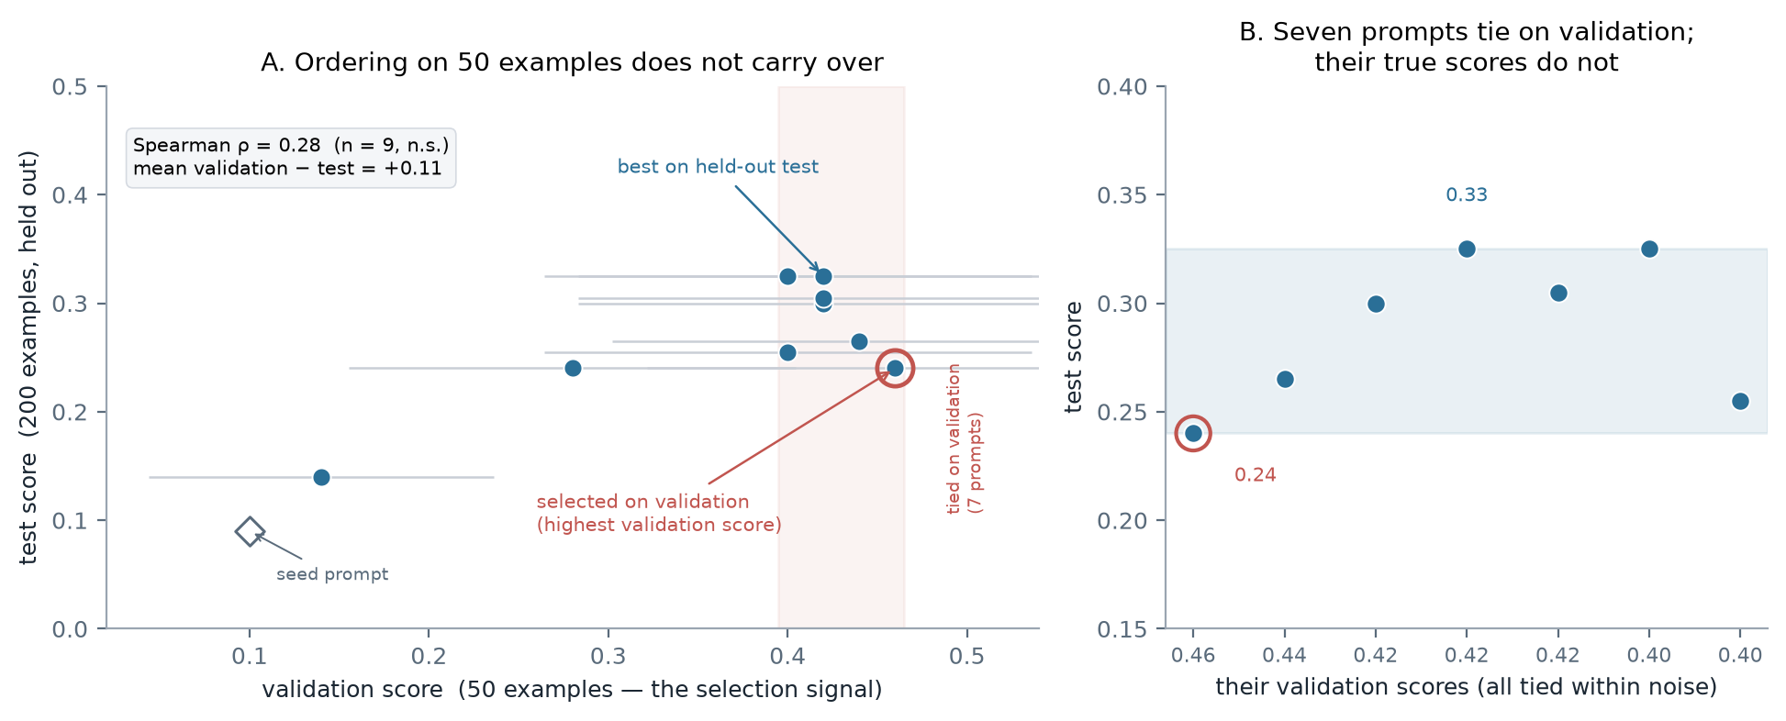
2 · THE MEASUREMENT
Where the choice is made, the signal carries no ordering
ρ = 0.28 (n = 9, not significant)
7 prompts tie with the leader on validation.
Their true scores span 0.24–0.33 — eight points.
The prompt validation picks is 7th of 9 on test.
Post-hoc: nine prompts already generated were re-scored on the held-out set.
GAAPO: replication audit and adaptive operator selection
6
Notes:
This is the slide I would spend the most time on. It is post-hoc and labelled as such. At the coarse scale the signal works — the worst prompt on validation is the worst on test. But among the seven prompts that are statistically tied at the top, the true score ranges from 0.24 to 0.33, and the one validation picks is seventh of nine. So the search is not blind; the ranking it uses to choose is.

Slide 7
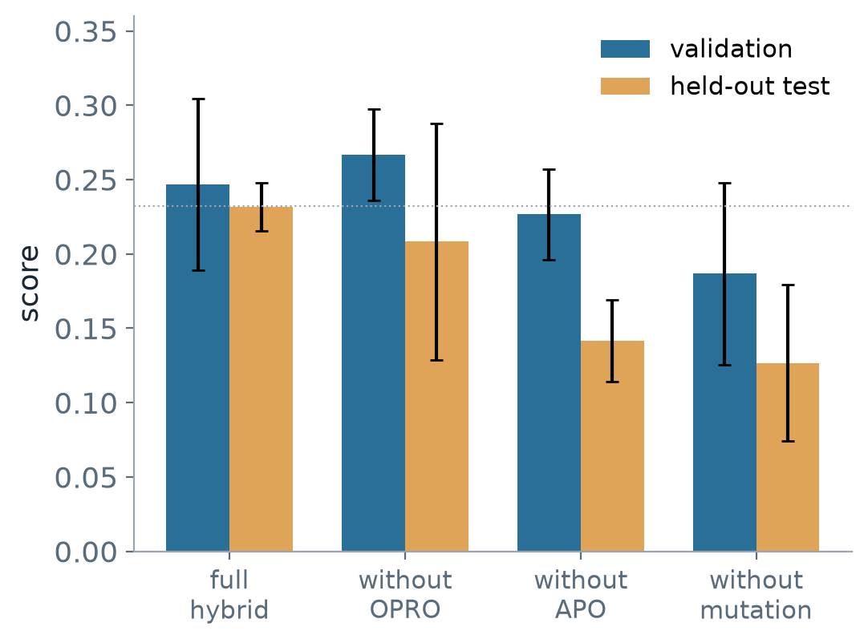
3 · ABLATION
Which operators actually carry the method?
Configuration | Best validation | Held-out test | Δ test
full hybrid | 0.247 ± 0.058 | 0.232 ± 0.016 | —
without OPRO | 0.267 ± 0.031 | 0.208 ± 0.079 | −0.023
without APO | 0.227 ± 0.031 | 0.142 ± 0.028 | −0.090
without mutation | 0.187 ± 0.061 | 0.127 ± 0.053 | −0.105
Mutation is load-bearing. Removing it costs 10.5 test points, significant in 2 of 3 repeats.
APO helps, evidence thinner. Same sign in 3/3, significant in 1/3 after correction.
OPRO is unresolved. The ablated arm had the best validation score and a worse test score.
GAAPO: replication audit and adaptive operator selection
7
Notes:
The paper has no leave-one-out ablation. This is the first one. The headline is that the 40 % operator is doing real work — and the caution is that the arm with the best validation score was worse on test, which is the same measurement problem again.

Slide 8
4 · EXTENSION
The extension: learn the allocation instead of fixing it
Credit. After each generation, score every child by its improvement over its best parent.
Smooth. Exponential average per operator, because the search is non-stationary.
Select. Softmax over credit, with a 10 % exploration floor and a one-slot minimum.
Test it against controls. The paper's weights, uniform, and a random allocation redrawn every generation — that last one rules out “any variation helps”.
Arm | Question it answers
fixed | does the paper's default hold up?
uniform | is the prior doing any work?
random | is a gain just extra noise?
adaptive | does learning the allocation help?
Twelve runs · population 10 × 6 generations · three paired seeds · identical call budget
Hypotheses fixed before looking at the results.
GAAPO: replication audit and adaptive operator selection
8
Notes:
Two points to make. First, the random-allocation control is the one that makes the result interpretable. Second, hypotheses were pre-registered, which is why the negative result is still a result.

Slide 9
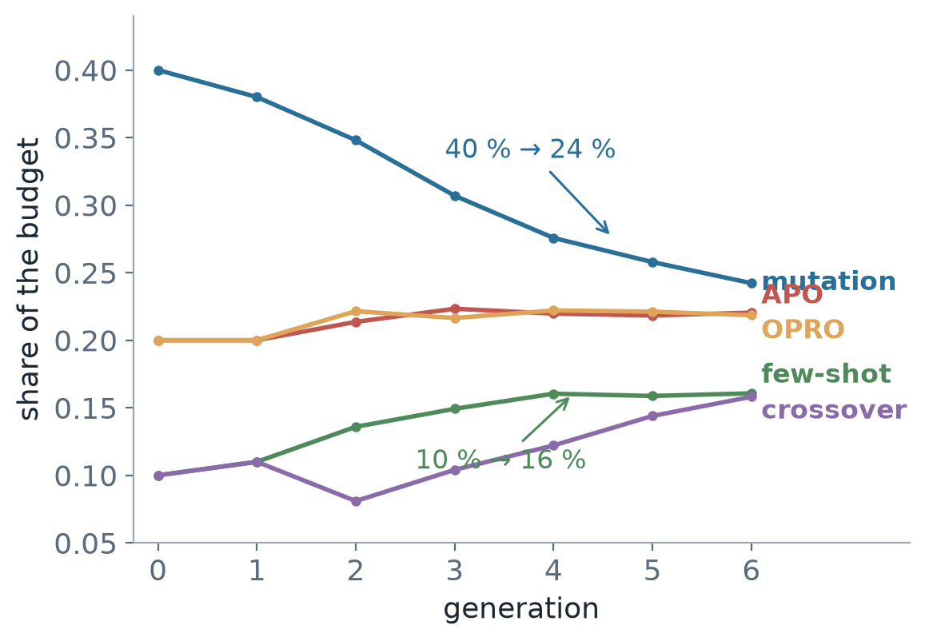
5 · RESULT
The controller does not beat the fixed weights
Arm | Best validation | Held-out test | Weight entropy
fixed (paper) | 0.347 ± 0.042 | 0.292 ± 0.028 | 0.914
adaptive | 0.347 ± 0.042 | 0.293 ± 0.049 | 0.963
uniform | 0.333 ± 0.042 | 0.262 ± 0.043 | 1.000
random | 0.327 ± 0.031 | 0.228 ± 0.051 | 0.776
Adaptive − fixed: +0.002. The sign flips between repeats; no p-value survives correction.
But the controls speak. Both prior-based arms beat random allocation by 6–7 points, consistently in sign. The 40/20/20/10/10 vector is not arbitrary.
And the response surface is flat. Two very different allocations perform identically.
GAAPO: replication audit and adaptive operator selection
9
Notes:
Lead with the null: no detectable difference. Then the useful part — the controls show the paper's weights encode something real, because random allocation is measurably worse. Flat response surface explains why two very different allocations tie.

Slide 10
5 · DIAGNOSIS
It failed for an identifiable reason, not a mysterious one
Credit arrives in ±0.2. One or two children per operator per generation, on 50 examples.
The controller could express a 1.5 : 1 odds ratio at most. Temperature 0.5 against that credit spread; a 20 % operator could reach 27 % at best.
So it drifted toward uniform while the credits said the opposite: few-shot had the worst credit every generation and still gained weight.
The fix is arithmetic, not conceptual. Match the temperature to the credit scale, use rank-based credit, and give it a longer horizon.
±0.2
spread of observed credit
0.5
temperature it was divided by
The credit was noisy. The controller was also built so it could not use what signal there was.
GAAPO: replication audit and adaptive operator selection
10
Notes:
This is the slide that turns a null result into a contribution. The failure is mechanical and demonstrated by reconstructing the controller's internal state from the logs — not asserted. Section 4.1 adds the second half: even with the arithmetic fixed, the credit it was learning from comes from a validation ranking that does not survive a change of examples.

Slide 11
DISCUSSION
What the study establishes
The method works.
A 0.09 → 0.24 held-out gain, with the operators demonstrably doing different amounts of work.
The paper's precision does not.
A 22-point optimism, no derivation for the weights, a headline that mixes evaluation sets.
The weights are a reasonable prior.
Better than random, but not an optimum — the response surface is flat.
Measurement, not operators, is the bottleneck.
At this scale the selection signal is too noisy to learn from.
GAAPO: replication audit and adaptive operator selection
11
Notes:
Four sentences, in order of confidence. The last one is the one I would carry into a follow-up: spend the budget on measuring the candidates, not on smarter operators.

Slide 12
HONESTY
Limitations, and what I would run next
Small models. qwen2.5:7b writing prompts for qwen2.5:3b — far below the paper's 70B-class optimiser, so rankings may not transfer.
Few observations. Three seeds per arm; the same configuration varied by six points between sessions.
One dataset, one task. Multi-label hate-speech classification only; prompt optimisation helps most where the base prompt is weak.
Not run. The paper's selection-method comparison (bandit vs halving); it is implemented in the notebook and disclosed as unfinished.
Next, in order
1 Bigger validation set
2 Selection that accounts for noise
3 Re-run the controller with matched temperature
GAAPO: replication audit and adaptive operator selection
12
Notes:
Be explicit that the negative result is a statement about this scale. The one thing I would do with more compute is the second item: selection under noise, not more operators.

Slide 13
Thank you
Questions, and the parts I got wrong.
Code, logs and per-example predictions: GAAPO_improved.ipynb, run_sweep.py, run_adaptive.py, run_probe.py
Notes:
Invite the obvious challenge: 'why should I believe a null result from three seeds?' Answer: I do not claim equivalence, only that any effect is smaller than the design can see — and the report gives the interval that quantifies exactly how small.

