Slide 1
Cats and Dogs Object Detection (CaDoD)
Group 30 – PHASE 2

Slide 2


Group 30 - Team

Slide 3
Presentation Outline
Work done previously - Phase 1
Goal - Phase 2
Data Pre-processing
Homegrown Logistic and Linear Regression
Data Preparation for Pytorch Object Detector Models
MLP for Image Classification
MLP for Regression
Multiheaded Cat Dog Detector using OOP API
Experiments Conducted
Problems Faced
Conclusion
Phase 3 Goals

Slide 4
Work done previously
SECTION 1

Slide 5
Work done in previous phase (Phase 1)
Data Pre-processing and EDA
SKLearn Baseline models for Logistic Regression
SGD classifier
Grid Search Comparison between different Classifiers
SKLearn Baseline models for Linear Regression
Grid Search Comparison between different Regressors
Homegrown logistic regression

Slide 6
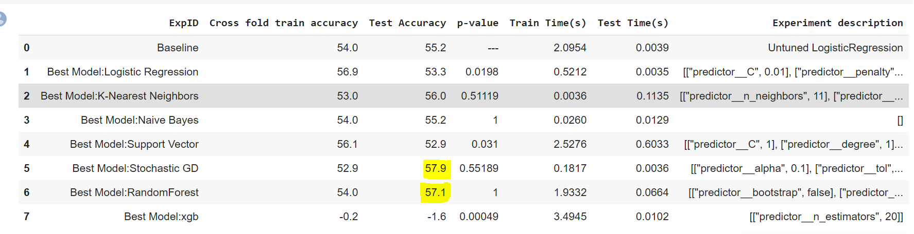
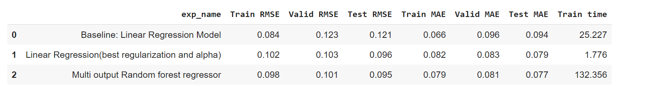
Baseline Classification and Models
Baseline Linear Regression and Models

Slide 7
Project Goal
SECTION 2

Slide 8
Work accomplished in Phase 2
Built a homegrown Linear and logistic regression model for the cat dog detector and complex multitask loss function.
Built a PyTorch model for image classification and regression using multilayer perceptron (MLP)
Built a multi-headed cat-dog detector using the OOP API in PyTorch with a combined loss function: CXE + MSE.
Built a baseline pipeline in PyTorch to do object classification and object localization.

Slide 9
Project Description
SECTION 3

Slide 10
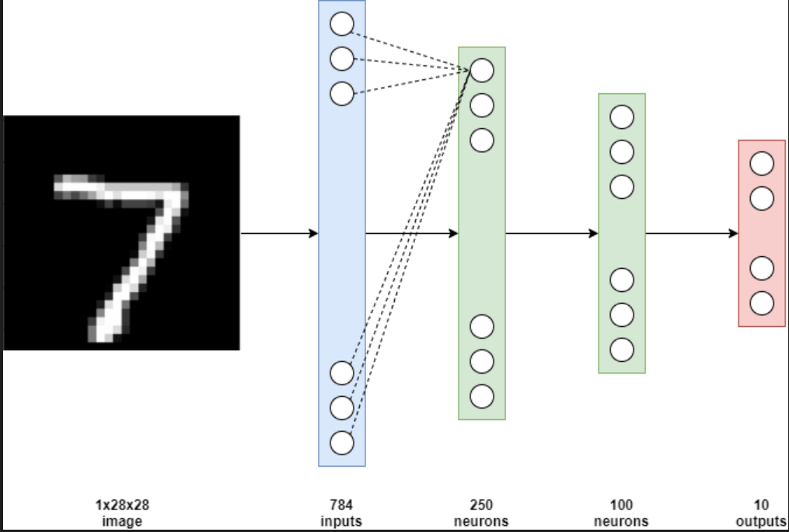

Implementing Neural Network
Using Pytorch
2 (Classification) , 4 (Regression) Outputs
1x32x32
Image
Input layer - 3072
Hidden layer - 250
Hidden layer - 100

Slide 11
Goal: To develop an end-to-end Cats v Dogs Object Detector using PyTorch.
Dataset exploration:13,000 images of varying shapes and aspect ratios. They are all RGB images with bounding box coordinates in a .csv file.
Pre-processing: We have performed scaling of images, reshaping and normalization of images.
Model: Implemented MLP models for Image Classification and Regression which define our baseline pipeline models, Multiheaded Cat and Dog Detector using OOP API and conducted different experiments by changing the number of hidden layers, learning rate, epochs and other parameters.

Slide 12
Baseline Pipeline Models: MLP Image Classification and Regression
SECTION 4

Slide 13
MLP Image Classification without Drop out
Using the OOP API of PyTorch, we created a class MLP with 2 hidden layers with relu activation.
We convert the scaled and normalized input image arrays to tensors and pass it into the input layer of our MLP.
The output layer will have 2 nodes to retrieve the classification results. The loss used here is the CXE loss based on which the weights are updated.
With this method, we obtained 55.9% accuracy as seen in the results slide.
MLP Image Classification with Drop out
Using the approach discussed above, we introduced dropout into the picture with a rate of 0.5.
We also created a pipeline for this model and ran it through GridSearchCV to perform hyperparameter tuning.
We made use of NeuralNetClassifier which helped resolve the problem of incompatibility of Dataloader with GridSearchCV.
With this NeuralNetClassifier over our designed MLP, we obtained a classification accuracy of 54.2%.

Slide 14
MLP Linear Regression Without Drop out
In order to explore more about PyTorch, we experimented with the Sequential package to build the MLP neural net for regression.
Here we used MSE loss as requested based on which the weights were updated.
The input dimensions are same as that as the previous models but the output dimension for this regression is 4.
We obtained a MSE loss of 0.954.
MLP Linear Regression With Drop out
Using the OOP API of Pytorch we defined a pipeline for a MLP to perform regression to predict the bounding box values.
After running GridSearchCV, we obtained a MSE of 0.5429 with a droupout rate of 0.5 introduced into the network.

Slide 15
Multi Head Cat Dog Detector Using pytorch OOP API
SECTION 5

Slide 16
Multi Head Cat Dog Detector Using Pytorch OOP API
In order to design a multiheaded cat-dog detector, we altered our existing MLP to have two output layers of different dimensions.
One output layer of 2 dimensions that will give us a result for classification.
The other output layer has a dimension of 4 that will give us the values of bounding box through regression.
We calculate the CXE and MSE separately and add it together to send it through backward inbuilt function to update the weights.
This in turn makes our MLP neural net learn the weights for both classification as well as regression.

Slide 17
Experiment Results and Analysis
SECTION 6

Slide 18
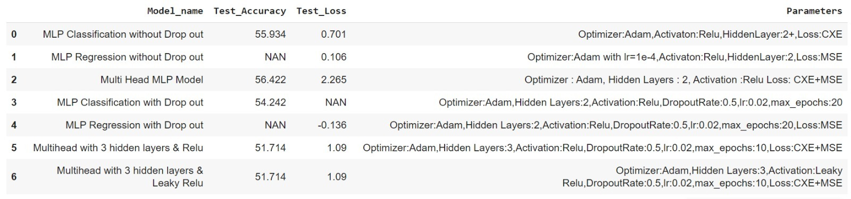
Overall Results from Experiments
As seen in the data frame below, drop out worked wonders for MLP regression by reducing the loss.
For classification, drop out did not really make much of a difference to our MLPs.
Introducing additional layers reduced the accuracy in but also reduced the MSE+CXE loss in multi-headed.
Using relu and leakyrelu did not make a difference in results.
Respective best parameters can be seen for MLP models with drop out.
52.56% classification accuracy and 47.53 MSE loss was obtained in the combined Homegrown Logistic regression model that does classification and regression at the same time.
48.55 MSE loss was obtained in homegrown linear regression.

Slide 19
Challenges
SECTION 7

Slide 20
Problems Faced/ Challenges
In homegrown method to implement both classification and regression at the same time, we had to come up with a way to use the same object class and functions for both. We solved this by debugging the fact that logistic regression with unnormalized distances is the same as linear regression making it easy to implement both classification and regression at the same time.
A major problem we faced while designing our MLP was to alter our dataset in order for it to fit into the input layer of the MLP. This was resolved after we converted the data to float32 tensors.
While creating the pipeline for MLPs respectively for regression and classification, we were unable to combine it with gridsearchCV due to its incompatibility with the Dataloader. This was resolved by using NeuralNetClassifier and NeuralNetRegressor which uses SliceDataset instead of Dataloader to iterate over our data. It was also easier to give parameters such as learning rate, batch size etc.
Due to a sampling bias present in our split dataset, the testing accuracy was at times higher than the training accuracy.
In certain areas, data leakage was noticed. We avoided this by normalizing and scaling the training and testing data separately and not together.

Slide 21
Conclusion
SECTION 8

Slide 22
CONCLUSION
In phase 1, we have focused on the SKLearn Baseline models for Logistic Regression, SGDClassifier to classify the images into cats and dogs and Linear Regression for marking the bounding boxes around the cats and dogs inside the image.
We have also implemented the Homegrown Logistic Regression and Homegrown Linear Regression to compare the results.
In phase 2, we re-showcase the homegrown implementation of logistic regression to do both classification and regression at the same time.
Adding on, we built 2 MLPs each for classification and regression with and without drop out exploring both Sequential as well as OOP API of PyTorch.
A multi-headed MLP was also implemented with 2 different outputs from the same neural net one for each of classification and regression trained with one set of weights using a combined loss of CXE+MSE.
Multiple experiments were conducted with respect to number of hidden layers, drop out, learning rate, number of epochs etc and the results were tabulated.

Slide 23
Future Plan
SECTION 8

Slide 24
Plan for future
Do transfer learning for object detection and fine-tuning using EfficientDet (D0-D7) for Cats and Dogs detection
Transform the cats' and dogs' training data (primarily the annotations data) so that EfficientDet can use them.
Do transfer learning and fine-tune the head of the network.
Summarize the architecture and loss functions of EfficientDet
Highlight the differences between EfficientDet D0 and EfficientDet D7
Build a fully convolutional neural network network (FCN) for a single object classifier and detector.
Implement Fully Convolutional Neural Network (FCN) model using OOP API
Implement a model that has two heads with output feature maps
1x1x
2x2x
Report and short video presentation (2-minute video presentation; 300 words)
Post your presentation (video and slides) on the Canvas discussion board

