Slide 1


CONTEXT-AWARE HYBRID CRYPTOGRAPHY WITH ADAPTIVE BIOMETRIC SECURITY FOR DYNAMIC FILE STORAGE ENVIRONMENTS
PROJECT STUDENTS GUIDE
SANJU S 41111120 DR. A .MOHANAPRIYA, M.E., PH.D. SANTHOSH G 41111127 Asst Professor, CSE

Slide 2
AGENDA
Abstract
Objective(s)
Literature Survey
Inferences from Literature Survey
Proposed System
System Architecture
Conclusion
References

Slide 3
ABSTRACT
The secure file transmission system integrates biometric fingerprint verification with advanced encryption methods. It generates ECC key pairs for secure key exchange, uses ChaCha20 for symmetric encryption, and applies BLAKE2b for file integrity checks. The process involves creating and managing encryption keys, generating nonces, encrypting and decrypting files, and verifying data integrity. Encrypted files, keys, nonces, and hashes are securely stored on the server. Upon client request, files are decrypted, and their integrity is verified against stored hashes before being returned, ensuring secure and tamper-proof file transmission.

Slide 4
OBJECTIVE(S)
The objective of this project is to develop a file storage system that integrates context-aware hybrid cryptography with adaptive biometric security to dynamically adjust its protection measures based on real-time user context. This involves designing a hybrid cryptographic framework that adapts encryption parameters according to factors such as file sensitivity, user location, and device status, alongside creating an adaptive biometric authentication system that modifies authentication requirements based on context. The project aims to implement context-based access control for enhanced security, balance usability with robust protection, and ensure reliable performance through comprehensive testing. Additionally, it includes developing deployment strategies and detailed documentation to facilitate practical implementation and user training.

Slide 5
LITERATURE SURVEY
REFERENCE NO/PUBLICATION | AUTHORS | TITLE OFPAPER | OBJECTIVE | METHODS | LIMITATIONS
2024 5th International Seminar on Artificial Intelligence, Networking and Information Technology (AINIT), Nanjing, China, 2024, pp. 1186-1189, doi: 10.1109/AINIT61980.2024.10581534. | H. Liu and Z. Chen. | Optimizing Shared File Access in Distributed Parallel File System. | The primary objective of this project is to improve I/O performance in distributed parallel file systems, particularly in high-performance computing (HPC) environments, by addressing the issue of poor performance under high contention. | Proposed a new locking mechanism that operates with byte-range granularity, as opposed to broader lock ranges, to reduce false lock conflicts and improve efficiency. | The experiments were conducted on a 4-node cluster, which may not fully represent the performance characteristics in larger or more diverse HPC environments.
2023 IEEE International Conference on Artificial Intelligence, Blockchain, and Internet of Things (AIBThings), Mount Pleasant, MI, USA, 2023, pp. 1-5, doi: 10.1109/AIBThings58340.2023.10292453. | K. Ahmadi, M. Esmaili and S. Khorsandi. | A P2P File Sharing Market Based on Blockchain and IPFS with Dispute Resolution Mechanism. | The objective of this work is to develop a decentralized and secure online merchandising platform that addresses the key challenges associated with traditional centralized online markets, leveraging Web3.0 and blockchain technologies. | Ethereum Blockchain: Utilized Ethereum blockchain for executing smart contracts, ensuring secure and immutable transaction records. | Smart contracts are susceptible to coding errors and vulnerabilities.

Slide 6
REFERENCE NUMBER/PUBLICATION | AUTHORS | TITLE OF PAPER | OBJECTIVE | METHODS | LIMITATION
2023 IEEE International Conference on Blockchain and Distributed Systems Security (ICBDS), New Raipur, India, 2023, pp. 1-6, doi: 10.1109/ICBDS58040.2023.10346324. | S. Khandagale, M. Naikar, S. Shaikh, V. Jadhav and A. Boyanapalli. | SECURELY - A Golang CLI Tool for Secure File Sharing with Shamir's Secret Sharing Scheme. | The primary objective of this paper is to develop a secure and confidential file-sharing system using Shamir's Secret Sharing technique to enhance data protection and privacy. | AES-256 Encryption: Files are encrypted using AES-256, a strong symmetric encryption algorithm, to secure the data. | The distribution of shares needs to be managed carefully to ensure that they are securely transferred and stored, avoiding potential loss or theft.
2023 IEEE 13th International Conference on CYBER Technology in Automation, Control, and Intelligent Systems (CYBER), Qinhuangdao, China, 2023, pp. 1235-1240, doi: 10.1109/CYBER59472.2023.10256639. | D. Zhan, X. Lin, W. Wang, X. Gan and S. Bi. | A Design of File Sharing System. | The primary objectives of this paper are to design and implement a file-sharing system called Cloud Folder that addresses common shortcomings in existing cloud storage solutions and provides an efficient, user-friendly file-sharing experience. | design and implement key features of the file-sharing system, including user file uploads, access controls, and file management. | Allowing users to upload files to cloud storage raises security and privacy concerns, including potential malicious file uploads and unauthorized access.

Slide 7
REFERENCE NUMBER/PUBLICATION | AUTHORS | TITLE OF PAPER | OBJECTIVE | METHODS | LIMITATIONS
2023 International Conference on Advancement in Computation & Computer Technologies (InCACCT), Gharuan, India, 2023, pp. 773-777, doi: 10.1109/InCACCT57535.2023.10141817. | J. Anthal, S. Choudhary and R. Shettiyar. | Decentralizing File Sharing: The Potential of Blockchain and IPFS. | The objective of this research paper is to explore the potential of combining blockchain technology and the Interplanetary File System (IPFS) to address the challenges associated with traditional centralized file-sharing methods. | Security and Privacy Assessment: Evaluated the security and privacy features of blockchain and IPFS-based systems compared to traditional file-sharing methods. | Legal Compliance: Ensuring compliance with data protection regulations and legal requirements in decentralized file-sharing systems can be complex.
2021 5th International Conference on Electrical Information and Communication Technology (EICT), Khulna, Bangladesh, 2021, pp. 1-5, doi: 10.1109/EICT54103.2021.9733608. | M. N. Uddin, A. H. M. A. Hasnat, S. Nasrin, M. S. Alam and M. A. Yousuf. | "Secure File Sharing System Using Blockchain, IPFS and PKI Technologies. | Implement a secure and decentralized file-sharing environment that leverages blockchain technology, the Interplanetary File System (IPFS), and Public Key Infrastructure (PKI) to address key issues associated with centralized systems, such as security, trust, immutability, and transparency. | Smart Contracts: Developed and deployed smart contracts on the Ethereum blockchain to control access privileges and enforce predefined access-control lists. | The performance of IPFS can be affected by network latency and availability, impacting file access speeds.

Slide 8
REFERENCE NUMBER/PUBLICATION | AUTHORS/PUBLICATION | TITLE OF PAPER | OBJECTIVE | METHODS | LIMITATIONS
2020 IEEE Infrastructure Conference, San Francisco, CA, USA, 2020, pp. 1-4, doi: 10.1109/IEEECONF47748.2020.9377623. | C. M. Wolff and J. Gouger. | Share File Updating for Test Farms Using a File Cache. | The primary objective of this project is to develop and implement a file cache system to efficiently handle concurrent updates to a shared file by multiple parallel tests running in a compute farm. | Lock Mechanism: Implemented a network file lock to control access to the shared file, preventing simultaneous updates that could cause data inconsistency. | Merge Overhead: The process of merging temporary files can introduce complexity and overhead, especially if there are many concurrent updates.
2016 12th International Conference on Computational Intelligence and Security (CIS), Wuxi, China, 2016, pp. 642-645, doi: 10.1109/CIS.2016.0155. | X. He, Y. Long and L. Zheng. | ‘A Transparent File Encryption Scheme Based on FUSE. | The objective of this project is to design and implement a transparent file encryption system based on FUSE (File System in User Space) that addresses the inefficiencies of traditional file encryption systems. | File System in User Space (FUSE): Utilized FUSE to implement the file encryption system in user space, which allows for custom file system operations without modifying the kernel. | User Space Processing: Operating in user space may introduce performance overheads compared to kernel-based file systems, potentially affecting the speed of file operations.

Slide 9
REFERENCE NUMBER/PUBLICATION | AUTHORS | TITLE OF PAPER | OBJECTIVE | METHODS | LIMITATIONS
2012 International Conference on Computing, Electronics and Electrical Technologies (ICCEET), Nagercoil, India, 2012, pp. 948-952, doi: 10.1109/ICCEET.2012.6203898. | P. Golda Jeyasheeli and L. Rajashree. | Cost effective file replication in P2P file sharing systems. | The main objective of this paper is to develop and evaluate an efficient file replication algorithm for peer-to-peer file-sharing systems to address the challenges of file overload and high query costs. | Hot Spot Selection: Identify hot spots (i.e., nodes with high request rates) as potential candidates for file replication. | The dynamic adaptation to non-uniform and time-varying file popularity adds complexity to the replication algorithm, which may require sophisticated mechanisms to implement and manage effectively.
2012 IEEE International Conference on Computational Intelligence and Computing Research, Coimbatore, India, 2012, pp. 1-4, doi: 10.1109/ICCIC.2012.6510207. | S. Malgaonkar, S. Surve and T. Hirave. | Distributed files sharing management: A file sharing application using distributed computing concepts. | The objective of this project is to design and implement a distributed file sharing application that provides users with a seamless and efficient way to share and access files remotely, leveraging the concepts of distributed computing. | Distributed Architecture: Implemented a distributed file system where files are stored across multiple nodes in a network. | Distributed systems may be more vulnerable to security risks such as unauthorized access and data breaches if not properly secured.

Slide 10
INFERENCES ON SURVEY (Existing Systems)
Decentralized and Secure Online Merchandising Platform
- Add blockchain to make the marketplace more secure and transparent.
- Enhance security measures for protecting users and transactions.
Distributed File Sharing Application
- Create a system for sharing files across multiple nodes.
- Enhance file access speed and reliability for remote users.
- Streamline the file-sharing process.
Secure and Decentralized File-Sharing Environment
- Merge blockchain and IPFS for secure and decentralized file sharing.
- Apply PKI for encrypted file sharing.
- Make file transactions clear to users.

Slide 11
Privacy and Security in P2P File Sharing
- Enhance privacy in peer-to-peer file sharing systems.
- Develop security features for decentralized file sharing.
- Comply with data protection regulations.
Improving I/O Performance in Distributed Systems
- Improve input/output performance in distributed file systems.
- Solve performance problems caused by high contention.
- Improve performance in high-performance computing environments.
Secure and Confidential File-Sharing Using Shamir's Secret Sharing
- Use Shamir's Secret Sharing for secure file sharing.
- Enhance data protection using Shamir’s technique.
- Develop a confidential file-sharing system.
Efficient File Replication Algorithm
- Develop an efficient file replication algorithm.
- Solve problems with file overload and high query costs.
- Optimize file replication in peer-to-peer networks.

Slide 12
Proposed system
Biometric fingerprint verification
Generate ECC Key Pair: Creates the private and public key pair for key exchange.
Perform ECDH Key Exchange: Uses the public and private keys to generate a shared secret.
Generate Symmetric Key: Creates a symmetric key using os.urandom(32).
Generate Nonce: Produces a unique nonce for encryption.
Encrypt File Data: Encrypts the file using ChaCha20 with the generated key and nonce.
Generate Hash: Computes the hash of the original file using BLAKE2b for integrity checking.
Store Data: Saves the encrypted file, symmetric key, nonce, and hash securely on the server.
Client Request: Handles a request to retrieve the file.
Decrypt File Data: Decrypts the file using ChaCha20 with the symmetric key and nonce.
Recompute Hash: Computes the hash of the decrypted file and compares it with the original hash.
Verify Integrity: Checks if the recomputed hash matches the stored hash.
Return Decrypted File: Returns the file if integrity is verified; otherwise, alerts if compromised.

Slide 13
PROPOSED SYSTEM
1. Elliptic Curve Cryptography (ECC) and Key Exchange
ECC Key Pair Generation: ECC is employed to generate a private and public key pair. The private key is kept secret, while the public key is shared with the other party.
ECDH Key Exchange: The Elliptic Curve Diffie-Hellman (ECDH) algorithm is used to securely generate a shared secret between parties. This shared secret is used for deriving symmetric keys, ensuring that even if the public key is intercepted, the shared secret remains secure due to the difficulty of solving the elliptic curve discrete logarithm problem.

Slide 14
PROPOSED SYSTEM
Symmetric Encryption with ChaCha20
ChaCha20 Stream Cipher: ChaCha20 is a modern, high-performance stream cipher used for encrypting data. It is designed to be secure and fast, making it suitable for both small and large data volumes.
Symmetric Key and Nonce: The symmetric key is generated using random(32), which provides a secure random 32-byte key. The nonce ensures that each encryption operation is unique, preventing the reuse of key-streams and avoiding potential cryptographic attacks.

Slide 15
PROPOSED SYSTEM
Hashing for Integrity Verification
BLAKE2b Hash Function: BLAKE2b is used to compute a cryptographic hash of the original file before encryption. This hash acts as a fingerprint of the file.
Integrity Check: After decryption, the system recalculates the hash of the decrypted file and compares it with the original hash. If the hashes match, the integrity of the file is confirmed, indicating that it has not been altered during transmission.

Slide 16
PROPOSED SYSTEM
File Handling
Secure File Storage: Encrypted files, symmetric keys, and nonces are securely stored on the server. This ensures that unauthorized access to sensitive data is prevented.
Decryption and Integrity Verification: Upon request, files are decrypted, and their integrity is verified using the previously computed hash before being returned to the user. This ensures that the file remains secure and unaltered.

Slide 17
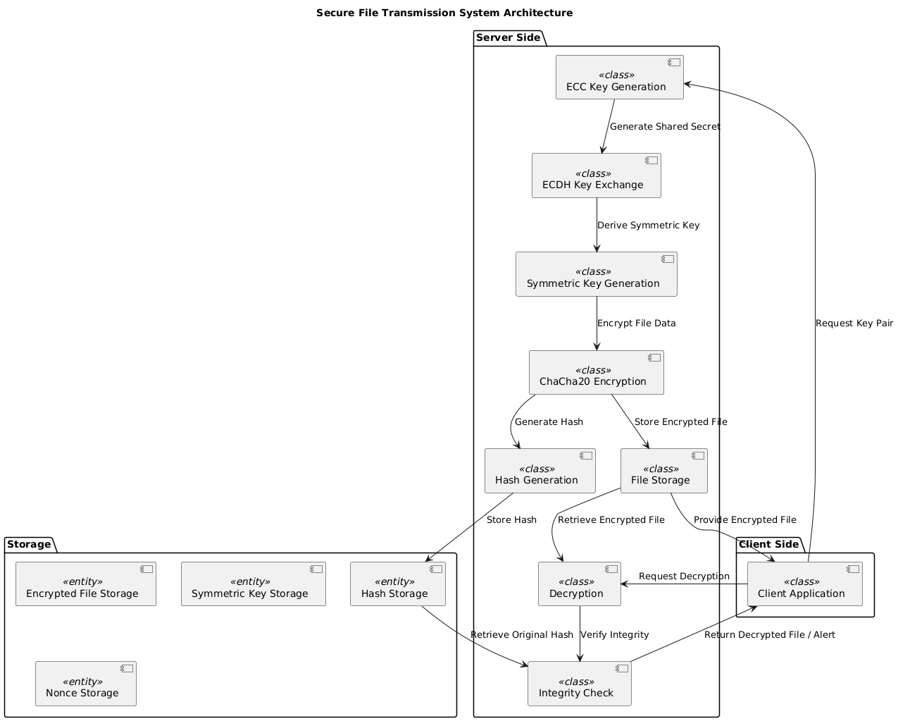
SYSTEM ARCHITECTURE

Slide 18
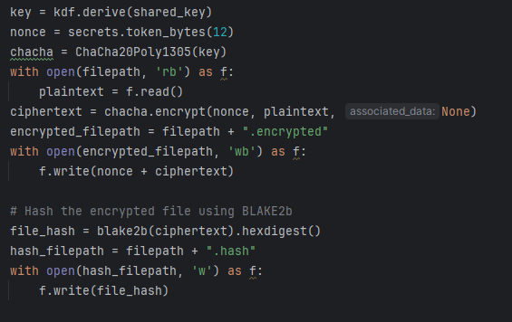
Modules
Key Derivation: A key is derived using HKDF based on the shared key for ChaCha20 encryption.
Nonce Generation: A random nonce (12 bytes) is generated for the ChaCha20 cipher.
File Encryption: The file at filepath is read, encrypted using ChaCha20 with the derived key and nonce, and saved with the .encrypted extension.
Hashing: The encrypted file content is hashed with BLAKE2b to ensure integrity. The hash is saved in a .hash file.

Slide 19
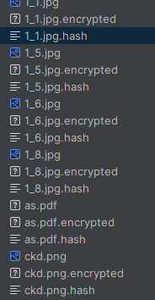
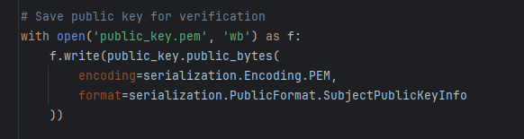
Public Key Storage: The public key is saved as public_key.pem in PEM format. This public key is intended to be shared openly or stored securely in a way that can be accessed by those who need to verify or encrypt messages to the owner of the corresponding private key

Slide 20
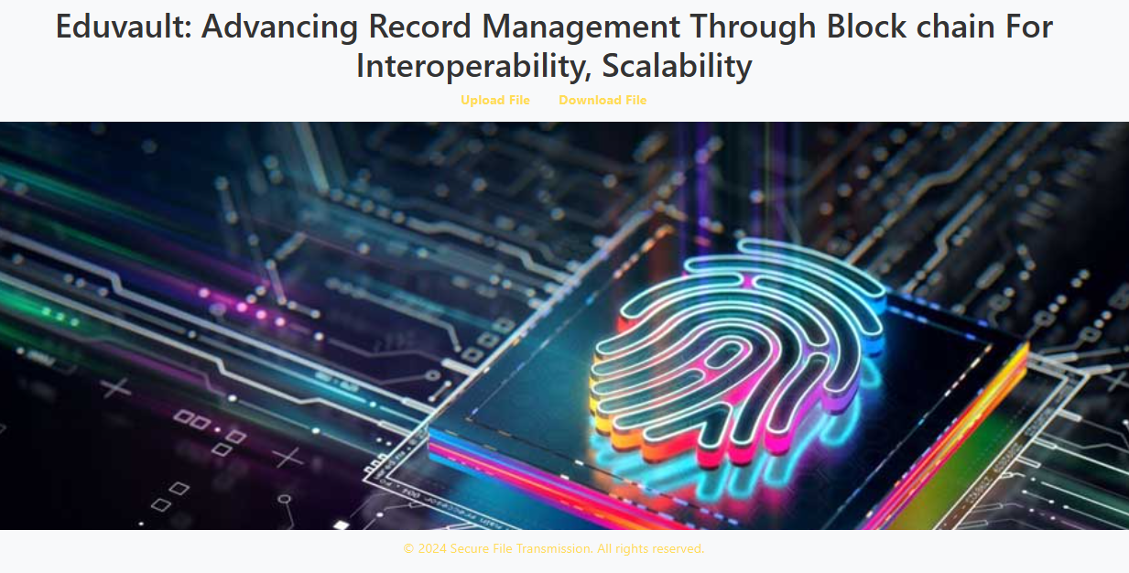

Slide 21
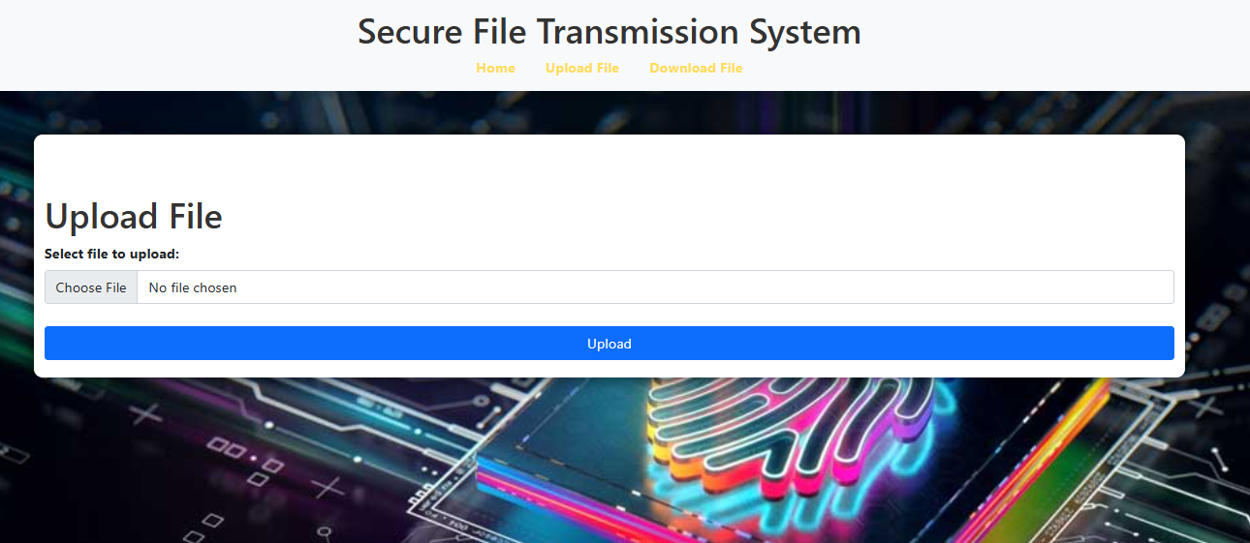

Slide 22
Upcoming
Biometric fingerprint module
Integration module
File handling

Slide 23
CONCLUSION
In conclusion, the secure file transmission system robustly safeguards data through a combination of advanced cryptographic techniques and biometric verification.
By utilizing ECC for secure key exchange, ChaCha20 for encryption, and BLAKE2b for integrity checks, the system ensures that files are encrypted, securely stored, and protected against tampering.
The meticulous process of generating and managing encryption keys, nonces, and hashes, along with rigorous integrity verification, guarantees that transmitted files remain confidential and intact.
This comprehensive approach provides a reliable framework for secure file handling and transmission.

Slide 24
REFERENCES
K. Ahmadi, M. Esmaili and S. Khorsandi, "A P2P File Sharing Market Based on Blockchain and IPFS with Dispute Resolution Mechanism," 2023 IEEE International Conference on Artificial Intelligence, Blockchain, and Internet of Things (AIBThings), Mount Pleasant, MI, USA, 2023, pp. 1-5, doi: 10.1109/AIBThings58340.2023.10292453.
S. Malgaonkar, S. Surve and T. Hirave, "Distributed files sharing management: A file sharing application using distributed computing concepts," 2012 IEEE International Conference on Computational Intelligence and Computing Research, Coimbatore, India, 2012, pp. 1-4, doi: 10.1109/ICCIC.2012.6510207.
M. N. Uddin, A. H. M. A. Hasnat, S. Nasrin, M. S. Alam and M. A. Yousuf, "Secure File Sharing System Using Blockchain, IPFS and PKI Technologies," 2021 5th International Conference on Electrical Information and Communication Technology (EICT), Khulna, Bangladesh, 2021, pp. 1-5, doi: 10.1109/EICT54103.2021.9733608.
X. He, Y. Long and L. Zheng, "A Transparent File Encryption Scheme Based on FUSE," 2016 12th International Conference on Computational Intelligence and Security (CIS), Wuxi, China, 2016, pp. 642-645, doi: 10.1109/CIS.2016.0155.
J. Anthal, S. Choudhary and R. Shettiyar, "Decentralizing File Sharing: The Potential of Blockchain and IPFS," 2023 International Conference on Advancement in Computation & Computer Technologies (InCACCT), Gharuan, India, 2023, pp. 773-777, doi: 10.1109/InCACCT57535.2023.10141817.

Slide 25
W. -C. Huang, L. -Y. Yeh and J. -L. Huang, "A Monitorable Peer-to-Peer File Sharing Mechanism," 2019 20th Asia-Pacific Network Operations and Management Symposium (APNOMS), Matsue, Japan, 2019, pp. 1-4, doi: 10.23919/APNOMS.2019.8892963.
H. Liu and Z. Chen, "Optimizing Shared File Access in Distributed Parallel File System," 2024 5th International Seminar on Artificial Intelligence, Networking and Information Technology (AINIT), Nanjing, China, 2024, pp. 1186-1189, doi: 10.1109/AINIT61980.2024.10581534.
S. Khandagale, M. Naikar, S. Shaikh, V. Jadhav and A. Boyanapalli, "SECURELY - A Golang CLI Tool for Secure File Sharing with Shamir's Secret Sharing Scheme," 2023 IEEE International Conference on Blockchain and Distributed Systems Security (ICBDS), New Raipur, India, 2023, pp. 1-6, doi: 10.1109/ICBDS58040.2023.10346324.
P. Golda Jeyasheeli and L. Rajashree, "Cost effective file replication in P2P file sharing systems," 2012 International Conference on Computing, Electronics and Electrical Technologies (ICCEET), Nagercoil, India, 2012, pp. 948-952, doi: 10.1109/ICCEET.2012.6203898.
D. Zhan, X. Lin, W. Wang, X. Gan and S. Bi, "A Design of File Sharing System," 2023 IEEE 13th International Conference on CYBER Technology in Automation, Control, and Intelligent Systems (CYBER), Qinhuangdao, China, 2023, pp. 1235-1240, doi: 10.1109/CYBER59472.2023.10256639.
R. Mathwale and R. Ramisetty, "Blockchain Based Inter-Organizational Secure File Sharing System," 2023 2nd International Conference for Innovation in Technology (INOCON), Bangalore, India, 2023, pp. 1-5, doi: 10.1109/INOCON57975.2023.10101350.

