Slide 1
Text Generation using Keras
Kirit Thadaka
kirit.thadaka@gmail.com
Clone the repo from :
https://github.com/kirit93/PyDataNYC
Or use Azure :
https://notebooks.azure.com/kirit93/libraries/textgenpydata

Slide 2
History
In the late 1950s researchers from Stanford developed “ADALINE” and “MADALINE”.
ADALINE could recognise binary patterns.
MADALINE was the first Neural Network to be applied to real work problems (removing echoes on phone lines). Still in commercial use! Anecdote - Frank Rosenblatt, a neuro-biologist of Cornell, began work on the Perceptron. He was intrigued with the operation of the eye of a fly. Much of the processing which tells a fly to flee is done in its eye.

Slide 3
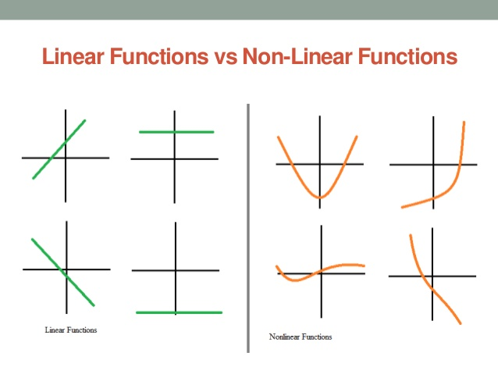

Slide 4
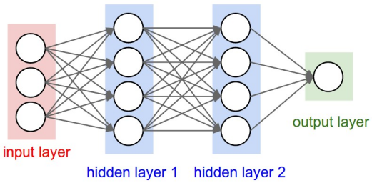
Feed Forward Neural Network
Made of many perceptrons.
Used for regression and classification problems.
Connections have no cycles.
Information only goes forward.

Slide 5
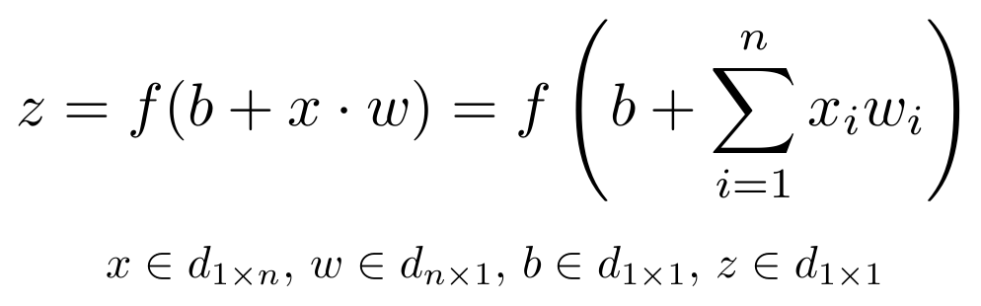
Feed Forward Neural Network
Weights and biases are used to find the output of a perceptron.
And activation function is used to make the output smooth.
Eg. Sigmoid, Tanh.

Slide 6

Loss
After the outputs are calculated, the loss is computed based on the computed output and the expected output.
This loss is used to calculate the gradients for the weight matrices so that they can be updated during the backward pass.

Slide 7
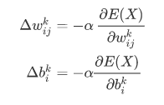
Gradient Update
The loss needs to be minimised.
SGD, RMSProp, Adam etc.

Slide 8
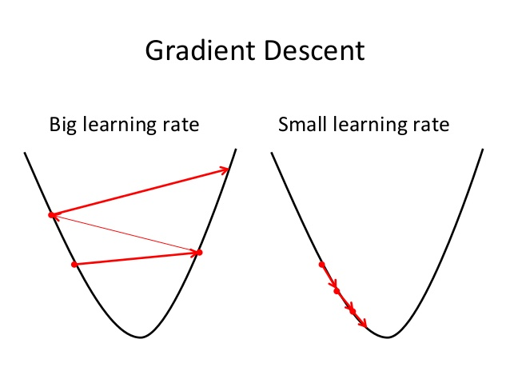
Gradient Update

Slide 9
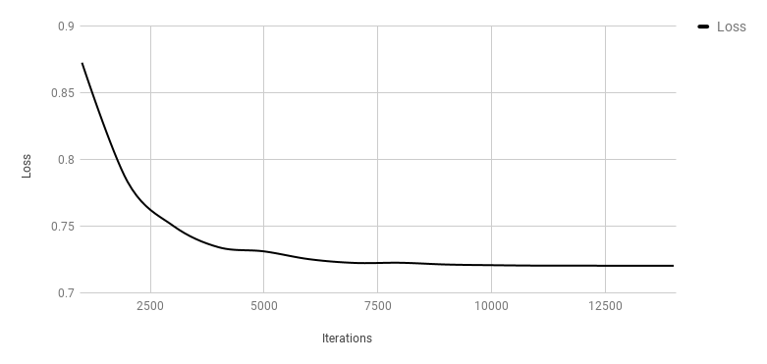
Training
The forward and backward pass continuously go on until the loss value converges.
The weights and biases during convergence are stored and used for testing.

Slide 10
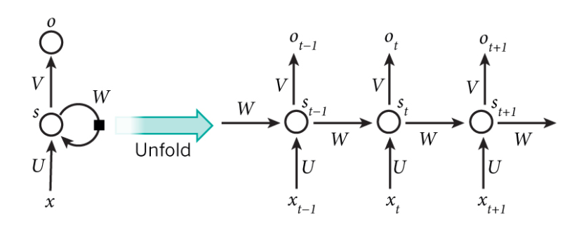
Recurrent Neural Networks
RNNs can recognise sequences.
Signals travel in more than one direction due to the loops in the network.
The hidden states act like memory.
BPTT.

Slide 11
Recurrent Neural Networks

Slide 12
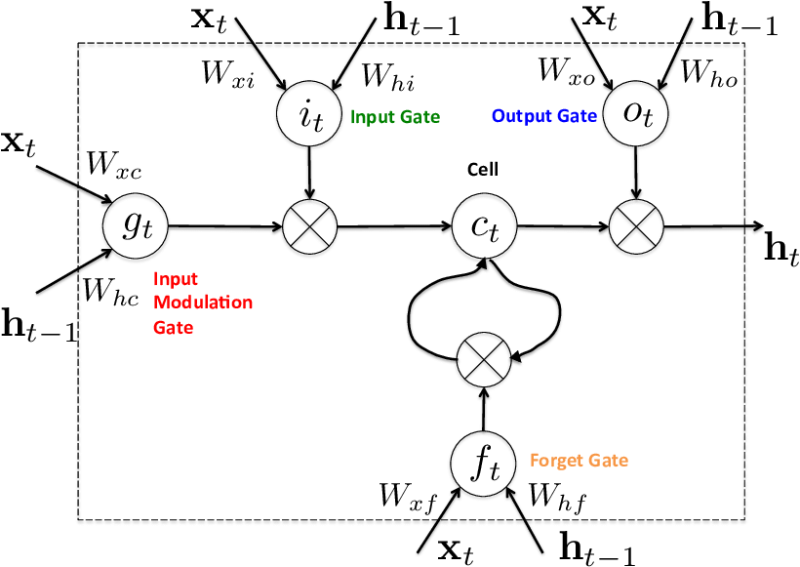
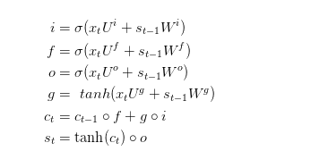
Long Short Term Memory

Slide 13
Practical

Slide 14
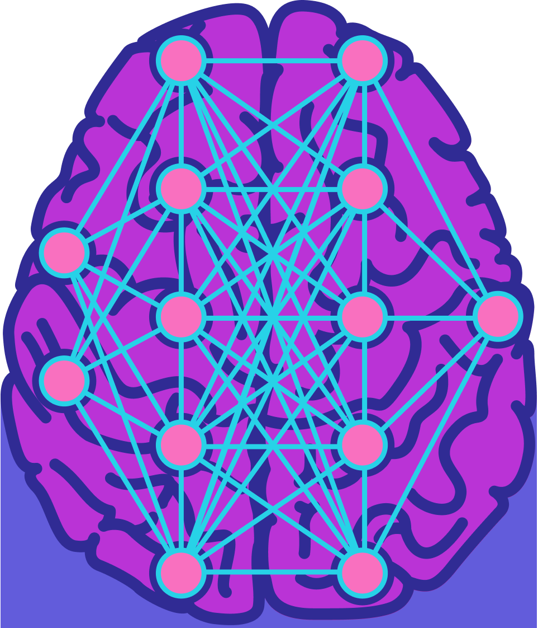
Problems
Data
Compute power
Features

Slide 15
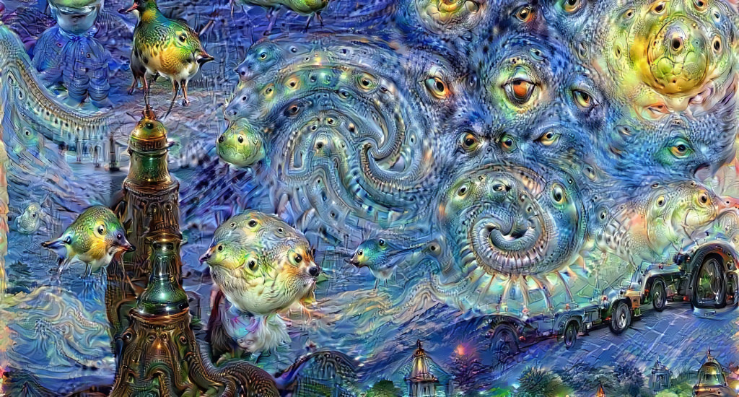
Where are they used?
DeepDream
Google uses neural networks for text to speech with near human accuracy.
Translation on Facebook happens with neural networks (CNNs)
AlphaGo Zero

Slide 16
