Slide 1
Sentiment Analysis on Twitter Data
CS 5593 – Data Mining
Fall 2022
Bhargav Durga Prasad Vummadi
Sai Prakash Davuluri
Sai Sharath Kumar Sabbarapu

Slide 2
Outline
Introduction
Related Work
Proposed Work
Application Overview
Dataset
Pre-processing
Classification Algorithms
Performance Evaluation
Web Application
Conclusion
Future Work
Demo of Execution

Slide 3
Introduction
What is Sentiment Analysis?
Why perform Sentiment Analysis/why is it important?
Why do opinions matter?
Why Twitter data?
To perform sentiment analysis, we have utilized the following algorithms:
Support Vector Machines (SVM)
Naïve Bayes
K Nearest Neighbors (KNN)

Slide 4
Related Work
Sentiment Analysis of Tweets using SVM [Ahmad 2017]
Sentiment Analysis of Review Datasets Using Naïve Bayes‘ and K-NN Classifier [Lopamudra 2016]
Election Result Prediction using Twitter Analysis [Ajay 2022]

Slide 5
Proposed Work
The objective of this project is to experiment a classification model that predicts the sentiment of a given tweet.
Based on this model, we have developed a web application to predict the sentiment of tweets related to the keyword provided by the user.

Slide 6
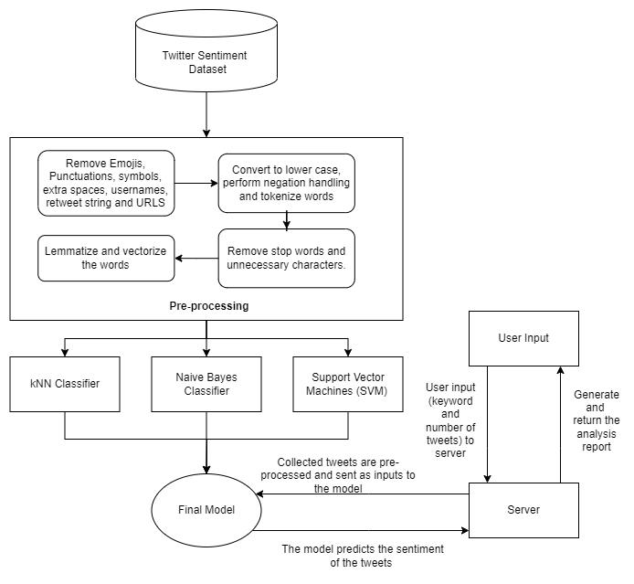
Application Overview
Our project has the following architecture: first, we collect the required data, apply the pre-processing techniques as mentioned and apply the classifier algorithms. Based on performance metrics, we finalized the best model.
From the user point of view: the web application requires the user to input a keyword and the number of tweets to analyze.
The collected tweets are pre-processed and used as inputs for the trained classification model.
Based on the predictions, we generate a report with the average sentiment of the tweets collected.

Slide 7
Dataset
We have selected a dataset containing Twitter data for this project. This dataset is obtained from the Kaggle website, which contains “1,600,000” tweets extracted using the Twitter API. The tweets have been labeled as negative and positive, which are represented as 0 and 4, respectively.
The CSV file which contains the data has 1,600,000 rows and 6 columns which constitute 227MB size in total.

Slide 8
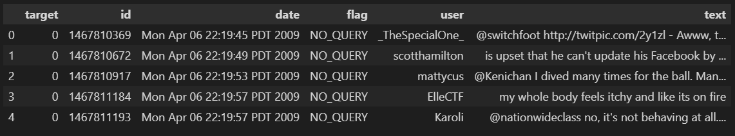
Dataset attributes and information
The dataset contains 5 attributes and a class label.
Attributes and examples
Ids: Contains the id of the tweet (2087)
Date: Date of the posted tweet (Mon Apr 06 22:19:45 PDT 2009)
Flag: The query of the tweet; if there is none, the value is NO_QUERY
User: Username of the account from which the tweet originated.
Text: Text data in the tweet
Class label
Target: Represents if the tweet is positive(4) or negative(0)

Slide 9
Data Pre-processing
The pre-processing techniques applied to the dataset are as follows:
Noise reduction.
Removal of Contraction words.
Stop words removal.
Lemmatization of tweets.

Slide 10
Naïve Bayes Classifier
This is a probabilistic machine learning algorithm for classification and clustering tasks.
Steps to build the classifier:
Class Instantiation
Class separation to know the prior probability of the class.
Gaussian distribution function for probability calculation based on the mean and standard deviation.
Fit function to learn from input training data
Predict function to pick the class with highest probability.
Accuracy calculation for model performance.

Slide 11
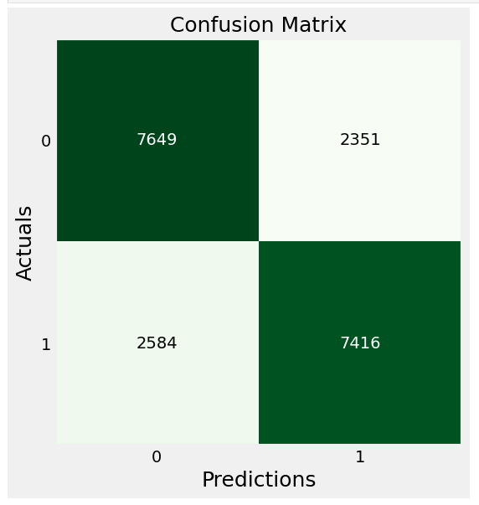
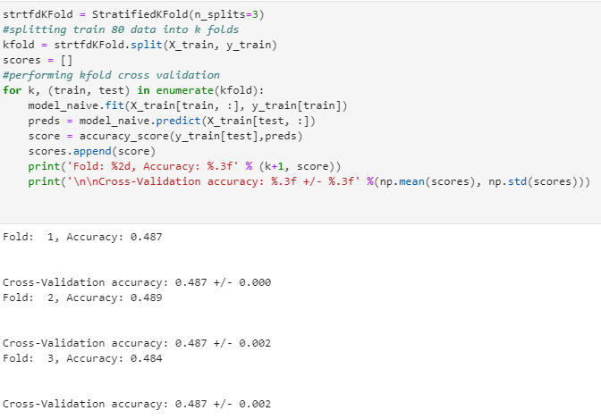
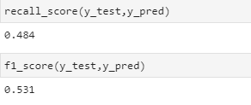
Performance metrics

Slide 12
KNN

Slide 13
KNN Performance Metrics

Slide 14
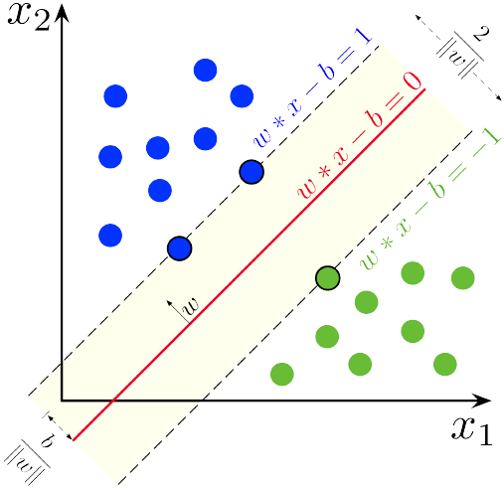
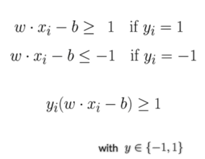
SVM
Use a linear model and try to find a linear decision boundary or hyperplane that best separates the data.
The best hyperplane is the one that yields the largest margin between both the classes. (positive class and negative class).
We choose the hyperplane so that the distance from it to the nearest data point on each side is maximized.

Slide 15
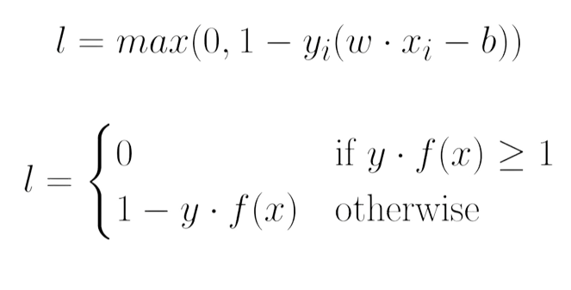
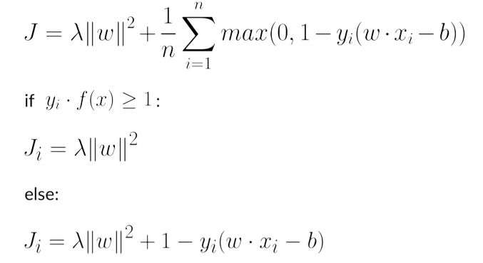
SVM
Hinge Loss Function
Regularization

Slide 16
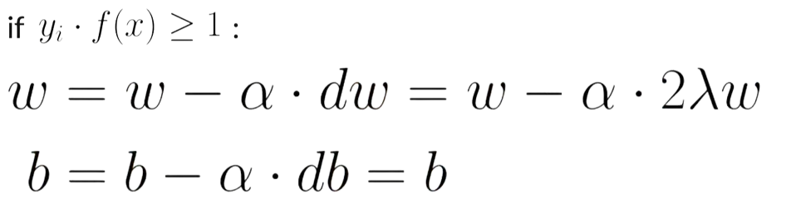
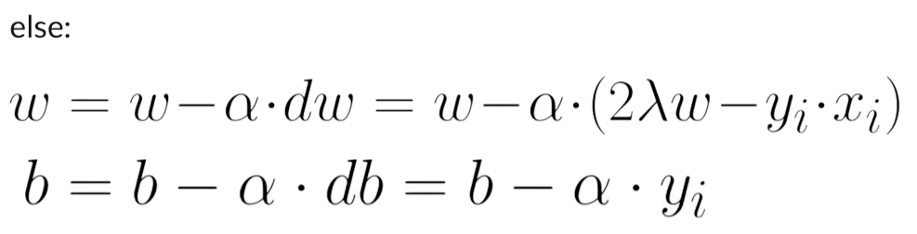
SVM
Updating weights

Slide 17
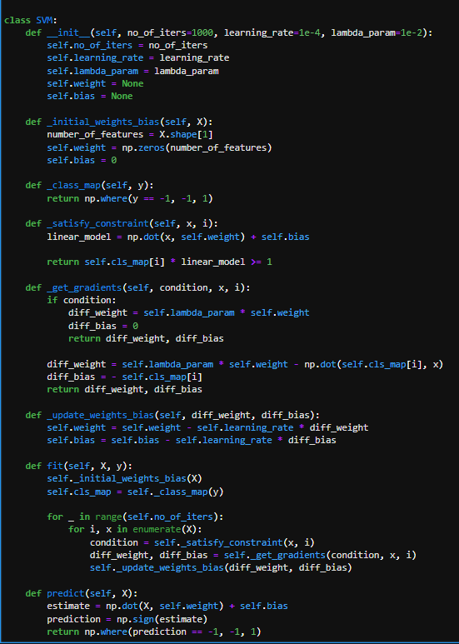
SVM
Algorithm working
Add initial weights
Map output class
Check loss constraint
Add gradients
Update weights
Predict the class

Slide 18
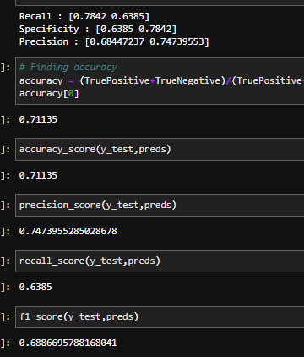
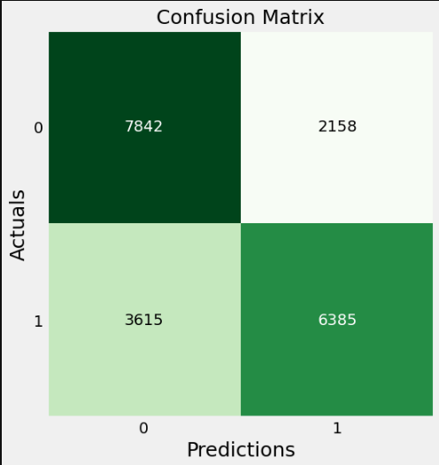
SVM Metrics

Slide 19
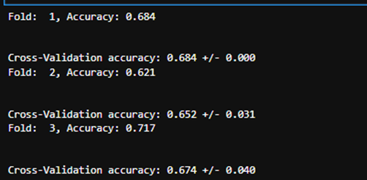
Performance Evaluation
Performing K-Fold Cross Validation with 3 Folds

Slide 20
Web Application
For development utilized Flask MVC or MVT architecture
Front End – HTML, CSS, JavaScript and BootStrap5
Back End – Python Flask
Ninja Api – For Quotes
Plotly – For Visualizations

Slide 21
Web Application
For development utilized Flask MVC or MVT architecture
Front End – HTML, CSS, JavaScript and BootStrap5
Back End – Python Flask
Ninja Api – For Quotes
Plotly – For Visualizations

Slide 22
Web Application
For development utilized Flask MVC or MVT architecture
Front End – HTML, CSS, JavaScript and BootStrap5
Back End – Python Flask
Ninja Api – For Quotes
Plotly – For Visualizations

Slide 23
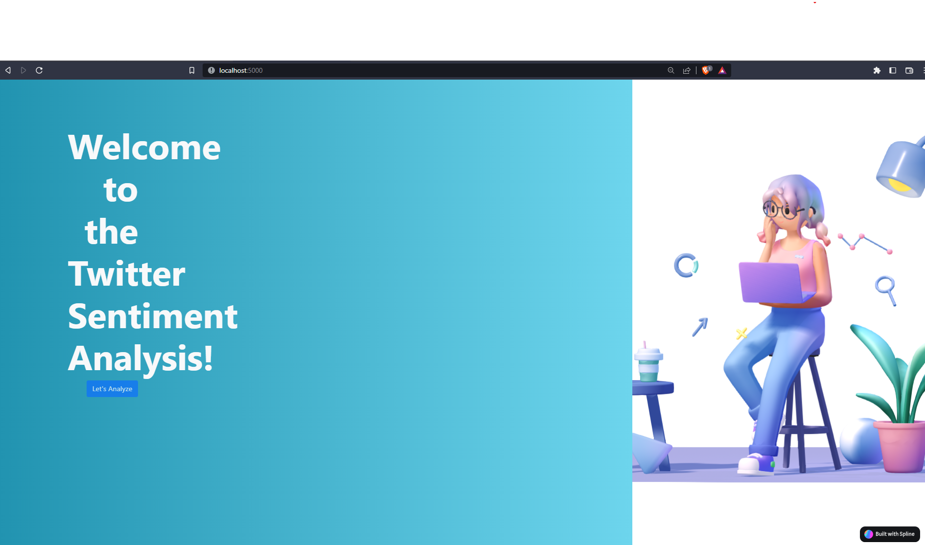
Web Application
Landing Page

Slide 24
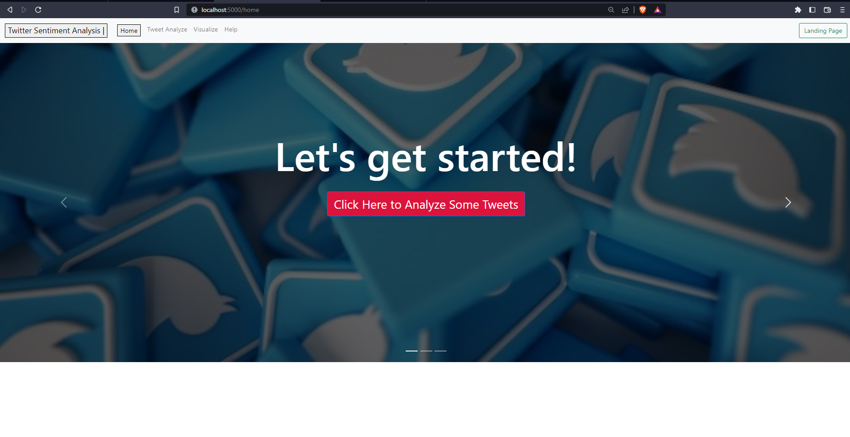
Web Application
Home Page

Slide 25
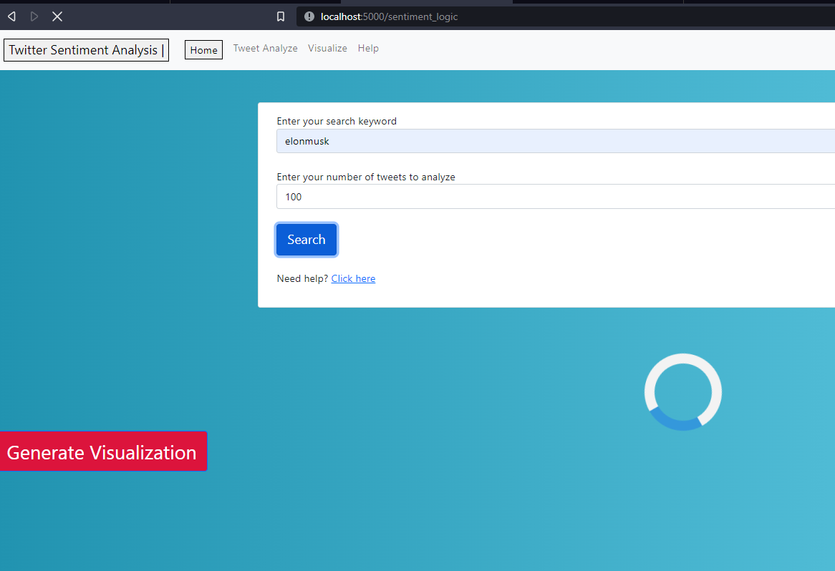
Web Application
Sentiment Analyzer

Slide 26
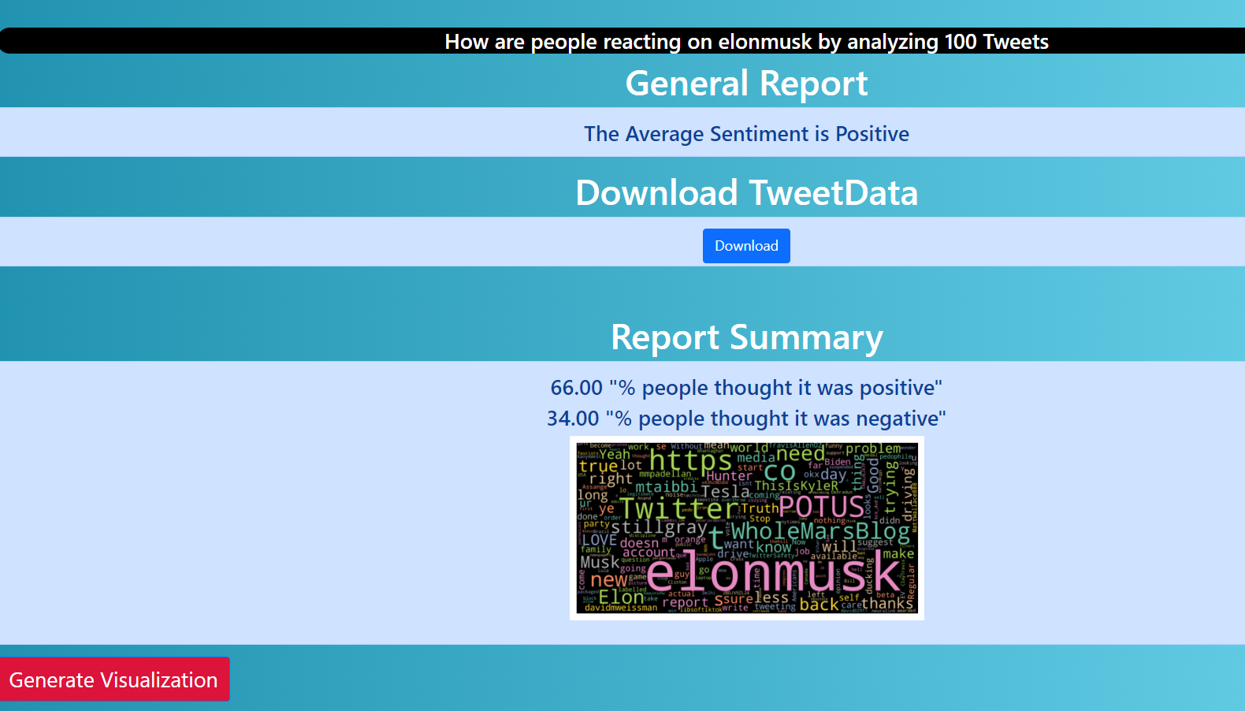
Web Application
Sentiment Analyzer Report

Slide 27
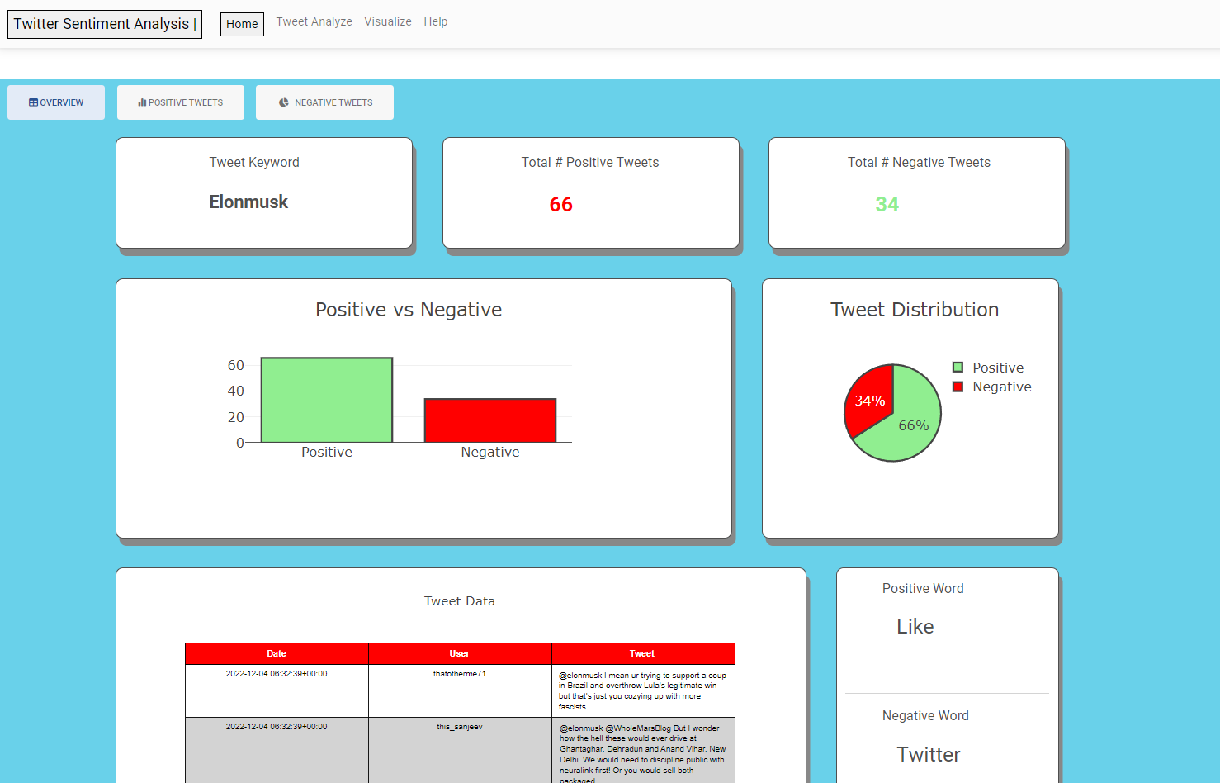
Web Application
Visualization Overview Page

Slide 28
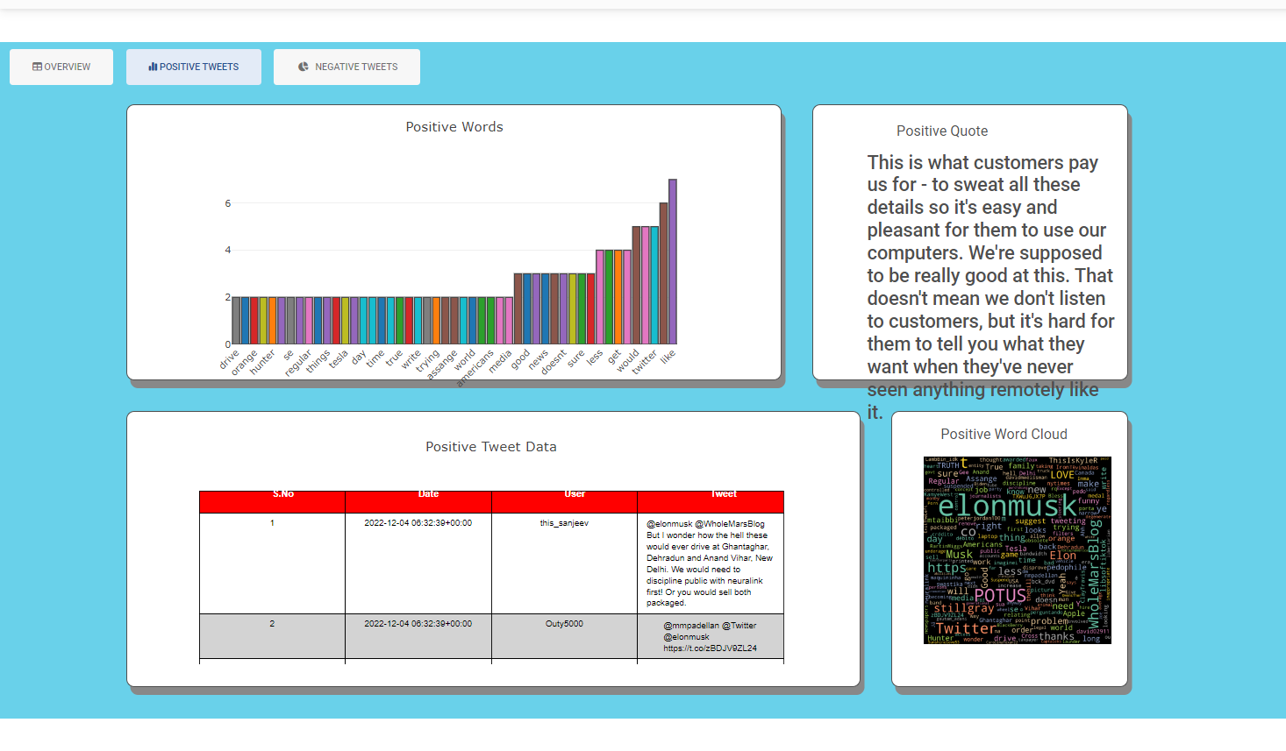
Web Application
Visualization Positive Tweet Page

Slide 29
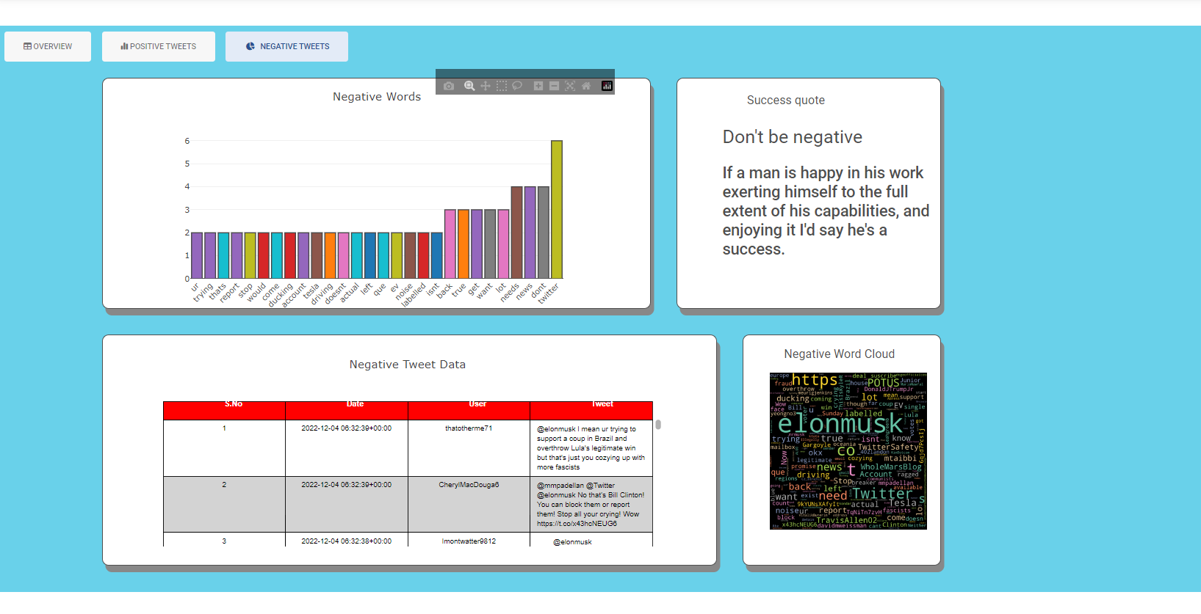
Web Application
Visualization Negative Tweet Page

Slide 30
Conclusion

Slide 31
Future Work

Slide 32
Demo of Execution

