Slide 1
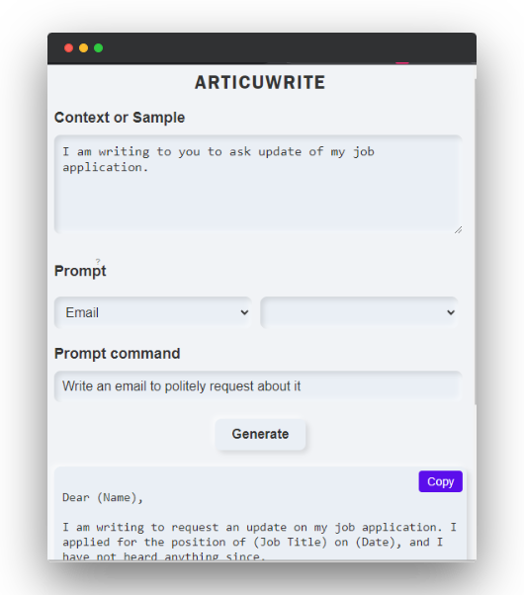
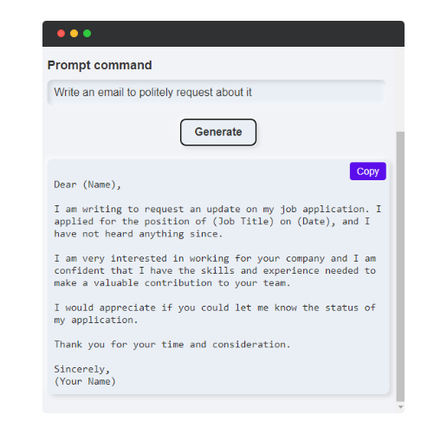
ReWrite
Hassle-free AI based Paraphraser Chrome Extension to help you write concisely and accurately

Slide 2
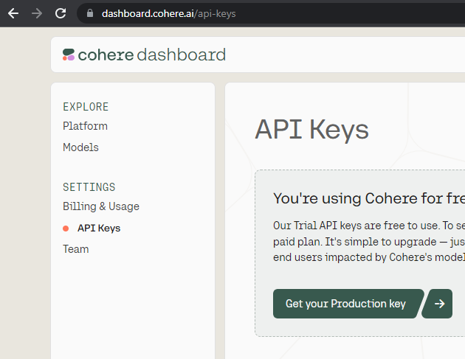
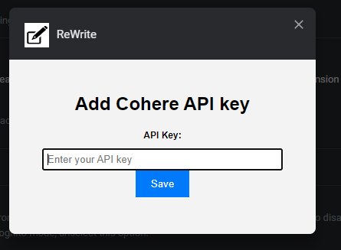
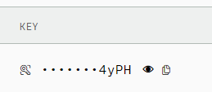
Uses the Cohere Generative Model - One of the best models in Text Generation
Configure in Seconds :
Visit dashboard.cohere.ai/api-keys
Paste them in Manage Extension > Extension Options
Copy API Keys.

Slide 3
Enhanced Writing Clarity
100% Data Privacy
Saves Time by more than 40%.
Free*
Increases Productivity

Slide 4
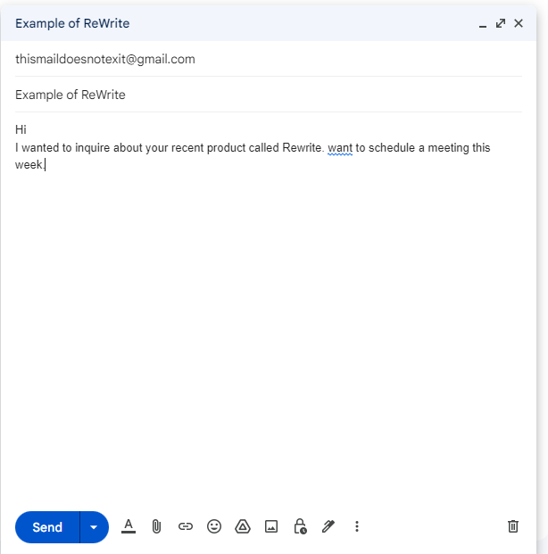
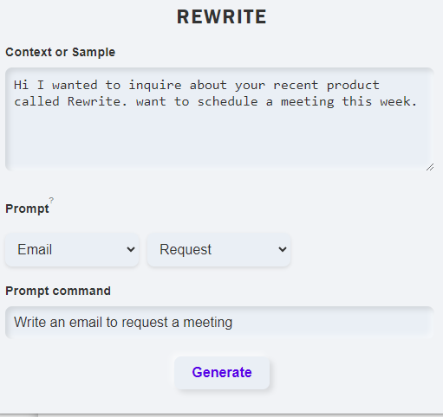
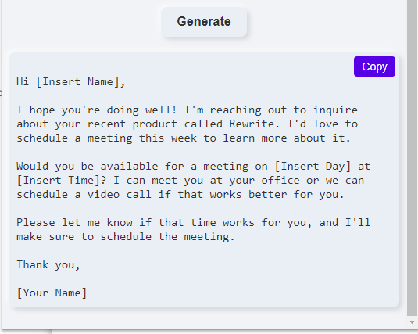
Made for Emails

Slide 5
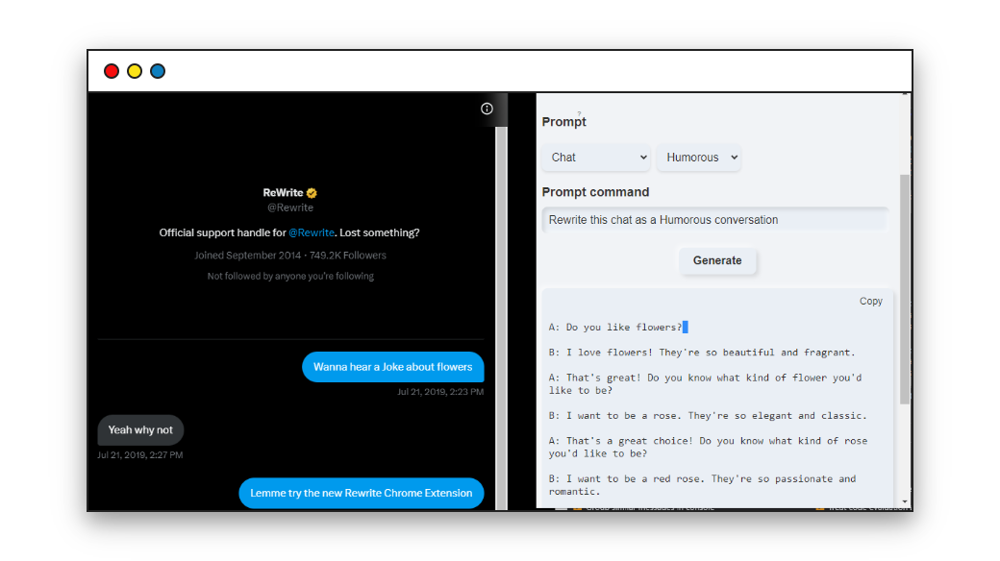
Made for Text

Slide 6
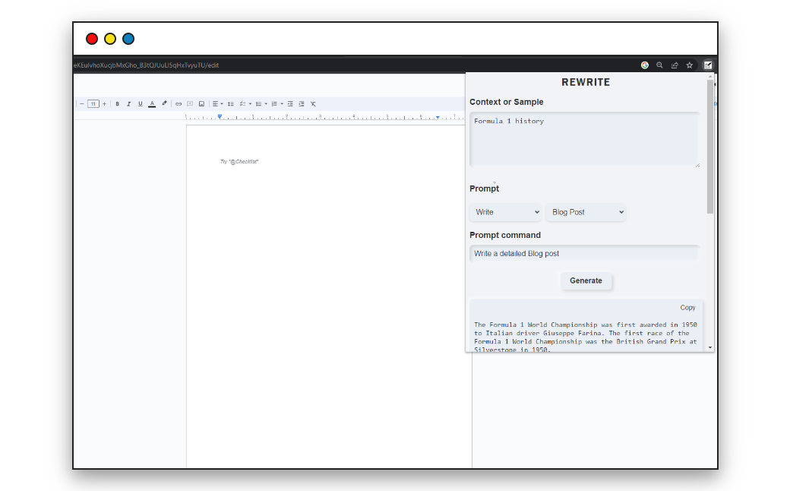
Made for Blogs

Slide 7
Made for Writers

Slide 8
Made with Love
Visit
www.bhargavyagnik.com

