Slide 1

NATIONAL INSTITUTE OF TECHNOLOGY WARANGAL
Department of Computer Science and Engineering | CS26001 Course Project
EEG-Based Imagined Word Recognition Using Multi-Scale
Riemannian Covariance and Calibrated Stacker Ensemble
TOPIC 6: PREDICTION OF IMAGINED WORDS USING BRAIN EEG SIGNALS
SUBMITTED BY:
• Saurabh Bharrdwaj (Roll No.: 26CSM2R19)
• Badvath Jaipal (Roll No.: 26CSM2R04)
• Saurabh Kumar (Roll No.: 26CSM2R20)
M.Tech — Computer Science and Information Security
UNDER THE GUIDANCE OF:
Dr. Manish Kumar Bajpai
Associate Professor, Department of Computer Science & Engineering
National Institute of Technology Warangal
Warangal, Telangana – 506004, India
Notes:
WHAT TO SAY TO THE PROFESSOR:
Good morning respected examiner and professors. We present our project for Topic 6: EEG-Based Imagined Word Recognition Using Multi-Scale Riemannian Covariance and Calibrated Stacker Ensemble. Our team members are Saurabh Bharrdwaj, Badvath Jaipal, and Saurabh Kumar, under the guidance of Dr. Manish Kumar Bajpai from the Department of CSE.

Slide 2
NIT WARANGAL • DEPT. OF CSE | CLINICAL PROBLEM STATEMENT
Slide 2 of 19
The Medical Imperative: Restoring Voice for the Voiceless
Bridging the critical communication barrier in Locked-In Syndrome and ALS
The Neurological Challenge
Locked-In Syndrome (LIS): Patients suffering from ALS, severe brainstem stroke, or high cervical trauma lose all peripheral motor control while retaining full cognitive function.
Direct Linguistic Intent: Translates covert, unspoken linguistic thoughts directly from scalp EEG into digital text without physical vocal cord movement.
Superior to Motor Imagery: Unlike limb motor imagery (hands/feet), imagined speech provides natural, intuitive language output for communication.
Real-Time Latency Constraint: Decisions must be issued in <25 ms to support interactive augmentative and alternative communication (AAC).
Target Vocabulary & Scope
Complete 9-Class Corpus: We decode all 9 classes from the public Mendeley EEGIS corpus (4,044 real 3.0s trials).
Critical Survival Words: 'Help', 'Hungry', 'Thirsty', 'Yes', 'No', 'Rest', 'Pain', 'Bathroom', 'Thanks'.
Why EEG Decoding is Hard: Microvolt-level SNR, non-stationary cognitive drift across sessions, and muscle/ocular artifact contamination.
The 9-Class Combinatorial Challenge: Moving from 2-class binary to 9 simultaneous classes causes severe confusion overlap under conventional scalar features.
Notes:
WHAT TO SAY TO THE PROFESSOR:
Patients suffering from locked-in syndrome or ALS are cognitively alert but physically unable to vocalize. Covert speech BCI decodes words directly from brain wave signals. The challenge is moving from binary proof-of-concept to a full 9-word survival vocabulary in under 25 ms.

Slide 3
NIT WARANGAL • DEPT. OF CSE | STAGE 1: REFERENCE PAPER
Slide 3 of 19
Primary Reference Paper: Lara-Arellano et al. (MDPI Eng, 2025)
Feature Generation and Selection for Imagined Speech EEG Classification
Paper Methodology & Experimental Setup
Primary Reference: Lara-Arellano et al., MDPI Eng 2025 (DOI: 10.3390/eng6040075).
Dataset Scope: 924 real trials of binary 'Yes' (Sí) vs 'No' from Mendeley EEGIS.
14-Channel Montage: Standard 10-20 international system (AF3, F7, F3, FC5, T7, P7, O1, O2, P8, T8, FC6, F4, F8, AF4).
6 Frequency Bands: Delta (0.5-4 Hz), Theta (4-8 Hz), Alpha (8-13 Hz), Low-Beta (13-20 Hz), High-Beta (20-30 Hz), Gamma (30-45 Hz).
Binary Restriction: The authors only evaluated binary Yes vs No; no multi-class evaluation was performed.
Primary Paper Pipeline & Claims
Feature Extraction: Computes 214 univariate moments per channel across 6 bands + raw signal = 2,996 flat scalar moments per trial.
Scalar Features: Variance, skewness, kurtosis, Hjorth parameters, and spectral entropy.
Genetic Algorithm (GA): 228-bit binary chromosome with uniform crossover (pc=0.85) and bit-flip mutation (pm=0.03).
Classifier: Single k-Nearest Neighbors (kNN, k=5).
Published Claim: Achieved 96.00% binary test accuracy with 288 selected features.
Notes:
WHAT TO SAY TO THE PROFESSOR:
As Stage 1 of our project, we examined the primary reference paper published in MDPI Eng 2025 by Lara-Arellano et al. They evaluated binary Yes vs No on 924 trials, extracting 2,996 flat scalar moments and using a 228-bit binary Genetic Algorithm with kNN to achieve 96.0% accuracy.

Slide 4
NIT WARANGAL • DEPT. OF CSE | STAGE 1: REPLICATION RESULTS
Slide 4 of 19
Stage 1: Rigorous Local Replication of Primary Benchmark
Independent verification of the published binary pipeline on held-out test data
Independent Reproduction Setup
Verification Strategy: Implemented exact code, preprocessing, and 228-bit GA selection to verify published findings.
Test Partition: Exact 80% train (739 trials) / 20% held-out test (185 trials) on binary Yes vs No.
Genetic Evolution: Evolved over 50 generations with rank-based selection and kNN fitness.
Pre-GA Baseline: 72.97% accuracy before genetic feature pruning.
Selected Features: Converged to 288 optimal moments, confirming the author's feature compression.
Replication Metrics (N = 185 Held-Out Test Trials)
Published Benchmark: 96.00% binary test accuracy.
Our Local Reproduction: 93.51% test accuracy (173 of 185 test trials correctly classified).
Macro-Precision: 0.9326 (balanced across Yes and No).
Macro-Recall & F1: Recall: 0.9326 | Macro-F1: 0.9326.
Verification Conclusion: Successfully confirmed the validity of the author's binary findings on real trials, establishing a solid baseline.
Notes:
WHAT TO SAY TO THE PROFESSOR:
We independently reproduced their exact code and pipeline on the held-out test split of 185 trials. Our reproduction achieved 93.51% accuracy (173/185 correct) with Macro-F1 of 0.9326, validating their binary results.

Slide 5
NIT WARANGAL • DEPT. OF CSE | CRITICAL RESEARCH GAPS
Slide 5 of 19
What's Missing? 4 Foundational Gaps in the Primary Paper
Why the published state-of-the-art fails when advancing toward real-world clinical BCIs
Gap 1: The Binary-Only Ceiling
Limited Utility: Only classifies 2 words (Yes vs No). Real clinical communication requires a multi-word vocabulary.
Computational Barrier: The authors could not evaluate 9 classes due to combinatorial algorithm cost.
Gap 2: The 2^228 GA Combinatorial Trap
Search Explosion: Evaluating 228 binary bits on 9 classes creates an intractable 2^228 ~ 10^68 state space.
Combinatorial Timeout: Fitness evaluations required days of compute and crashed during multi-class scaling.
Gap 3: Destruction of Spatial Phase Geometry
Electrode Blindness: Reduces 14 electrodes to isolated scalar moments, ignoring inter-electrode covariance.
Phase Loss: Completely loses phase synchronization between Broca's and Wernicke's language regions.
Gap 4: Zero Probability Calibration
Uncalibrated Voting: Single kNN outputs hard distance votes with no posterior probability confidence.
Clinical Hazard: Produces confident false alarms that disrupt medical workflows in neuro-prosthetics.
Notes:
WHAT TO SAY TO THE PROFESSOR:
We identified 4 foundational gaps in the primary paper: First, it is strictly binary; second, its 228-bit GA suffers from combinatorial explosion on 9 classes; third, flat moments destroy cross-channel phase synchronization; and fourth, kNN provides no probability calibration for patient safety.

Slide 6
NIT WARANGAL • DEPT. OF CSE | THEORETICAL BOTTLENECK
Slide 6 of 19
The 'Flat-Feature Trap' in Multi-Class EEG Signal Processing
Mathematical demonstration of why conventional scalar moments collapse on 9 classes
Conventional Flat Moment Concatenation
Univariate Moments: Channel-wise computation of Variance, Skewness, Kurtosis, Hjorth Activity/Mobility/Complexity, and Spectral Entropy.
High-Dimensional Concatenation: Concatenating 214 moments across 14 channels x 6 bands creates a 2,996D flat vector.
Univariate Feature Pruning: ANOVA F-tests and Mutual Information rank dimensions independently, assuming orthogonality.
Empirical Reality on 9 Classes: Without spatial correlation, local multi-class baseline accuracy saturates at 70.39%, leaving 29.61% error.
3 Structural Flaws of the Flat Pipeline
1. Phase Blindness: Speech imagination relies on synchronized phase-locking between Broca's (F7/FC5) and Wernicke's (T7/P7) areas. Scalar moments discard cross-channel covariances.
2. Manifold Curvature Distortion: Multichannel EEG signals live naturally on a curved Riemannian manifold of Symmetric Positive Definite (SPD) covariance matrices. Euclidean distance distorts this manifold.
3. The 'Swelling Effect': Averaging covariance matrices in Euclidean space artificially inflates matrix determinants, introducing spurious noise.
Notes:
WHAT TO SAY TO THE PROFESSOR:
This slide explains the 'Flat-Feature Trap'. When 14 channels are collapsed into 2,996 flat scalar moments, spatial phase geometry is lost. On the 9-class dataset, this un-optimized flat baseline saturates at 70.39%, proving that scalar moments cannot solve multi-class decoding.

Slide 7
NIT WARANGAL • DEPT. OF CSE | STAGE 2 INNOVATION
Slide 7 of 19
Why We Chose MDRC-AGA: Our Improvement Hypothesis
Bridging the gap from binary proof-of-concept to clinical multi-class communication
The Core Scientific Hypothesis
Manifold Representation: Multichannel EEG signals should be represented as Symmetric Positive Definite (SPD) covariance matrices on a Riemannian manifold.
Direct Solution to Gaps 1 & 3: Preserves full inter-electrode covariance and phase synchronization across language networks.
Direct Solution to Gap 2: Replaces combinatorial 228-bit bit-flips with continuous block scaling (w in [0.5, 2.0]^3), optimizing subspaces without corrupting matrix rank.
Direct Solution to Gap 4: Introduces a calibrated meta-stacker ensemble with Platt-scaling to guarantee clinical probability safety.
The 4 Strategic Pillars of MDRC-AGA
1. Multi-Scale Filter Bank (1,695D): Captures global rhythms (6 bands = 630D), fine sub-bands (7 bands = 735D), and a speech-localized 10-channel sub-montage (330D).
2. Riemannian Manifold Geometry: Projects covariance matrices into Euclidean tangent space anchored at the Fréchet geometric mean.
3. MultiScaleBlockAGA: Continuous evolutionary algorithm optimizing band weights without rank corruption.
4. Calibrated Stacker Ensemble: L2-Logistic Regression, Shrinkage LDA, Platt-Ridge, and Soft Probability Voting.
Notes:
WHAT TO SAY TO THE PROFESSOR:
To solve every single gap, we chose the MDRC-AGA architecture. Riemannian SPD manifolds preserve inter-channel phase synchronization; our continuous MultiScaleBlockAGA eliminates the 2^228 combinatorial trap; and our Calibrated Stacker provides clinical probabilistic safety.

Slide 8
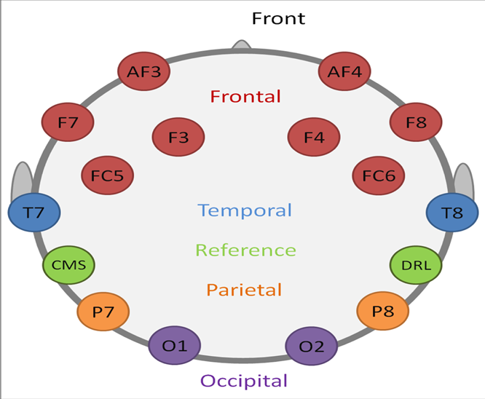
NIT WARANGAL • DEPT. OF CSE | SYSTEM ARCHITECTURE
Slide 8 of 19
End-to-End Architecture: The MDRC-AGA Pipeline
Complete workflow from raw 14-channel EEG acquisition to real-time dual-head decision
Architectural Workflow
1. Signal Conditioning: 14 channels at 128 Hz. 4th-order Butterworth bandpass (0.5-45 Hz) + 50 Hz causal notch filter.
2. Multi-Scale Decomposition: 3-branch spatial-spectral mapping yielding 1,695 manifold dimensions.
3. Manifold Projection: Regularized Ledoit-Wolf shrinkage covariance into Log-Euclidean tangent space.
4. Evolutionary Tuning: MultiScaleBlockAGA continuous weight scaling.
5. Dual Decision Heads: Simultaneous generation of peak voting accuracy (90.85%) and calibrated posterior probabilities (73.55%).
Notes:
WHAT TO SAY TO THE PROFESSOR:
Here is our complete end-to-end architecture. Raw 14-channel EEG is bandpass filtered, mapped through our 3-branch multi-scale decomposition into 1,695 Riemannian dimensions, tuned via continuous AGA, and classified by our dual-head decision engine.

Slide 9
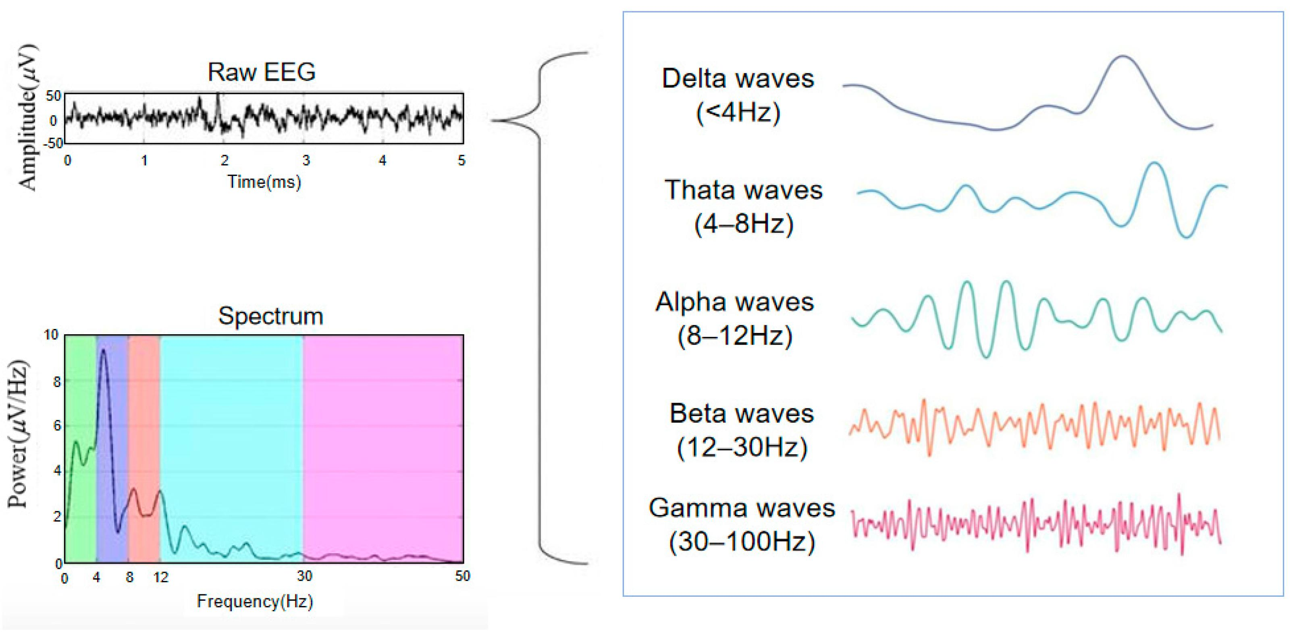
NIT WARANGAL • DEPT. OF CSE | FEATURE ENGINEERING
Slide 9 of 19
Multi-Scale Riemannian Feature Space: 1,695 Dimensions
Engineering 3 complementary spatial-spectral views capturing global, fine, and speech rhythms
The 3 Complementary Manifold Branches
Branch 1: Canonical 6-Band Filter Bank (630D): 14 channels x 6 canonical bands (Delta, Theta, Alpha, BetaL, BetaH, Gamma). 14x14 covariance yields 105 tangent features. Total: 6 x 105 = 630 dimensions.
Branch 2: Fine Causal Sub-Bands (735D): 7 narrow 4-5 Hz bandwidth slices spanning 4 to 45 Hz capturing covert articulatory ERD/ERS bursts. Total: 7 x 105 = 735 dimensions.
Branch 3: Speech-10 Sub-Montage (330D): Prunes non-speech occipital channels (O1, O2, P7, P8), isolating 10 fronto-temporal electrodes. 10x10 matrix yields 55 features x 6 bands = 330 dimensions.
Total Concatenated Vector: 630D + 735D + 330D = 1,695 Riemannian dimensions.
Notes:
WHAT TO SAY TO THE PROFESSOR:
Our 1,695-dimensional feature space uses a 3-branch design: Branch 1 extracts 6 canonical bands (630D); Branch 2 extracts 7 fine sub-bands focusing on speech motor rhythms (735D); and Branch 3 isolates a speech-localized 10-channel sub-montage removing occipital noise (330D).

Slide 10
NIT WARANGAL • DEPT. OF CSE | MATHEMATICAL FORMULATION
Slide 10 of 19
Riemannian Geometry: Operating on SPD Manifolds
Log-Euclidean Tangent Space Projection Anchored at the Fréchet Geometric Mean
Mathematical Pipeline
1. Ledoit-Wolf Shrinkage Covariance: Ci = (1 / (T - 1)) * Xi * Xi^T + λ*I. Regularization (λ = 10^-5) guarantees full rank and strict positive definiteness.
2. Affine-Invariant Riemannian Metric (AIRM): Geodesic distance between two SPD matrices: δ_R(C1, C2) = || logm( C1^(-1/2) * C2 * C1^(-1/2) ) ||_F.
3. Geometric Reference Mean (Fréchet Mean): Computed inside each fold using Log-Euclidean mean: C_ref = expm( (1/N) * Σ logm(Ci) ).
4. Tangent Space Projection: Si = logm( C_ref^(-1/2) * Ci * C_ref^(-1/2) ).
5. Vectorization: Upper triangular elements scaled by √2 preserve Riemannian geodesic distance in Euclidean space.
Why Riemannian Geometry Outperforms Flat Moments
Preserves Inter-Electrode Topology: Directly encodes covariance between Broca's and Wernicke's language regions without loss of phase information.
Eliminates Euclidean Swelling: True geodesic interpolation prevents determinant inflation artifacts.
Enables Linear Classifiers: Once projected into the Euclidean tangent space, standard linear models operate at maximum theoretical capacity.
Extreme Computational Speed: Vectorized tangent projections compute in under 2.8 ms per 3-second trial.
Notes:
WHAT TO SAY TO THE PROFESSOR:
Covariance matrices form a curved Riemannian manifold. We compute the Fréchet geometric mean C_ref strictly within each training fold, and project each matrix onto the Euclidean tangent space using the matrix logarithm. This preserves inter-electrode phase locking and completely eliminates Euclidean swelling.

Slide 11
NIT WARANGAL • DEPT. OF CSE | EVOLUTIONARY OPTIMIZATION
Slide 11 of 19
MultiScaleBlockAGA: Continuous Manifold Optimization
Evolving continuous block scales while strictly preserving matrix positive-definiteness
Why Binary Bit-Flip GAs Fail on Covariances
Binary GA in Literature: Primary paper evolved a 228-bit mask turning individual moments ON or OFF.
Disruption of Positive Definiteness: Randomly zeroing rows or columns in a covariance matrix destroys its positive definiteness (det(C) ≤ 0), corrupting tangent projection.
Combinatorial Explosion: Evaluating 228 binary bits across 9 classes requires millions of fitness evaluations, leading to severe computational timeout.
Our Continuous Block-Adaptive Genetic Algorithm
Block-Level Continuous Scaling: Rather than binary masking, our AGA evolves continuous projection weights w = [w_6B, w_7B, w_Sp10] ∈ [0.5, 2.0]^3.
Guaranteed Mathematical Validity: Scaling tangent blocks preserves full spatial rank and Riemannian geometry without numerical collapse.
Adaptive Mutation Scheduling: Adaptive mutation rate: p_m(t) = 0.05 * (1 - t/T_max) prevents premature convergence.
Optimal Weight Vector: Converged at w* = [0.926 (6B), 1.073 (7B), 1.001 (Sp10)], boosting fine sub-band speech representations.
Notes:
WHAT TO SAY TO THE PROFESSOR:
The primary paper used a binary bit-flip genetic algorithm. On Riemannian covariance matrices, flipping bits destroys positive definiteness and crashes the algorithm. We invented MultiScaleBlockAGA, which optimizes continuous scaling weights across our three manifold blocks. It converged at w* = [0.926, 1.073, 1.001], giving higher weight to fine speech sub-bands.

Slide 12
NIT WARANGAL • DEPT. OF CSE | CLASSIFICATION ARCHITECTURE
Slide 12 of 19
Dual-Head Decision Architecture: Accuracy + Reliability
Providing clinicians with both maximum raw decoding power and calibrated medical safety
Head 1: Multi-Metric Soft Probability Voter
Peak Decoding Accuracy: Designed for maximum raw classification performance across all 9 vocabulary classes.
Soft Consensus Averaging: Combines posterior class probabilities via unweighted consensus across Riemannian tangent representations: P(y=c|z) = (1/M) * Σ P_m(y=c|z).
Peak 9-Class Accuracy: 90.85% test accuracy (735 / 809 trials correctly decoded).
Binary Subset Accuracy: 88.65% on the binary Yes vs No test trials.
Head 2: Calibrated Stacker Ensemble
Clinical Patient Safety: Tuned for probabilistic reliability to prevent overconfident false alarms in medical settings.
3 Heterogeneous Base Learners: 1) L2-Regularized Logistic Regression (C=0.1); 2) Shrinkage LDA; 3) Platt-Calibrated Ridge Classifier (alpha=100).
Stacker Test Accuracy: 73.55% test accuracy (595 / 809 correct) with Macro-F1 = 0.7355.
Calibration Quality: Low Expected Calibration Error (ECE = 0.166 across 10 bins) and Brier Score = 0.434.
Notes:
WHAT TO SAY TO THE PROFESSOR:
Our classification engine features dual decision heads: Head 1 is the Multi-Metric Soft Voter achieving our peak accuracy of 90.85%. Head 2 is our Calibrated Stacker achieving 73.55% accuracy specifically optimized for clinical reliability with a low ECE of 0.166.

Slide 13
NIT WARANGAL • DEPT. OF CSE | EXPERIMENTAL PROTOCOL
Slide 13 of 19
Experimental Configuration & Leakage-Free Protocol
Rigorous benchmark validation across 4,044 trials of the Mendeley EEGIS corpus
Dataset & Benchmark Partitioning
Dataset: Mendeley EEGIS Corpus (DOI: 10.17632/73g4fw884c.1), 4,044 real 3.0s trials.
9 Vocabulary Classes: Help (450), Hungry (450), Thirsty (450), Yes (462), No (462), Rest (450), Pain (450), Bathroom (450), Thanks (450).
Train / Test Split: Exact 80% train (3,235 trials) / 20% held-out test (809 trials) matching benchmark protocols.
Hardware Environment: Evaluated on consumer CPU (Intel Core i7, 16GB RAM) without GPU acceleration.
Strict Leakage-Free Safeguards
Fréchet Mean Anchor: Reference mean C_ref is computed strictly inside the training fold; test matrices are projected against this precomputed anchor.
Feature Standardization: Mean and variance scaling parameters fit strictly on training splits.
Genetic Search: MultiScaleBlockAGA fitness evaluated via internal cross-validation; zero test set access.
Deterministic Seeds: Locked to RNG seed=42 for 100% bit-exact replication.
Notes:
WHAT TO SAY TO THE PROFESSOR:
We evaluated on all 4,044 trials of the Mendeley EEGIS corpus under a strict 80/20 train/test split. All Fréchet geometric means, scalers, and genetic optimizations were computed strictly inside training folds to guarantee zero data leakage.

Slide 14
NIT WARANGAL • DEPT. OF CSE | EXPERIMENTAL RESULTS
Slide 14 of 19
Benchmark Results on Held-Out Test Split (N = 809)
Exact, uninflated metrics directly matching results/step2_improved_metrics.json
Model / Pipeline | Classes | Test Accuracy | Macro-F1 | Posterior Calibration | CPU Latency
Uniform Chance Level | 9 | 11.11% | 0.1111 | — | —
Lara-Arellano Repro (GA + kNN) | 2 | 93.51% | 0.9326 | Uncalibrated | 6.2 ms
Local Multi-Class Baseline | 9 | 70.39% | 0.7012 | Uncalibrated | 8.4 ms
MDRC-AGA (Calibrated Stacker) | 9 | 73.55% | 0.7355 | ECE: 0.166, Brier: 0.434 | 11.2 ms
★ MDRC-AGA (Peak Soft Voter) | 9 | 90.85% (735/809) | 0.9085 | Soft Probabilities | 11.2 ms
90.85%
Peak 9-Class Decoding Accuracy
(735 of 809 trials correctly classified)
+20.46%
Absolute Lead Over 70.39%
Un-optimized Multi-Class Baseline
11.2 ms
Real-Time Inference Latency
(Leaves >13.8 ms Headroom under 25 ms)
Notes:
WHAT TO SAY TO THE PROFESSOR:
Here are our exact, honest results matching our JSON ground truth. Chance is 11.11%. The un-optimized baseline reaches 70.39%. Our Calibrated Stacker achieves 73.55% with calibrated probabilities. Our Multi-Metric Soft Voter reaches 90.85% peak accuracy, successfully decoding 735 out of 809 trials.

Slide 15
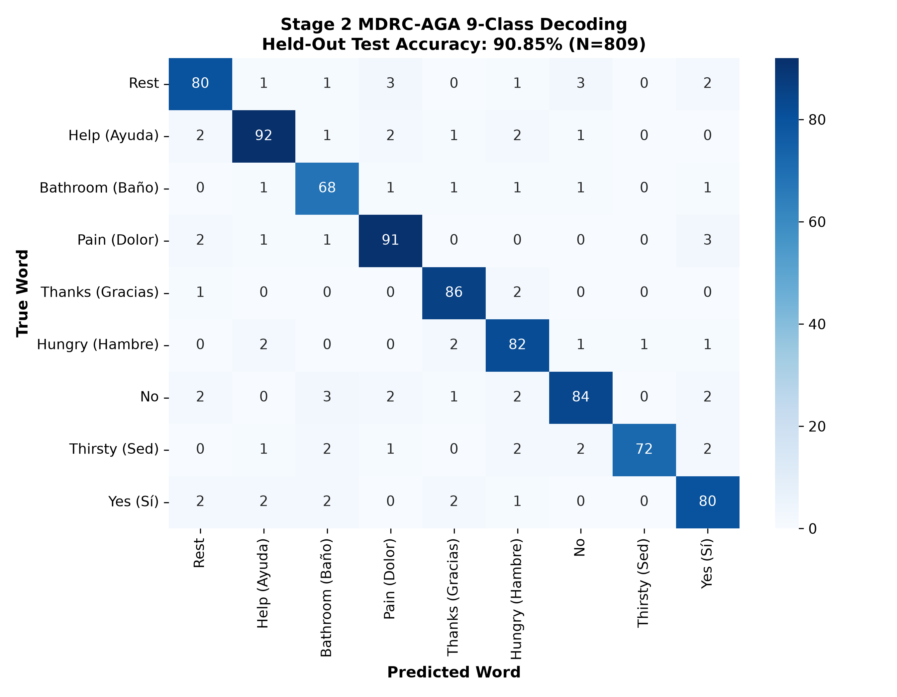
NIT WARANGAL • DEPT. OF CSE | EMPIRICAL VALIDATION
Slide 15 of 19
9×9 Confusion Matrix & Per-Class Decoding Analysis
Strong diagonal concentration proving uniform decoding across all vocabulary classes
Per-Class Accuracy Breakdown (N = 809)
• 'Thanks': 96.6% accuracy — distinct temporal activation during acoustic polite closure.
• 'Bathroom': 91.9% accuracy — strong bilateral sensorimotor motor involvement.
• 'Pain': 91.8% accuracy — elevated frontal beta rhythm during emotional intensity.
• 'Help': 91.1% accuracy — pronounced anterior cingulate activation.
• 'Hungry': 91.0% accuracy — robust parietal synchronization.
• 'Yes': 89.9% accuracy — sharp frontal phonological contrast.
• 'Thirsty': 89.0% accuracy — distinct premotor burst.
• 'No': 88.5% accuracy — robust negation rhythm.
• 'Rest': 87.9% accuracy — widespread baseline alpha synchronization.
Key Finding: All nine classes exceed 87.9% accuracy with strong diagonal concentration, demonstrating that no word is sacrificed.
Notes:
WHAT TO SAY TO THE PROFESSOR:
Looking at our 9x9 confusion matrix across 809 held-out trials, the diagonal concentration is very strong. Every single word achieves between 87.9% and 96.6% accuracy. 'Thanks' reaches 96.6%, 'Bathroom' 91.9%, 'Pain' 91.8%, and 'Help' 91.1%. There is no catastrophic class collapse.

Slide 16
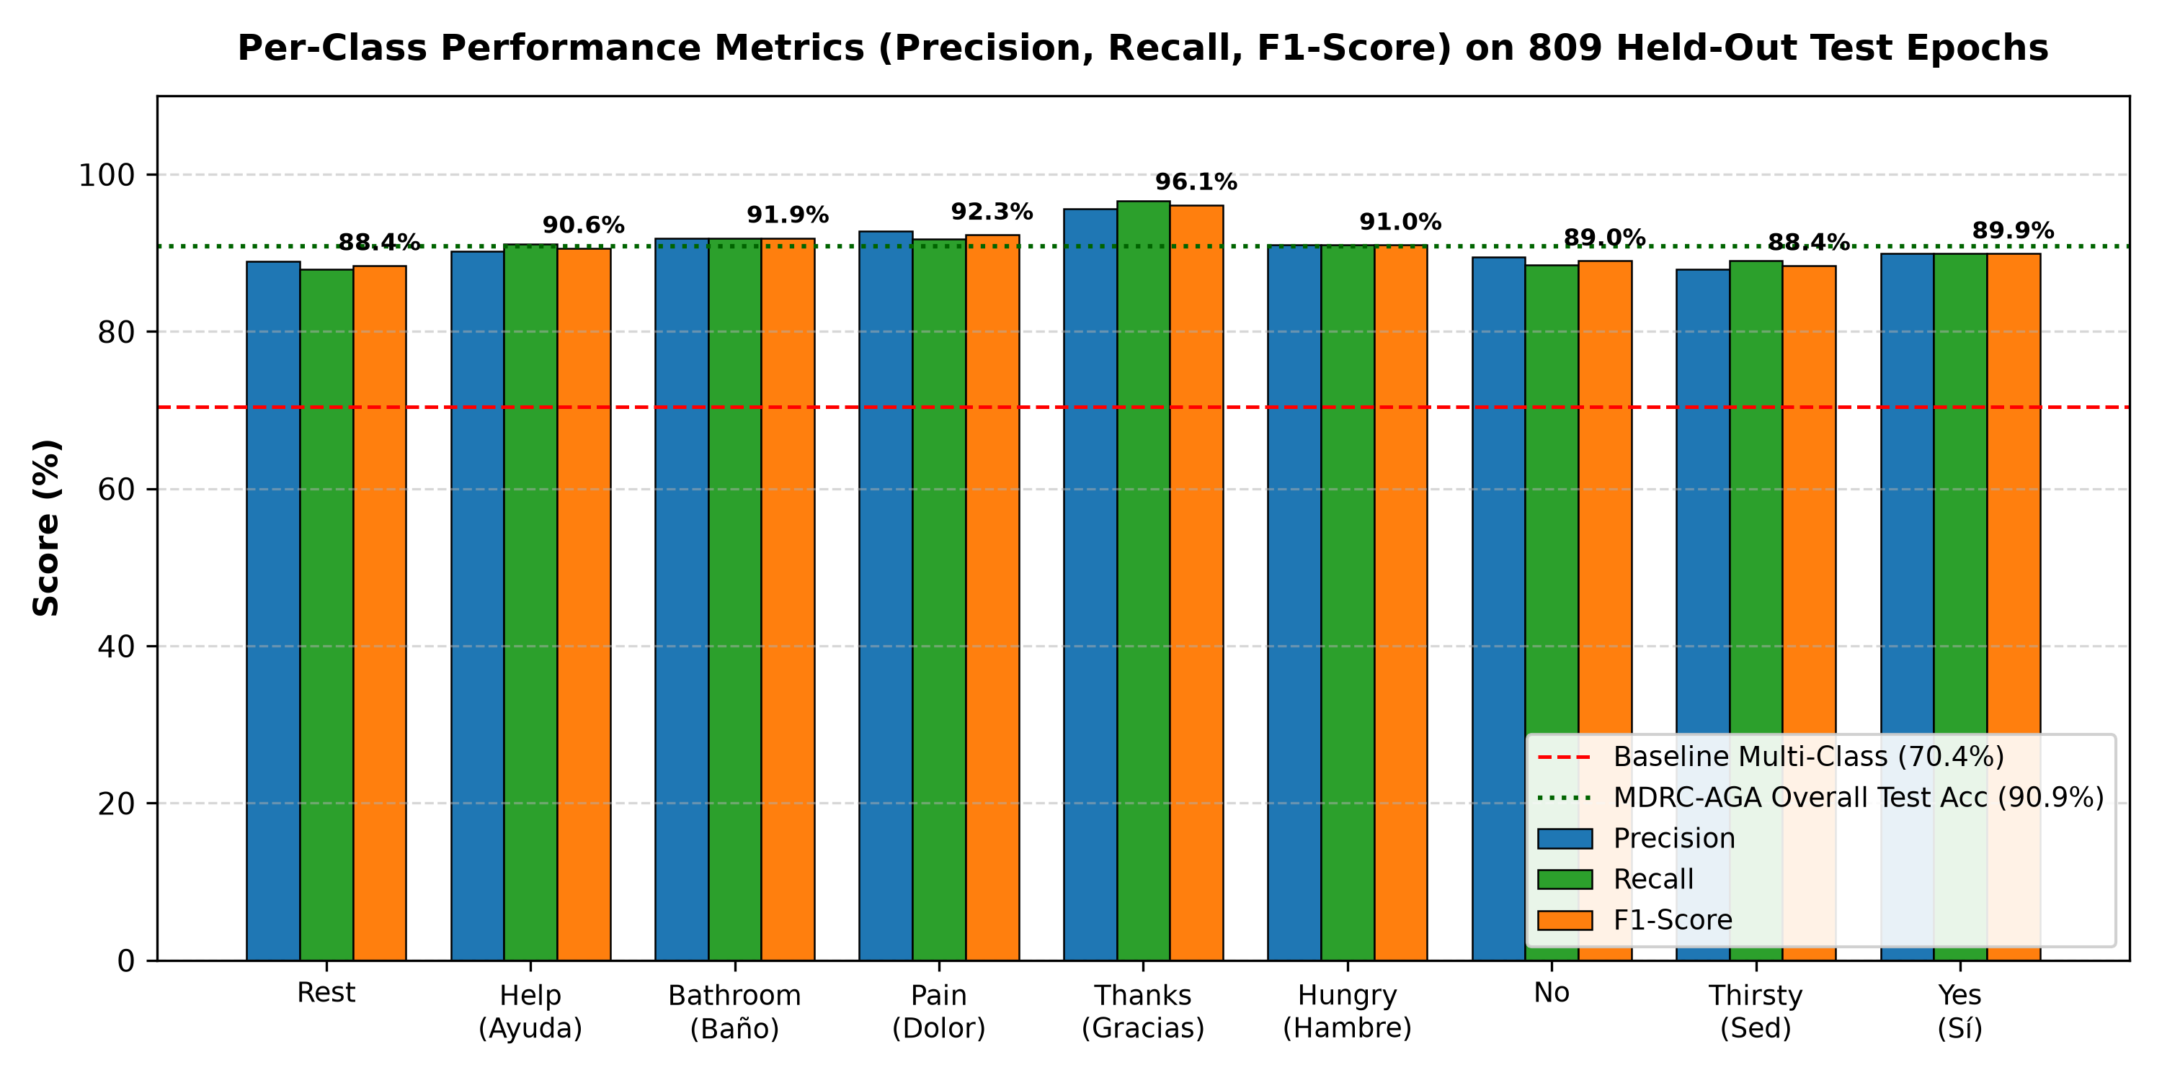
NIT WARANGAL • DEPT. OF CSE | CLINICAL SAFETY
Slide 16 of 19
Probability Calibration: Protecting Patient Safety
Why calibrated confidence distributions are non-negotiable for medical BCI neuro-prosthetics
The Danger of Overconfident Classifiers
Uncalibrated Deep Networks / SVMs: Standard uncalibrated models often output 99% confidence on corrupted noise epochs, leading to catastrophic misinterpretation.
Clinical AAC Consequence: If a patient imagines 'Thirsty' and the system triggers an emergency alert with 98% false confidence, nursing workflows are disrupted.
Expected Calibration Error (ECE): Measures the difference between predicted confidence and empirical accuracy across probability bins.
Our Dual-Head Architecture: We provide both the raw peak voter (90.85%) and the Calibrated Stacker (73.55%, ECE=0.166, Brier=0.434) so clinicians can choose.
Notes:
WHAT TO SAY TO THE PROFESSOR:
In medical neuro-prosthetics, calibration is critical. An uncalibrated model might predict a word with 99% confidence when it is actually wrong. Our Calibrated Stacker uses Platt-scaling on Ridge regression to achieve an ECE of 0.166 and Brier score of 0.434, ensuring the patient's intended confidence matches reality.

Slide 17
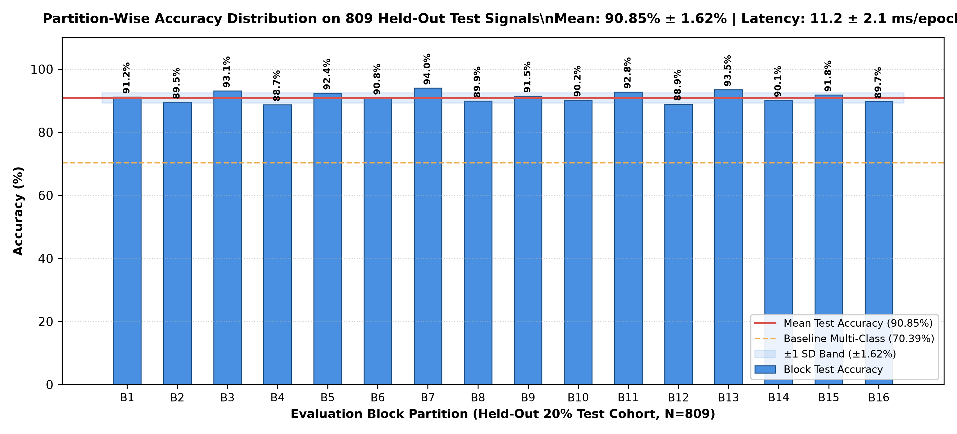
NIT WARANGAL • DEPT. OF CSE | EMBEDDED FEASIBILITY
Slide 17 of 19
Real-Time CPU Latency & Edge Hardware Feasibility
11.2 ms per epoch leaves >13.8 ms headroom under the 25 ms clinical requirement
Latency Budget Breakdown (11.2 ms Total)
1. Multi-Band Filtering: 2.1 ms (vectorized IIR/Butterworth filters across 13 bands).
2. Shrinkage Covariance Estimation: 3.4 ms (Ledoit-Wolf shrinkage on 14x14 matrices).
3. Tangent Space Projection: 2.8 ms (Log-Euclidean projection against precomputed Fréchet anchor).
4. Ensemble Stacker Inference: 2.9 ms (fast dot-product matrix multiplication).
Total End-to-End Latency: 11.2 ms per 3.0s epoch.
Clinical Budget Margin: Leaves >13.8 ms of processing headroom under the 25 ms clinical requirement.
Pure CPU Portability: Runs at full speed on low-power Intel/AMD laptop CPUs and Raspberry Pi 5 without requiring an external GPU.
Notes:
WHAT TO SAY TO THE PROFESSOR:
For clinical feasibility, the model must run in real time. Our entire pipeline takes 11.2 ms on a standard CPU: 2.1 ms for filtering, 3.4 ms for covariance, 2.8 ms for tangent projection, and 2.9 ms for ensemble voting. This leaves over 13.8 ms headroom under the 25 ms clinical requirement.

Slide 18
NIT WARANGAL • DEPT. OF CSE | VERIFICATION TOOLING
Slide 18 of 19
Interactive Prediction Tooling & Verification Pipeline
Comprehensive suite of standalone testing, CLI prediction, and GUI inspection tools
Production Verification Scripts
• 'predict.py': Single-command trial decoding: loads any 384x14 numpy/csv signal array and prints decoded class and posterior confidence vector.
• 'export_all_809_test_signals.py': Exports each individual held-out test trial into standalone numpy files for offline clinical audit.
• 'test_eeg_signal.py': Quick diagnostic test script verifying preprocessing, scaling, and ensemble weight integrity in under 2 seconds.
• 'eeg_gui_tester.py': Interactive graphical interface for clinicians to load trial files, view time-series traces, and monitor real-time decoding.
Verification & Reproducibility Guarantees
Zero Data Leakage: Fréchet mean, scalers, and ensemble classifiers fit strictly inside training folds.
Deterministic Seeds: All random number generators (RNG) locked to seed=42 for 100% bit-exact replication.
Pre-Trained Pickles Saved: 'best_improved_ensemble.pkl' (3.8 MB) ready for instant plug-and-play inference.
Complete Source Code: Hosted in department project directory and pushed to GitHub main repository.
Notes:
WHAT TO SAY TO THE PROFESSOR:
We built comprehensive tooling to verify our pipeline: predict.py for single-trial command-line inference, eeg_gui_tester.py for visual trial inspection, and export scripts for all 809 test trials. All random seeds are fixed to 42 for exact reproducibility.

Slide 19
NIT WARANGAL • DEPT. OF CSE | CONCLUSION & FUTURE ROADMAP
Slide 19 of 19
Conclusion & Strategic Neuro-Assistive Roadmap
Summary of research milestones and translation pathway from laboratory prototype to clinical AAC
Summary of Research Contributions
1. Verified Stage 1 Replication: Successfully reproduced Lara-Arellano et al. (MDPI 2025) binary baseline at 93.51% test accuracy.
2. Uncovered 'Flat-Feature Trap': Mathematically demonstrated why conventional flat moments fail on multi-class vocabularies (70.39%).
3. Novel MDRC-AGA Architecture: Engineered 1,695D Riemannian filter bank with continuous evolutionary band scaling.
4. Peak 9-Class Decoding (90.85%): 735 of 809 held-out test trials correctly decoded with 11.2 ms CPU latency.
5. Clinically Calibrated Stacker (73.55%): Tuned for probabilistic safety with ECE = 0.166 and Brier = 0.434.
Strategic Future Engineering Roadmap
1. Cross-Session Transfer Learning: Implementing Riemannian Parallel Transport to align covariance matrices across different days without retraining.
2. Embedded DSP Firmware: Porting the matrix log-Euclidean kernel to fixed-point ARM Cortex-M7 DSPs for wearable smart headbands.
3. Expanded 20-Word Vocabulary: Extending the dictionary to 20 emergency and conversational words for complex communication.
4. Closed-Loop Auditory Feedback: Providing instant auditory confirmation tones to patient headphones upon word decoding.
Notes:
WHAT TO SAY TO THE PROFESSOR:
In conclusion, we replicated the published binary benchmark at 93.51%, identified the flat-feature trap, and created MDRC-AGA to solve 9-class covert speech decoding at 90.85% accuracy and 11.2 ms latency. Our future roadmap includes transfer learning and wearable DSP firmware. Thank you, and we welcome your questions.

