Slide 1
Program Analysis of Corefiles (PAC) and Crash-Blamer
Ali, Ananth, Bharathi, Djordje, Ivan
Compilers and System Tools
1/25/2021

Slide 2
Motivation
Crash debugging/triaging workflow in Cisco and our team’s recent contributions
Live debugging with GDB and/or reverse debugging with Undo
Much more popular is core-file and traceback decoding: 200+ per day
Getting list of function/line frames in crash backtrace
#0 __list_del (prev=0x0, next=0x0) at appqoe/sslproxy/common/utils/src/list.h:90 #1 list_del (entry=0x7f39a120a570) at appqoe/sslproxy/common/utils/src/list.h:104 #2 sdhs_free_encs_buf (packet=0x7f39a120a570) at appqoe/sslproxy/common/utils/src/encs_buf.c:358 #3 0x00005578a26a8fbc in lwssl_fs_cleanup (lfs=<optimized out>) at appqoe/sslproxy/lwssl/src/lwssl_fs.c:3077 #4 lwssl_fs_close (fs=0x5578a59b8af8, fs@entry=0xa0812832ac05) at appqoe/sslproxy/lwssl/src/lwssl_fs.c:3137 #5 0x00005578a26a9809 in lwssl_drain_n_propagate_rst (lfs=lfs@entry=0x7f39240313c8, dir=<optimized out>, dir@entry=S2C) at appqoe/sslproxy/lwssl/src/lwssl_fs.c:2572 #6 0x00005578a26b2861 in fsm_flush_done_event_handler (lfs=lfs@entry=0x7f39240313c8, msg_code=LWSSL_FLOW_ISM_FLUSH_DONE_S2C, dir=S2C) at appqoe/sslproxy/lwssl/src/lwssl_fsm.c:2132 #7 0x00005578a26a53bc in lwssl_ism_work_cb (data=data@entry=0x5578a420c320) at appqoe/sslproxy/lwssl/src/lwssl_fs.c:1087 #8 0x00005578a26913db in tcpproxy_process_rx_ism_ctrl_worker (tg=0x5578a41c7938) at appqoe/tcpproxy/src/tcpproxy.c:3004 #9 tcpproxy_worker_thread (ctx=0x5578a41c7938) at appqoe/tcpproxy/src/tcpproxy.c:3896 #10 0x00007f39ba44f490 in __pthread_start_routine (arg=0x0) at infra/prelib/src/prelib_pthread.c:345 #11 0x00007f39a58b3f46 in start_thread (arg=<optimized out>) at pthread_create.c:479 #12 0x00007f39a3e0d6bf in clone () at ../sysdeps/unix/sysv/linux/x86_64/clone.S:95
If DT, assign CDET to appropriate component
If DE, look for unusual argument values or control flow
Our team developed:
If arg is <optimized out>, track value at parent (caller) of the function - contributed this feature to community
Source code browsing
CDET duplication
How can we further simplify triaging and provide more insights into the root cause and even suggest a possible fix?

Slide 3
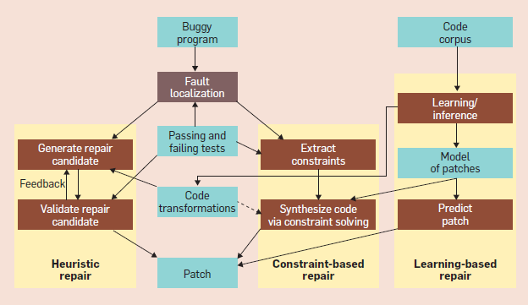
Motivation by academia/industry
Long-term goal: Automatic Program Repair
Automatically identify patches for a given bug, which can then be applied with little, or even without, human intervention
Recently we’ve seen interesting industry work – Facebook
Goues at al. Comm ACM, Dec. 2019

Slide 4
Our approach and design goals
Begin with specific common issues: segfaults corefiles, bad uses of pointers
The first function in crash backtrace is usually not bad, so analyze functions in reverse order to identify bad function and ideally source line => Crash-Blamer
Corefile
Decompiler
Machine IR
Compiler Analyses
Report: bad function, source code lines
Binaries
Binaries
Linux environment, leverage open-source LLVM libraries and tools as building blocks
Start with program (compiler/decompiler) analyses
Incorporate new tool in our existing decoding infrastructure to bring immediate value to our customers
Enhance with ML approaches

Slide 5
Team development goals
Bring together and cross-pollinate our expertise in Compilers and analyses and Debugging and decoding
Learn new technologies, or expand existing technologies to solve new problems
We develop and support major tools in Cisco, so we work only part-time on this project

Slide 6
Overview of our Work-in-Progress
Motivation and goals for PAC and Crash-Blamer - Ivan
Decompiler – Djordje
Compiler taint analysis – Bharathi
Integration with Decoder and demo – Ananth
Corefile test generation and tool testing – Ali
Q&A
Corefile
Decompiler
Machine IR
Compiler Analyses
Report: bad function, source code lines
Binaries
Binaries
DevX Decoder Infrastructure for XE/XR

Slide 7
Decompilation

Slide 8
Compilation
How LLVM/Clang generates an executable file?
Source code as an input (e.g., written in C)
Lexer/Parser/AST
IR + optimization/analysis on the IR
Instruction selection
MIR + optimization/analysis on the MIR
Assembler/Object file
Debug Info production

Slide 9
Compilation
; Function Attrs: noinline nounwind optnone uwtable
define dso_local i32 @foo() #0 {
entry:
%retval = alloca i32, align 4
%call = call i32 (...) @baa()
%tobool = icmp ne i32 %call, 0
br i1 %tobool, label %if.then, label %if.end
if.then: ; preds = %entry ➔
store i32 1, i32* %retval, align 4
br label %return
if.end: ; preds = %entry
store i32 0, i32* %retval, align 4
br label %return
return: ; preds = %if.end, %if.then
%0 = load i32, i32* %retval, align 4
ret i32 %0
}
int foo() {
if (baa())
return 1; ➔
return 0;
}
`-FunctionDecl 0xa12e5b0 <line:3:1, line:7:1> line:3:5 foo 'int ()'
`-CompoundStmt 0xa12e750 <col:11, line:7:1>
|-IfStmt 0xa12e700 <line:4:3, line:5:12>
| |-CallExpr 0xa12e6b0 <line:4:7, col:11> 'int’ ➔
| | `-ImplicitCastExpr 0xa12e698 <col:7> 'int (*)()' <FunctionToPointerDecay>
| | `-DeclRefExpr 0xa12e650 <col:7> 'int ()' Function 0xa12e4a0 'baa' 'int ()'
| `-ReturnStmt 0xa12e6f0 <line:5:5, col:12>
| `-IntegerLiteral 0xa12e6d0 <col:12> 'int' 1
`-ReturnStmt 0xa12e740 <line:6:3, col:10>
`-IntegerLiteral 0xa12e720 <col:10> 'int' 0
# Machine code for function foo: NoPHIs, TracksLiveness, NoVRegs, TiedOpsRewritten
bb.0.entry:
frame-setup PUSH64r undef $rax, implicit-def $rsp, implicit $rsp
CFI_INSTRUCTION def_cfa_offset 16
dead $eax = XOR32rr undef $eax(tied-def 0), undef $eax, implicit-def dead $eflags, implicit-def $al
CALL64pcrel32 @baa, <regmask $bh $bl $bp $bph $bpl $bx $ebp $ebx $hbp $hbx $rbp $rbx $r12 $r13 $r14 $r15 $r12b $r13b $r14b $r15b $r12bh $r13bh $r14bh $r15bh $r12d $r13d $r14d $r15d $r12w $r13w $r14w $r15w $r12wh and 3 more...>, implicit $rsp, implicit $ssp, implicit $al, implicit-def $rsp, implicit-def $ssp, implicit-def $eax
renamable $ecx = XOR32rr undef $ecx(tied-def 0), undef $ecx, implicit-def dead $eflags
TEST32rr killed renamable $eax, renamable $eax, implicit-def $eflags ➔
renamable $cl = SETCCr 5, implicit killed $eflags, implicit killed $ecx, implicit-def $ecx
$eax = MOV32rr killed $ecx
$rcx = frame-destroy POP64r implicit-def $rsp, implicit $rsp
CFI_INSTRUCTION def_cfa_offset 8
RETQ $eax
# End machine code for function foo.
<foo>:
push %rax
xor %eax,%eax
callq 8 <foo+0x8>
xor %ecx,%ecx
test %eax,%eax ➔
setne %cl
mov %ecx,%eax
pop %rcx
retq
10010001000100
…
100..
1010000.00101011…

Slide 10
Compilation
LLVM MIR
Machine Function attributes
Registers/Register state flags
CFG
Data Flow Analysis
# Machine code for function foo: NoPHIs, TracksLiveness, NoVRegs, TiedOpsRewritten
bb.0.entry:
frame-setup PUSH64r undef $rax, implicit-def $rsp, implicit $rsp
CFI_INSTRUCTION def_cfa_offset 16
dead $eax = XOR32rr undef $eax(tied-def 0), undef $eax, implicit-def dead $eflags, implicit-def $al
CALL64pcrel32 @baa, <regmask $bh $bl $bp $bph $bpl $bx $ebp $ebx $hbp $hbx $rbp $rbx $r12 $r13 $r14 $r15 $r12b $r13b $r14b $r15b $r12bh $r13bh $r14bh $r15bh $r12d $r13d $r14d $r15d $r12w $r13w $r14w $r15w $r12wh and 3 more...>, implicit $rsp, implicit $ssp, implicit $al, implicit-def $rsp, implicit-def $ssp, implicit-def $eax
renamable $ecx = XOR32rr undef $ecx(tied-def 0), undef $ecx, implicit-def dead $eflags
TEST32rr killed renamable $eax, renamable $eax, implicit-def $efl
renamable $cl = SETCCr 5, implicit killed $eflags, implicit killed $ecx, implicit-def $ecx
$eax = MOV32rr killed $ecx
$rcx = frame-destroy POP64r implicit-def $rsp, implicit $rsp
CFI_INSTRUCTION def_cfa_offset 8
RETQ $eax
# End machine code for function foo.

Slide 11
DeCompilation
Reverse order
Assembler/Object file as an input
MIR + deoptimization/analysis on the MIR
Instruction deselection
IR + deoptimization/analysis on the IR
AST
Source code
Crash Blamer tool
Reading core file
Disassembly (functions from backtrace only)
Decompilation to the MIR level

Slide 12
DeCompilation Disassembly
Disassembly
Corefile (contains info about .text segment of funcs from backtrace)
libLLDB Library
Multiple architecture support
For now, we are testing X86 architecture only
LLDB debugger also uses the libLLDB library
(lldb) bt
* thread #1, name = 'clang-test00', stop reason = signal SIGSEGV
* frame #0: 0x000000000040111c clang-test00`h(r=0x0000000000000000) at test.c:7:6
frame #1: 0x0000000000401150 clang-test00`g(q=0x00007ffe7822d248) at test.c:12:3
frame #2: 0x0000000000401181 clang-test00`f at test.c:20:3
frame #3: 0x00000000004011a4 clang-test00`main at test.c:24:2
frame #4: 0x00007f530f84b545 libc.so.6`__libc_start_main + 245
frame #5: 0x000000000040104e clang-test00`_start + 46
(lldb) disassemble
clang-test00`h:
0x401110 <+0>: pushq %rbp
0x401111 <+1>: movq %rsp, %rbp
0x401114 <+4>: movq %rdi, -0x8(%rbp)
0x401118 <+8>: movq -0x8(%rbp), %rax
-> 0x40111c <+12>: movl $0x0, (%rax)
0x401122 <+18>: popq %rbp
0x401123 <+19>: retq

Slide 13
DeCompilation Decompilation to the MIR level
There are existing LLVM utilities that could be used
MIR is good for analysis
Create IR Module (necessary for creation of Machine IR Module)
Create IR Dummy function for each function from bt
Create Machine IR Module with real Machine Functions (by creating debug info in order to report real line:column – by using DIBuilder and DI metadata – debug sections needed in the executable)
CFG
Reconstruct register state flags (we created LLVM Pass - FixRegStateFlags)
Create regInfo new Machine Function attribute with register values (read from corefile), so it can be used during analysis; crash-start MI attribute;
libCrashBlamerCoreFile and libCrashBlamerDecompiler

Slide 14
DeCompilation Decompilation to the MIR level
MIR in form of YAML (standard way of printing MIR; for testing purposes; llc tool uses it)
$ crash-blamer --core-file=core.clang-test00.25393 clang-test00 -print-decompiled-mir=test.mir
Crash Blamer -- crash analyzer utility
Loading core-file core.clang-test00.25393
core-file processed.
Decompiling...
Decompiled.
Blame Function is f
At Line Number 18, from file /home/djtodorovic/projects/cpp_examples/crashes/cisco-standard-case/test.c
RESULT: SUCCESS
We created a stand alone tool that parses the MIR generated from crash-blamer for testing purposes (e.g., we can make some tests for the analysis by hand)
$ crash-blamer-ta test.mir

Slide 15
DeCompilation Decompilation to the MIR level
$ cat test.mir
--- |
; ModuleID = 'clang-test00'
source_filename = "clang-test00"
target datalayout = "e-m:e-p270:32:32-p271:32:32-p272:64:64-i64:64-f80:128-n8:16:32:64-S128"
; Materializable
define void @f() !dbg !2 {
entry:
unreachable
}
…
!llvm.dbg.cu = !{!0}
!0 = distinct !DICompileUnit(language: DW_LANG_C, file: !1, producer: "crash-blamer", isOptimized: true, runtimeVersion: 0, emissionKind: FullDebug)
!1 = !DIFile(filename: "/home/djtodorovic/projects/cpp_examples/crashes/cisco-standard-case/test.c", directory: "/")
!2 = distinct !DISubprogram(name: "f", linkageName: "f", scope: null, file: !1, line: 1, type: !3, scopeLine: 1, spFlags: DISPFlagDefinition | DISPFlagOptimized, unit: !0, retainedNodes: !4)
…
...
---
name: h
alignment: 16
regInfo: { GPRegs:
- { reg: rax, value: '0x0000000000000000' }
- { reg: rbx, value: '0x0000000000000000' }
- { reg: rcx, value: '0x00000000004011b0' }
- { reg: rdx, value: '0x00007ffe7822d368' }
- { reg: rdi, value: '0x0000000000000000' }
- { reg: rsi, value: '0x00007ffe7822d358' }
- { reg: rbp, value: '0x00007ffe7822d210' }
- { reg: rsp, value: '0x00007ffe7822d210' }
- { reg: r8, value: '0x00007f530fbf1e80' }
- { reg: r9, value: '0x0000000000000000' }
- { reg: r10, value: '0x000000000000000d' }
- { reg: r11, value: '0x0000000000000006’ }
…
crashOreder: 1
body: |
bb.0:
liveins: $rbp, $rdi
PUSH64r $rbp, implicit-def $rsp, implicit $rsp, debug-location !DILocation(line: 6, scope: !6)
$rbp = MOV64rr $rsp, debug-location !DILocation(line: 6, scope: !6)
MOV64mr $rbp, 1, $noreg, -8, $noreg, $rdi, debug-location !DILocation(line: 6, scope: !6)
$rax = MOV64rm $rbp, 1, $noreg, -8, $noreg, debug-location !DILocation(line: 7, column: 4, scope: !6)
crash-start MOV32mi $rax, 1, $noreg, 0, $noreg, 0, debug-location !DILocation(line: 7, column: 6, scope: !6)
$rbp = POP64r implicit-def $rsp, implicit $rsp, debug-location !DILocation(line: 8, column: 1, scope: !6)
RETQ debug-location !DILocation(line: 8, column: 1, scope: !6)
…

Slide 16
DeCompilation Future work
Investigate high level of optimizations –O2/-O3
Support functions that are not part of the backtrace
Support/test targets other than X86
Investigate the usefulness of the decompilation library in other areas
Reverse engineering (good purposes only)
Decoding some viruses/malwares
Analysis of programs compiled with compilers other than clang (e.g., decompile program compiled with gcc to LLVM MIR, and then apply some LLVM analysis/optimization on the code)

Slide 17
Taint Analysis

Slide 18
PAC Tool Flow
PAC
CORE
DECOMPILER
ANALYSIS
RESULT
SOURCE

Slide 19
Taint Analysis
Information Flow Analysis
Track a data of interest from source to sink
Attach a tag to data of interest (tainting the data at source)
Track the flow of tainted object along the program flow
Taint relevant data
Observe if it reaches sensitive functions (sink)
Applications
Finding information leakage
Finding program vulnerability
Notes:
Info leakage: If a variable x contains sensitive data, x is tainted. Any variable depending on x will also get tainted (for eg, a = b +x ). Here a is also tainted. Observe if the tainted data will flow to sensitive functions (sink)
Prog vulnerability: Say you want to observe where any user data (potentially unchecked) flows into your code to sensitive functions.

Slide 20
Types of Taint Analysis
Dynamic Taint Analysis
Needs runtime instrumentation
Does not explore all program paths
Static Taint Analysis
No instrumentation needed
Over tainting
Scalability problems
Less Accurate
Forward Taint Analysis
Source to Sink
Backward Taint Analysis
Sink to Source
PAC uses this

Slide 21
Example
void f() {
T p;
p.fn = NULL; // blame point
g(&p);
}
int main() {
f();
return 0;
}
void h(int *r) {
*r = 3; // crash
}
void g (T*q) {
int *t = q->fn;
h(t);
}
Backtrace:
#0 h (r=0x0) at test.c:7
#1 g (q=0x7ffd71b147e8) at test.c:12
#2 f () at test.c:20
#3 main () at test.c:24

Slide 22
Analysis
Uses Backward Taint Analysis
Analysis done on LLVM Machine Intermediate Representation (MIR)
Sink – Crash Instruction [h(): *r = 3]
Tainted data – Memory operands of the crash instruction [h:r]
Source -- Origin of bad data [g(): p.fn = NULL]
One sink but potentially multiple source(s)
Notes:
Track how private information flows through the program and detect if it is leaked

Slide 23
Basic Outline of Backward Taint Analysis
Start-Taint
Crash Instruction corresponding to #0 in bt
movl $3, (%rax)
Taint memory operands ({reg,offset} {reg, base, index})
Memory address: (%rax)
Create a TaintList
(%rax)

Slide 24
Basic Outline of Backward Taint Analysis
Propagate Taint
Backward traversal of MIR
Examine Source(s) and Destination Op of each MIR
If tainted Op is a Dest, add the Src Op to the taint list, remove the Dest Op
If func call has tainted operands, propagate taint within the func def (Not Impl)
movq %rdi, -8(%rbp) // Taint List {%rdi}
movq -8(%rbp), %rax // Taint List {-8%rbp}
movl $3, (%rax) // Taint List {%rax}

Slide 25
Basic Outline of Backward Taint Analysis
Terminate Taint
TaintList is empty – reached end of backtrace
If a store instruction has
Tainted destination operand
Constant source operand
(Algorithm development in progress)
movq $0, -8(%rbp) // Taint Terminated
leaq -8(%rbp), %rdi // Taint List: {-8(%rbp)}

Slide 26
Decoder to Crash-Blamer Integration

Slide 27
Triaging core-files
Core-file is the process snapshot at failure point: SEGV,ABRT,BUS,ILL,ALRM
Contains text, data, stack, shared memory of process including LIBs
Top frame Register-set for all threads, with crashing thread high-lighted.
Triaging core-files involves decoder/debugger
Unwind top register-set into full call backtrace with symbolic annotation
What else can be done to help triage and RCA?

Slide 28
Architecture
Inputs:
Core
Program Exec
Crash-Blamer
Output: RCA report
Core Reader
Decompiler
Analysis
F0..Fn, RS0..RSn
MIR
LLDB
LLVM
LLVM

Slide 29
PAC modules
Core reader extracts functions and register-set in the backtrace of the crashing thread. Manages symbol look-up.
Decompiler: For all functions in backtrace, produces disassembly, MIR , register-state and other LLVM module state.
Analysis: Performs backward taint analysis and other compiler semantic analysis: forward control flow, backward data-flow analysis. Reports RCA on success.

Slide 30
Decoder to CrashBlamer Integration
Decoder passes sysroot and program exec location to crash-blamer
Core
Decoder, decode.py
Crash-Blamer
Decode o/p
PAC RCA report

Slide 31
PAC expectations
Effective
Not expected to be effective
Deterministic errors such as SEGV, ABRT, BUS
Blame code is in the crashing thread and in the backtrace
Blame code is NOT in the backtrace, but called by one of the functions in BT
Blame code belongs to some other thread
Memory corruption issues
Memory allocation errors
Race condition, timing issues

Slide 32
Demo example
void f() {
T p;
p.fn = NULL; // blame point
g(&p);
}
int main() {
f();
return 0;
}
void h(int *r) {
*r = 3; // crash
}
void g (T*q) {
int *t = q->fn;
h(t);
}
Backtrace:
#0 h (r=0x0) at test.c:7
#1 g (q=0x7ffd71b147e8) at test.c:12
#2 f () at test.c:20
#3 main () at test.c:24

Slide 33
Automatic test case generation for crash-blamer

Slide 34
Motivation
Crash-blamer requires corefiles for analysis
To test crash-blamer, we require corefiles and binaries at the minimum.
There are various ways to generate corefiles.
Current focus is to generate core files from SIGSEGV
From man 7 signal:
Signal | Value | Reason
SIGQUIT | 3 | Quit from keyboard
SIGILL | 4 | Illegal Instruction
SIGABRT | 6 | Abort signal from abort(3)
SIGFPE | 8 | Floating-point exception
SIGSEGV | 11 | Invalid memory reference

Slide 35
Csmith
Csmith is an open-source tool that generates random C code.
Its primary objective is to stress test compilers, static analyzers and similar tools.
It is available here: https://embed.cs.utah.edu/csmith/ and https://github.com/csmith-project/csmith
It has been used to detect 400 compiler bugs.
Csmith provides a good base code for modification.

Slide 36
Generating Index Out-of-Bounds(OOB) in code
One feature for csmith is to generate and access multi dimension arrays.
We extended the csmith project itself to generate a mix of cases with index out-of-bounds situations.
Changes made have been upstreamed back to the project repo.
This was achieved by implementing a new --array-oob-prob flag in csmith. $ csmith –array-oob-prob 100
generates code with a 100% probability of having index out of bounds accesses (r/w).

Slide 37
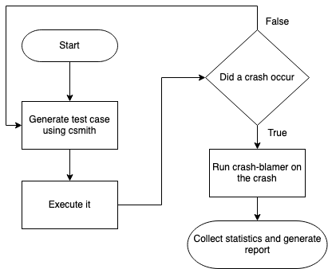
Creating a pipeline for test case

Slide 38
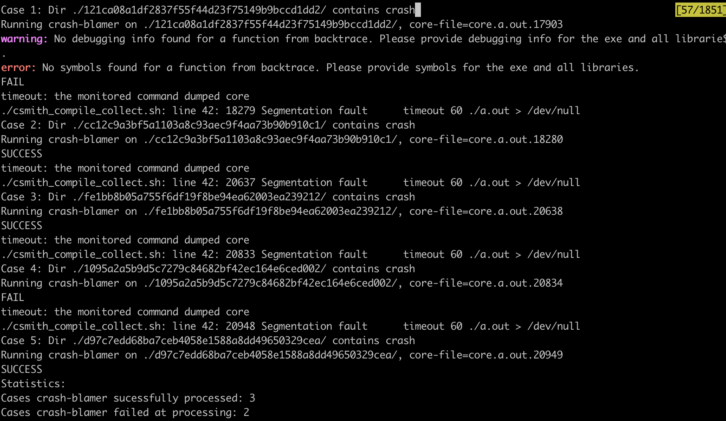

Slide 39
Future Work
Using csmith to generate pointers that reference to NULL
Explore other ways of generating corefiles:
SIGILL
SIGABORT
Reduce code length in the generated test case

