Slide 1
Using neural networks to recognize eyeglasses in Twitter profile pictures
Robert V Gramillano

Slide 2
Outline
Abstract
Data Wrangling and Cleaning
Modeling with convolutional neural networks
Deploying to cloud
Conclusion

Slide 3
Outline
Abstract
Data Wrangling and Cleaning
Modeling with convolutional neural networks
Deploying to cloud
Conclusion

Slide 4
Why care about detecting eyeglasses?
Eyeglass companies like Warby Parker can use this model to identify users on social media that wear eyeglasses and subsequently target them with advertisements and specialty deals
The goal of this project is to train convolutional neural network to recognize eyeglasses in social media profile pictures

Slide 5
Outline
Abstract
Data Wrangling and Cleaning
Modeling with convolutional neural networks
Deploying to cloud
Conclusion

Slide 6
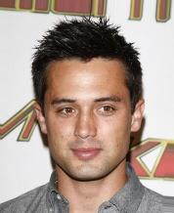
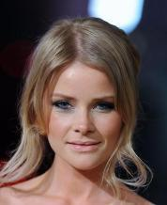
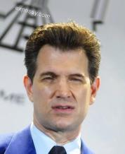
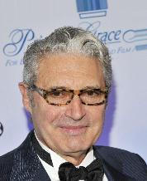
The Celebrity Faces Attribute (CelebA) dataset
“A large-scale face attributes data with more than 200K celebrity images, each with 40 attribute annotations.”
Attributes include wearing a hat, having a moustache, having bangs, etc.
Model could thus be retrained on a different attribute for a different company
Each image of size 178 x 218, ~10 KB each

Slide 7
Creating the modeling dataset
Gather all the images in the dataset where someone is wearing eyeglasses
13,193 images, ~6.5%.
We would like our modeling dataset to consist of 80K images all together, so gather the rest of the images
Then:
Realign images to make consistent with later social media profile pictures
Convert to grayscale
Resize to 28 x 28
Save dataset with labels (zero for no eyeglasses, one for eyeglasses)

Slide 8
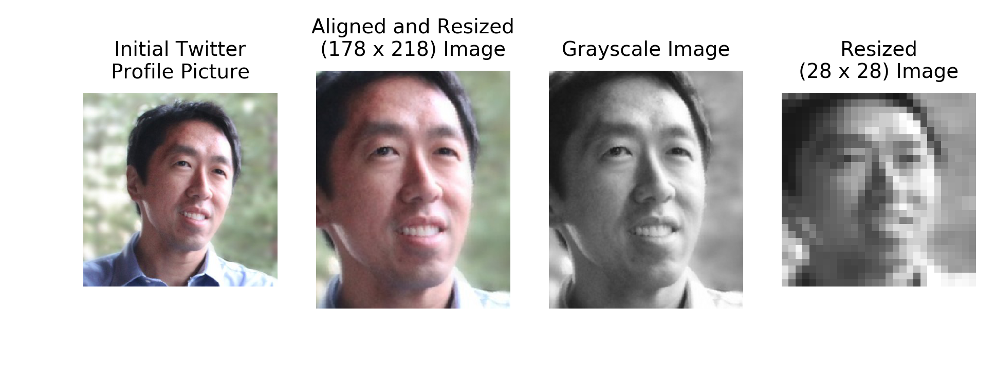
Social media profile pictures
Twitter used as primary social media profile picture dataset
Run through same pipeline as CelebA dataset (20 images)

Slide 9
Outline
Abstract
Data Wrangling and Cleaning
Modeling with convolutional neural networks
Deploying to cloud
Conclusion

Slide 10
Convolutional Neural Networks (CNNs)
Similar to ordinary neural networks (series of hidden layers) but adapted for image inputs
Arrange neurons in three dimensions
Neurons in CNNs are connected only to a small region of the layer before it
Reduces overfitting and number of parameters
https://cs231n.github.io/convolutional-networks/ for more detail

Slide 11
CNN architecture and modeling
Used a previously constructed CNN architecture in TensorFlow from a similar project for modeling
INPUT -> CONV (32 filters) -> POOL -> CONV (64 filters) -> POOL ->
FLATTEN -> FC -> DROPOUT -> FC (prediction)
~80K modeling images split (80/20) for training/testing
Batch size 100
2000 epochs
Loss: softmax cross entropy
Optimizer: Adam

Slide 12
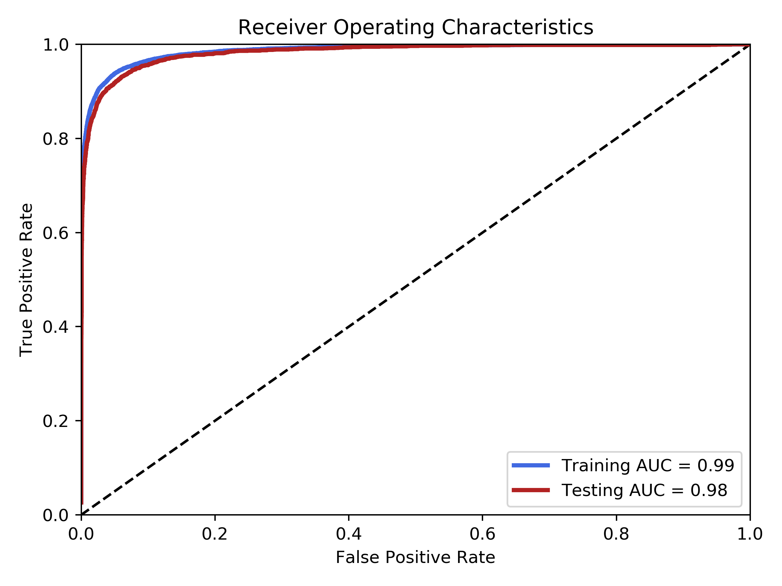
Modeling Results

Slide 13
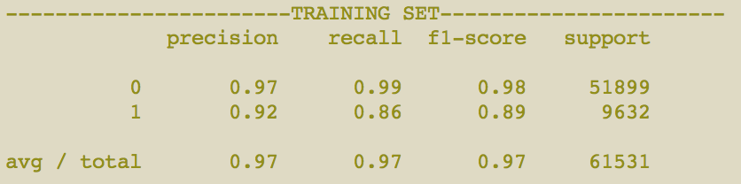
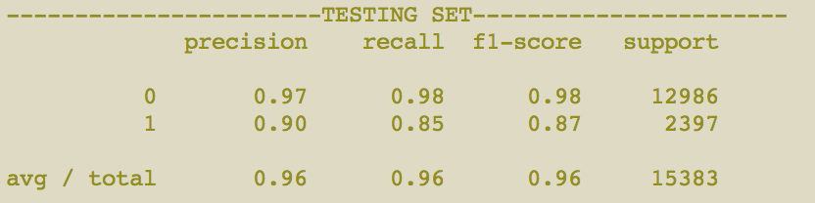
Modeling Results

Slide 14
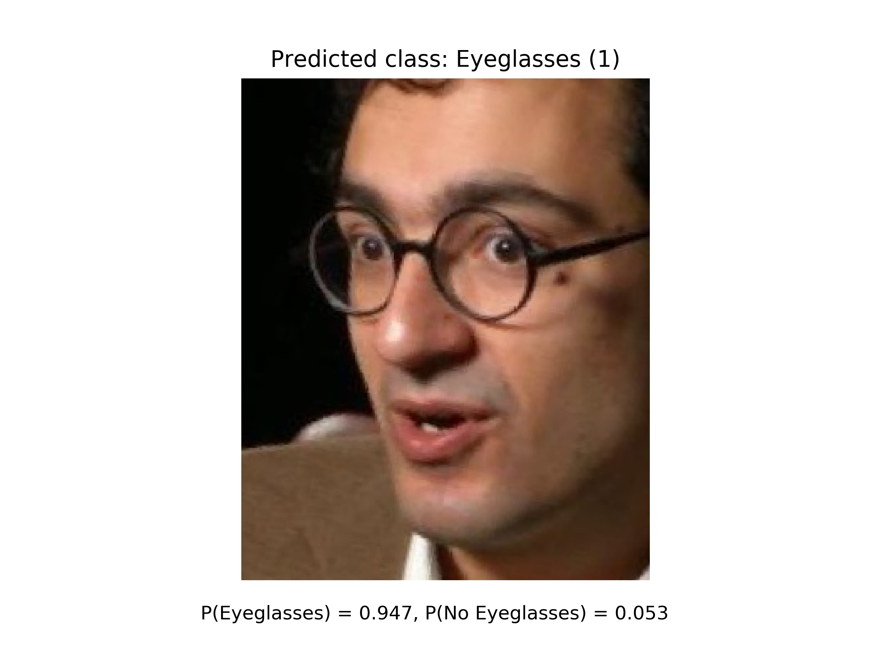
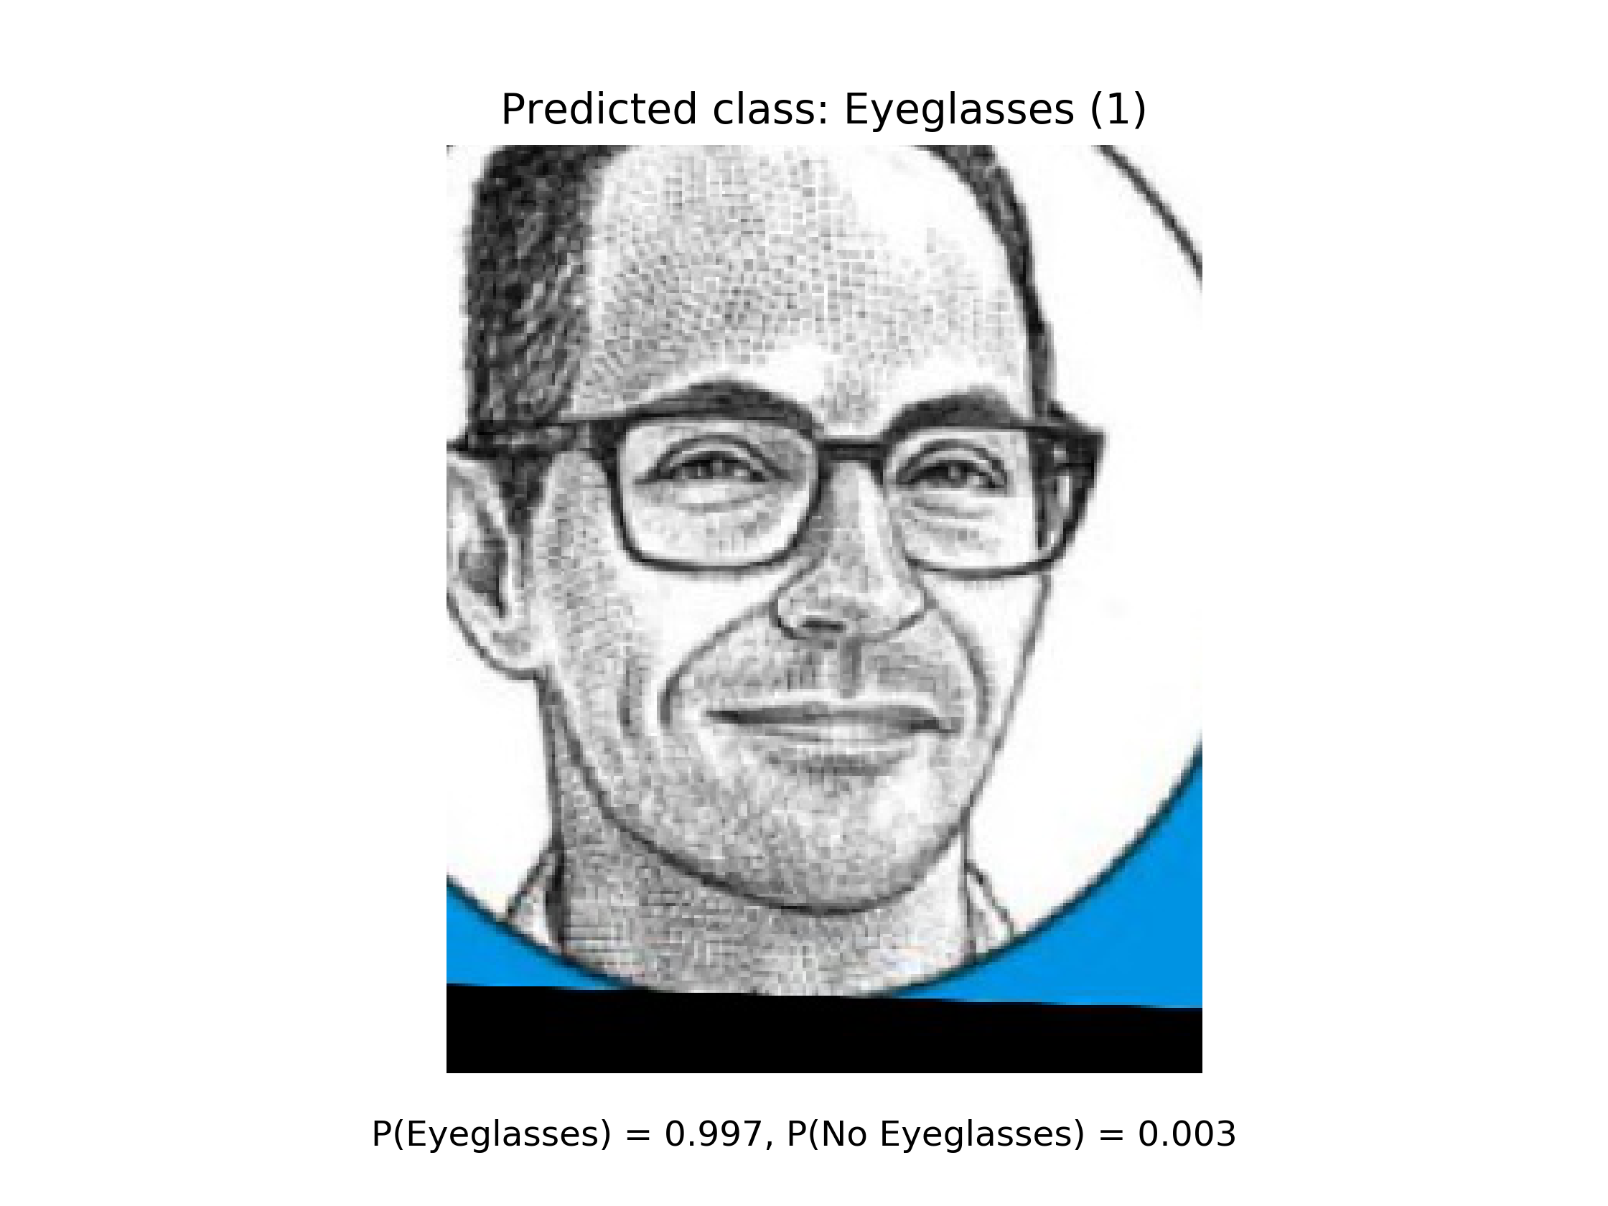
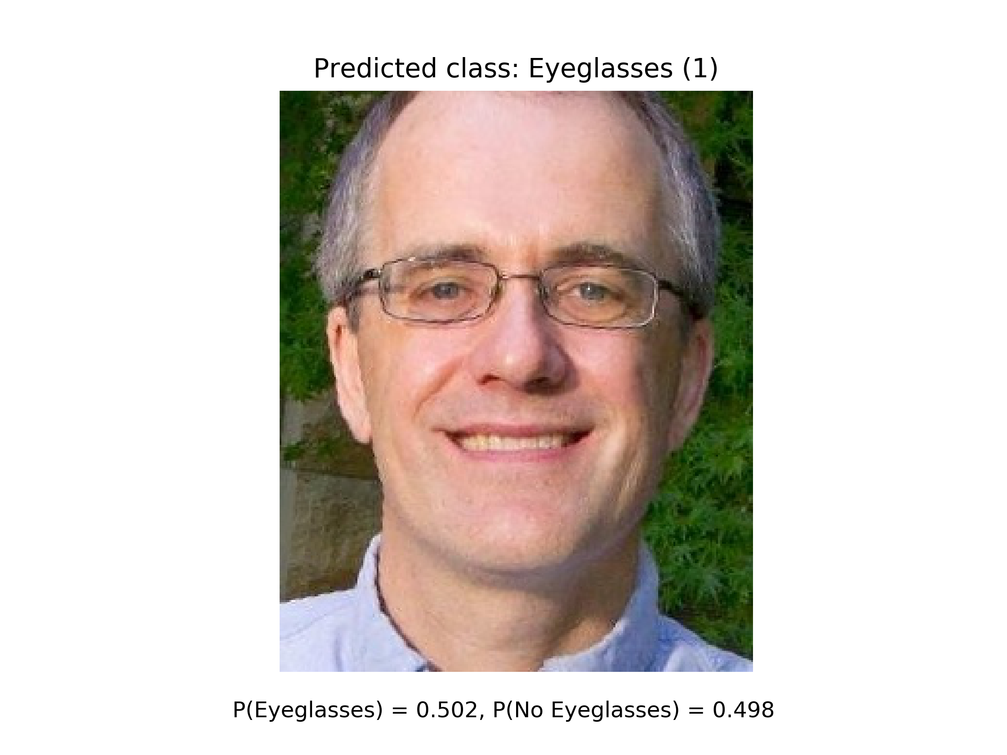
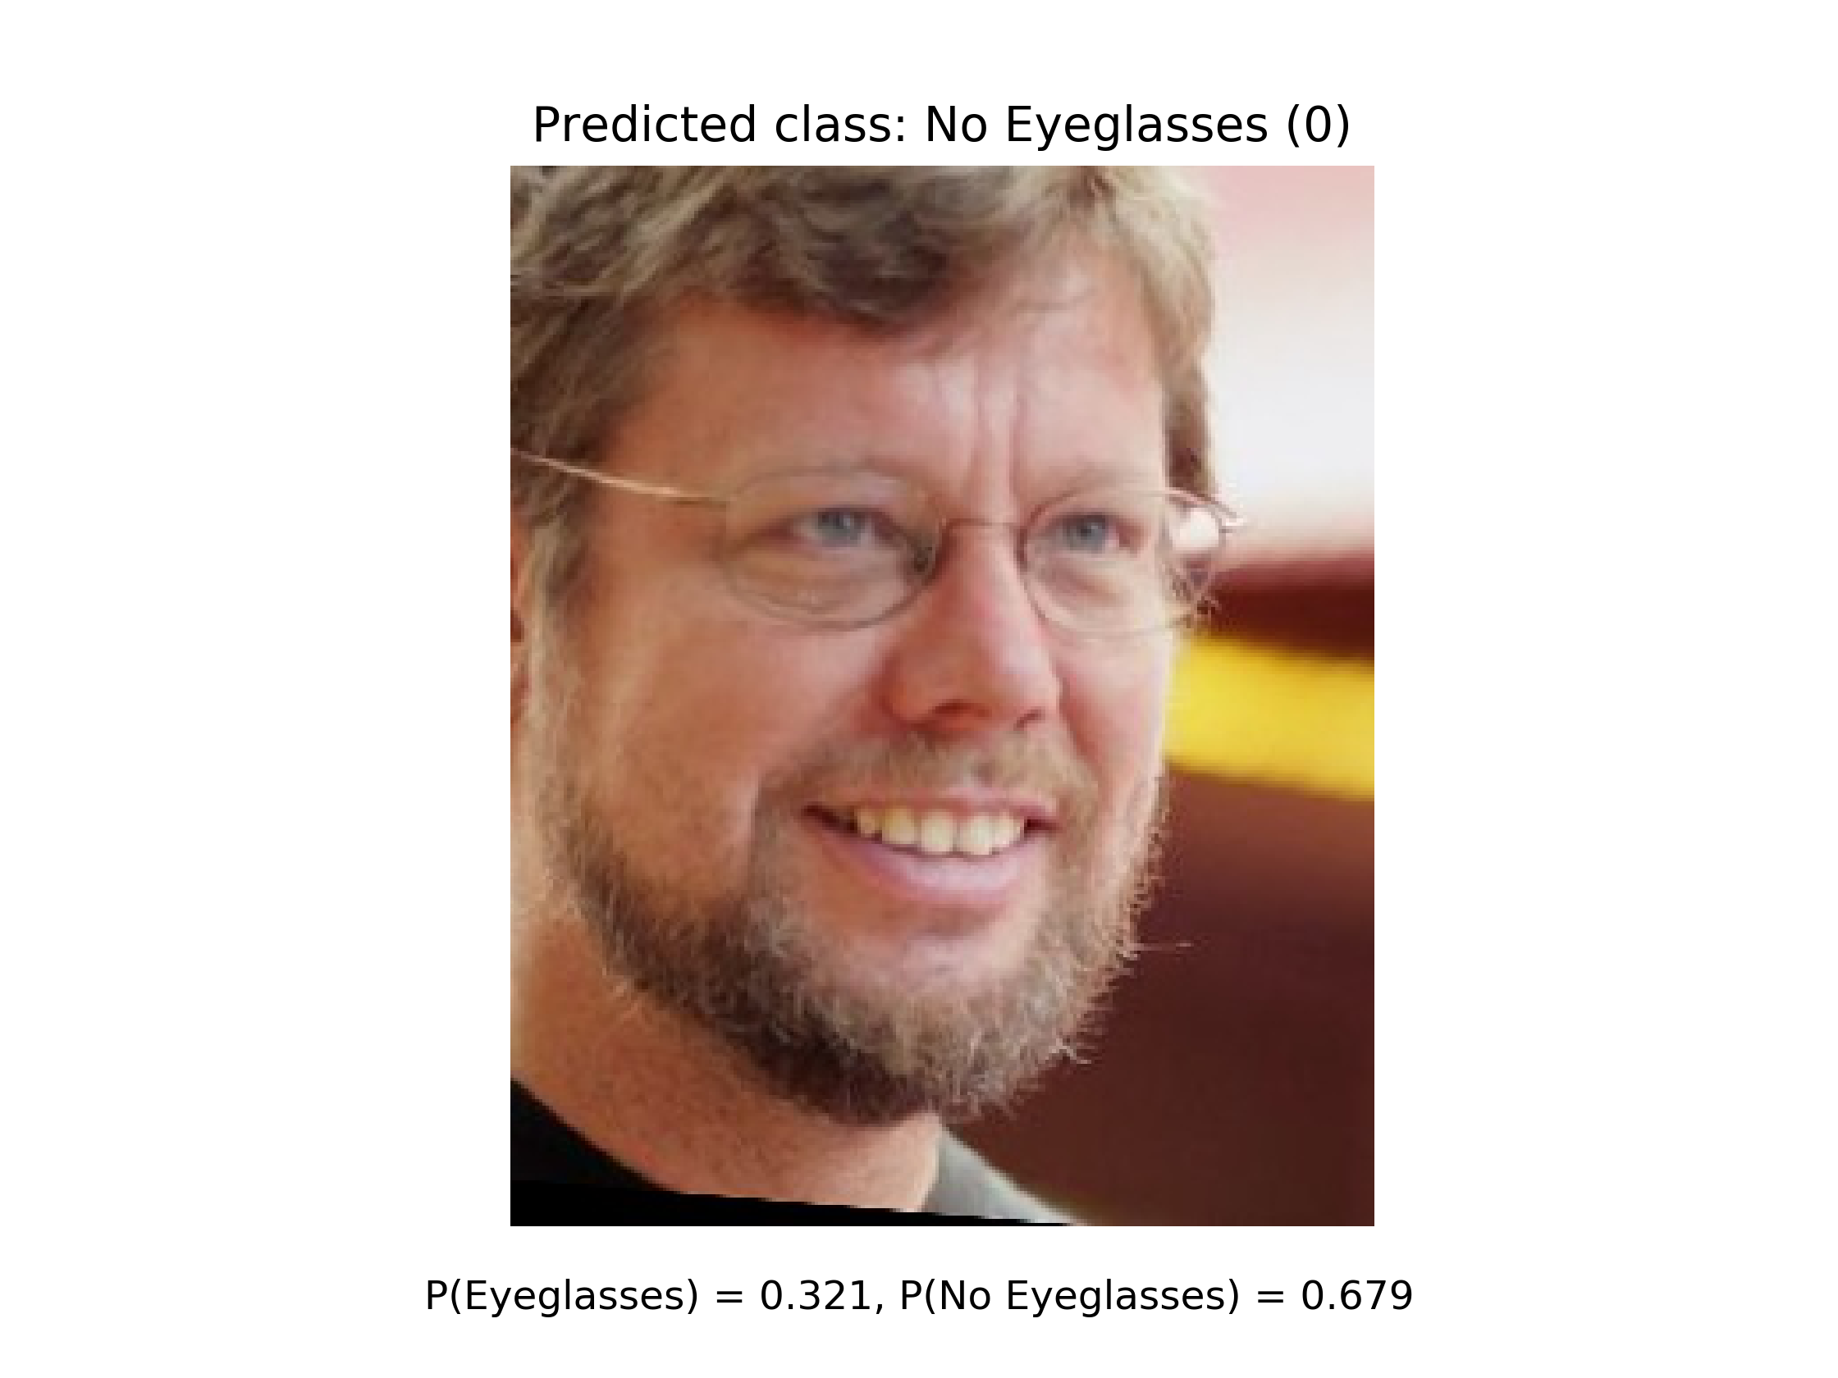
Twitter Profile Pictures
85% accuracy on all 20 images
Recall most difficult
Lowering threshold could improve results, but still decent performance

Slide 15
Outline
Abstract
Data Wrangling and Cleaning
Modeling with convolutional neural networks
Deploying to cloud
Conclusion

Slide 16
Conclusion: useful for advertising campaigns
85% accuracy on Twitter profile pictures is good and useful
Could adapt this pre-trained CNN for other business applications
Facial hair
Hats, etc.

Slide 17
Next Steps
Potential to generalize to more attributes and thus different companies with CelebA data set
Automate process for scraping social media profile pictures
Could try applying matrix operations to training to account for translational/rotational invariance and improve the model
Make less reliant on face aligner

Slide 18
Thanks!
https://github.com/rvgramillano/ https://www.linkedin.com/in/robert-v-gramillano-8b49aa93/

