Slide 1
Predicting Electricity Demand using Weather Data
Robert V Gramillano

Slide 2
Outline
Abstract
Data Wrangling and Cleaning
Exploratory Data Analysis
Machine learning and modeling
Using RNNs and LSTM
Comparison to other forecasts
Conclusion

Slide 3
Outline
Abstract
Data Wrangling and Cleaning
Exploratory Data Analysis
Machine learning and modeling
Using RNNs and LSTM
Comparison to other forecasts
Conclusion

Slide 4
Why care about electricity demand?
Energy companies rely on accurate forecasts to predict upcoming demand.
An improved forecast helps energy companies take next steps to fully capitalize on and perhaps better brace for large spikes in electricity demand.
The goal of this project is to train a machine learning model on weather/electricity data to generate a more nuanced energy-demand forecast.

Slide 5
Outline
Abstract
Data Wrangling and Cleaning
Exploratory Data Analysis
Machine learning and modeling
Using RNNs and LSTM
Comparison to other forecasts
Conclusion

Slide 6
Scope of the project: Electricity Data
Hourly electricity and weather data gathered from the Los Angeles metropolitan areas
Electricity demand data was retrieved using the Energy Information Administration’s (EIA) API
LA electricity data gathered from Los Angeles Department of Water and Power
Data from July 2015 to September 2018

Slide 7
Scope of the project: Weather Data
Hourly weather data was retrieved from the National Oceanic and Atmospheric Administration’s (NOAA) website
Local Climatological Data (LCD) was obtained LA metropolitan
LCD data includes, heating degree days, relative humidity, pressure, temperature, etc.

Slide 8
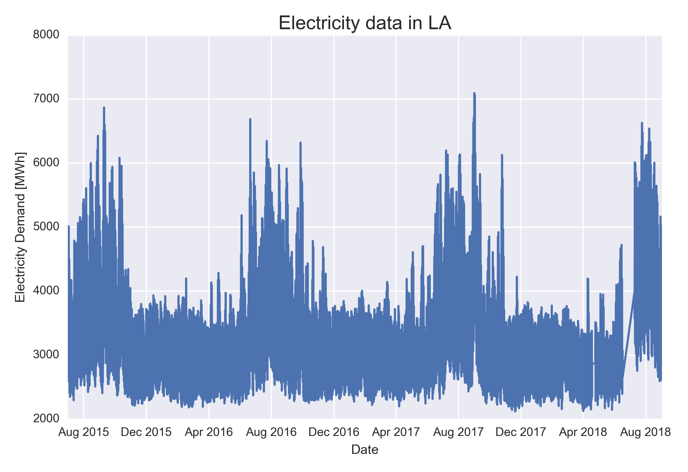
Cleaning Electricity Data
Electricity demand is measured in megawatt-hours (MWh) and had few outliers
Removing outliers reduced the size of the data set by ~.01% for LA

Slide 9
Cleaning Weather (LCD) Data
Dropped monthly and daily measurements, since we are only interested in hourly granularity
-Kept daily heating degree and cooling degree days (HDD/CDD) since they are an important indicator of energy demand
Multiple entries per hour, whereas electricity data only had one measurement per hour
-Kept measurement closest to the hour per hour such that LCD data will align with electricity data

Slide 10
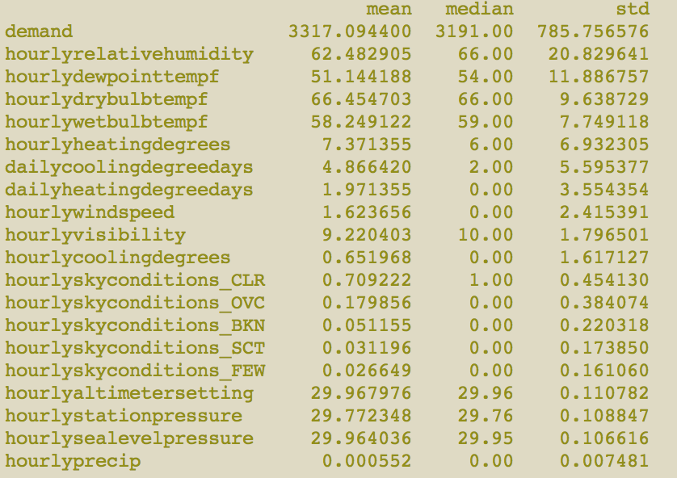
Null values in weather data
Since mean values are not too far away from median values, the median and pandas’ ffill function were used to fill null values for LCD data
Feature statistics

Slide 11
Combined Data Set
All together, our combined data set contains electricity and weather data, from July 2015 to September 2018 with a total of ~27K data points to be used for training

Slide 12
Outline
Abstract
Data Wrangling and Cleaning
Exploratory Data Analysis
Machine learning and modeling
Using RNNs and LSTM
Comparison to other forecasts
Conclusion

Slide 13
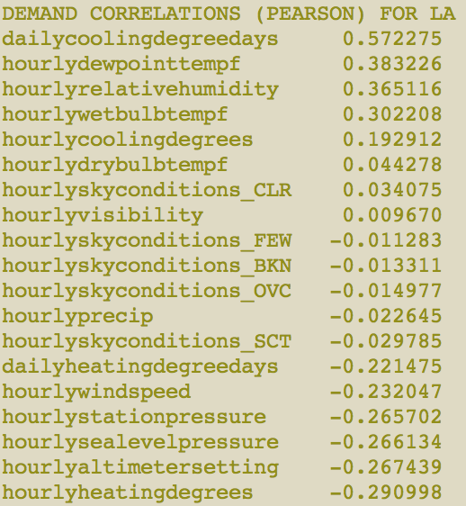
Initial Demand Correlations
Computed Pearson Correlation Coefficients between LCD data (x-variables) and electricity demand (y-variables)

Slide 14
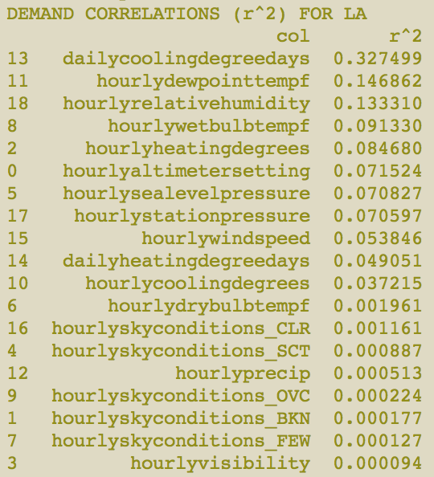
R² correlations

Slide 15
R² correlations
Collinearities in pressure and temperature

Slide 16
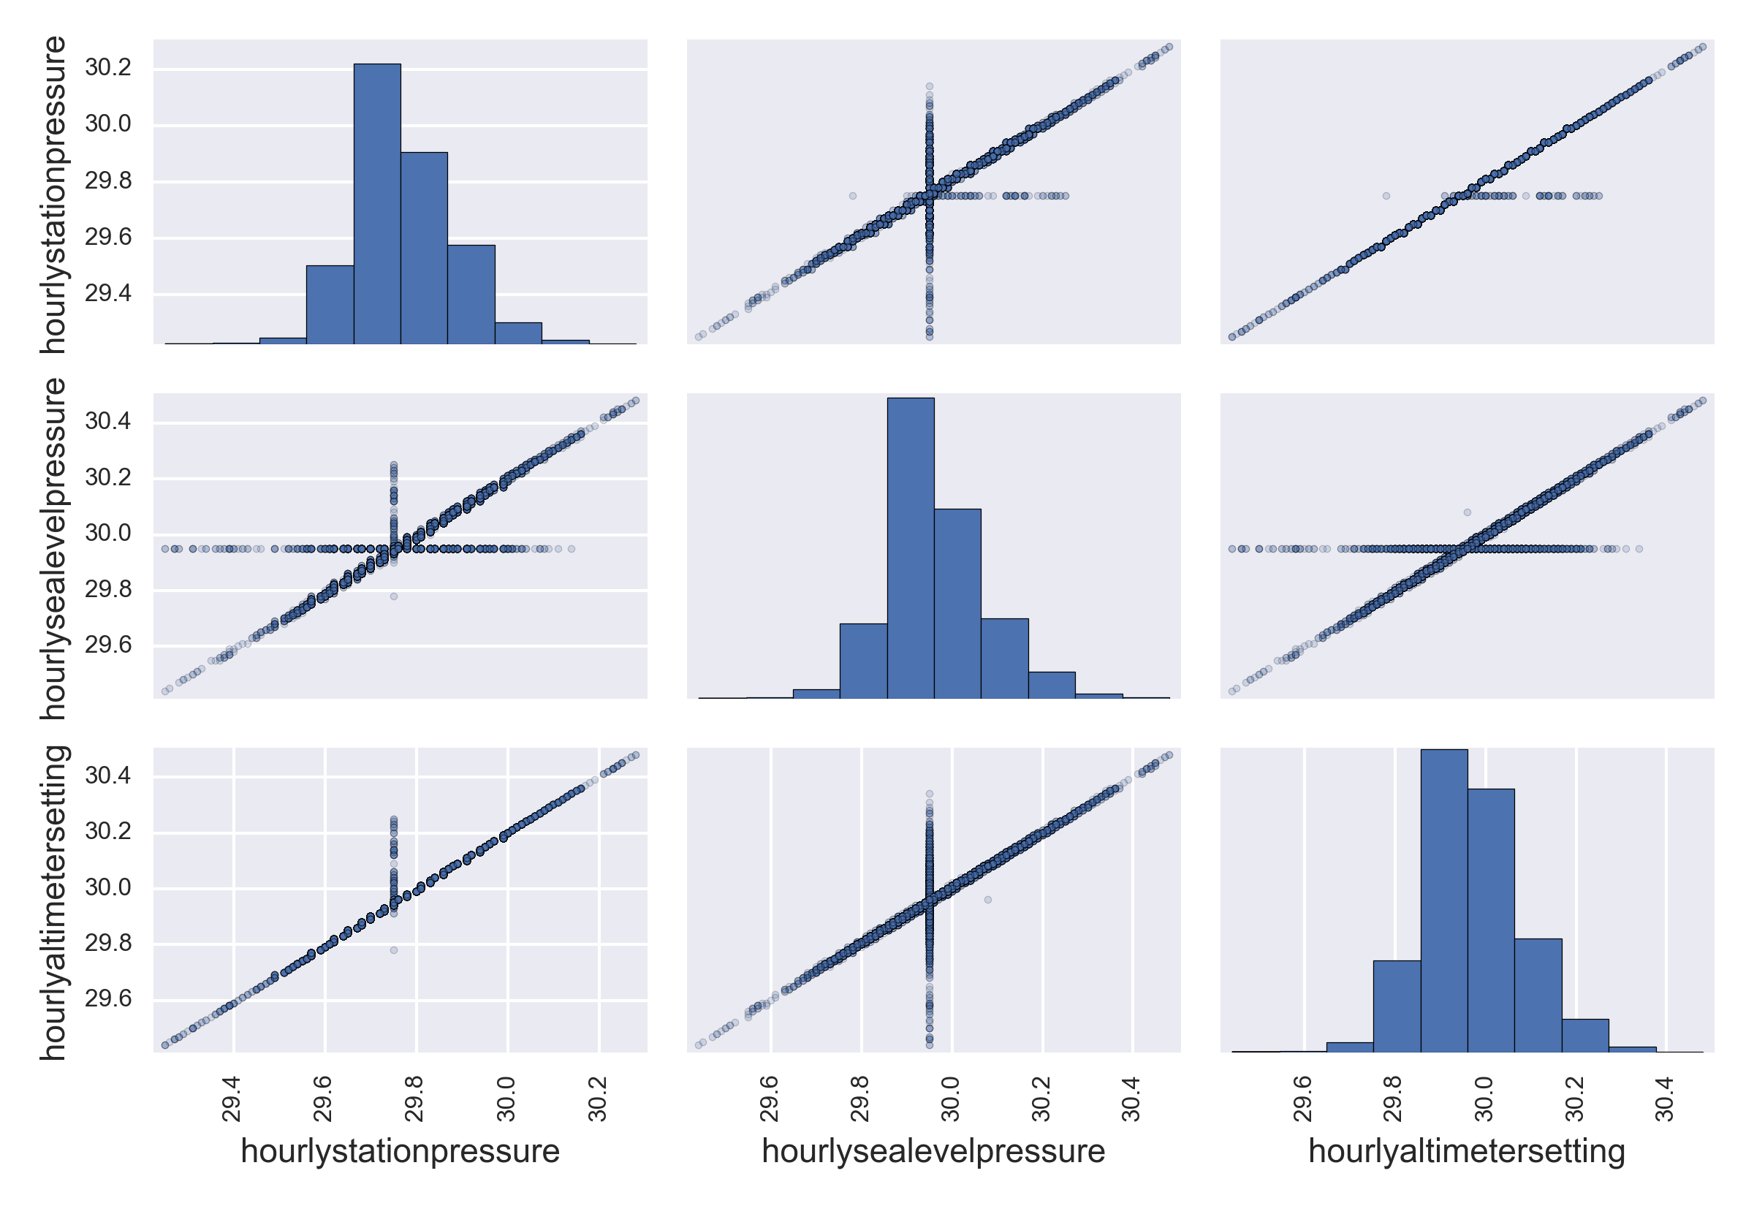
Pressure collinearities
LA

Slide 17
Pressure collinearities
LA
Dropped all but station pressure

Slide 18
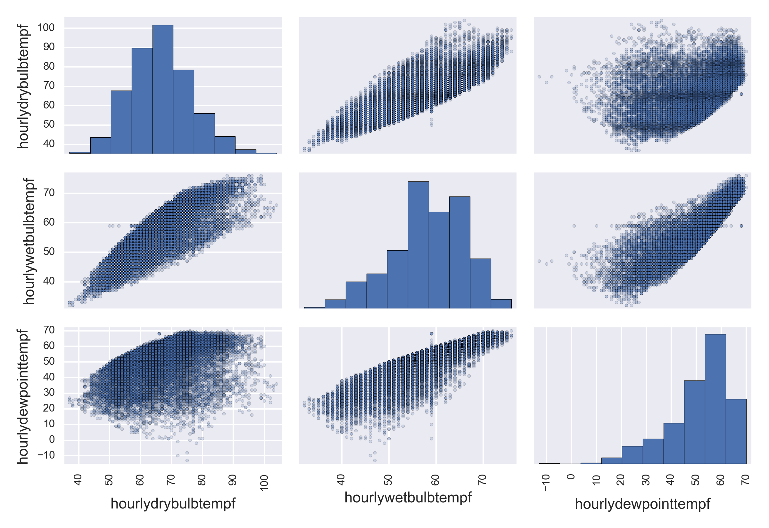
Temperature collinearities
LA

Slide 19
Temperature collinearities
LA
Dropped all but dew point temperature

Slide 20
Multivariate OLS regression

Slide 21
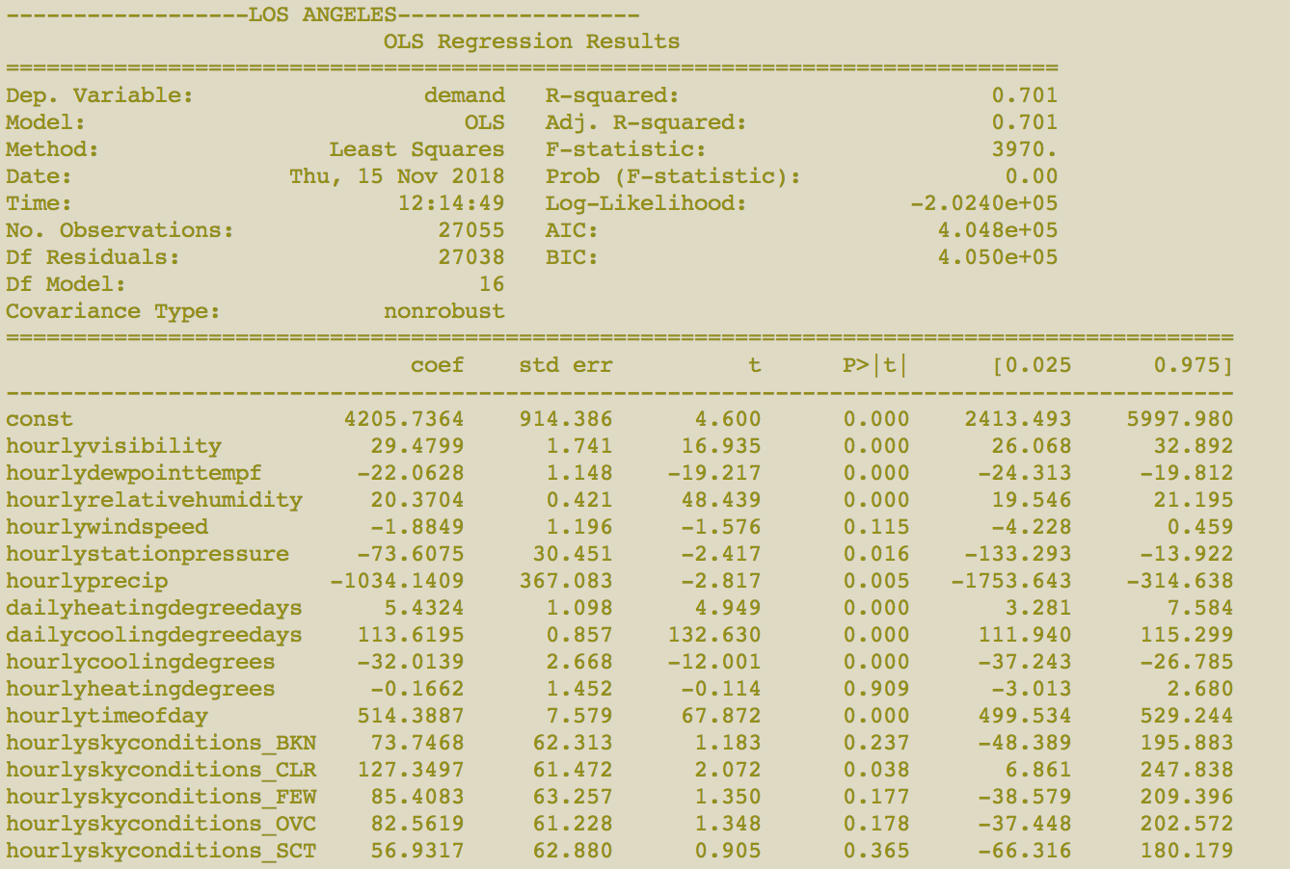

Slide 22
Heating not important in LA
Drop high p-value features (p>.1)

Slide 23
Outline
Abstract
Data Wrangling and Cleaning
Exploratory Data Analysis
Machine learning and modeling
Using RNNs and LSTM
Comparison to other forecasts
Conclusion

Slide 24
Reframing problem
Time stream data
Utilize all features from PREVIOUS TIMESTEP to predict electricity demand at the current time step
Left with N-1 samples

Slide 25
First pass modeling
Split into training and testing set (first year training, the rest testing)
Create default machine learning model with sklearn (no hyperparameter tuning)
Scale all features with min-max scaler
Fit data
Evaluate model with r² and RMSE
Compare

Slide 26
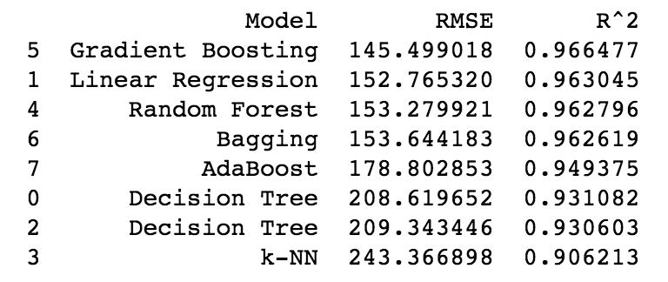
First pass modeling: results
Great results and not a large discrepancy between testing and training data, indicating low overfitting

Slide 27
Outline
Abstract
Data Wrangling and Cleaning
Exploratory Data Analysis
Machine learning and modeling
Using RNNs and LSTM
Comparison to other forecasts
Conclusion

Slide 28
LSTM
Same train-test split
50 neurons in first layer, 1 neuron in output layer
Loss with mean-absolute error (MAE) and Adam version of stochastic gradient descent
50 training epochs, batch size of 72
keras with tensorflow backend

Slide 29
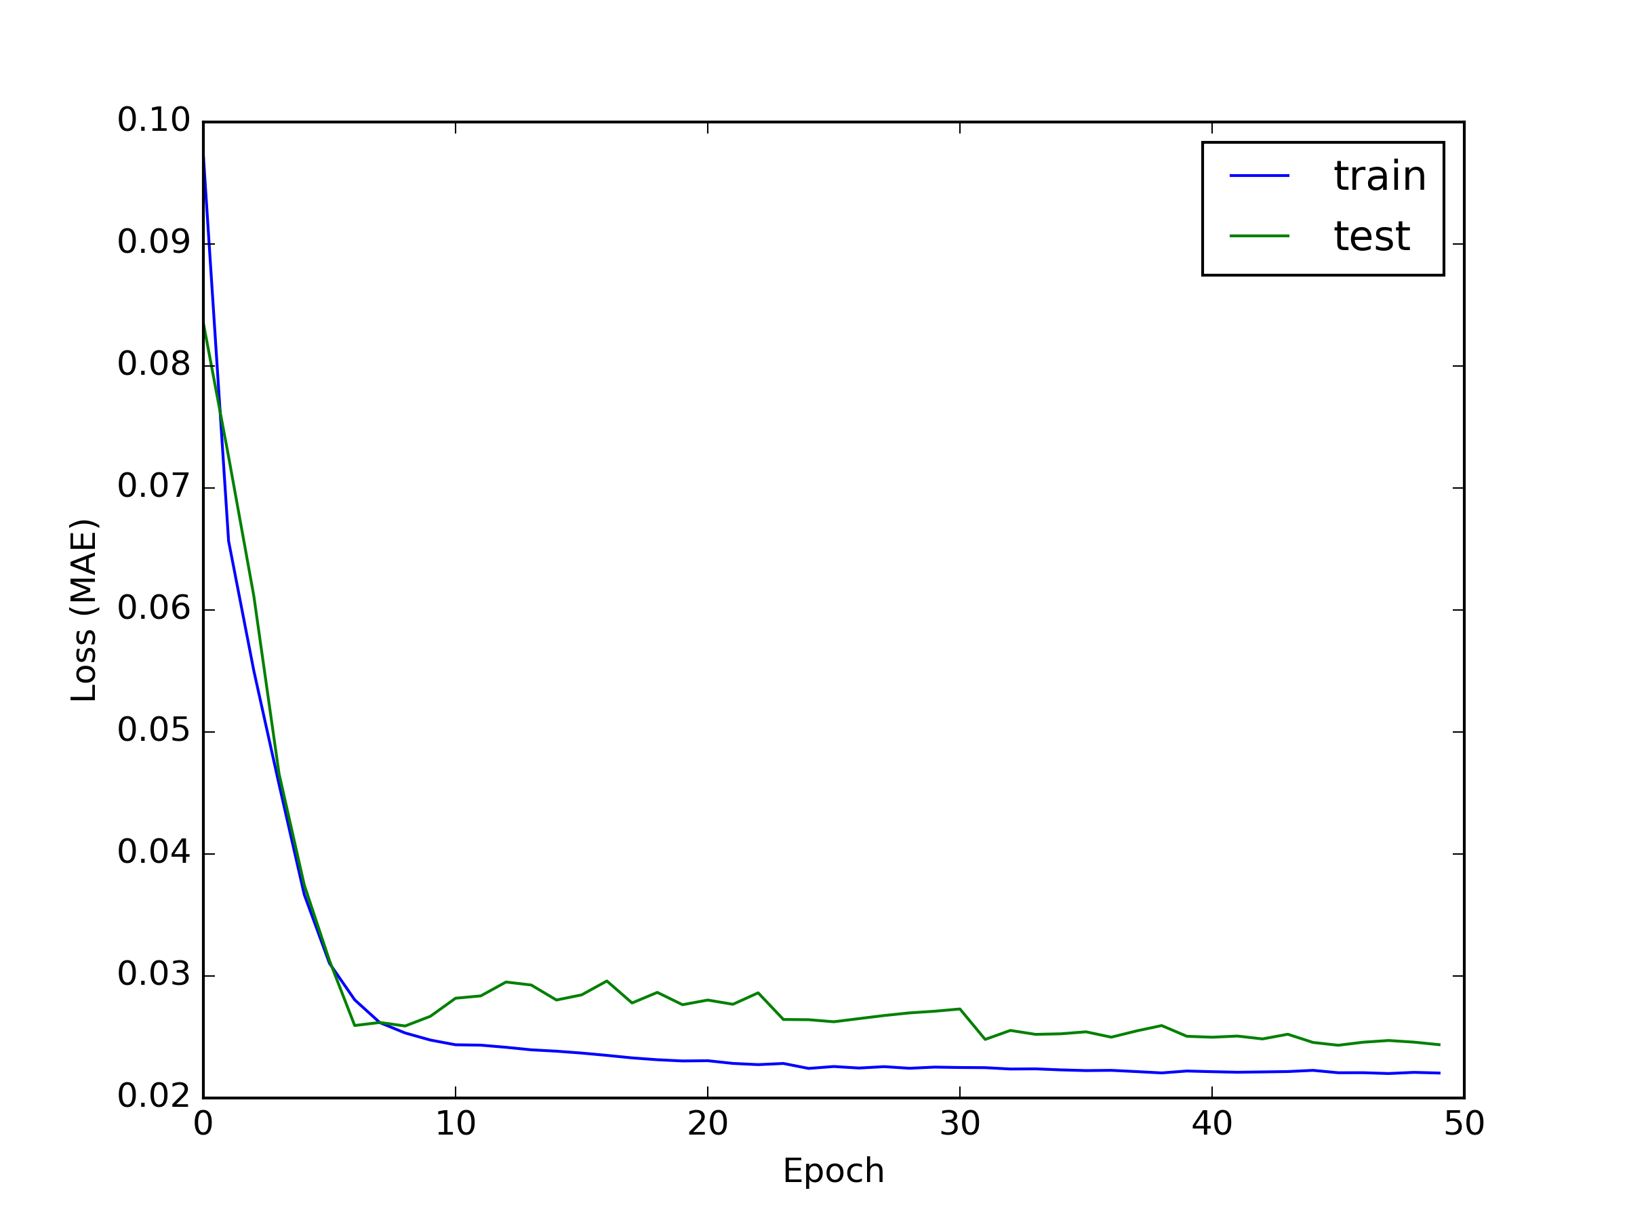
LSTM: results
r²: 0.961
RMSE: 156.8 MWh
Test loss above training indicates we’re not overfitting

Slide 30
Outline
Abstract
Data Wrangling and Cleaning
Exploratory Data Analysis
Machine learning and modeling
Using RNNs and LSTM
Comparison to other forecasts
Conclusion

Slide 31
EIA’s day-ahead forecast
EIA has their own forecast for electricity demand
Depends heavily on weather forecasts and the day of the week.
r²: 0.917
RMSE: 227.9 MWh
We perform better than EIA!

Slide 32
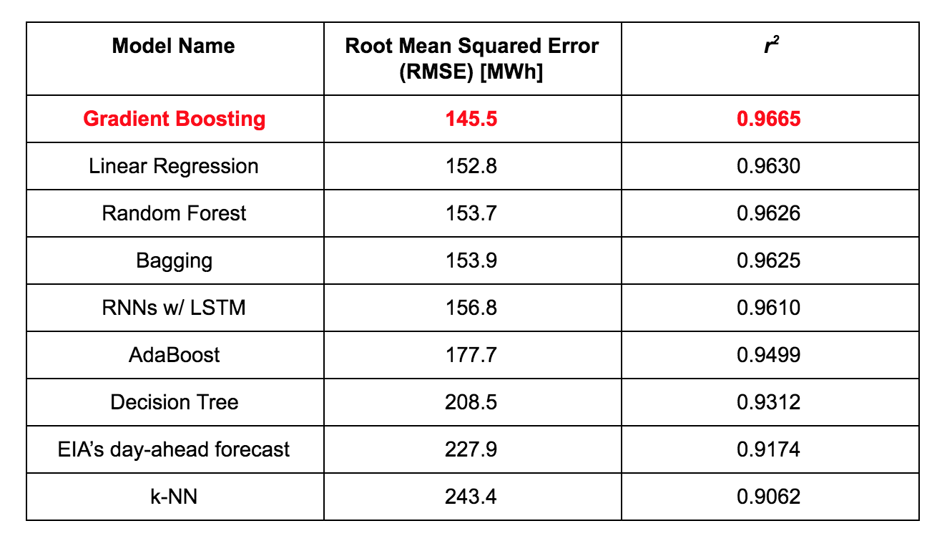

Slide 33
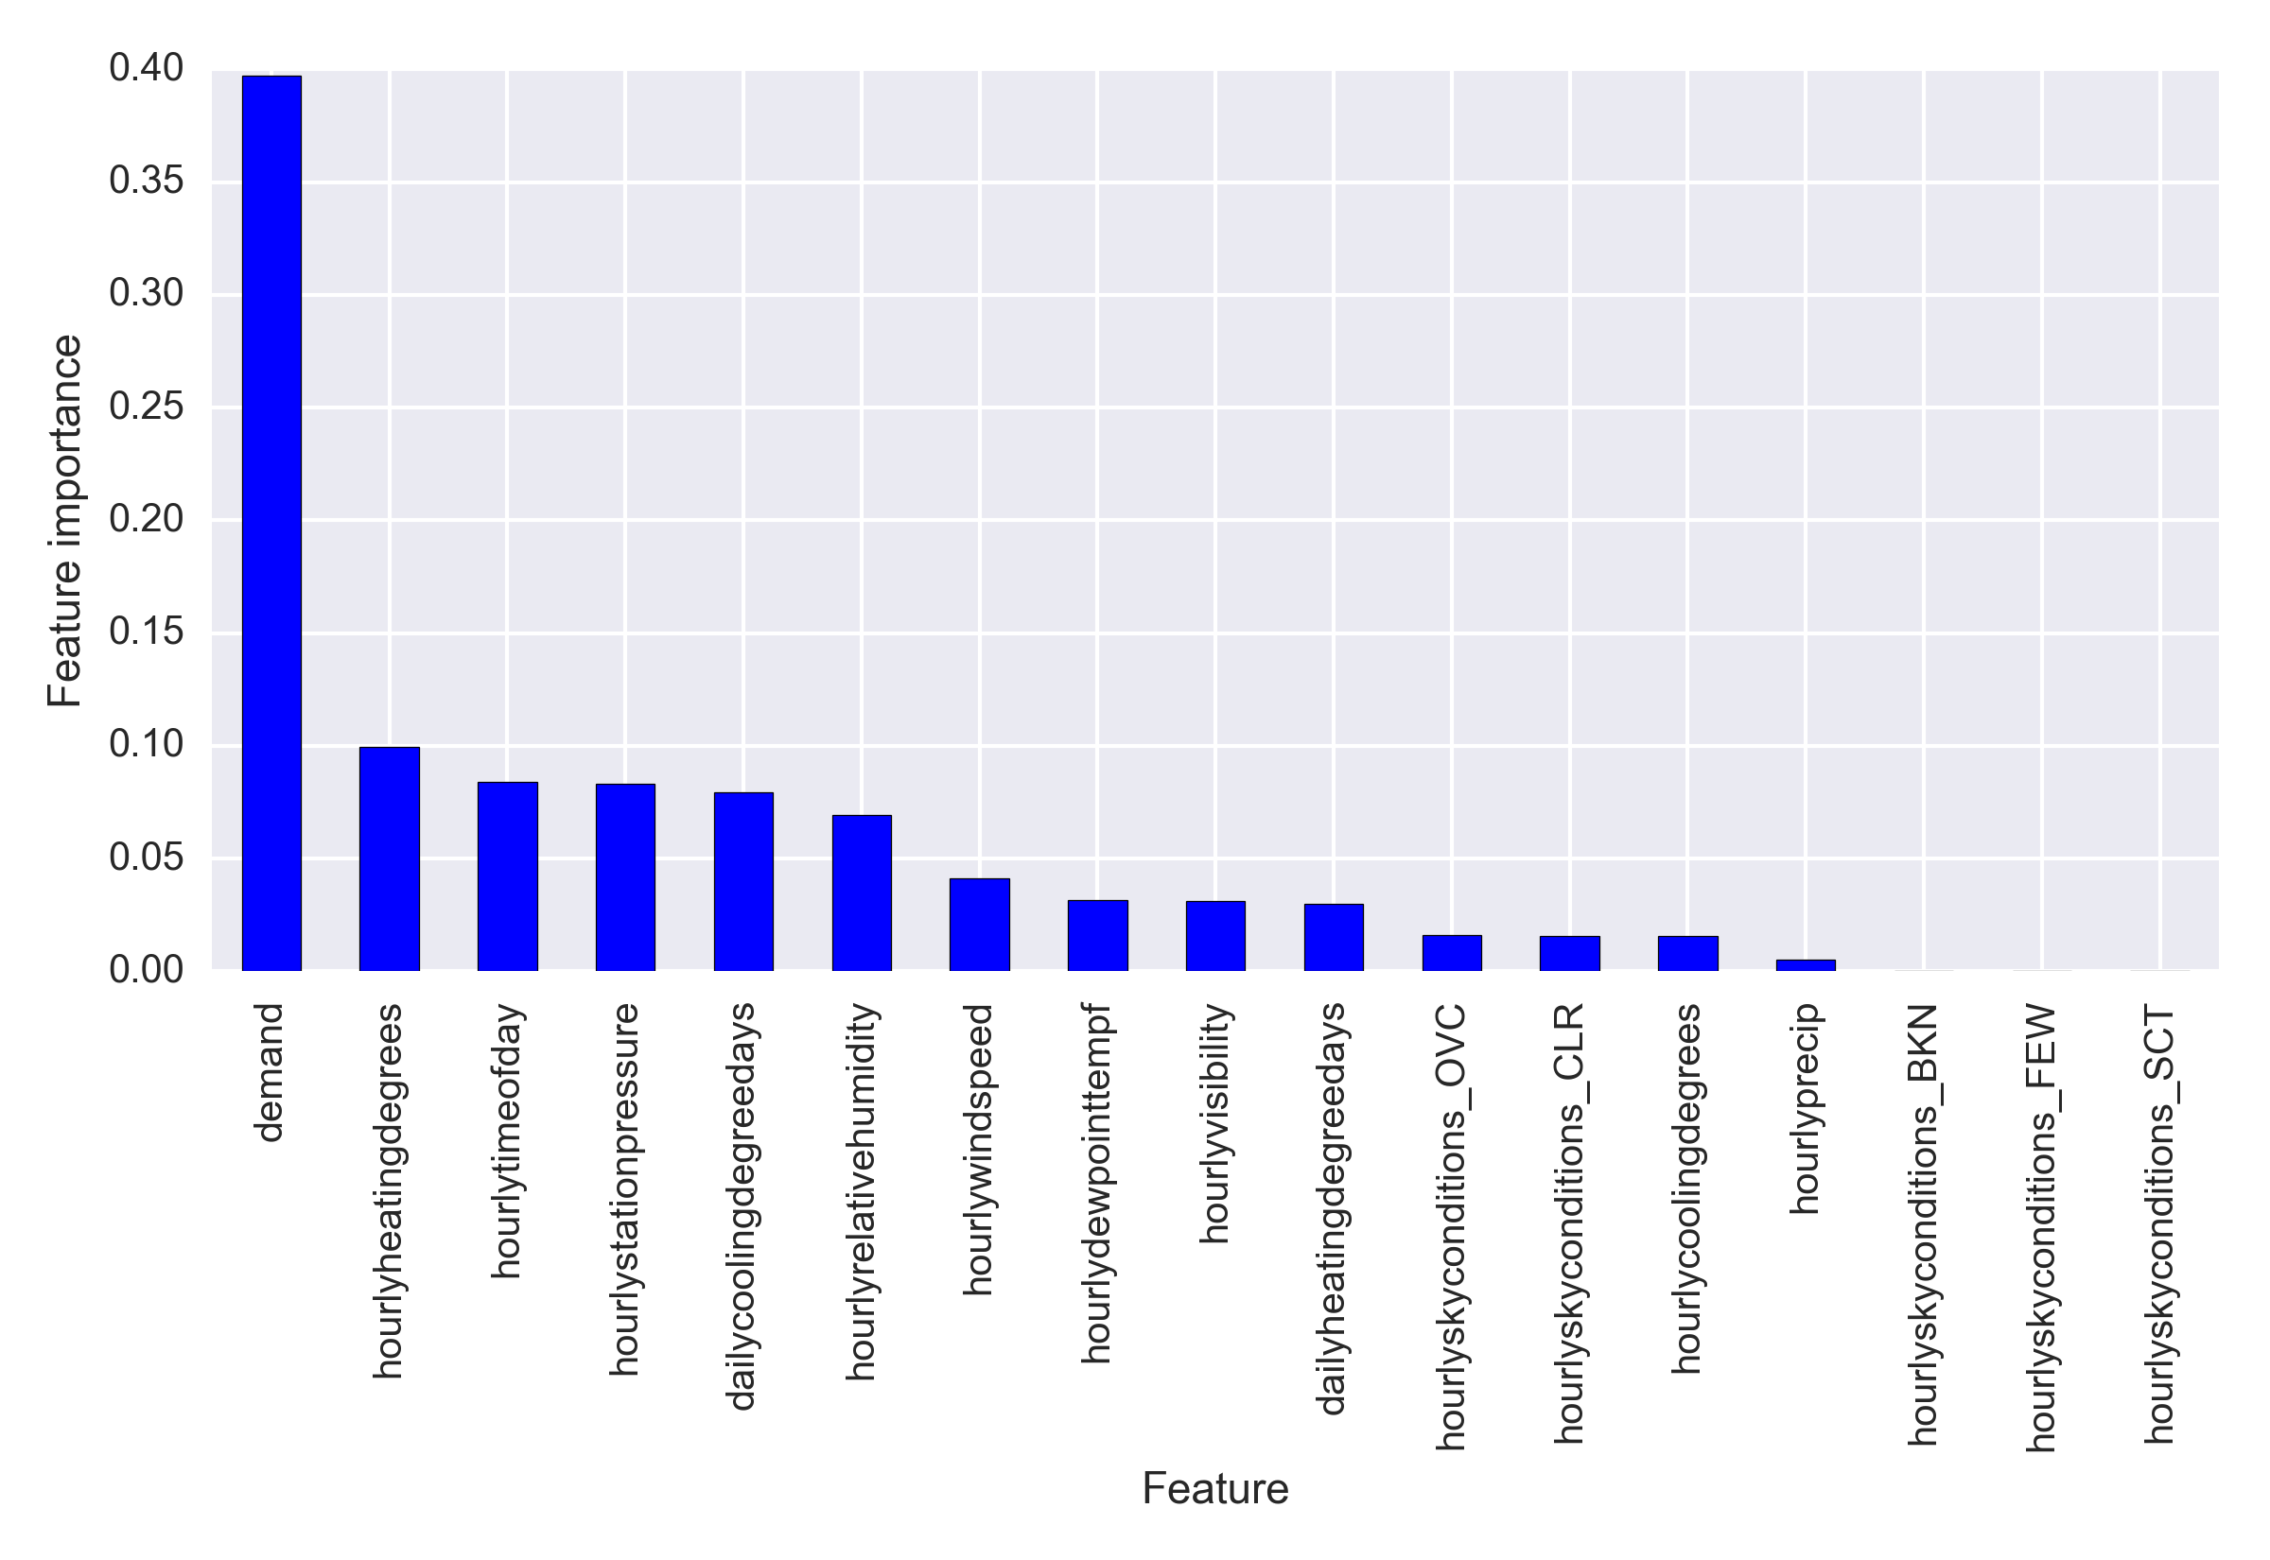

Slide 34
Outline
Abstract
Data Wrangling and Cleaning
Exploratory Data Analysis
Machine learning and modeling
Using RNNs and LSTM
Comparison to other forecasts
Conclusion

Slide 35
Concluding remarks
All but one model performs better than EIA’s day-ahead demand forecast (~5% improvement)
Models could be used to better brace for spikes in demand
Relatively simple data collection and modeling from open source software and free databases resulted in better modeling than EIA

Slide 36
Thank you!
Robert V Gramillano
rvgramillano@yahoo.com
https://github.com/rvgramillano

