Slide 1
Spam Filtering- YouTube Comment
Bharti Goel

Slide 2
Outline
Introduction
Data
Dataset Details
Data Cleaning/Preprocessing

Slide 3
YouTube Spam Comment
Spam comment can be described as undesired information with low quality content.
It is difficult to distinguish between an informative and spam comment.
Due to monetization system of YouTube, spammers are more active.
It is inconvenient, annoying and wasteful of computer resources.

Slide 4
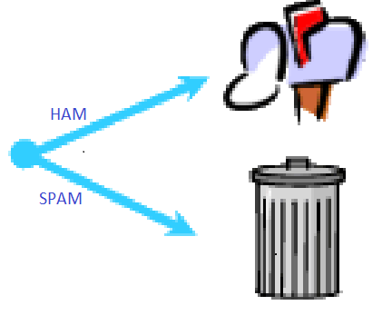

Spam Detection

Slide 5
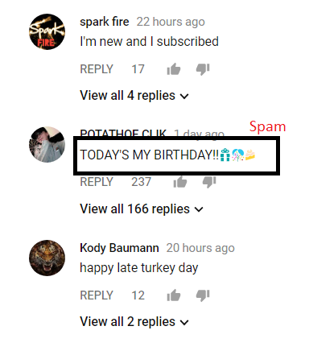
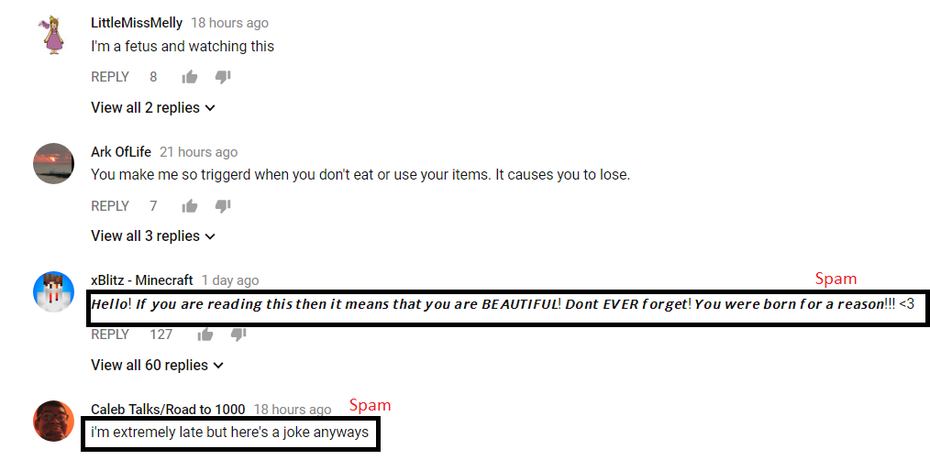
Examples of comment spam posted in YouTube

Slide 6
Dataset Details
There are six datasets.
First five datasets were taken from UCI Repository. (https://archive.ics.uci.edu/ml/datasets/YouTube+Spam+Collection)
Sixth dataset (Rotten Tomatoes) is extracted from YouTube video and labelled manually (spam or ham).
Data set | YouTube ID | #spam | #ham | total
Eminem | uelHwf8o7_U | 247 | 207 | 454
PSY | 9bZkp7q19f0 | 175 | 175 | 350
LMFAO | KQ6zr6kCPj8 | 236 | 202 | 438
Katty Perry | CevxZvSJLk8 | 174 | 175 | 359
Shakira | pRpeEdMmmQ | 174 | 196 | 370
Rotten Tomatoes | ZjKLItXpi1U | 174 | 178 | 352

Slide 7
Cont..
The collection is composed by one CSV file per dataset, where each line has the following attributes:
COMMENT_ID, AUTHOR, DATE, CONTENT, TAG
Each Instance is labeled as spam (represented as 1) or ham(represented as 0).
We offer one example below:
z12oglnpoq3gjh4om04cfdlbgp2uepyytpw0k, Francisco Nora,2013-11-28T19:52:35,please like :D https://premium.easypromosapp.com/voteme/19924/616375350,1

Slide 8
Data Cleaning / Preprocessing
Data cleaning process includes removal of
Extra attributes- We have removed COMMENT_ID, AUTHOR and DATE.
Considering only CONTENT and TAG.
Unicode are removed (/u,:P,-_-)
Punctuations (, ! . ‘ “)
Preprocessing includes-
Stop-word removal – e.g. a, an, for, it.
Case conversion- each alphabet is considered into lowercase. E.g. cat and Cat are considered same.
Stemming- We have used Weka stemmer (IteratedLovinsStemmer). E.g. sleep and sleeping both are considered as same word after stemming.

Slide 9
Spam Detection Process-
We have used bag of words approach.
Where each word is considered as an independent attribute. And number of times that word occurs in a particular instance give value of the attribute.
Content attribute is converted from string to word vector.
Later, Supervised Machine learning is applied to the resultant attributes with tag as class attribute.

Slide 10
Conclusion

Slide 11
References
Alberto, T.C., Lochter J.V., Almeida, T.A. TubeSpam: Comment Spam Filtering on YouTube. Proceedings of the 14th IEEE International Conference on Machine Learning and Applications (ICMLA'15), 1-6, Miami, FL, USA, December, 2015.
Eibe Frank, Mark A. Hall, and Ian H. Witten (2016). The WEKA Workbench. Online Appendix for "Data Mining: Practical Machine Learning Tools and Techniques", Morgan Kaufmann, Fourth Edition, 2016.
[Online] www.youtube.com.

Slide 12
Thank you……

