Slide 1

Income Prediction on Census Data
Using Machine Learning

Slide 2
Contents
Problem Description
Steps of Proposed Solution
Data Overview
Data Cleaning
Exploratory Data Analysis
Analysing Target Variable- Income
EDA- Numeric Variables
EDA- Categorical Variables
Feature Engineering
Model Implementation
Model Assessment
Characteristics impacting the income-level
Results
More about Execution

Slide 3
Problem Description
The prominent inequality of wealth and income is a huge concern especially in the United States. The likelihood of diminishing poverty is one valid reason to reduce the world's surging level of economic inequality.
This work aims to conduct a comprehensive analysis to highlight the key factors that are necessary in improving an individual's income. Such an analysis helps to set focus on the important areas which can significantly improve the income levels of individuals.
Given a dataset of the US Census data comprising of variety of demographic and economic information such as age, education, occupation, race, and hours worked per week, the goal is to analyze the data and build a predictive model that can accurately classify individuals as making more or less than $50,000 per year based on their characteristics.

Slide 4
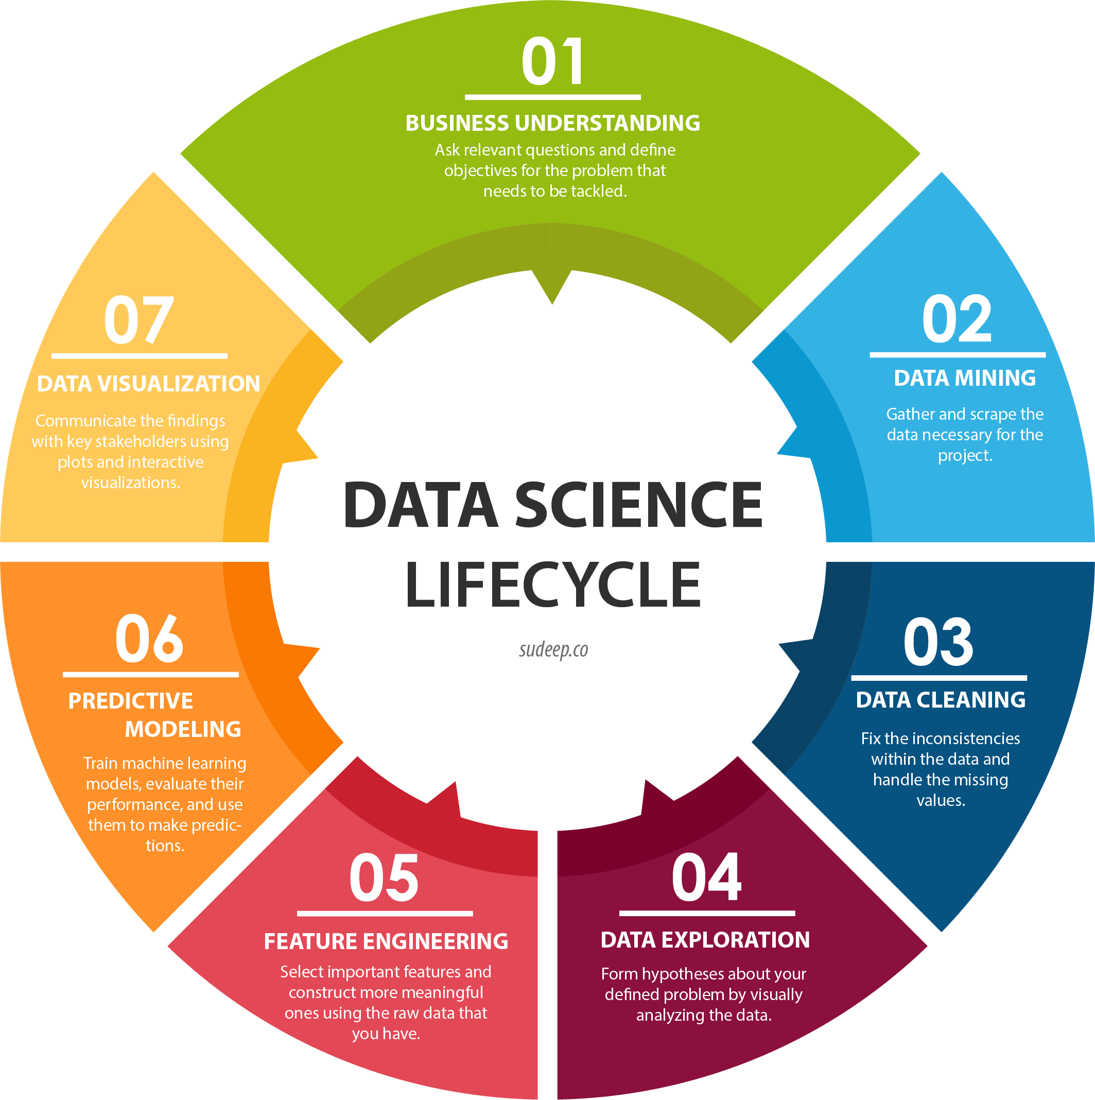
Steps of Proposed Solution
The proposed solution comprises of following steps:
Understand and Model the Business Requirements.
Understand the distribution of the data and the relationships between the different variables in the dataset.
Clean and preprocess the data to handle any missing or inconsistent values and to ensure that the data is in a format that can be used for analysis and modeling.
Explore the data and perform statistical analysis to identify the most important features that are associated with a person making more or less than $50,000 per year.
Selecting the relevant features according to the business requirements.
Build a predictive model using a machine learning algorithm that can accurately classify individuals as making more or less than $50,000 per year based on their characteristics. Use evaluation metrics such as accuracy, precision, recall and Confusion Matrix to evaluate the performance of the model. Use hyperparameter tuning to improve the performance of the model.
Use the trained model to make predictions on new, unseen data and interpret the results to identify the important features determining the income of an individual.
Steps for Proposed Methodology
(Source: https://www.sudeep.co/images/post_images/2018-02-09-Understanding-the-Data-Science-Lifecycle/chart.png)

Slide 5
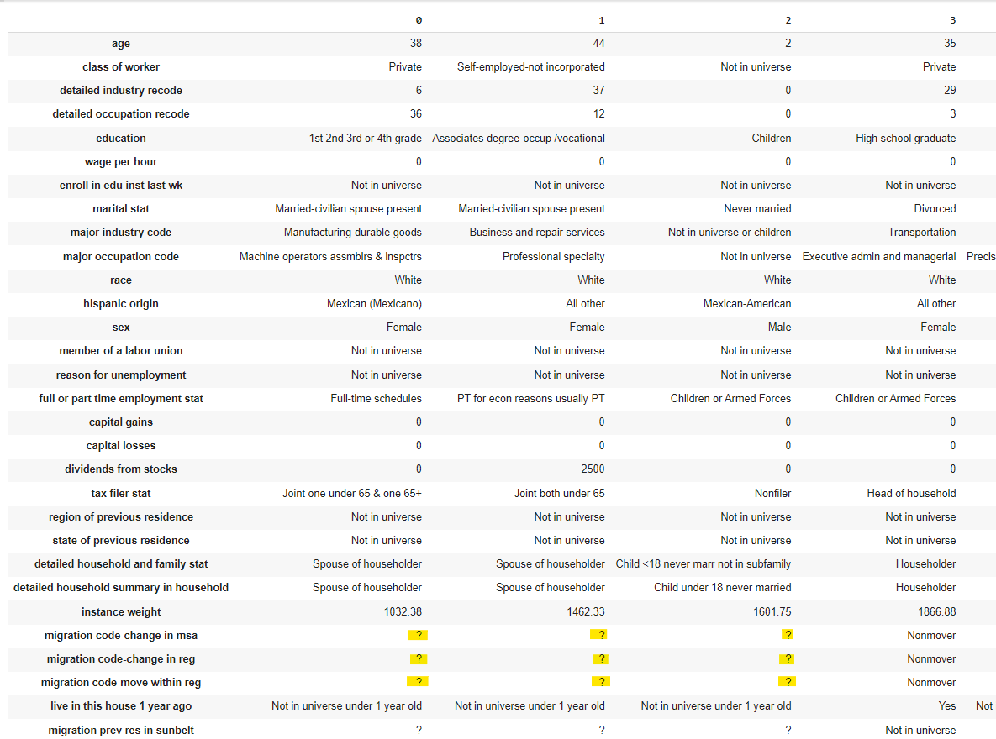
Data Overview
There are 42 features containing 199523 and 99762 records in training and testing data respectively.
Data belongs to different data types- Integer, Float, and Object.
As evident from the Figure 2, the data comprises of some inconsistent values- ‘?’ which needs to be cleaned.
Sample Data from Training Data : 4 observations with 30 features

Slide 6
Data Cleaning
Data Cleaning is an important step in the machine learning process as it ensures that the data used for training and testing models is of high quality and free of errors.
During this step, the data is cleaned to ensure that there are no inconsistencies present in the data such as treating missing values, dropping duplicates, no outliers, etc.
There are also several other steps of Data Cleaning such as handling categorical variables, handling imbalanced dataset, feature scaling which is performed at later stages.
At this stage, initially duplicates are dropped from the data. Since ‘ ?’ is present in categorical columns, thus replaced with Mode which is the most frequently value for that feature.

Slide 7

Exploratory Data Analysis
There is no denying fact that visuals are more interactive and better way than numbers for analysing data and finding answers to various business requirements.
Python offers numerous visualisation libraries such as Seaborn, Matplotlib, Plotly, and many more to gain deep insights about the data.
Initially, the univariate and bivariate analysis is done for 12 numeric features followed by 29 categorical features.

Slide 8
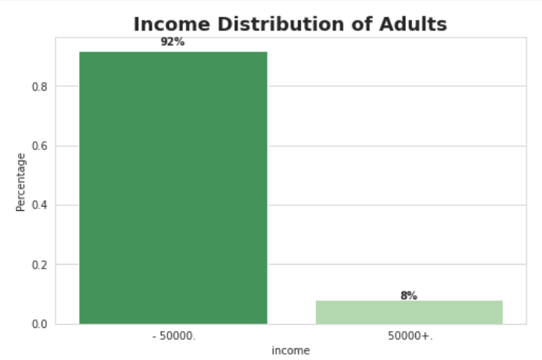
Analysing Target Variable - Income
According to the given data, the number of people earning less than 50K dollars in year is 92% whilst the people earning more than it is just 8%.
Analysing the distribution of Income

Slide 9
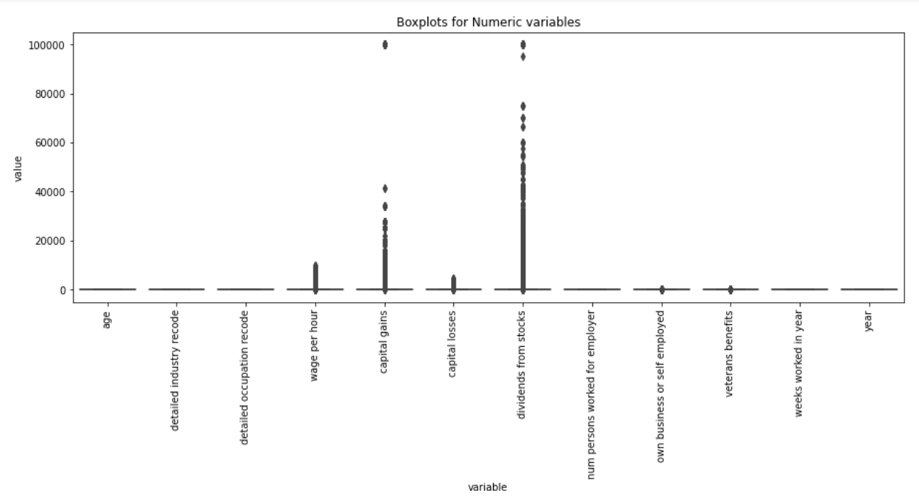
EDA- Numeric Variables
Univariate Analysis has been proved useful in detecting the outliers which may hamper the decision-making ability of model. It has been identified from the box plot that columns - 'wage per hour', 'capital gains', 'capital losses', and 'dividends from stocks’ contain outliers.
Boxplots for Numeric Variables

Slide 10
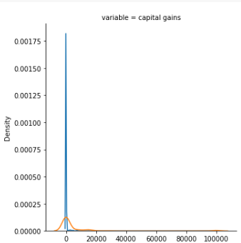
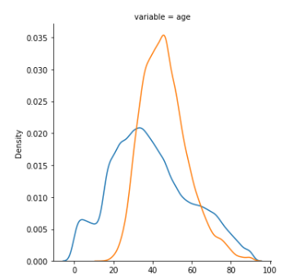
EDA- Numeric Variables
In Bivariate Analysis, the relationship of all the characteristics of numeric type have been analysed with the income feature.
Some of the major key points from bivariate analysis are:
As the age increases, the income-level also increases upto a certain extent. A large number of people belonging to age group 25-60 tend to earn more than 50000 dollars in a year.
People having low wage per hour have yearly income less than 50000 dollars.
People having some capital gains, dividends from stocks, or who have worked for larger number of weeks in a year tend to earn more than 50000 dollars in a year.
Analysing Capital Gains and Income-Level
Analysing Age and Income-Level

Slide 11
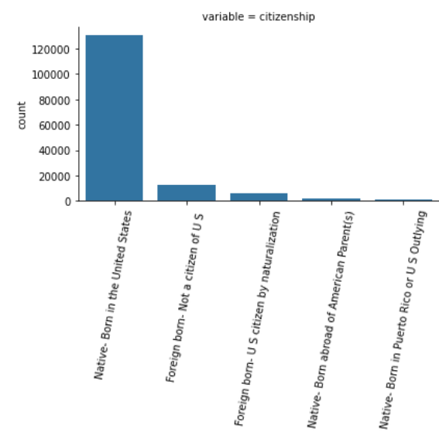
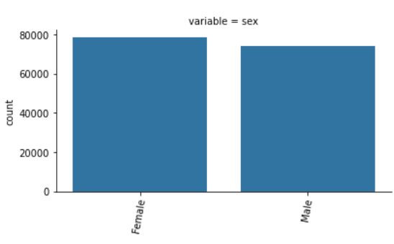
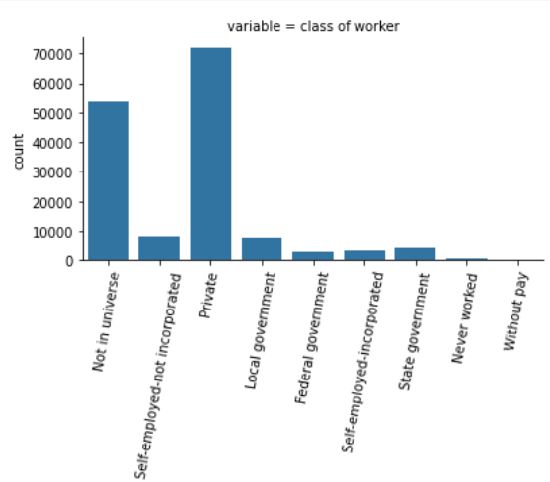
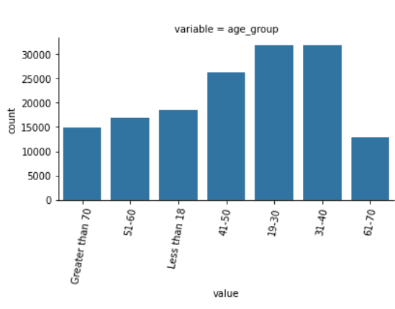
EDA - Categorical Variables
Some of the observations from Univariate Analysis of Characteristics which are Categorical in nature are:
A major chunk of people are private class workers.
Majority of the individuals are Native-Born in the United States having same country of birth for both parents.
There are large number of people with earning less than 50000 dollars.
Analysing Some Categorical characteristics

Slide 12
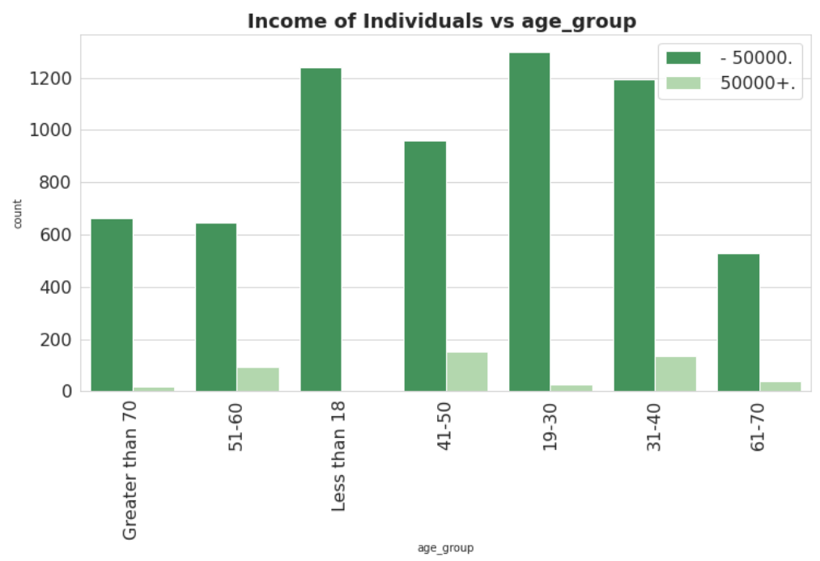
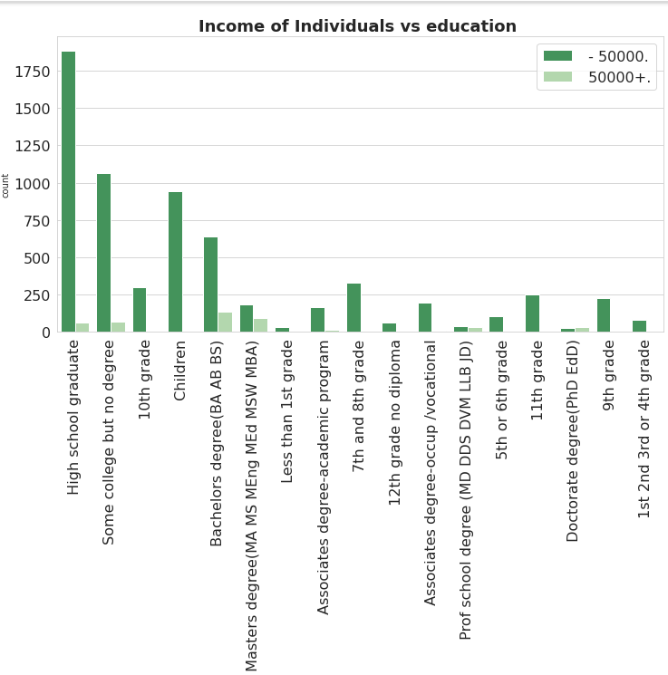
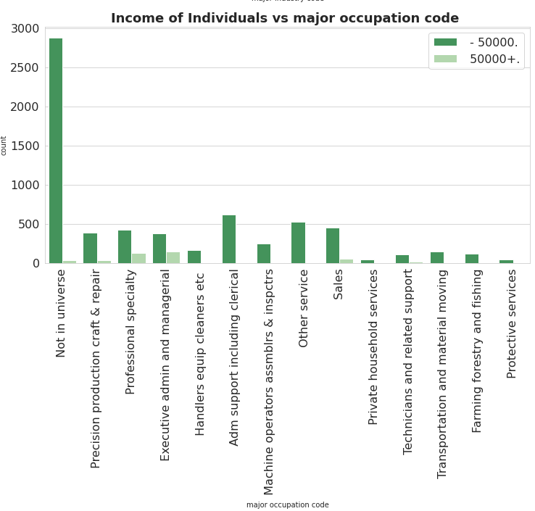
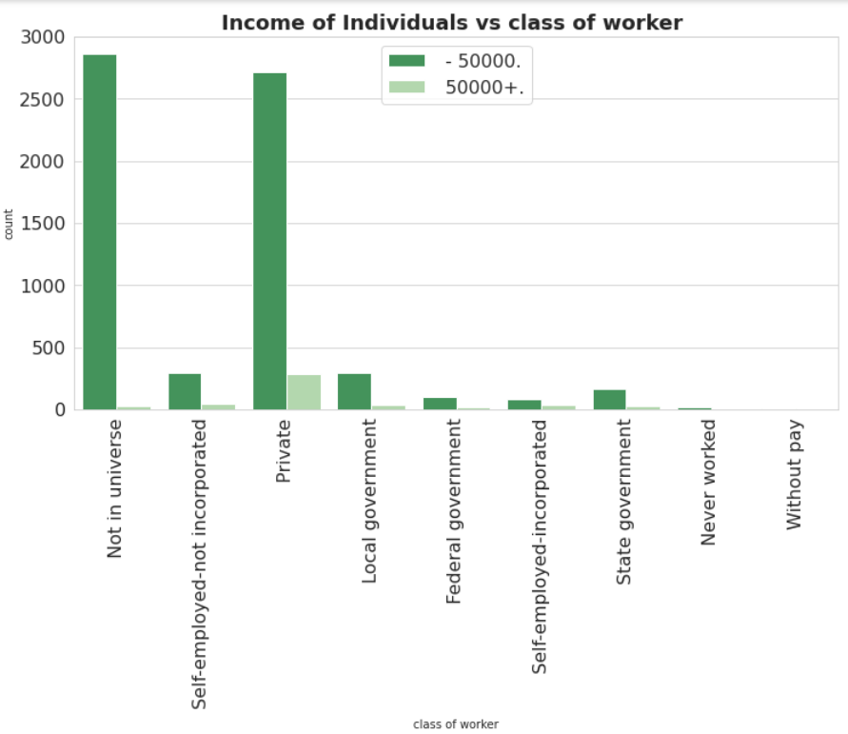
EDA – Categorical Variables
As one might imagine, there is no income for people aged less than 18 years and the number of people earning more than 50K is quite negligible amongst people of age group 19-30.
People working in the Private Sector face a significant difference between their pays where majority of them earn less than 50K dollars an year. There is a very minute difference between the number of people whose income is more or less than 50K dollars an year who work for the Federal Govt or are self-employed-incorporated. People belonging to the category Without-Pay and Never-Worked hardly contain any data in both the categories
Individuals having Masters degree, Prof school degree, or Doctorate degree have high probability of earning more than 50K dollars.
People who work in educational sector, finance insurance and real estate, or manufacturing durable goods may earn more than 50K dollars. There are negligible chances of people working in Agriculture, Forestry and fisheries, Mining to earn more than 50K dollars.
Analysing some Categorical Variables and Income-Level

Slide 13
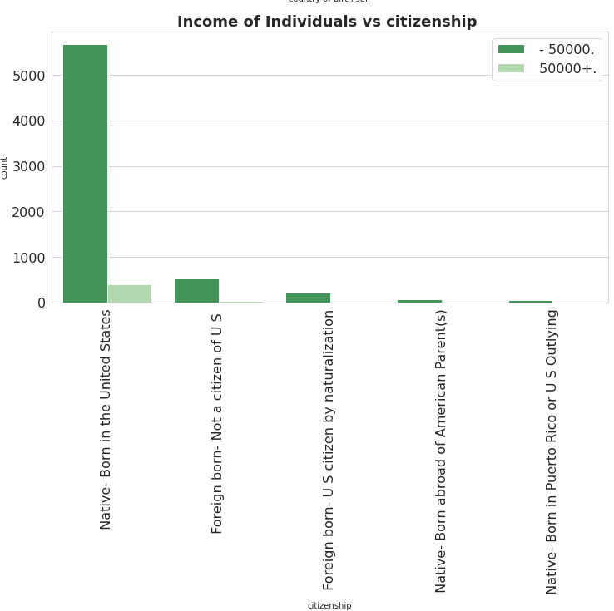
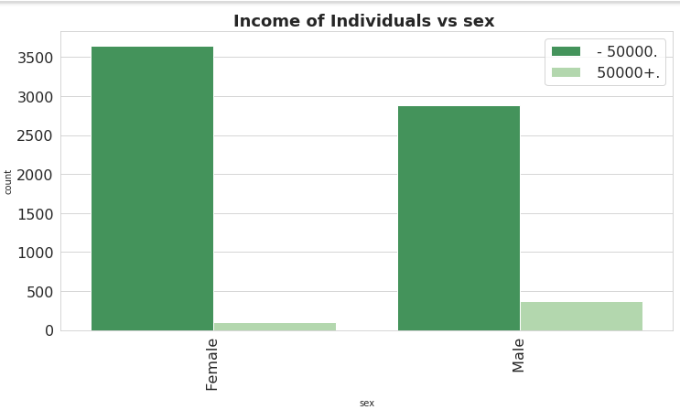
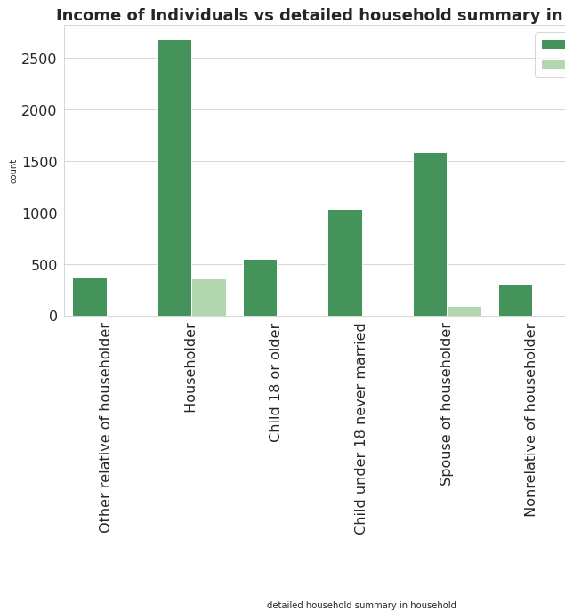
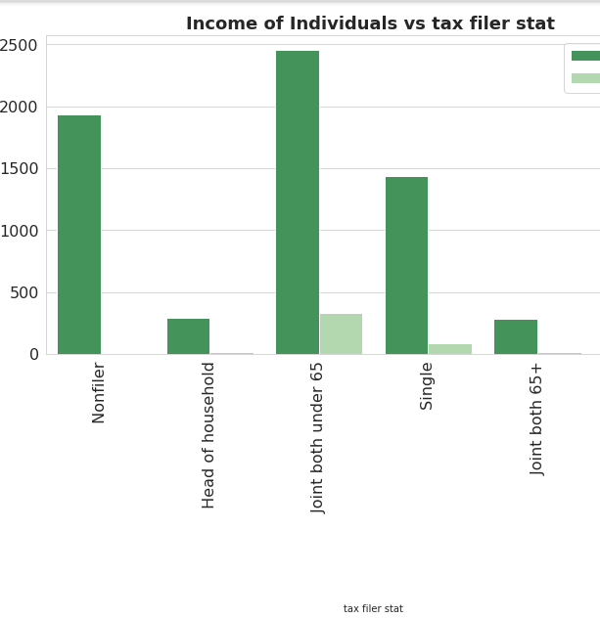
EDA – Categorical Variables
More number of males tend to earn more than 50K dollars in a year than females.
People having age less than 65 years and earning more than 50K dollars are likely to file the joint Income Tax application. Individuals who do not file their Income tax mostly earn less than 50K dollars in a year.
Householders generally earn more than other family members and have high chances of earning more than 50K dollars.
People who are native-born in the US are more vulnerable to have yearly income more than 50K dollars.
Analysing some Categorical Variables and Income-Level

Slide 14
Feature Engineering
Encoding Features- It is always good practice to pass the features in numerical format instead of Categorical features. Thus, all the categorical features such as Citizenship, Education, and many more are converted to numerical format using One-Hot Encoding.
Selecting Relevant Information- Afterwards, features which are collinear with each other or have less correlation coefficient with target variable ‘income’ are dropped such as 'region of previous residence’, 'detailed household and family stat', 'detailed household summary in household’, and many others.
Forming Data Splits- In order to prepare the model for predictions, the given data is then split in two parts in the ratio of (80-20) to train and validate the model.
Feature Scaling- Input features are also scaled to enhance the model performance.

Slide 15
Model Implementation
Algorithms experimented to develop high quality income predictor:
Random Forest Classifier
Extreme Gradient Boost Classifier
AdaBoost Classifier
CatBoost Classifier
Factors taken into consideration while technique selection-
Suitability for handling large volume of data having large variety of features
Robustness to Outliers due to detected outliers
Capable of handling missing and categorical data considering future scenarios
Delivering high accuracy in providing similar business solutions
Able to generate important characteristics aiding in decision-making
Ability of Parallel Computing

Slide 16
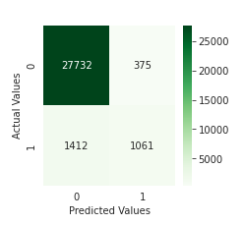
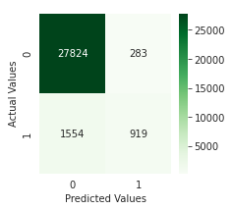
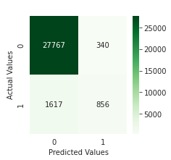

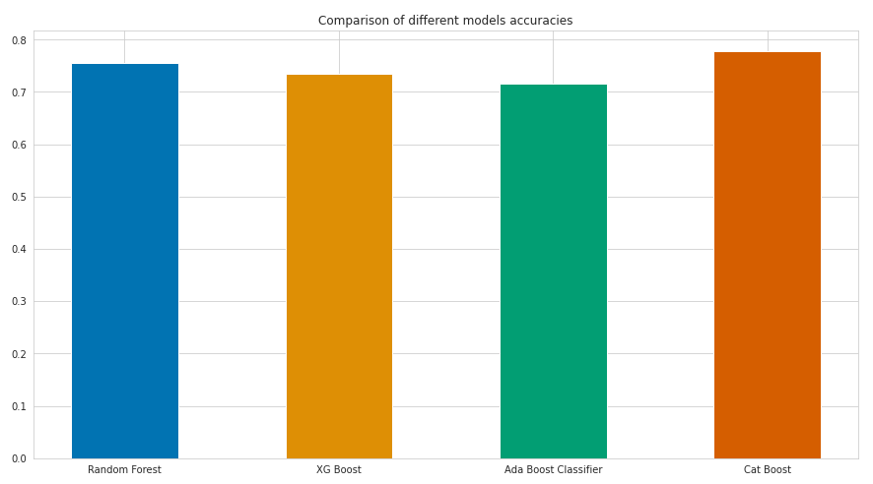
Model Assessment
CM of Random Forest
CM of XGBoost
Criteria used to assess the performance of implemented predictors:
Classification Report (Primarily Macro F1 Score due to imbalanced dataset)
Confusion Matrix (CM) giving the insights regarding the count of correct and incorrect predictions on validation data for two classes – income greater than 50K and income less than 50K represented with 1 and 0 respectively.
Results Observed:
CatBoost Classifier outperformed all the other algorithms, thus used for predicting income on Testing Data.
CM of AdaBoost
CM of CatBoost
Comparison of Results

Slide 17
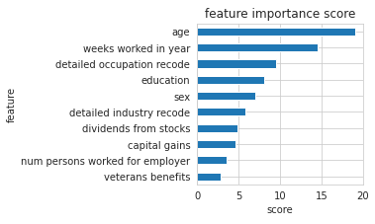
Characteristics impacting Income-level
Since CatBoost Classifier yielded the best performance with the highest macro F1 score of 78%. Thus, CatBoost has been used to identify the characteristics impacting if the individual is earning 50000 dollars yearly or not.
10 Topmost Features Identified- Age, Weeks worked in year, Detailed Occupation Recode, Education, and many more which can be analyzed in the figure.
Characteristics determining the income-level of individuals in the US

Slide 18
Results
The purpose of this work is to develop a classifier predicting if the income-level of individual in a year is more or less than 50000 dollars along with determining the features influencing the income-level.
The findings are useful to eradicate the poverty in the region by emphasizing on the vital identified factors for income-level.
Future Recommendations:
The work can be further experimented with stacked approaches which was not possible due to limited availability of time period.
Currently there is limited information about individuals earning 50000 dollars which might have hampered the performance of classifiers. Thus, more data about the same can be collected to improve the performance.

Slide 19
More about Execution
To gain more insights about execution, please refer to below Colab notebook.
https://colab.research.google.com/drive/10ONcBabBiIZZ4Uhv-cINZrE4s8EZIPU8?usp=sharing

Slide 20


