Slide 1

Movie Review Classification using Naive Bayes
Explore the power of NLP in analyzing and categorizing movie reviews. Discover how the Naive Bayes algorithm can uncover the sentiment and themes hidden within user-generated content.

Slide 2
Features of Naive Bayes Classifier
Probabilistic Model
Text Classification
Scalable and Efficient
Naive Bayes is a simple probabilistic classifier based on applying Bayes' theorem with strong (naive) independence assumptions.
It is particularly well-suited for text classification tasks, such as movie review sentiment analysis, spam detection, and topic modeling.
Naive Bayes is a fast and scalable algorithm that can handle large datasets and high-dimensional feature spaces effectively.

Slide 3
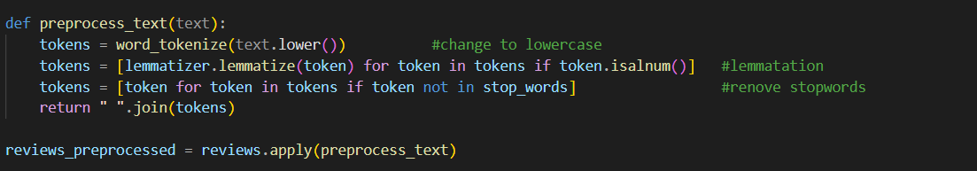
Data Preprocessing for Movie Reviews
❖ Tokenize the movie review text into individual words or token
✨ Remove stop words, punctuation, and non important text
🔍 Apply lemmatization to reduce words to their base form
📊 Encode the preprocessed text into a numerical format, such as bag-of-words or TF-IDF vectors
🗂️ Split the dataset into training and test sets to evaluate the model's performance (In this code 80% training set and 20% test set).We are using Naïve Bayes Model.

Slide 4

Feature Extraction & Selection
Important steps in building accurate movie review classification models.
We can use various techniques like TF-IDF, word embeddings, n-grams, and the bag of words to capture the most informative aspects of movie reviews.
We have used the bag of words technique to represent text as a collection of words, disregarding grammar and word order.
This approach creates a word frequency matrix that can be used for text classification tasks.

Slide 5
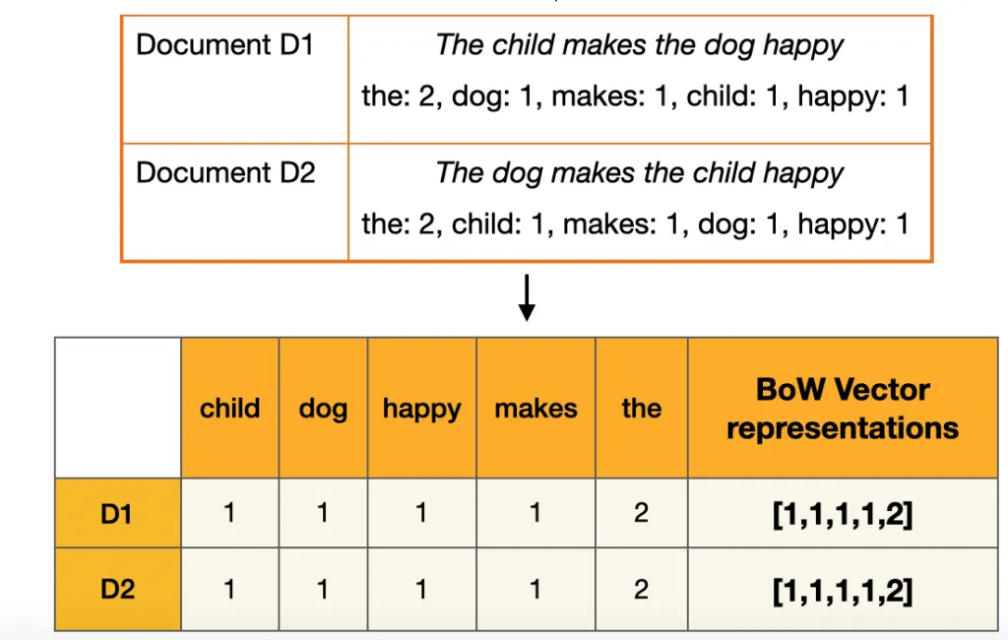
BAG OF WORDS

Slide 6

Naive Bayes Model Training
With the preprocessed data and selected features, the next step is to train the Naive Bayes classifier. This involves estimating the prior probabilities and conditional probabilities from the training data.
The Naive Bayes algorithm makes predictions by applying Bayes' theorem to calculate the probabilities of each class label given the input feature values.

Slide 7
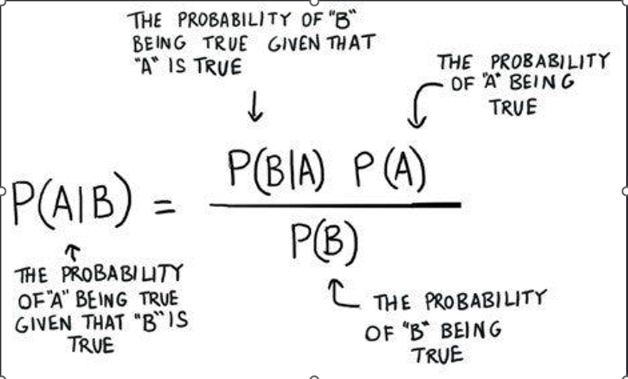
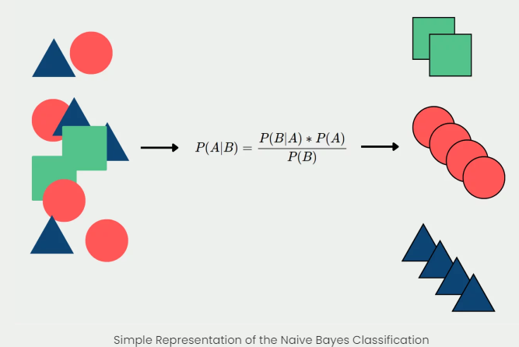
BAYES - THEOREM

Slide 8
Benefits of Naive Bayes Classifier
1
Fast and Efficient
2
Simple and Easy to Implement
Naive Bayes is computationally efficient and can handle large datasets with ease, making it ideal for real-time applications and big data analysis.
Naive Bayes has a simple and straightforward algorithm, requiring minimal training time and fewer computational resources.
3
Effective in Handling High-Dimensional Data
4
Robust to Irrelevant Features
Naive Bayes is robust to irrelevant features, meaning it can still produce accurate results even when some features are not informative.
Naive Bayes performs well even when the number of features is large, making it suitable for text classification and spam filtering tasks.

Slide 9

Limitations of Naive Bayes
1
Lack of Feature Interactions
2
Sensitivity to Feature Correlations
3
Zero-frequency problem
Naive Bayes assumes that features are conditionally independent given the class label. This assumption may not hold true in real-world scenarios where feature interactions play a significant role in classification.
If features are highly correlated, Naive Bayes may assign excessive importance to those features, leading to biased predictions. Feature engineering and dimensionality reduction techniques can help mitigate this issue.
Assigns zero probability to a categorical variable whose category in the test data set wasn’t available in the training dataset. It would be best if you used a smoothing technique to overcome this issue.

Slide 10
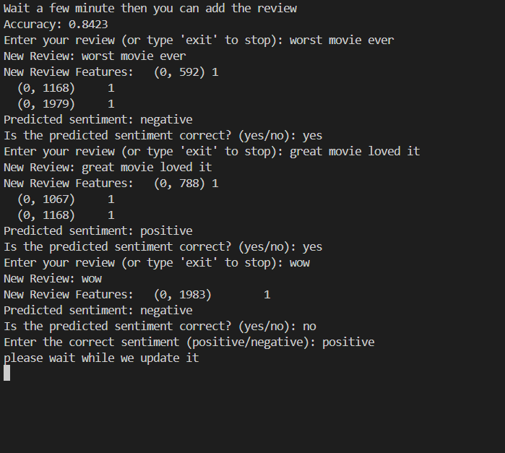
OUTPUT

Slide 11
THANK YOU!!

