Slide 1



Energy Based Models:
Maximum Entropy (MaxEnt),
Generative Models, and Boltzmann Learning
Benedikt Hartl
Institute for Theoretical Physics, TU-Wien

Slide 2
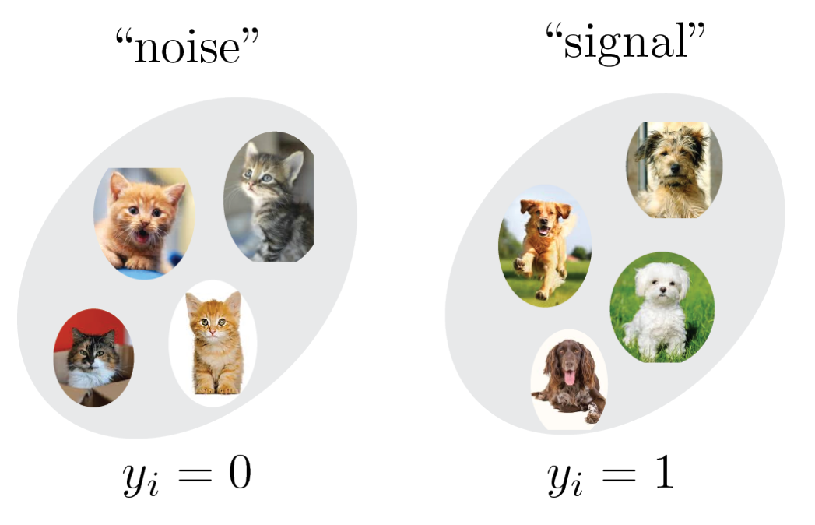
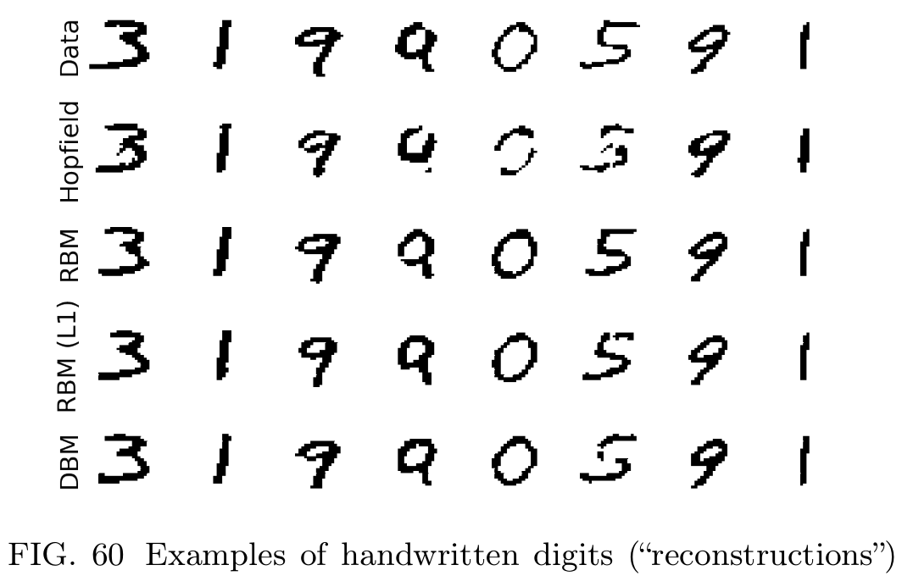
Motivation and Outline
Discriminative Models (what we did until now)
  categorize data (cats vs. dogs )
  supervised learning
  require labeled data
Generative Models (GEM)
  learn to represent and sample
  from unknown probability distribution
  e.g. new example based on MNIST-dataset
  beyond scope of discriminative models
  more complicated procedure → less prominent
Outline
  generative Models on principle of Maximum Entropy
  training of Generative Models (Boltzmann Learning)
  applying Maximum Entropy Model to the MNIST dataset
Müllen, Angew. Chem. 2007, JACS 2009
Notes:
new class of Machine Learning algorithm

Slide 3
Generative Models
Parametrize model for probability distribution from which data was drawn
  minimize cost function using gradient descent
  no automatic gradients
  no back-propagation
  ideas from Markov Chain Monte Carlo: Boltzmann learning
  package paysage – based on PyTorch – to train Boltzmann Machines
  (next semester)
Once (complex) parametrized model is learned:
  generate new examples using e.g. Markov Chain Monte Carlo
  can do more than sampling
    de-noising
    filling missing data
    discriminating

Slide 4
Generative Models
Generative models must
  generalize beyond examples in data
  be expressive enough to capture essential features
  avoid over-fitting
Deciding for generative models:
  how expensive is training?
  how well does model generalize?
  what does model capture from data?
Complex models (e.g. Boltzmann Machines): capture most features, hard to train
Simple Models (Maximum Entropy): capture less features, easy (easier) to train

Slide 5
Principle of Maximum Entropy (MaxEnt)
Learn probability distriubtion p(x) with partial information about a system
  we know average values for a set of functions
  represented by model with
make least assumptions about underlying data:
  maximize Shannon entropy
  ( uncertainty about value of random variable x drawn from p(x) )
Principle of Maximum Entropy: constraint optimization problem
Solve for p(x):
General form of MaxEnt model: Boltzmann distribution

Slide 6
Principle of Maximum Entropy (MaxEnt)
General form of MaxEnt model: Boltzmann distribution
  with partition function:
  and energy:
(Uniquely) parametrize p(x):
“Information Theory and statistical mechanics” [Jaynes 1957 a,b]:
  partial information about system → Boltzmann distribution follows form MaxEnt
  “Statistical mechanics is rather form of statistical inference than physical theory”
  choice of fixed quantity: working in different ensembles

Slide 7
Principle of Maximum Entropy (MaxEnt)
General procedure to learn generative model from data
Difference to physics:
  observed values not always directly accessible
  averages must be taken over samples of data
Implications on training
  we do not know averages exactly (minibatches, samples representative?)
  careful not to over-fit (finite amount of data)
  choosing {f_{i}(x)} often far from trivial (no conservation laws like in physics)

Slide 8
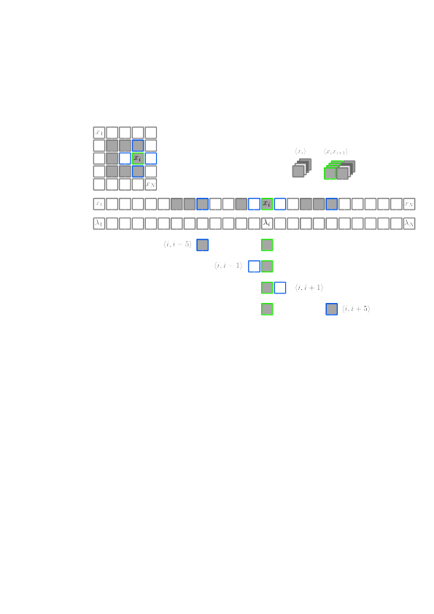
Principle of Maximum Entropy (MaxEnt) – Examples
Generalized Ising models from MaxEnt:
  : analytical solution
  : „intractable“ partition function

Slide 9
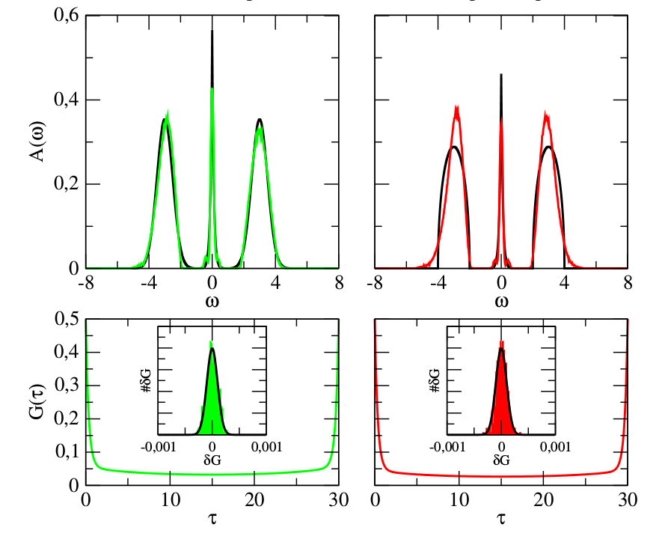
Principle of Maximum Entropy (MaxEnt) – Examples
Inverse Laplace Problem
[Physics Reports 269 ( 1996) 133-195]
BAYESIAN INFERENCE AND THE ANALYTIC
CONTINUATION OF IMAGINARY-TIME
QUANTUM MONTE CARLO DATA

Slide 10
Boltzmann Learning – Cost Function and Gradient
General, parametrized form of Energy based models:
  MaxEnt:
How to choose parameters ?
  must be inferred directly from data
  minimize cost function on (usually negative log-likelihood)
  regularize parameters
  stochastic gradient descent with respect to parameters
MaxEnt:

Slide 11
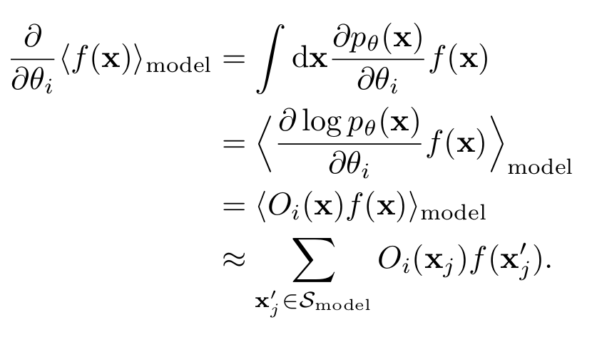
Boltzmann Learning – Gradient and Fantasy Particles
Gradient of cost function with respect to parameters
data enter training via positive phase:
negative phase:
  much more difficult to evaluate
  infeasible to calculate partition function
  numerical methods required
  “fantasy particles“
  sample e.g. with Markov Chain Monte Carlo
differentiation also works for
more complicated functions:

Slide 12
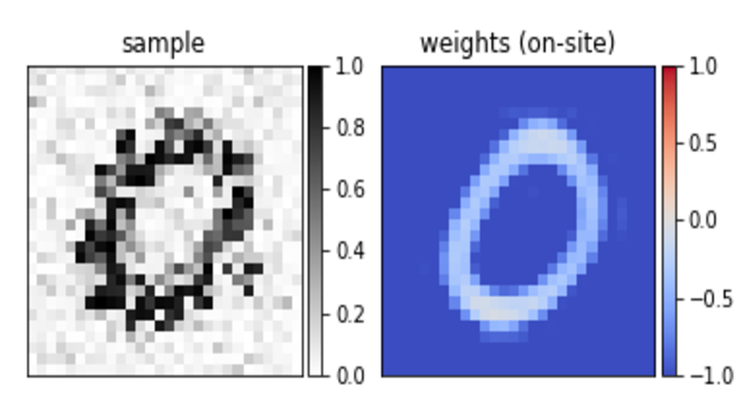
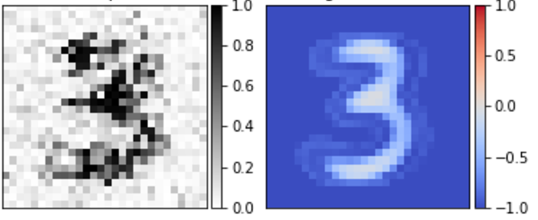
Boltzmann Learning – Stochastic Gradient Descent
Training energy based model of form
  1.) read mini-batch form data-set
  2.) generate fantasy particles using e.g. MCMC
  3.) compute gradient of cost function (log-likelihood)
  4.) update parameters with gradient descent
Python implementation for generative MNIST MaxEnt model
https://github.com/bhartl/generative-models

Slide 13
[A high-bias, low-variance introduction to Machine Learning for physicists, Phys Rep. 810 (2019) 1-124]
Energy Based Models
Benedikt Hartl
Institute for Theoretical Physics, TU-Wien

