Slide 1
Witty Title Here

Slide 3
1
Introduction

Slide 4
1
Introduction
2
Learning Goals

Slide 5
1
Introduction
2
Learning Goals
3
What is Data Science?

Slide 6
1
Introduction
2
Learning Goals
3
What is Data Science?
4
Getting My Legs

Slide 7
1
Introduction
2
Learning Goals
3
What is Data Science?
4
Getting My Legs
5
Politics

Slide 8
1
Introduction
2
Learning Goals
3
What is Data Science?
4
Getting My Legs
5
Politics
6
The Future

Slide 9
Introduction
1
Ben Harwood
B.S. Mathematics, Northern Kentucky University
Inventory Manager Mercedes-Benz of Fort Mitchell
2
Learning Goals
3
What is Data Science?
4
Getting My Legs
IST 652, IST 659, IST 664, IST 687,
IST 707, IST 718, IST 719, IST 722,
IST 736, IST 769, IST 772, FIN 654,
MBC 638, SCM 651
5
Politics
6
The Future

Slide 10
Introduction
1
Ben Harwood
B.S. Mathematics, Northern Kentucky University
Inventory Manager Mercedes-Benz of Fort Mitchell
2
Learning Goals
3
What is Data Science?
4
Getting My Legs
IST 652, IST 659, IST 664, IST 687,
IST 707, IST 718, IST 719, IST 722,
IST 736, IST 769, IST 772, FIN 654,
MBC 638, SCM 651
5
Politics
6
The Future

Slide 11
Learning Goals
1
Introduction
Describe a broad overview of the major practice areas in data science.
Collect and organize data. IST652, IST664, IST687, IST707, IST736, MBC638
Identify patterns in data visualization, statistical analysis, and data mining. IST687, IST719
Develop alternative strategies based on the data. IST 687, IST652, IST736
Develop a plan of action to implement the business decisions derived from the analyses. IST 687, IST772 (IST722, not included)
Synthesize the ethical dimensions of data science practice (e.g. privacy) IST659, IST664, IST772
Demonstrate communication skills regarding data and its analysis IST687, IST707, IST772
2
3
What is Data Science?
4
Getting My Legs
5
Politics
6
Conclusion

Slide 12
Learning Goals
1
Introduction
Describe a broad overview of the major practice areas in data science.
Collect and organize data. IST652, IST664, IST687, IST707, IST736, MBC638
Identify patterns in data visualization, statistical analysis, and data mining. IST687, IST719
Develop alternative strategies based on the data. IST 687, IST652, IST736
Develop a plan of action to implement the business decisions derived from the analyses. IST 687, IST772 (IST722, not included)
Synthesize the ethical dimensions of data science practice (e.g. privacy) IST659, IST664, IST772
Demonstrate communication skills regarding data and its analysis IST687, IST707, IST772
2
3
What is Data Science?
4
Getting My Legs
5
Politics
6
Conclusion

Slide 13
IST659, IST687, MBC638
What is Data Science?
1
Introduction
2
Learning Goals
Data Admin Concepts & Database Management
3
4
Getting My Legs
5
Politics
6
The Future

Slide 14


IST687, MBC638
What is Data Science?
1
Introduction
2
Learning Goals
IST659
Data Admin Concepts & Database Management
Data Analysis and Decision Making
3
Objective: Design and implement a database to solve a data management problem of your choice.
4
Getting My Legs
Problem: An inventory management system for an automotive dealership
5
Politics
6
The Future

Slide 15
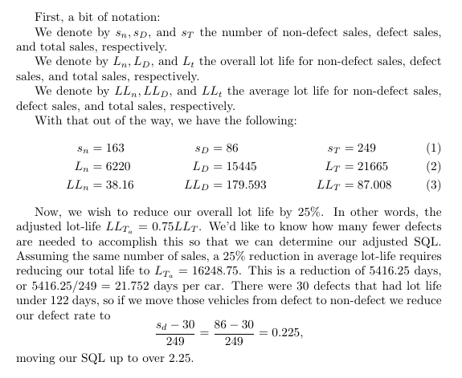
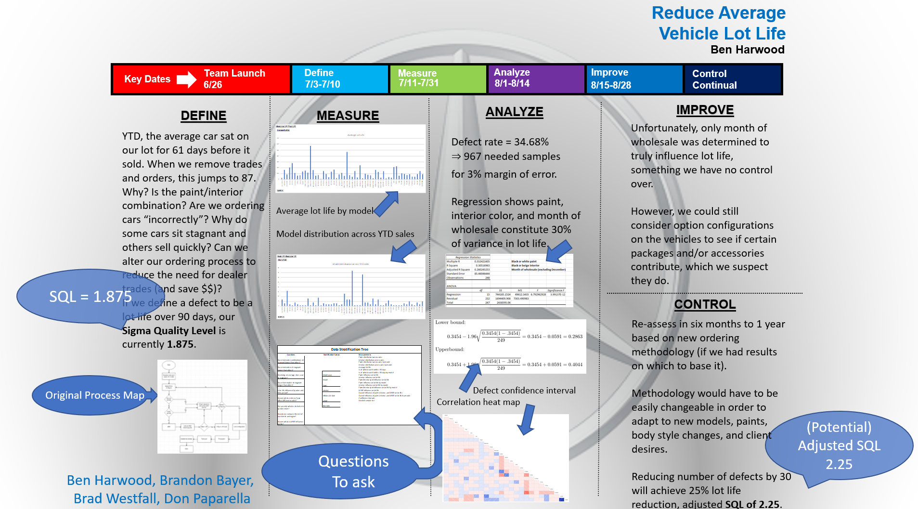
IST659, IST687
What is Data Science?
1
Introduction
2
Learning Goals
MBC638
Data Analysis and Decision Making
Introduction to Data Science
3
Objective: Identify and improve upon a process using Lean Six Sigma methodology.
4
Getting My Legs
Problem: Reduce the time new cars sit stagnant on a dealership lot.
5
Politics
6
The Future

Slide 16
IST659, MBC638
What is Data Science?
1
Introduction
2
Learning Goals
IST687
Applied Data Science
3
Objective: Pick and analyze a dataset.
4
Problem: My group and I studied data from Major League Baseball to determine the effectiveness of
the Designated Hitter and whether it should be adopted by the National League.
Getting My Legs
5
Politics
6
The Future

Slide 17
IST707, IST719, IST772
Getting My Legs
1
Introduction
2
Learning Goals
Data Analytics
3
What is Data Science?
4
5
Politics
6
The Future

Slide 18
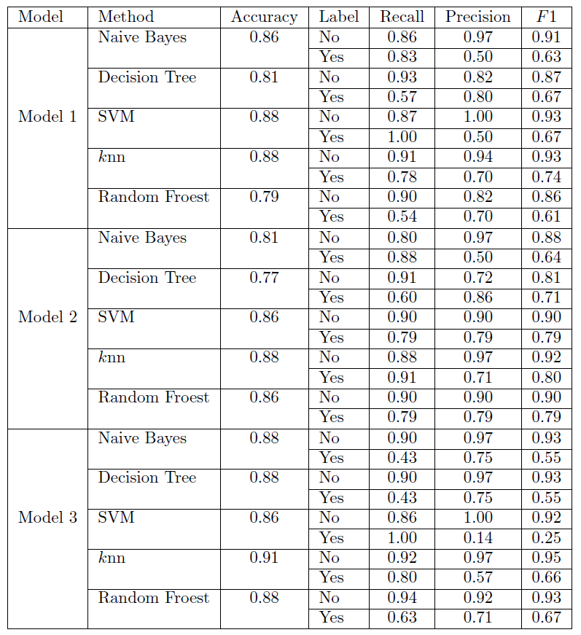
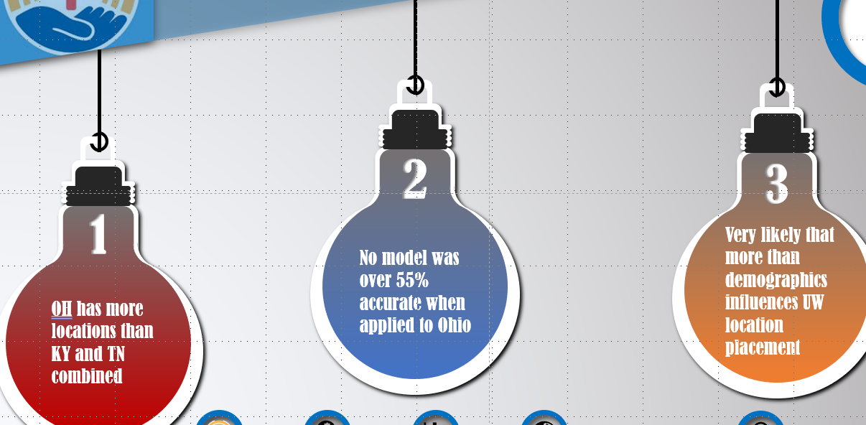
IST719, IST772
Getting My Legs
1
Introduction
2
Learning Goals
IST707
Data Analytics
Information Visualization
Objective: Solve a data mining problem.
3
What is Data Science?
Problem: Can we predict where the United Way places its locations?
4
5
Politics
6
The Future

Slide 19
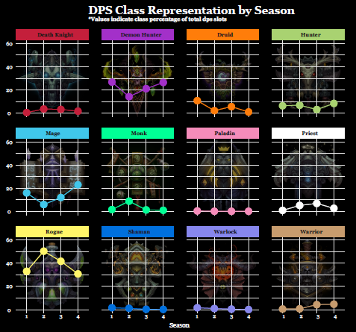
IST707, IST772
Getting My Legs
1
Introduction
2
Learning Goals
IST719
Information Visualization
Quantitative Reasoning in Data Science
Objective: Create and present a poster
3
What is Data Science?
Problem: Class distribution in World of Warcraft Mythic+ Dungeons
4
5
Politics
6
The Future

Slide 20
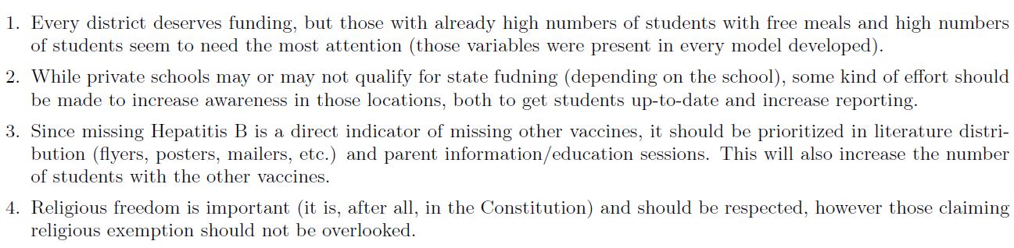
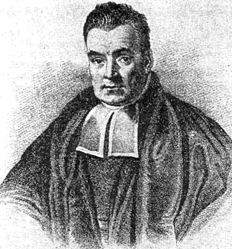
IST707, IST719
Getting My Legs
1
Introduction
2
Learning Goals
IST772
Quantitative Reasoning in Data Science
3
What is Data Science?
Objective: Perform a comprehensive statistical analysis
Problem: Analyze multiple datasets pertaining to vaccinations to make recommendations to a scientifically inclined member of a state legislator’s office
4
5
Politics
6
The Future

Slide 21
Politics
IST652, IST664, IST736
1
Introduction
2
Learning Goals
Scripting for Data Analysis
3
What is Data Science?
4
Getting My Legs
5
6
The Future

Slide 22
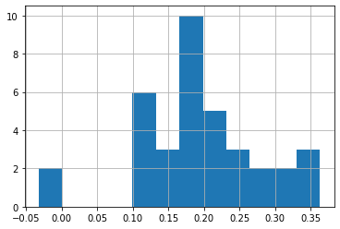
Politics
IST664, IST736
1
Introduction
2
Learning Goals
Natural Language Processing
IST652
Scripting for Data Analysis
3
What is Data Science?
Objective: Write a Python program to access and collect data from multiple sources and types (both structured and unstructured), and process and study the data.
4
Getting My Legs
Problem: Determine how much influence a governor can have on how their state votes in presidential
elections
5
Linear regression was performed to predict DemJumpers from Sentiment. Regression yields F(1, 35) = 13.47, p = 0.0007, R² = 0.257.
Considering the RepJumpers, regression yields F(1, 35) = 4.629, p = 0.0384, R² = 0.092.
6
The Future

Slide 23
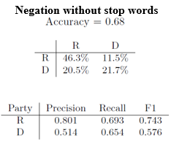
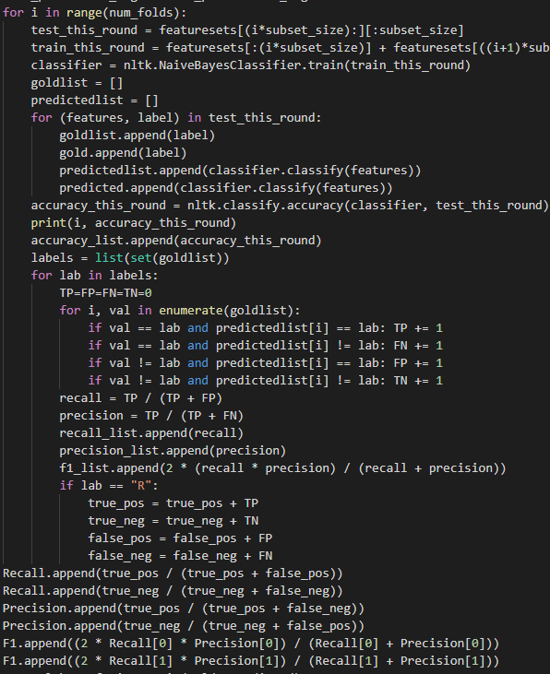
Politics
IST652, IST736
1
Introduction
2
Learning Goals
Text Mining
IST664
Natural Language Processing
3
What is Data Science?
Objective: Classification of text
Problem: Gubernatorial inaugural speeches
4
Getting My Legs
5
6
The Future

Slide 24
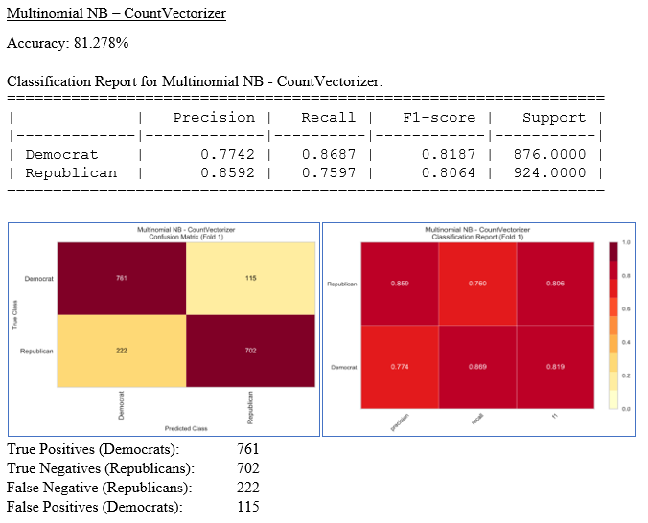
Politics
IST652, IST664
1
Introduction
2
Learning Goals
IST736
Text Mining
3
What is Data Science?
Objective: Solve a real-world text mining problem.
Problem: Can a Tweet predict political affiliation?
4
Getting My Legs
5
“The Georgia Senate races are indescribably important. The entire country hinges upon the outcome of these runoffs.”
6
The Future

Slide 25
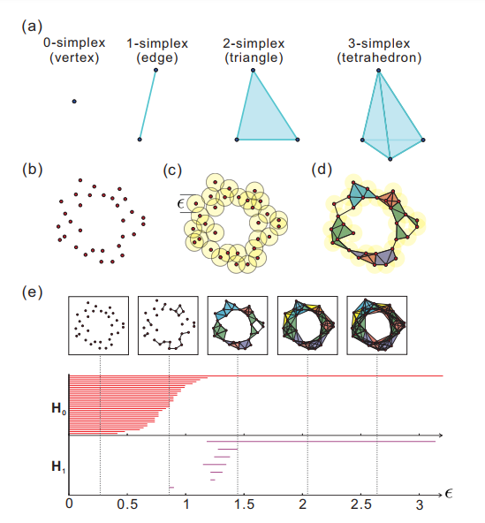


The Future
1
Introduction
2
Learning Goals
3
What is Data Science?
4
Getting My Legs
5
Politics
6

Slide 26

The Future
1
Introduction
2
Learning Goals
3
What is Data Science?
4
Getting My Legs
5
Politics
6

Slide 27
1
Introduction
2
Learning Goals
3
What is Data Science?
4
Getting My Legs
5
Politics
6
The Future

Slide 28
1
2
3
4
5
6

Slide 31
Thank you

