Slide 1
Prototype PCB Design
Week 11 — PV Integrated EV System

Slide 2
Component List
Gate driver — IR2110
Microcontroller — Arduino Uno
Gate resistor — 10Ω
Gate pull-down resistor — 10kΩ
R1 (feedback divider) — 100kΩ
R2 (feedback divider) — 10kΩ
PV Panel — 17.93V, 20W
Inductor (L) — 2200µH, hand-wound toroidal
Diode — MBR10100CT (Schottky)
Capacitor (C) — 33µF / 100V
MOSFET — IRF540N
Load resistor — 120Ω / 25W

Slide 3
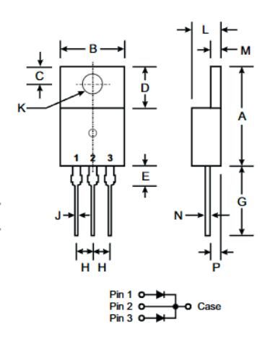
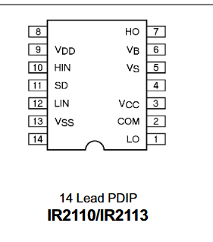
MBR10100CT Diode
IR2110 Gatedriver
Pin 9→ +5v of Arduino
Pin 3 → SOLAR PANEL + TERMINAL
Pin 12 → D9 Arduino
Pin 1 (Anode) → Switching node
(L1 / Q2 Drain)
Pin 2 (Cathode) → Output rail
Pin 1 → Gate of MOSFET

Slide 4
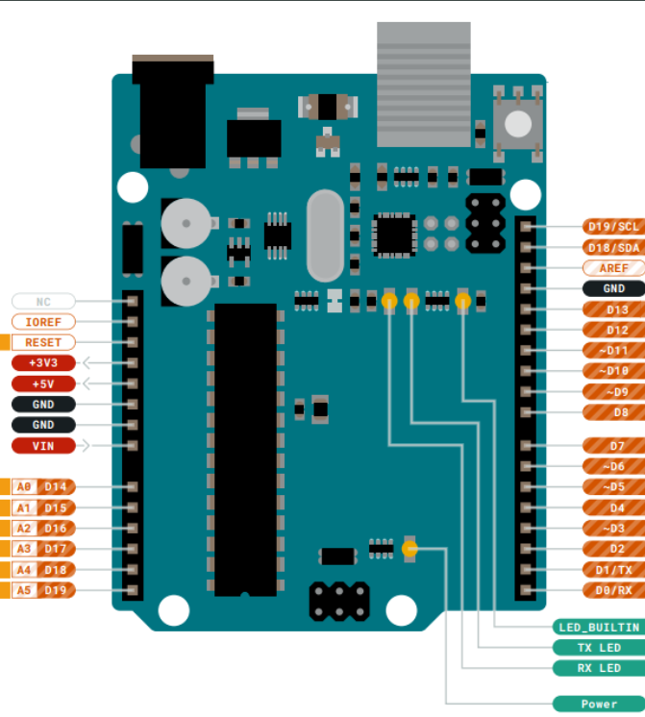
Pin 1 (LO) → R4 → Q2 Gate
Pin 2 (COM) → Ground /
MOSFET Source
Pin 13 (VSS) → Ground
Pin 12 (LIN) → Arduino digital pin
(PWM control input)
Pin 11 (SD) → Arduino digital pin
(shutdown control)
Pin 9 (VDD) → +5V supply
(from Arduino)

Slide 5
