Slide 1
PV Integrated EV System
Next-Generation 48V LiFePO₄ & Supercapacitor Infrastructure for EV Charging

Slide 2

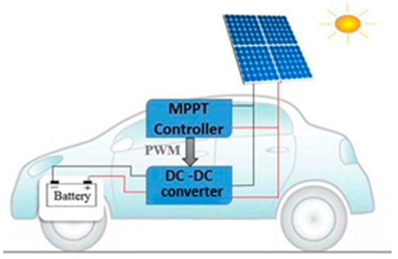
System Architecture & Principle
Solar Input: Photovoltaic panels convert sunlight to DC electricity (18–36V open circuit).
MPPT Controller: Maximum Power Point Tracking matches the 48V LiFePO₄ charging profile.
Supercap Buffer: Module absorbs rapid current surges from cloud-shade cycling.
Battery Pack: 48V system (15S configuration) with integrated BMS protection.

Slide 3






PV Panel Selection: Mono-Crystalline
Higher Efficiency
Lightweight & Flexible
Lower Degradation
Superior conversion of irradiance to electrical output under standard and low-light conditions.
Longer operational lifespan with minimal performance loss over time under environmental stress.
Conforms to curved or irregular rooftop surfaces without heavy mounting hardware.

Slide 4


Estimated Rooftop Output Power
Power Calculation
Parameter | Value
Solar Irradiance (G) | 1 kW/m²
Panel Efficiency (η) | 20%
Estimated Area (A) | 1.5 m²

Slide 5
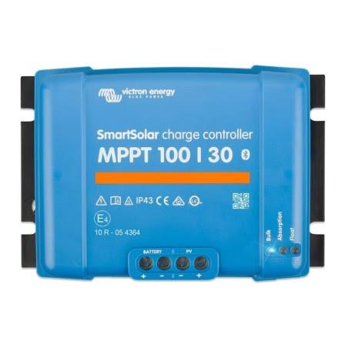
Maximum Power Point Tracking
Sense: Measures PV voltage and current continuously to monitor real-time output.
Track: Advanced algorithms (e.g., P&O) find the maximum power point on the P-V curve.
Adjust: Changes boost converter duty cycle to maintain the MPPT despite solar variation.
Ensures system operates at peak efficiency during changing irradiance, temperature, and partial shading.

Slide 6


DC-DC Boost Converter Hardware
Specifications
System Assumptions
High-Speed MOSFET Swich
Vin (PV): 18V – 36V
Fast Recovery Power Diode
Vout (Battery): 48V – 58.4V
Switching Frequency: 20-100 kHz
Estimated Efficiency: 90% – 95%

Slide 7
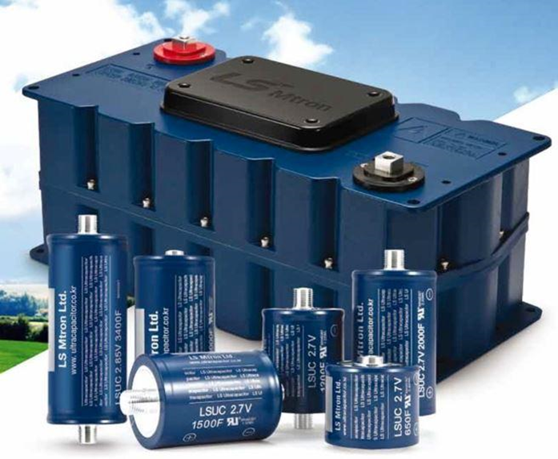
Supercapacitor Buffer Strategy
Surge Protection & Lifecycle
An EDLC (Electric Double-Layer Capacitor) module placed between MPPT and Battery:
Reduces battery stress by 20–30%
Handles rapid cloud-shade cycling
Prevents LiFePO₄ micro-charging cycles

Slide 8



DC-DC boost converter calculation
Equation used
$$D_{max}=1−\frac{V_{in(min)}}{V_{out}}$$
$$L_{min}=\frac{V_{in(min)}⋅D_{max}}{ΔI_{L}⋅f_{sw}}$$
$$C_{out}=\frac{I_{out(max)}⋅D_{max}}{f_{sw}⋅ΔV_{out}}$$

Slide 9
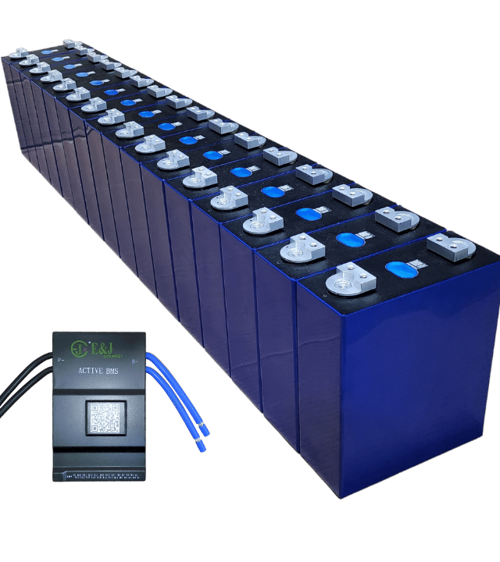
48V LiFePO₄ Solution
Safe & Stable: No thermal runaway risk for lab or field use.
Solar-Ready: 48V standard for MPPT controllers.
Long Life: 2000–4000+ cycles for years of daily use.
Budget-Friendly: 15S pack utilizes widely available 3.2V cells.

Slide 10
EV Battery Voltage Benchmarks
Vehicle Type | Voltage | Capacity | Chemistry
E-bicycle | 24–48 V | 10–20 Ah | LiFePO₄
E-scooter | 48–72 V | 24–60 Ah | Li-ion/NMC
E-rickshaw (3-whl) | 48–60 V | 100–150 Ah | LFP / Lead-acid
Mid-range EV car | 350–400 V | 40–82 kWh | NMC 811
Premium 800V EV | 800 V | 77–100 kWh | NMC 811
Electric City Bus | 500–700 V | 200–400 kWh | LFP

Slide 11

Energy Generation & Driving Range
1.5
18.7
kWh / Day Yield
Daily Km Range Added
The Efficiency Context
Based on 5 peak sun hours in Sri Lanka and a three-wheeler EV consuming 80 Wh/km. The solar integration provides a significant daily offset for urban commutes.

Slide 12
Prototype Selection & Cost
Configuration | Cells | Spec | Cost (LKR)
15S1P Basic Demo | 15 Cells | 48V / 6Ah (288 Wh) | 19,350
Cell Type | 32700 | 3.2V 6000mAh (5C) | 1,290 / cell
Peripheral Comp. | BMS, MPPT | Solar-Ready Module | TBC
*Peripheral component pricing for BMS, MPPT and Supercapacitor modules to be finalised on purchasing of batch.

