Slide 1
Week 11
Boost Converter PCB Update
Arduino shield connection, sensing, protection, and layout finalization
Bhashini A.J. (E/21/060)

Slide 2
This Week's Changes
Switched Arduino connection from loose wires to a shield-style plug-in design
Replaced the load resistor with battery connection pins
Added input voltage and current sensors for real-time monitoring
Added a zener diode to protect the feedback signal into the Arduino ADC
Planned physical clearance for heatsinks on the MOSFET and diode
Positioned all 4 Arduino header connectors using exact official coordinates
Finalized PCB layout zones and measured board dimensions

Slide 3
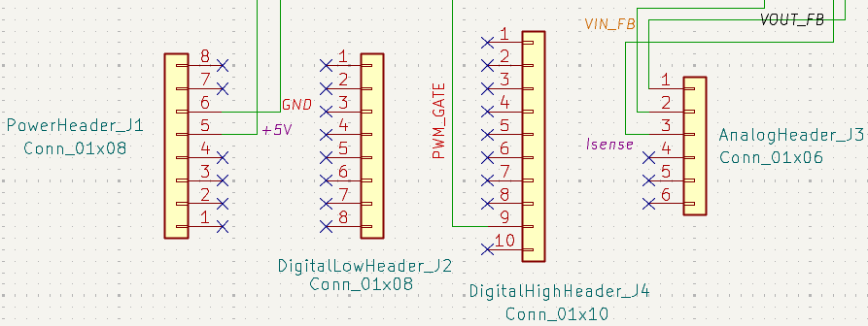
Arduino: Shield-Style Connection
Why: loose jumper wires near a 20kHz switching signal can pick up noise and interfere with each other
Fix: PCB plugs directly onto the Arduino, like a shield — short, fixed connections, no loose wires
Analog In
(6-pin)
Digital Low
(8-pin)
Digital High
(10-pin)
Power
(8-pin)
4 header connectors placed at exact Arduino Uno spacing — grouped and locked as one unit

Slide 4
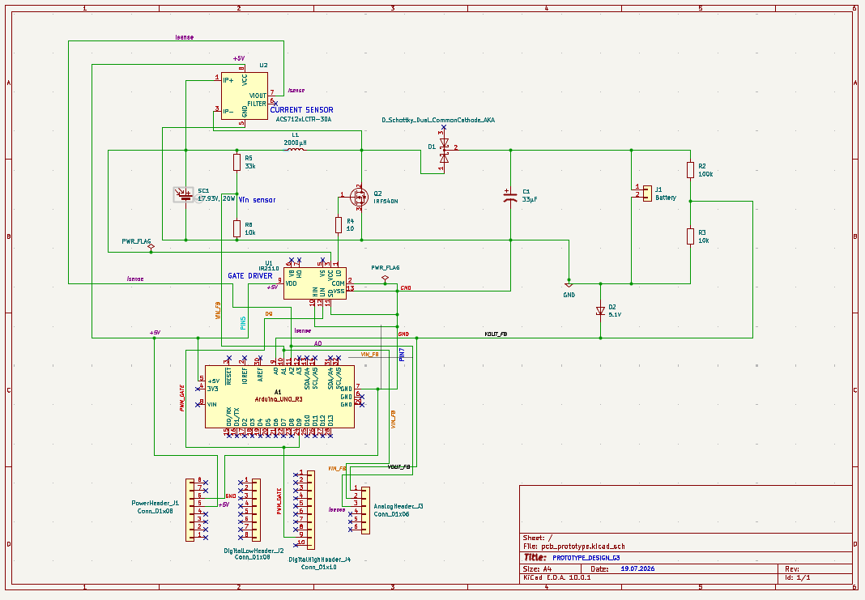

Slide 5
Voltage & Current Sensing + Protection
New sensors added
Protection added
Current sensor (ACS712) — inline between PV panel and inductor, feeds Arduino A2
Vin voltage sensor — divider tapping the PV input, feeds A1
Vout voltage sensor — existing R2/R3 divider, feeds A0
Zener diode (5.1V) placed between the Vout feedback line and GND
Clamps the signal into A0, protecting the Arduino's ADC from voltage spikes

Slide 6
Heatsinks & Component Clearance
Heatsinks needed on Q2 (IRF540N) and D1 (MBR10100CT) — both dissipate real power at switching frequency
Not a schematic component — purely a PCB layout and mechanical planning consideration
Kept 15-20mm clearance between Q2 and D1, so clip-on heatsinks don't collide
Repositioned C1 (output capacitor) away from Q2 to avoid crowding the heatsink zone
Insulating thermal pads planned if both heatsinks sit close together, in case TO-220 tabs are live
WANT TO CONSIDER THE

Slide 7
Building the Shield-Style Connector
Sourced the official Arduino Uno R3 Eagle CAD files (header pin coordinates)
Placed 4 generic pin headers (Power, Analog In, Digital Low, Digital High) at the exact official spacing
Grouped and locked the 4 headers, so relative spacing can't be accidentally disturbed
Result: PCB plugs directly onto a real Arduino Uno, no loose wiring needed
Reference template used:
github.com/LNSD/Arduino-Shield-Template

Slide 8
PCB Layout Dimensions
Board size
Approx. 110mm x 100mm — sized to comfortably fit the power stage, gate drive, sensing, and header zones
Key clearances
Q2 to D1 | 15-20mm (heatsink clearance)
Gate driver (U1) to Q2 gate | under 20mm (short gate trace)
Power stage to feedback/sensing zone | 25-30mm (noise isolation)
Component to board edge | 2.5-4mm minimum
Header block to nearest component | 20-25mm
PCB connections are in progress

Slide 9
