Slide 1

Network Structures & Cloud Computing
TEAM 05 :
Bhashmi Fatnani - 001449268
Harshitha SomaSundar – 001497986
Shuravi Barman - 001475070

Slide 2
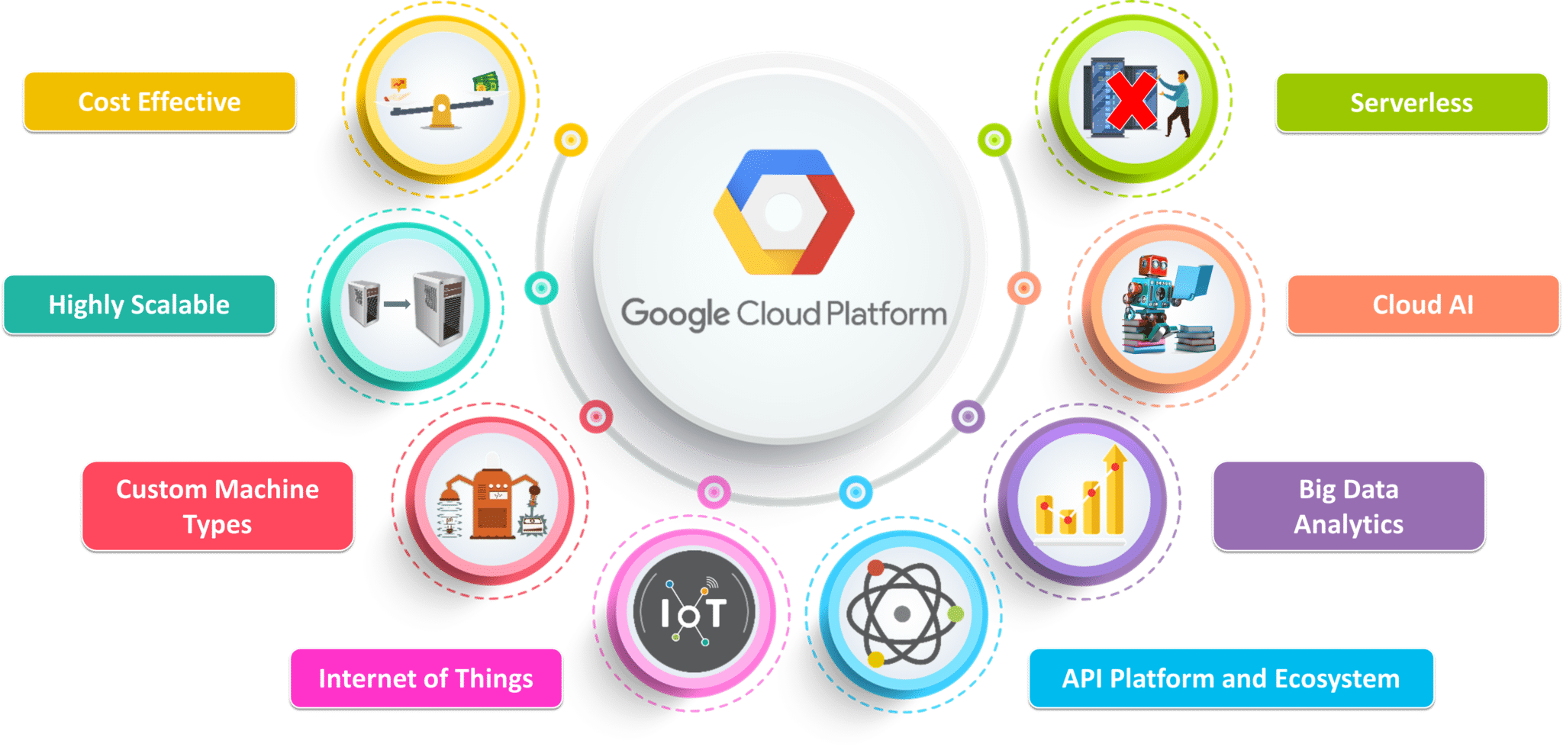

Slide 3
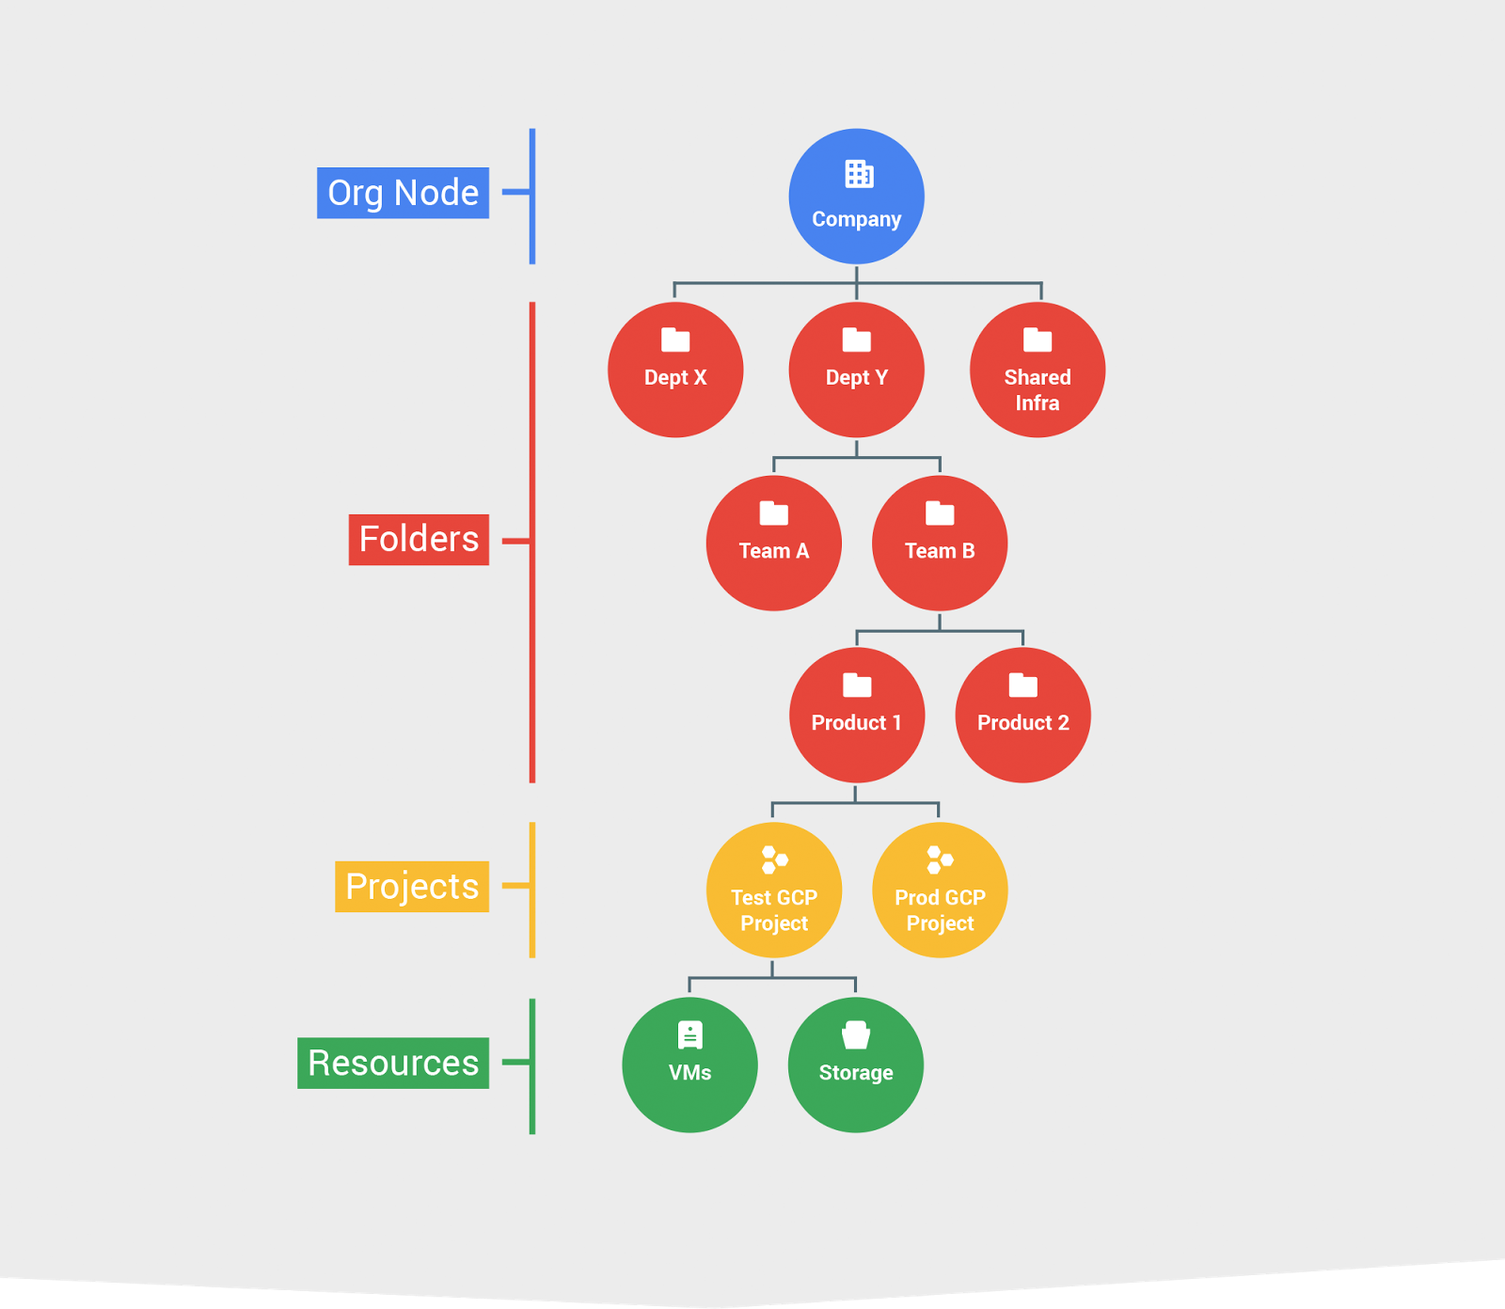
Provide a hierarchy of ownership, which binds the lifecycle of a resource to its immediate parent in the hierarchy.
Provide attach points and inheritance for access control and organization policies.

Slide 4
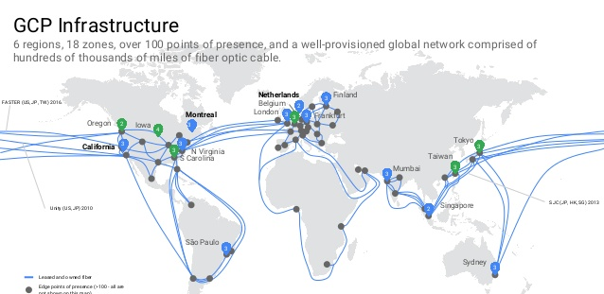

Slide 5
Developer and Management Tools for GCP
Cloud Console -> Integrated web based management UI
Cloud SDK -> Command-line interface for Google Cloud Platform products and services
Cloud Shell -> Manage your infrastructure and applications from the command-line in any browser
Android Studio -> Cloud platform can be added as a backend to your android app
Intellij Idea-> Google sponsored plugin “Cloud tools for intellij”

Slide 6
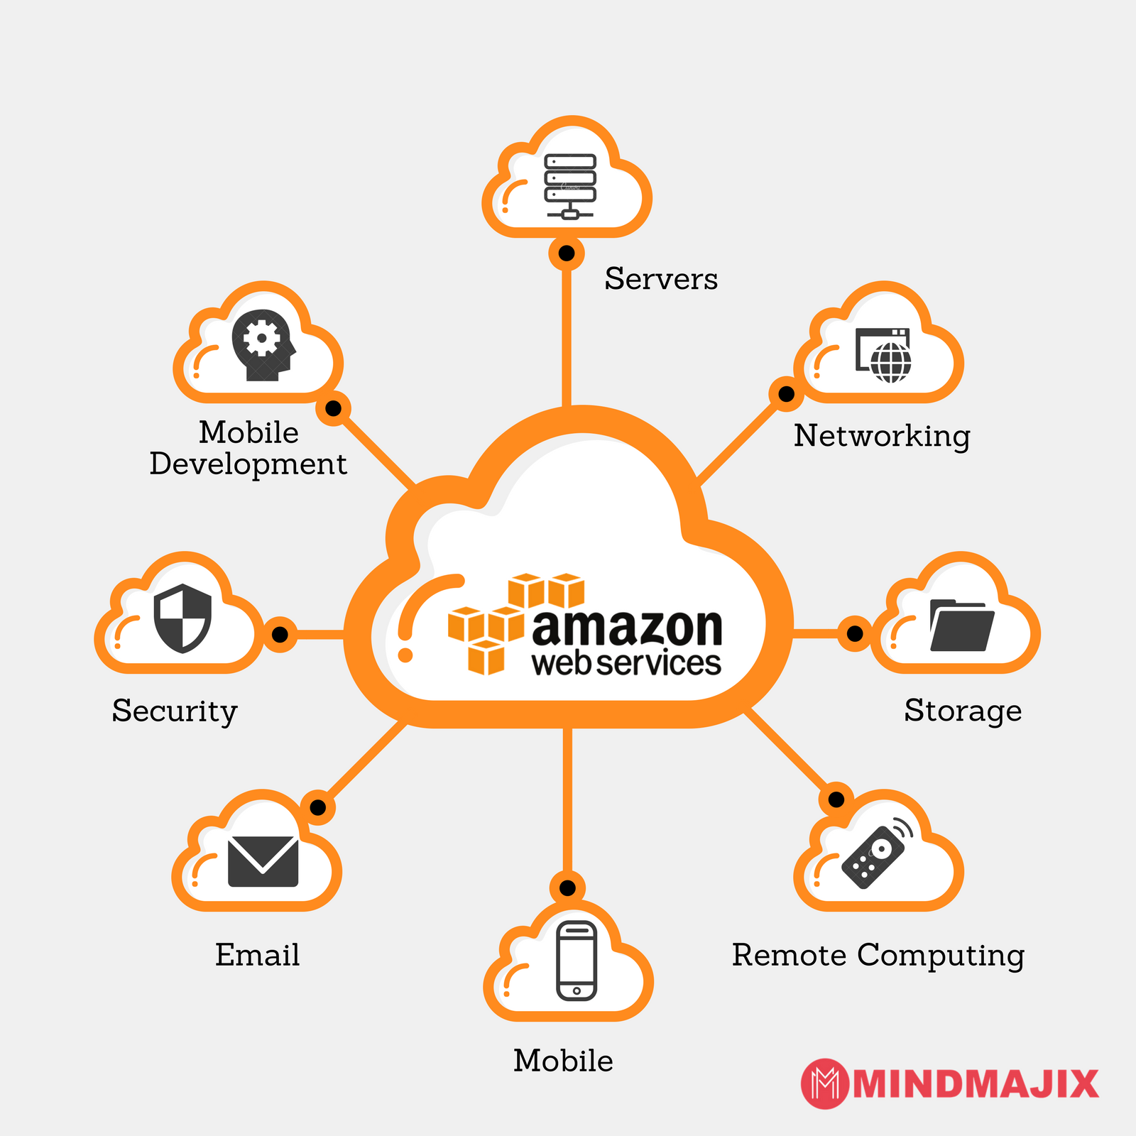
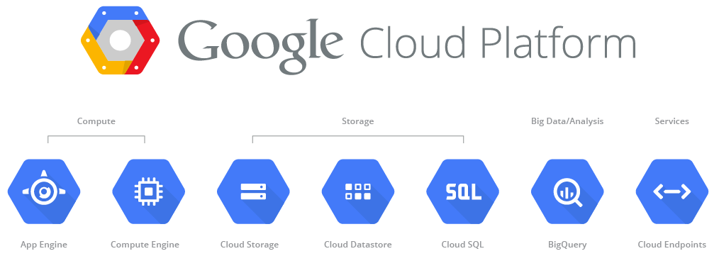

Slide 7
Comparison between AWS and GCP
SERVICE CATEGORY | SERVICE | AWS | GCP
Compute | IaaS | Amazon Elastic Compute Cloud | Compute Engine
 | PaaS | AWS Elastic Beanstalk | App Engine
 | Containers | Amazon Elastic Container Service | Google Kubernetes Engine
 | FaaS | AWS Lambda | Cloud Functions
Network | Virtual Networks | Amazon Virtual Private Cloud | Virtual Private Cloud
 | Load Balancer | Elastic Load Balancer | Cloud Load Balancing
 | Domains and DNS | Amazon Route 53 | Google Domains, Cloud DNS
 | CDN | Amazon CloudFront | Cloud CDN
Database | RDBMS | Amazon Relational Database Service, Amazon Aurora | Cloud SQL, Cloud Spanner
 | NoSQL: Key-value | Amazon DynamoDB | Cloud Firestore, Cloud Bigtable
Application Services | Messaging | Amazon Simple Notification Service, Amazon Simple Queueing Service | Cloud Pub/Sub
Management Services | Monitoring | Amazon CloudWatch | Stackdriver Monitoring
 | Deployment | AWS CloudFormation | Cloud Deployment Manager

Slide 8
Views during Implementation
Not many different services and features as AWS and Azure.
Delay in creation of resources
Managing user and roles is easier as compared to AWS
Not enough resources Online to refer

Slide 9


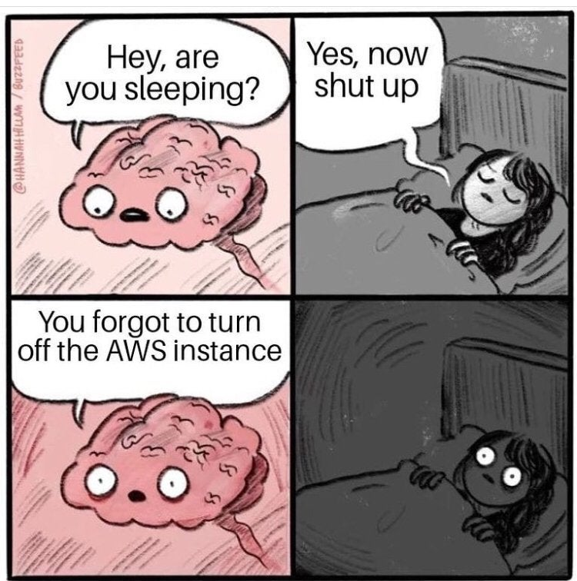
2CPU/8GB RAM 12months ~ $69/month
3.8TB RAM + 128 vCPU ~ $3.97/hr
The 12 month option of 100$
AWS EC2 offers what they call Reserved Instances,
2CPU/8GB RAM 12months ~ $52/month
3.8TB RAM + 160vCPU ~ $5.2/hr
Free Tier that isn’t time-limited
Sustained Discounts: Longer duration less pricing 25% save up to 30% based on your use and instance size.

Slide 10
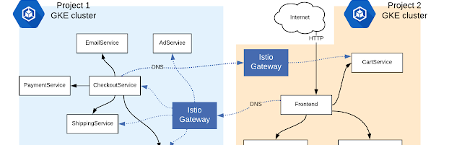
Hybrid Cloud
Split the microservices app in such a way that frontend components are migrated to GCP while retaining the backend services on-prem connected to MySQL in the private datacenter.
Istio (Gateway-Connected Clusters feature) combining two separate Istio service meshes into one logical, hybrid mesh.
Anthos enables consistency between on-premises and cloud environments

Slide 11



