Slide 1
Prediction of wine quality from physiochemical properties
Presented By:
Bhashwanth Kadapagunta
Mahalaxmi Sanathkumar
Nitish Pandey
Parul Upadhyaya
Venkatesh Sambandamoorthy

Slide 2
Introduction
What are physiochemical properties of wine ?
- Sulfates, citric acid, volatile acidity, residual sugar, chlorides, density, and alcohol etc
Benefits of using physiochemical properties.
- Statistical basis to quantify wine quality.\
Commercial Benefits
Preventing adulteration
Evaluation of price

Slide 3
Dataset
Taken from UCI machine learning repository
Dataset has two subsets – red wine and white wine
Total 6497 instances
There are a total of 11 physiochemical attributes
One quality label
All values are numeric and continuous

Slide 4
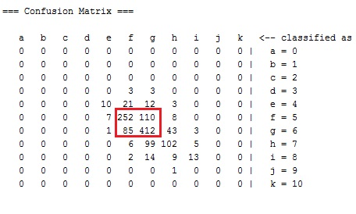
Our Contributions
Results on raw data:
Misclassifications in classes 5 & 6
Accuracy: 64.4608 %
Solution:
Merging of classes 5 & 6

Slide 5
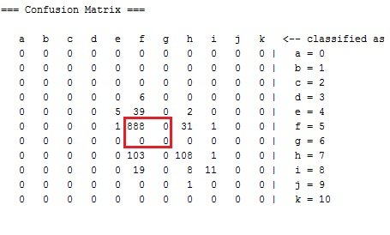
Results
Techniques used:
Random Forest, SVM, Neural networks, KNN
Random Forest: ensemble learning method
Accuracy: 83.1669%

Slide 6
Future Work
Application of boosting techniques to improve the performance further

Slide 7
Cheers

