Slide 1
“SHOW CASING A.P.”
FAPCCI Seminar on
“Meeting Global Outsourcing Requirement”
PRESENTATION
By
DR.P.V.APPAJI
M.Pharm, Ph.D
EXECUTIVE DIRECTOR
PHARMEXCIL
(PHARMACEUTICALS EXPORT PROMOTION COUNCIL)
Set up by Ministry of Commerce and Industry
GOVERNMENT OF INDIA
Date: 2nd & 3rd June 2006

Slide 2

Global Pharmaceutical Audited Market
MAT 12 Months to August 2005
(Sales Through Retail Pharmacies) US $ Bn % Share % Growth
United States 180.3 49.57 +6%
Japan 60.7 16.69 +5%
Germany 26.9 7.40 +6%
France 22.6 6.21 +5%
United Kingdom 15.5 4.26 0%
Selected World 363.70 100.00 +7%
Source Data :IMS Health

Slide 3
Indian Pharmaceutical Industry
Manufactures over 400 APIs ( Bulk Drugs )
Manufactures over 10,000 Medicaments (Formulations)
Almost self Sufficient (95%) in Domestic Requirement
Total Pharmaceuticals Production $8.0 Bn (Approximate)
Ranks 4th Globally in Volume Terms
Ranks 13th Globally in Value Terms
Among TOP 5 Global Producers of Bulk Drugs

Slide 4
Indian Pharmaceutical Industry – Key Strengths
Well developed industry with strong manufacturing base
Cost competitiveness
Well-established network of laboratories and R&D infrastructure
Highly trained pool of scientists and professionals
World-class quality products
Strong marketing and distribution network
Very strong process development skills
Potential ground for clinical trials
Fast growing health care industry
Rich biodiversity
A growing biotechnology industry

Slide 5
Approvals Received from Some Developed Countries
COMPANIES / FACILITIES
FDA - UNITED STATES 75
TGA - AUSTRALIA 19
MCA - SOUTH AFRICA 45
EDQM - EUROPE 3

Slide 6
Hyderabad in Indian Pharma
Contributes over 40% to National Output
Known as Hub for Production of API’s
Over 250 Active Bulk Drug Manufacturers
Strong in process development
Presence of about 5 Top Pharma Companies in Hyderabad
Strong Biotech presence
Several Clinical Research / Custom Research Centres

Slide 7
Economics of Drug Discovery
Cost of discovering a drug: About $ 800 –1,000 Mn
Without cost of capital, cost is about $ 400 –500 Mn
Development phase accounts for 28% -35% of total
Developing a single optimized lead costs $ 25 –40 Mn
This includes both development and animal studies
Cost of development phase: Generating enough “promising” or “optimized” leads to go to animal trials costs $ 10 –25 Mn per study
This activity is ripe for outsourcing to qualified service providers

Slide 8
Global Pharma Industry : Economics
Cost of discovering a drug (defined as total R&D spend divided by number of licensed NCE’s) : $ 800 – 1,000 Mn.
R&D spending has doubled in past seven years.
Number of licenses issued has remained constant.
Pipelines of new drug candidates drying up.
Most revenue comes from third-party insurers.
With high profit margins, no incentive to cut costs.
Customer revolt in USA against rising cost of healthcare.
Pressure to cut cost of drug discovery.
Outsourcing of discovery R&D is now a serious option.

Slide 9
Drug Discovery : Changing Landscape
Traditionally Pharma Companies did all four steps
Increasingly pharma companies are doing only last two steps (clinical trials and regulatory approvals + manufacturing, marketing, sales & distribution
Increasing development and /or pre-clinical work are being done by small, agile “discovery” companies
Most small / medium biotech companies develop validated or optimized leads, and license these to pharma companies against future “milestone” payments
Many discovery companies are now turning to biological formulations (biotech pharma’s)

Slide 10
Generics : Focus Area
Generics Market– over USD 46 billion
North America : USD 13.5 Billion
EU : USD 8 Billion
Japan : USD 5 Billion
ROW : USD 16 Billion
Trend of Molecules going off-patent
Year | No. of Molecules | Value (US$ Bn)
2004 | 19 | 17.2
2005 | 18 | 7.4
2006 | 18 | 14.9

Slide 11
Key Trends in the Pharmaceutical Industry
Extensive and Continued Consolidation of Big Pharma
Spin-off of non-strategic assets and businesses
R&D Centers
Manufacturing Plants
Chemical Synthesis plants
Office Buildings
Personnel
Warehouses

Slide 12
Outsourcing & Pharma..
Outsourcing in pharmaceuticals is broadly divided into
manufacturing outsourcing
development outsourcing
customised chemistry services.

Slide 13
Outsourcing & Pharma..
Manufacturing outsourcing will involve the supply of active pharmaceutical ingredients / intermediaries.
Development outsourcing will involve pre clinical and clinical trials
Customised chemistry services will involve contract research for molecules in the pre launch stage.

Slide 14
Outsourcing & Pharma..
Research & Development- 74% of offshored employment
Clinical Trials- worth (US$75 million for the year 2005…estimated at US$281 million by 2010)
Data Management
Medical writing,Drug Discovery
Contract Manufacturing- first Indian companies to enter into- Ranbaxy Laboratories & Lupin Laboratories
Clinical Research / Clinical Trials
Contract Research & Manufacturing Services(CRAMS)

Slide 15
Cost Comparison:-
Kotak estimates reports : -
Cost of doing clinical trials in India is 40-60 per cent lower than in developed markets.
CYGNUS Research quotes:-
Cost of Manufacturing a drug in US costs 60% more to that of manufacturing the same drug in India.

Slide 16
Pharma Outsourcing – Market Size (Estimates by 2009)
Contract Manufacturing
Prescription Drugs US$ 43.9 Bn +10.8%
OTC Drugs US$102.0 Bn +11.3%
Contract Research US$ 21.9 Bn +8.6%

Slide 17
Contract Research and Manufacturing Services (CRAMS)
Contract Research (CR)
1. Drug Discovery Stage (NCE Synthesis)
2. Pre Clinical Stage
3. Clinical Stage
To setup of laboratory as per requirements of customers
Procurement of requisite equipments and getting approvals
Recruiting personnel and providing requisite training
Possible returns 30-70%

Slide 18
Contract Research and Manufacturing Services (CRAMS)
Contract Manufacturing (CM)
Customised manufacturing of Intermediates for NCEs
Expected returns more than 50%
Offer manufacturing facility to companies having ANDA approvals
Supply of APIs to Generic Drug Formulators

Slide 19
Why Outsourcing India?
Greatest potential for cost saving
Highly trained pool of Scientists &
Professionals
Regulatory Compliance
Quality Standards,Rich biodiversity
Adopting cGMP and Good Clinical practices
Equipped with Infrastructural facilities
Good Service and On time delivery
Govt. policies favoring R & D
Growth in health insurance sector
Biggest market with vast potential

Slide 20
India high on the Outsourcing list for Clinical trials !
A number of 122 Clinical trials are conducted in India next to Taiwan,Mexico,Poland,Brazil.
GlaxoSmithKline, among the world’s top ten global pharma majors, is currently carrying out the largest number of clinical trials in India.
UK-based pharma major is conducting 13 drug trials in India for the treatment of diseases such as cancer,arthritis,heart disease and constipation.
Johnson & Johnson, Eli Lilly are conducting respectively eight studies in India.
Suven Life Sciences & Sipra Labs are also actively invloved in the Trials.
Clinical Trials in India, costs 50% to 60% less than the average cost in the US.
AstraZeneca another global pharma company outsourcing significant number of its trials to India

Slide 21
Conclusion on Outsourcing
India has an opportunity to become the “Drug Discovery R&D Outsourcing destination” to the world
Company can focus efforts on core competencies / skills and contract critical services
Speed to market can be enhanced through outsourcing strategic needs.

Slide 22
PHARMEXCIL
PHARMACEUTICAL EXPORT PROMOTION COUNCIL
SET UP BY MINISTRY OF COMMERCE ON 12 MAY, 2004
OBJECTIVE : TO GIVE FOCUSED ATTENTION TO PHARMA EXPORTS
SUPPORTED BY : ALL MAJOR PHARMA ASSOCIATIONS IDMA, BDMA, OPPI, IPA, ETC. AND GOVT., OF A.P.
H.O. AT HYDERABAD & R.O. AT MUMBAI

Slide 23
Product Groups Covered
Bulk drugs / drug intermediates
Drug formulations
Herbals / Ayurvedics / Homeopathic / Unani
Medicinal Plants
Bio-tech / Biological products
Diagnostics and Surgicals
Neutraceuticals
Collaborative /contract research
Clinical trials
Pharma consultancy services etc.

Slide 24
Assistance to Exporters
Issue of RCMC certificates
Delegations to foreign countries
Buyer seller meetings
Foreign buyer details
Embassy assistance
Exhibition participation
Seminars and Conferences
Technology assistance

Slide 25
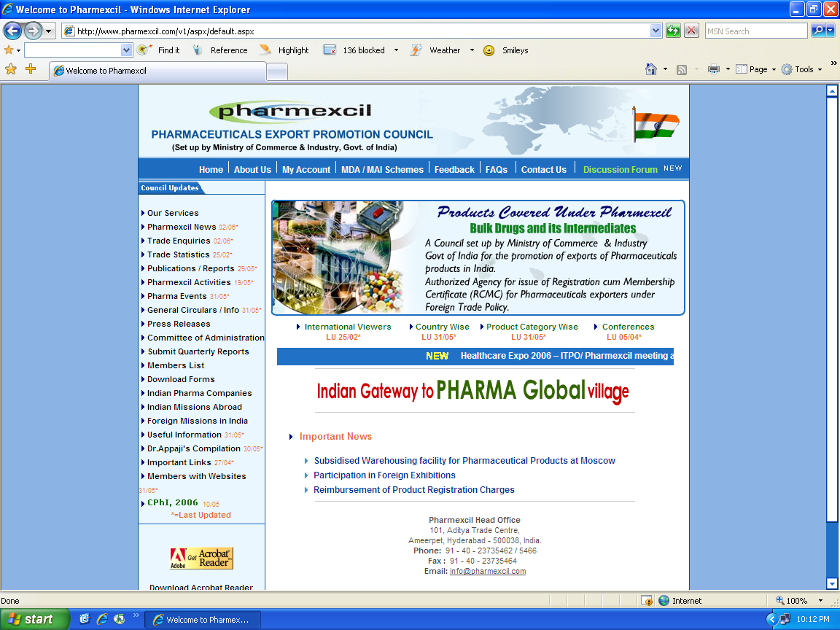
Pharmexcil’s Website
www.pharmexcil.com

Slide 26
PHARMEXCIL
Thanks You

