Slide 1
virtualMachine-Deploy.ps1 Instructions

Slide 2
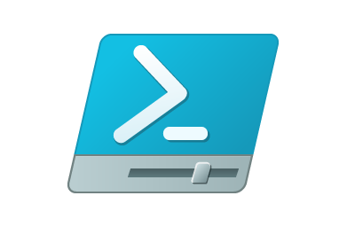
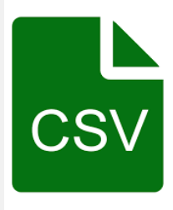


VM Deployment Script
1. Perform input validation and perform certain checks against Azure
4. Display output to console and store output in local CSV file
2. Generate ARM template
3. Deploy ARM template to Azure

Slide 3
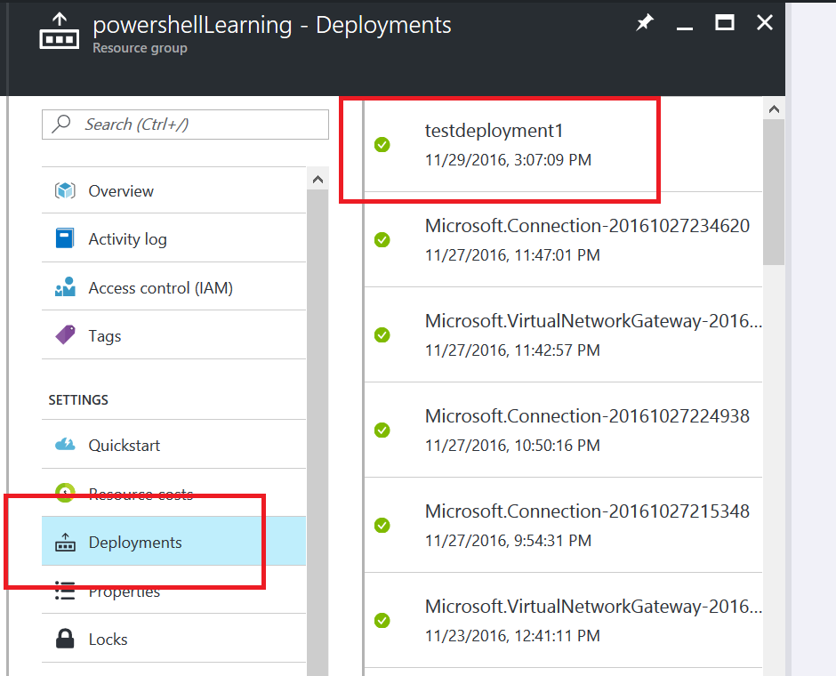
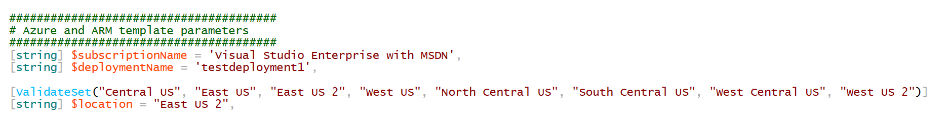
Azure and ARM Template Parameters
The “Deployment Name” simply describes the custom name given to describe the entire deployment of Azure resources into a particular resource group

Slide 4
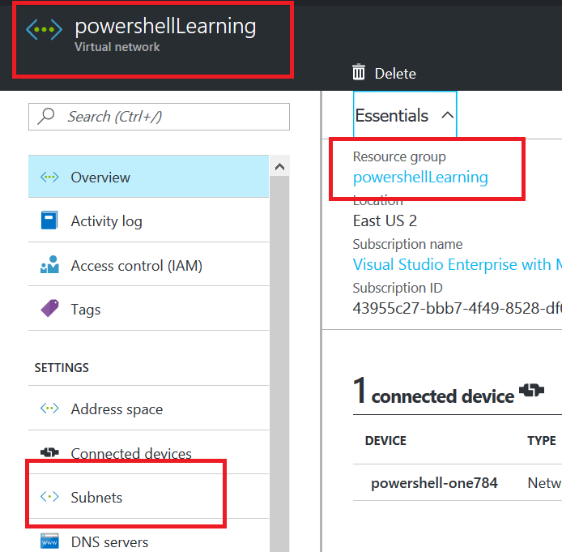
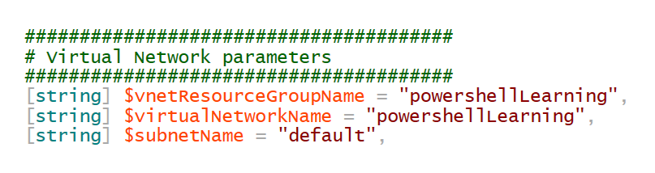
Virtual Network Parameters

Slide 5
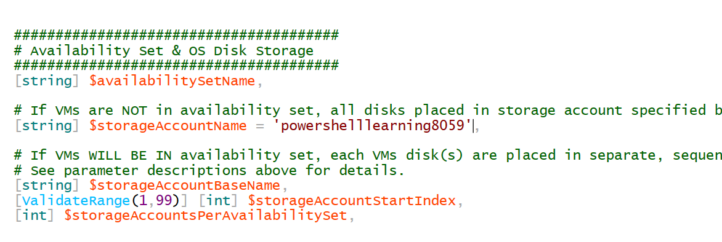
Storage Accounts, No Availability Set
If the VM(s) to be deployed will not be placed in an availability set, simply specify the one storage account where the VM disks will be located.
Availability Set Name left empty
Name of Storage Account specified here
These parameters ignored if Availability Set Name if left blank

Slide 6
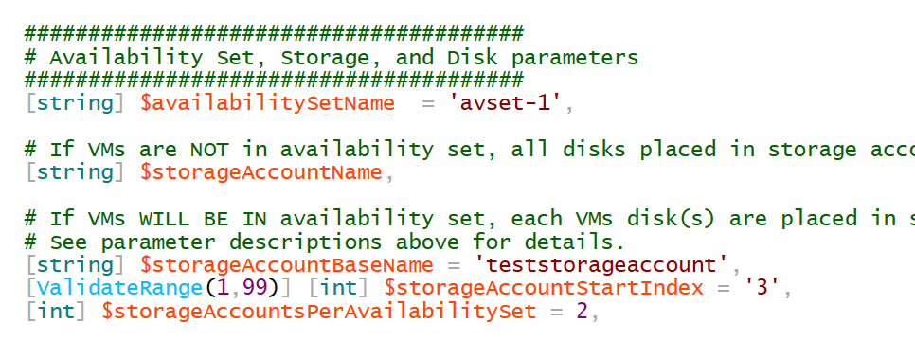
Storage Account, with Availability Set
If the VM(s) to be deployed will be placed in an availability set, it is a recommendation that the VM disks should be distributed across different storage accounts
The script takes the base name of the storage account, and appends to the base name a two-digit iteration number. A user-specified maximum number of storage accounts will be used (as specified by $storageAccountsPerAvailabilitySet)
If 3 VMs are being deployed in Availability Set ‘avset-1’, the following storage accounts will be used:
teststoraccount03 [VM #1 & VM #3]
teststoraccount04 [VM #2]

Slide 7
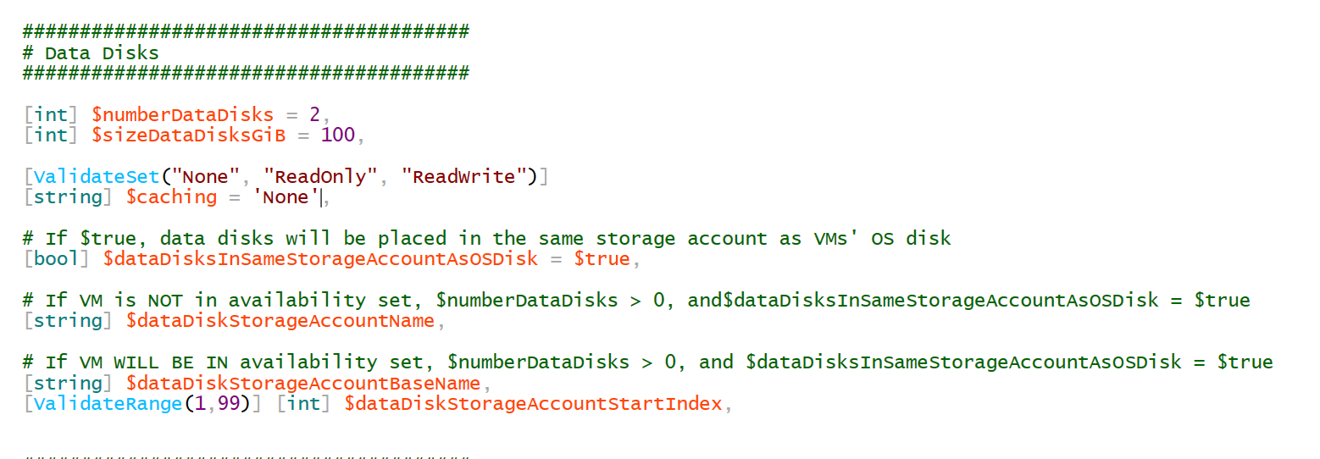
Adding Data Disks to the same Storage Account as OS Disk
Specify the number of data disks, and their size (in Gibibytes)
Specify caching preference on data disks
To place the data disks in the same storage account as the VM’s corresponding OS disk, set this parameter to $true

Slide 8
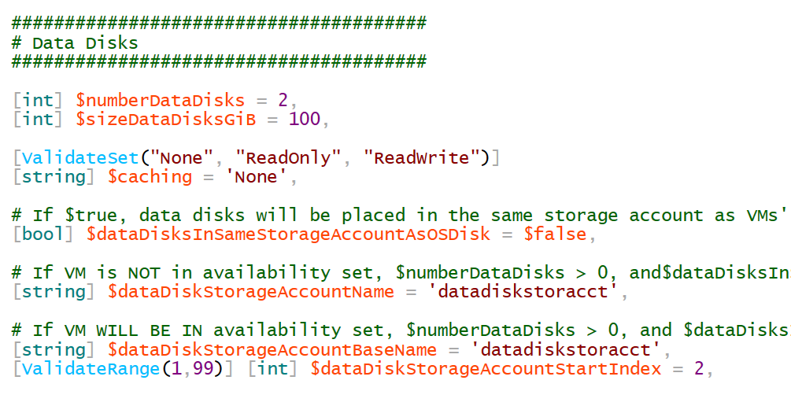
Adding Data Disks to different Storage Accounts from OS Disk
To place the data disks in a different storage account as the corresponding VM’s OS disk, set this parameter to $false
If not using availability sets, specify the single storage account in which all the data disks will be placed
If using availability sets, specify the base name and starting index of the storage account names for the data disks
E.g. if deploying 3 VMs, and
$storageAccountsPerAvailabilitySet = 2, then the following storage accounts will be used for data disks:
datadiskstoracct02
datadiskstoracct03

Slide 9
IP Configuration Parameters
Are Static Private IP addresses required?
No
Yes
Let Azure DHCP service assign private IP addresses dynamically
Do you need to assign specific private IP addresses to certain VMs?
Scenario “A”
No
Yes
Pass an array or CSV file containing the list of IP addresses to assign. VM #1 will get the 1st IP addresses listed in the array or CSV file, and so on.
Let Azure DHCP service assign private IP addresses dynamically, and then set those IP addresses to ‘Static’
Scenario “B”
Scenario “C”

Slide 10
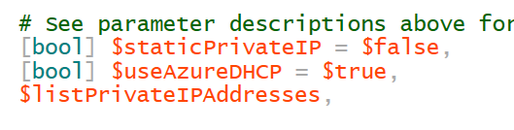
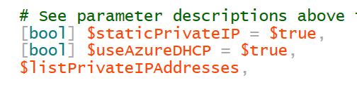
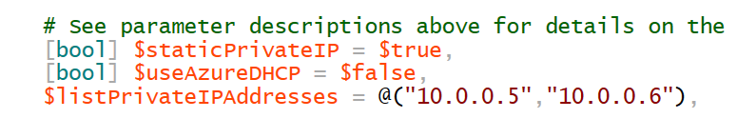
IP Configuration Parameters
Scenario “A”
Scenario “B”
Scenario “C”

Slide 11
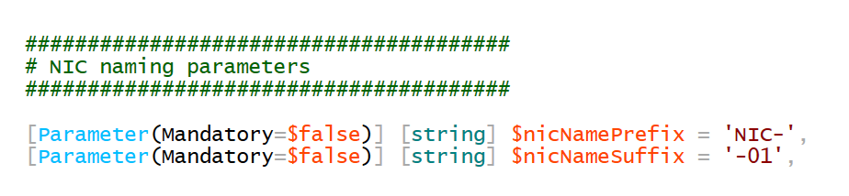
NIC naming parameters
The NIC name will be the name of the VM to which it is attached, plus a user-specified prefix and suffix
For a VM named “testvm02”, the name of its NIC with the below parameters will be “NIC-testvm02-01”

Slide 12
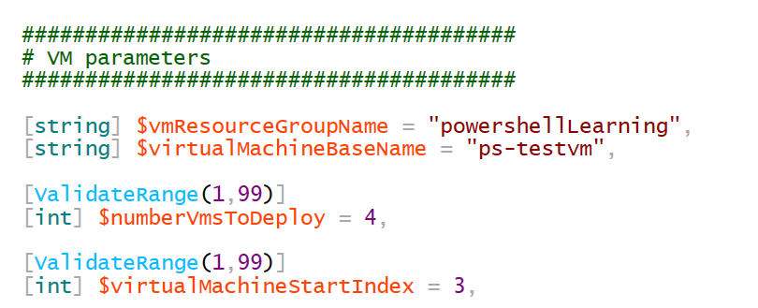
VM Parameters
Must specify the VM base name. A two-digit iteration number will be appended to the VM base name.
Must specify number of VMs to deploy and the starting iteration number
In the example below, the following VMs will be deployed:
ps-testvm03
ps-testvm04
ps-testvm05
ps-testvm06

Slide 13
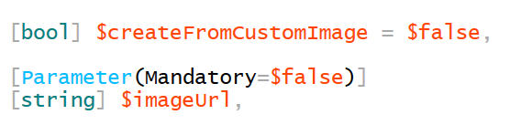
VM Parameters
Can either deploy VMs from the Azure gallery, or deploy VMs from a custom image
Must specify the URL in which the VHD of the image is located. This URL must point to a blob in an Azure storage account

Slide 14
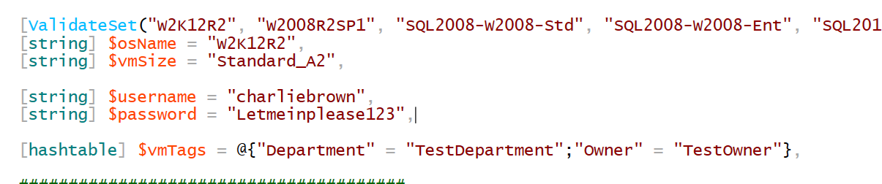
VM Parameters
Specify the name of the OS to install (from the Azure gallery)
Specify the size of the VM
Specify the username of the local administrator of the VM
(Optional) specify the password of the local admin. If no password is specified, one will be auto-generated and outputted to console
Specify the tags to associate with the resources to create
The tag “CreationDate” will automatically be included

Slide 15
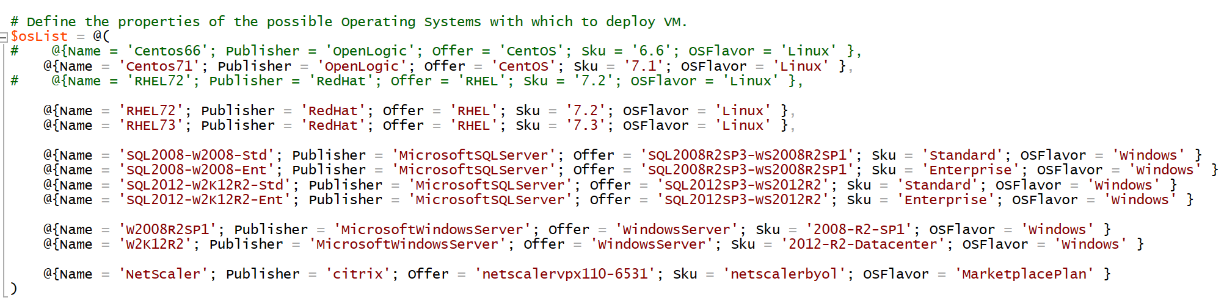
VM Parameters
The list of images to install from the Azure gallery has been hard-coded in the script. This list can be updated and expanded as desired:

