Slide 1
Provided Scripts
VM Creation – Creates one or more VMs and all associated resources (e.g. availability set, NICs, etc.)
Storage Account Creation – Creates storage accounts
Virtual Network Creation – Creates a virtual network, subnets, and virtual network gateway
Policy Enforcement – Creates and assigns subscription wide policies (e.g. enforce tags, approved/deny Azure regions and services, etc.)
Register All Microsoft Providers – Registers Microsoft services to allow them to be deployed
RBAC Custom Role – Creates a custom RBAC role to allow users to join VMs to a centrally managed virtual network
Email Alerts Based on Azure Operations – Email notifications when particular actions are performed (e.g. delete an NSG, create UDR, etc.)

Slide 2
VM Script Deployment

Slide 3
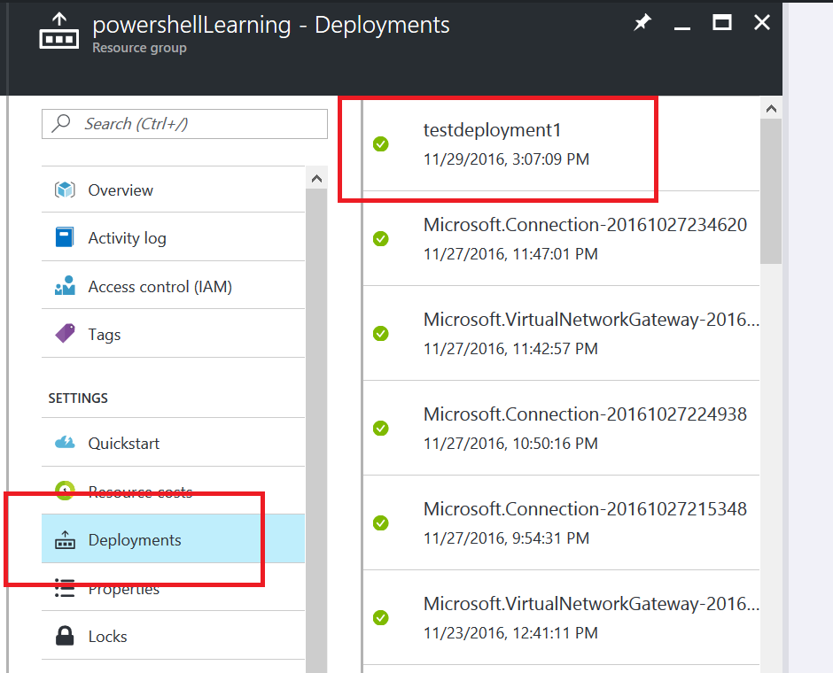
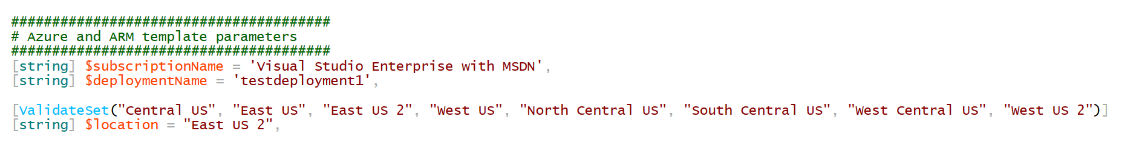
Azure and ARM Template Parameters
The “Deployment Name” simply describes the custom name given to describe the entire deployment of Azure resources into a particular resource group

Slide 4
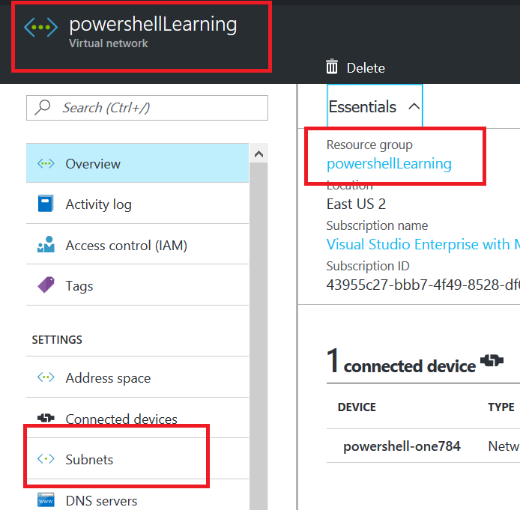
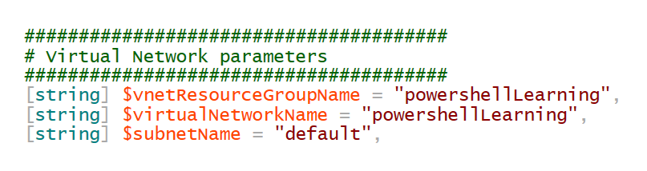
Virtual Network Parameters

Slide 5
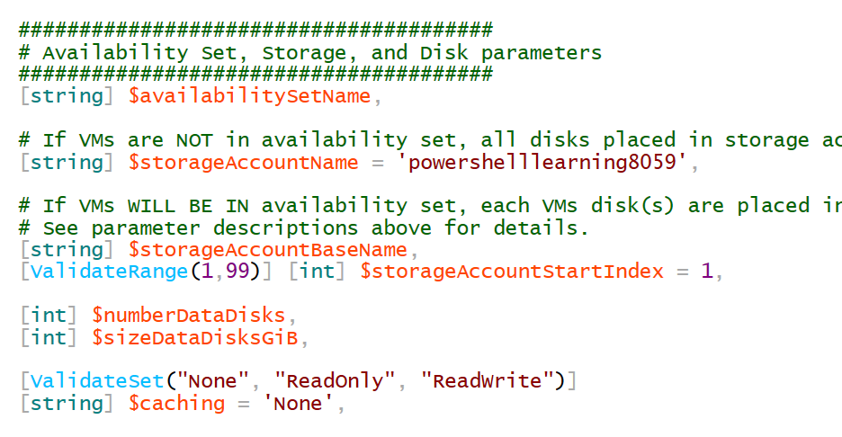
Storage Accounts, No Availability Set
If the VM(s) to be deployed will not be placed in an availability set, simply specify the one storage account where the VM disks will be located.
Availability Set Name left empty
Name of Storage Account specified here
These parameters ignored if Availability Set Name if left blank

Slide 6
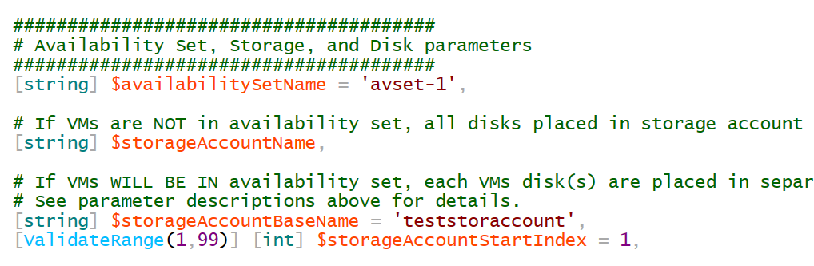
Storage Account, with Availability Set
If the VM(s) to be deployed will be placed in an availability set, it is a recommendation that the VM disks should be distributed across different storage accounts
The script takes the base name of the storage account, and appends to the base name a two-digit iteration number. One storage account per VM will be used.
If 3 VMs are being deployed in Availability Set ‘avset-1’, the following storage accounts will be used:
teststoraccount01
teststoraccount02
teststoraccount03

Slide 7
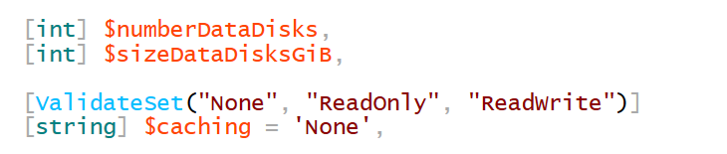
Data Disks to Add to VM
In addition to the OS disk
Script currently only supports “Standard” disks (i.e. HDD). Premium disks (i.e. SSD) is currently not supported by deployment script.

Slide 8
IP Configuration Parameters
Are Static Private IP addresses required?
No
Yes
Let Azure DHCP service assign private IP addresses dynamically
Do you need to assign specific private IP addresses to certain VMs?
Scenario “A”
No
Yes
Pass an array or CSV file containing the list of IP addresses to assign. VM #1 will get the 1st IP addresses listed in the array or CSV file, and so on.
Let Azure DHCP service assign private IP addresses dynamically, and then set those IP addresses to ‘Static’
Scenario “B”
Scenario “C”

Slide 9
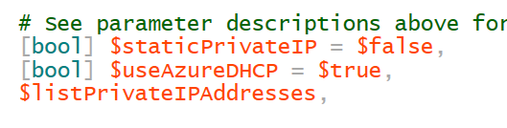
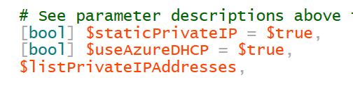
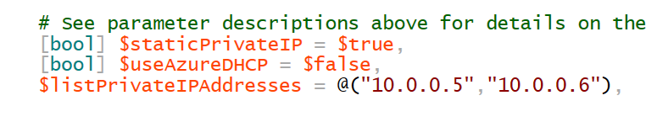
IP Configuration Parameters
Scenario “A”
Scenario “B”
Scenario “C”

Slide 10
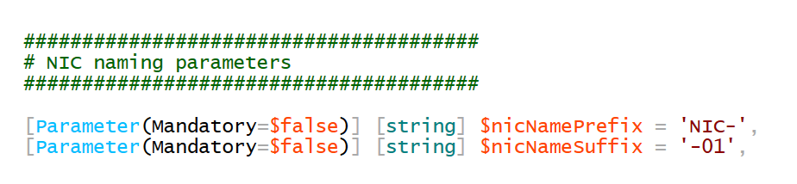
NIC naming parameters
The NIC name will be the name of the VM to which it is attached, plus a user-specified prefix and suffix
For a VM named “testvm02”, the name of its NIC with the below parameters will be “NIC-testvm02-01”

Slide 11
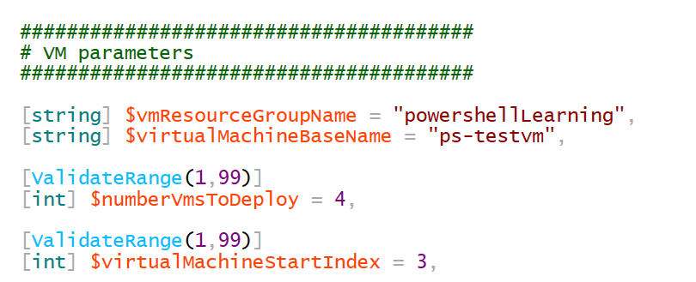
VM Parameters
Must specify the VM base name. A two-digit iteration number will be appended to the VM base name.
Must specify number of VMs to deploy and the starting iteration number
In the example below, the following VMs will be deployed:
ps-testvm03
ps-testvm04
ps-testvm05
ps-testvm06

Slide 12
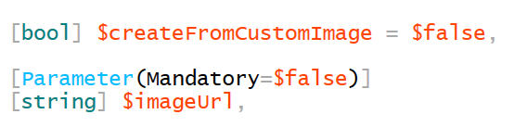
VM Parameters
Can either deploy VMs from the Azure gallery, or deploy VMs from a custom image
Must specify the URL in which the VHD of the image is located. This URL must point to a blob in an Azure storage account

Slide 13
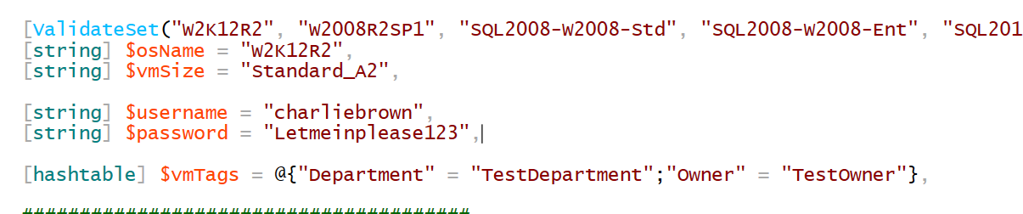
VM Parameters
Specify the name of the OS to install (from the Azure gallery)
Specify the size of the VM
Specify the username of the local administrator of the VM
(Optional) specify the password of the local admin. If no password is specified, one will be auto-generated and outputted to console
Specify the tags to associate with the resources to create
The tag “CreationDate” will automatically be included

Slide 14
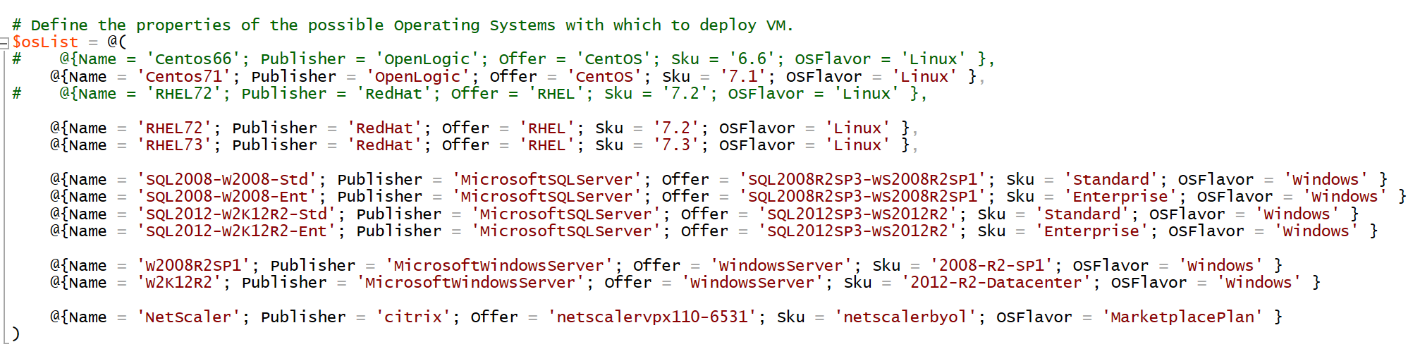
VM Parameters
The list of images to install from the Azure gallery has been hard-coded in the script. This list can be updated and expanded as desired:

